Slide 1






How To Pass
National 5
Practical Cookery

Slide 2
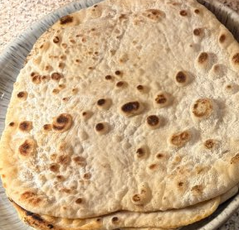
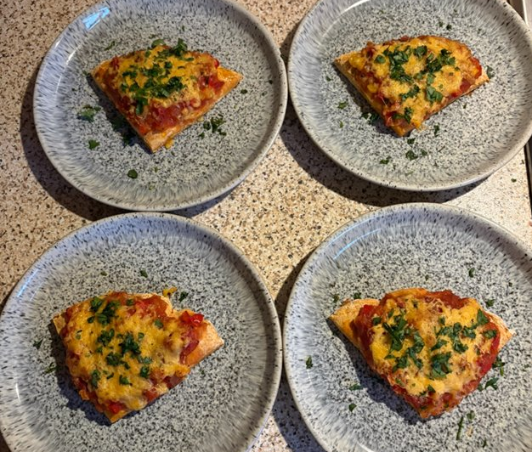
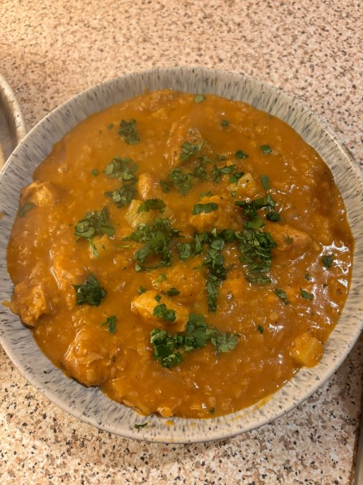
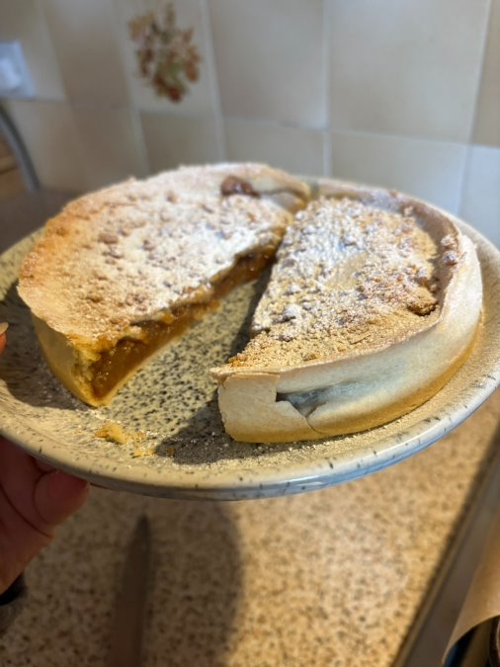

Two Exams
Practical Exam
Marked out of 65
65% of your final mark.
2 hours 30 minutes.
Recipes set by QS
During the school week, before Easter holidays
Question Paper
Marked out of 35
35% of your final mark.
1 hour, during QS exam diet.

Slide 3
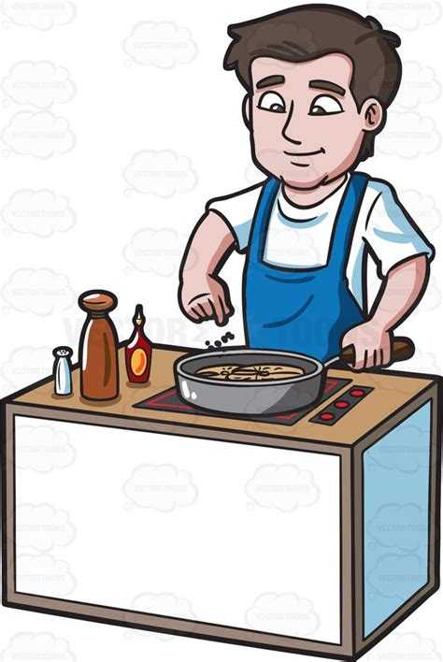
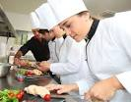
DATES
Practice of Practical Exam Dishes
Practice Starter W/B 01st February 2027
Practice Main W/B 08th February 2027
February Break
Practice Dessert W/B 22nd February 2027
Practical Exam
Practical Exams W/B 15th March 2027
Question Paper
Thursday 29th April 2027

Slide 4
Practical Exam 2026
Produce a 3-course meal for 4 people in 2 hours 30 minutes.
2025: Practical Exam
Sweet potato pizza
Chicken dahl with rotis
Cookie dough spiced apple pie

Slide 5
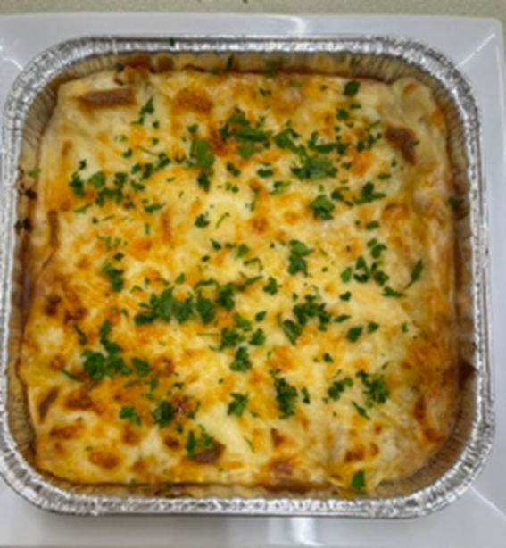
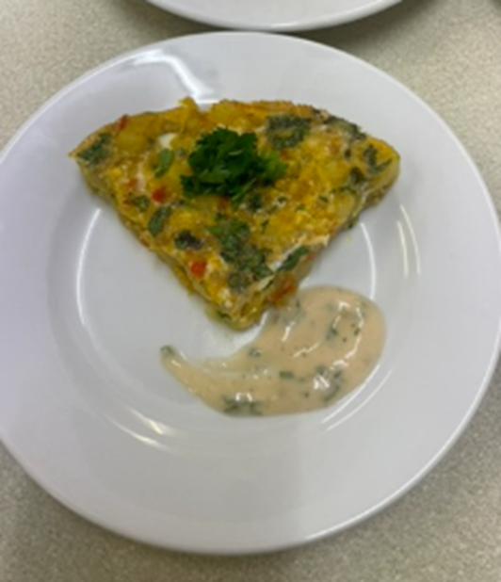
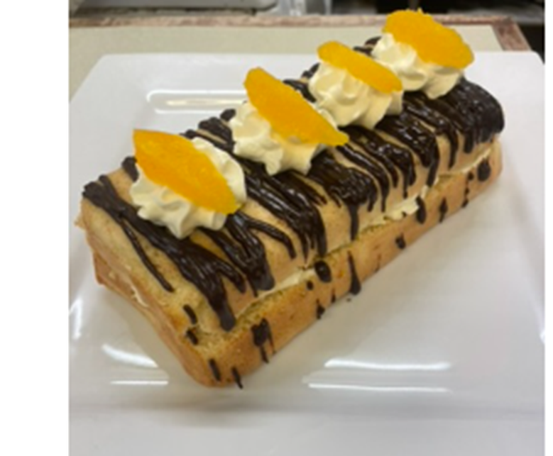
Practical Exam 2025
Produce a 3-course meal for 4 people in 2 hours 30 minutes.
2025: Practical Exam
Spicy frittata with mango dressing
Lentil and red pepper lasagne
Chocolate and orange layer cake

Slide 6
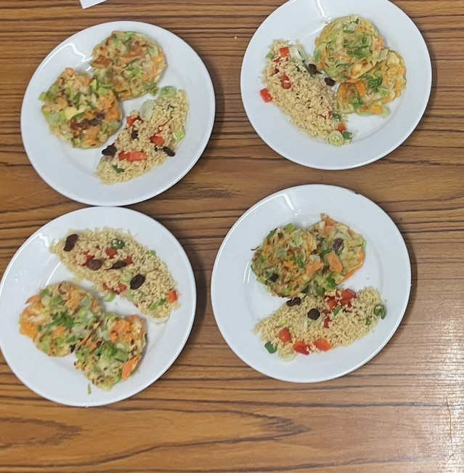
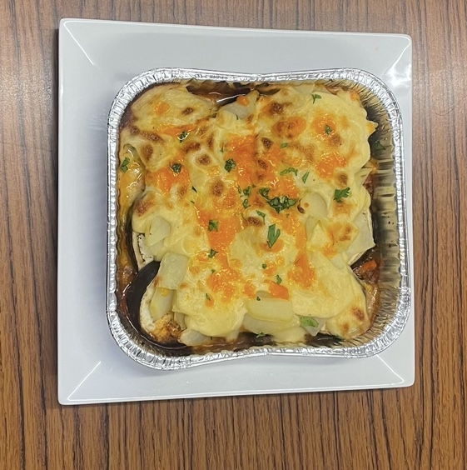
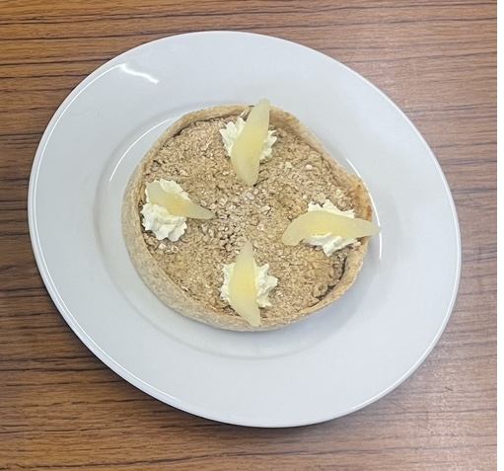
Practical Exam 2024
Produce a 3-course meal for 4 people in 2 hours 30 minutes.
2024: Practical Exam
Vegetable Fritters with Savoury Couscous
Beef Moussaka
Pear and Ginger Crumble Tart

Slide 7
Question Paper – 29th April 2027
QS Exam diet
There are five types of questions.
List
These words indicate a shorter answer is required.
Short Answers
Name
Identify
Describe
Detailed sentence
These words indicate a longer answer is needed.
Explain
Fact, BATS, Impact
Calculate
Evaluate
Fact, Opinion, Consequence

Slide 8
January Prelim
This will be based on all aspects of the final exam.
Practical – pupils will make a 2-course meal for 4 people in 1hr 40 minutes.
Written – Pupils will complete a full 35-mark written paper in 1hr.
Pupils should ensure they are completing past paper questions in preparation for this.
The NEW specimen paper can be found on the QS website. https://www.sqa.org.uk/sqa/47439.html
Mind maps can be an effective form of revision also.
Pupils will be given targeted areas to revise which will be posted on TEAMS nearer the time.

Slide 9
Supporting your child
Encourage them to cook at home and help prepare meals. Speedy & accurate vegetable prep is essential for the exam.
Ensure they are completing their homework and encourage them to ask if they are unsure. HW is posted on teams.
Complete past paper questions as revision.
Access TEAMS where there are past paper questions/PowerPoints and Homework tasks.
WEST OS: https://online.clickview.co.uk/libraries/categories/36254448/practical-cookery?sort=productionyear

