Slide 1


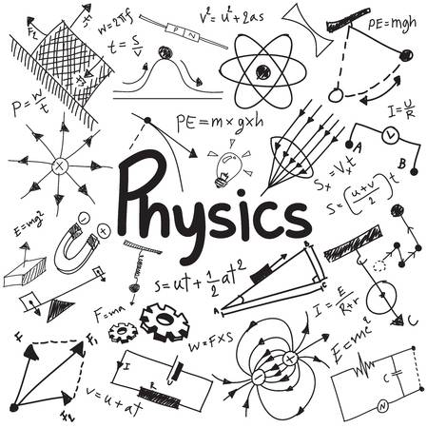





How To Pass
National 5 Physics
Mr R Gordon

Slide 2
What We’ll Cover
Course Structure
The basics to revision and success
Physics Specific tips
Student Books and Resources
Study Support

Slide 3
Course Structure
6 topics
Grading tests – used to make prediction of attainment
Test in October before holiday
2 prelims:
January:
March/April
Final exam Thursday 4th May 13:00 – 15:00
Radiation
Electricity
Energy & Gas Laws
Dynamics
Space
Waves
½ of course
2 hours exam
full course
Two 60-minute class tests
Assignment
Experimental write up
Worth 20% of final Grade

Slide 4
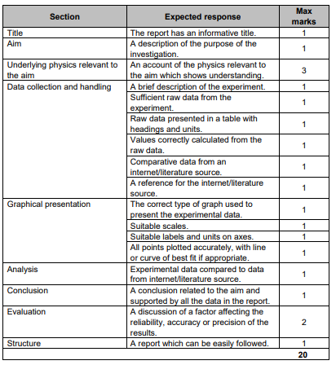
Assignment
Scientific Write Up
Marked by SQA
20% of your final grade
8 hours to complete
  6.5 hours for research (in class)
  1.5 hours to write it up

Slide 5
The Basics
Sleep
Studying
Mental/Physical Health

Slide 6


Sleep
A teenager should be getting anywhere from 8-10 hours sleep a night.
Low levels of sleep lead to:
Poor concentration
Low level cognitive loss
Irritable mood
Poor physical and mental health

Slide 7

Study Tips
Cramming doesn’t work!
Study routines prime the brain and get it ready for learning
Pick a goal and work towards that
Don’t just read books and copy them
Flashcards work as excellent memory enhancers.
Teach your parents!

Slide 8
Study Timetable
 | Monday | Tuesday | Wednesday | Thursday | Friday | Saturday | Sunday
4:00 – 4:15 | Physics | Maths | Subject 4 | Physics | Subject 3 | Subject 5 | Maths
6:00-6:15 | English | Subject 2 | English | Subject 4 | Subject 5 | Subject 2 | Subject 3
7:00 – 7:15 | Subject 4 | Subject 3 | Subject 5 | Maths | English | Physics | Subject 2

Slide 9

$$34 weeks until exam$$
$$34×45 minutes=25.5 hours study time per subject$$
If you wait until after Easter (14 days before exams start) that’s 1.8 hours per subject per day – 13 hours total.

Slide 10
When You’re Studying
Where
somewhere dedicated to study
What
everything you need to hand
Listen
If you need music, make it Mozart or LoFi. Rythmic music interferes with concentration
Stay away
from TVs and phones

Slide 11
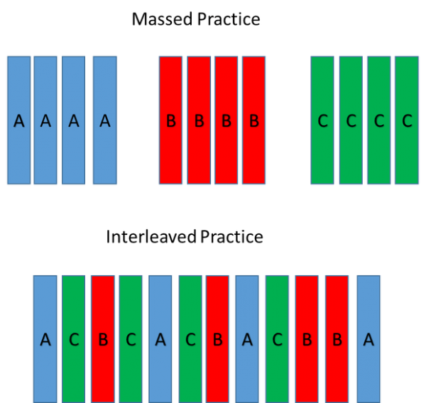
Interleaving
Don’t practice everything from 1 topic/subject.
Mix up the order.
Improves retention and comprehension.

Slide 12
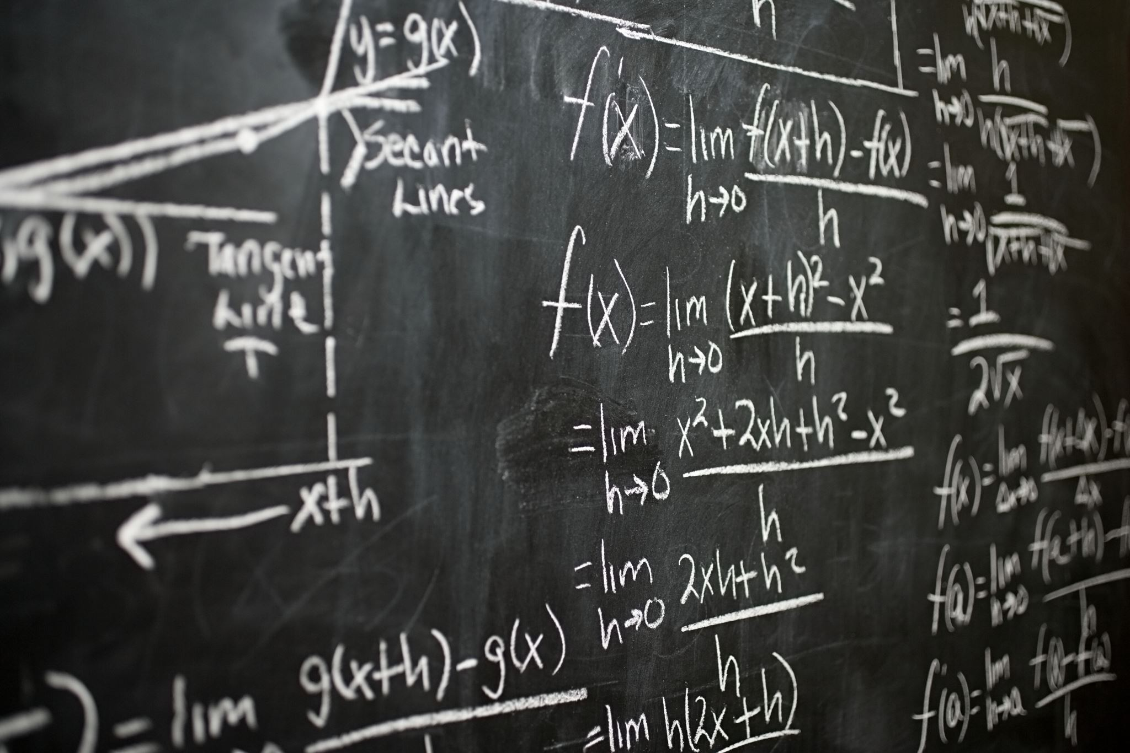
Physics Tips
Practice, Practice, Practice.
Test yourself for units and symbols
Practice definitions for things like Newton’s Laws
Understand what happens when you change part of a formula
S
L
O
P
eriously,
oads
f
ractice

Slide 13
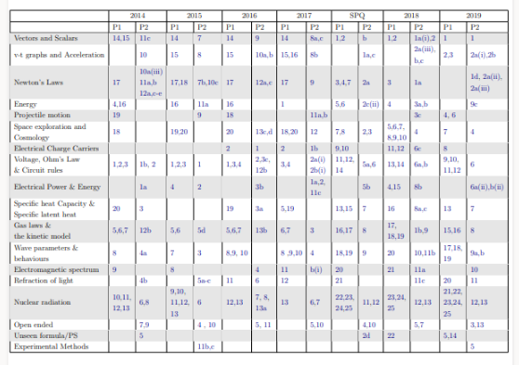


Slide 14
Mental & Physical Health
Don’t spend all day cooped up
Go outside, get some fresh air and exercise.
Natural sunlight helps calibrate your brain for sleep
Make sure you are doing something that makes you happy/relaxed but in a planned way to aid in routine building.

Slide 15
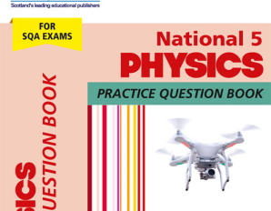
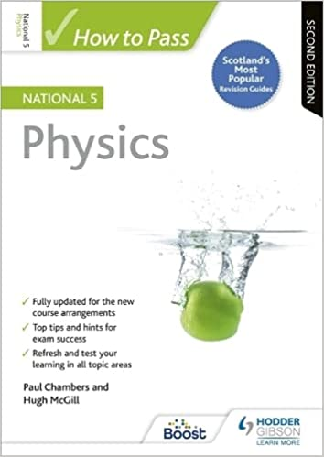
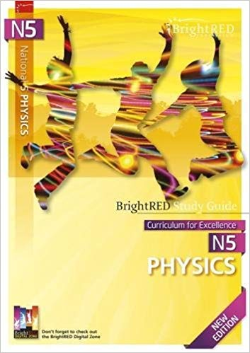
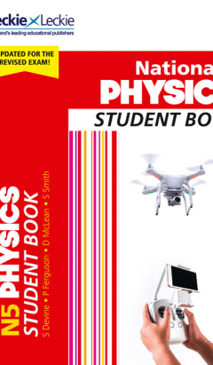
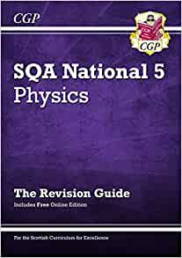
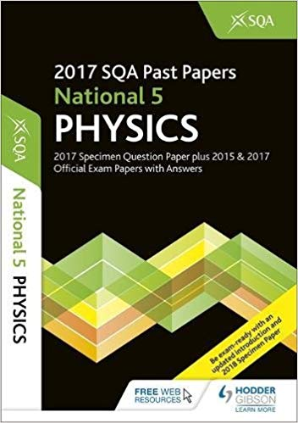
Student Books

Slide 16
Study Support
Every Thursday
3:20 – 4:30

Slide 17
Any Questions

