Slide 1






How To Pass
National 5
Physical Education

Slide 2
Course Deadlines
Portfolio – Due Thursday 25th March
One-off performances – Due Thursday 25th March

Slide 3
N5 Course Outline
COURSE OUTLINE (120 MARKS)
Portfolio – 60 marks total (50%) Made up of three sections Which is completed as on-going assessment throughout the year No exam | Performance – 60 marks total (50%) 2 assessed performances in an activity of pupils' choice

Slide 4
N5 Course Content
Portfolio
Section 1
  1 question (8 marks)
  Explain factors impacting on performance
Section 2
  9 questions (29 marks)
  Planning, developing and implementing approaches to improve performance
Section 3
  6 questions (23 marks)
  Monitoring, recording and evaluating performance
Practical assessment
Repertoire of skills— the range of fundamental to complex skills displayed in the performance (8 marks)
Control and fluency— the quality of the actions and transitions between skills (6 marks)
Effective decision making is evident (6 marks)
Using and applying straightforward composition, tactics or roles safely and effectively (6 marks)
Extent to which rules and regulations are followed and etiquette is displayed (2 marks)
Extent to which emotions are controlled on the day of the performance (2 marks)

Slide 5
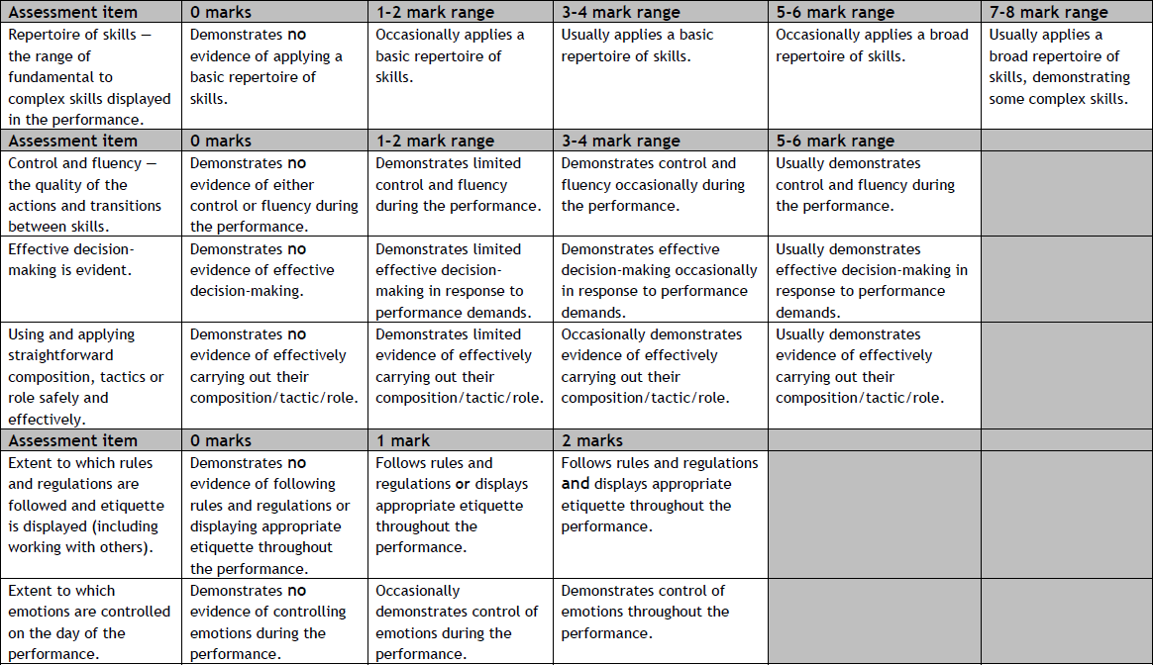
Performance Marking Criteria

Slide 6
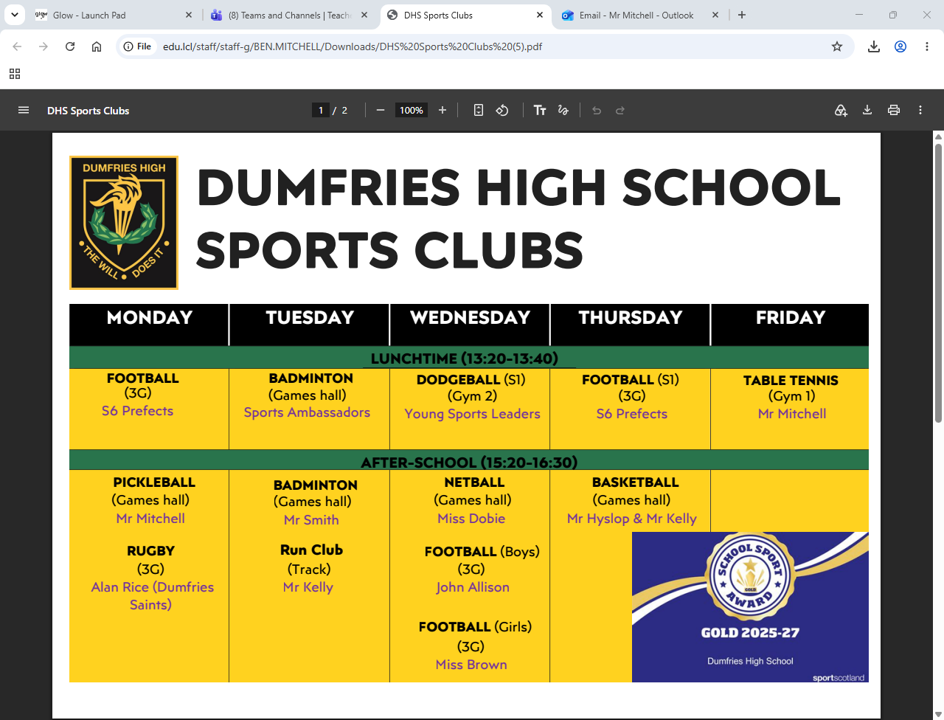
Improving Practical Performance

Slide 7
What Pupils Need To Do
Checklist
Keep up-to-date with work/homework.
If absent, the pupil should ask their teacher what work they have missed.
Always be prepared for both practical and theory classes.
If a pupil wants to compete in an activity outside of school for their ‘one-off practical assessment’, it is the pupil's responsibility to arrange this with the class teacher in advance of practical deadlines.
Use all support materials to help with answering portfolio.
Lastly, if you are stuck with anything, please ask the teacher.

Slide 8
Tools To Help Pass
Help list
Class booklet (has example answers and how to structure your answers).
Qualification Scotland Course specification on the QS website (gives marking schemes and what knowledge you need to know).
BBC bitesize.
Study support (Tuesday afterschool in G-74).

Slide 9

Questions?

