Slide 1






How To Pass
National 5 Modern Studies

Slide 2
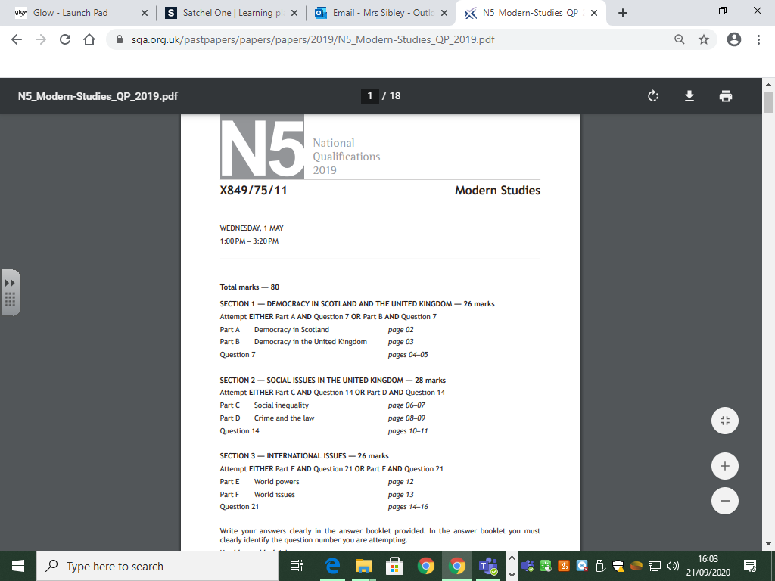

Slide 3

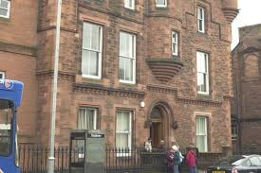

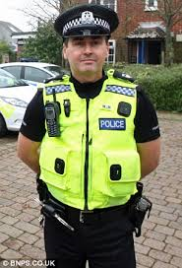
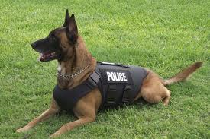
Crime and the Law

Slide 4
Crime and the Law
Nature of Crime
Causes of crime
Consequences of crime
Criminal Justice System
Responses to crime:- government responses, police, prisons

Slide 5
Crime and the Law
Assessment: 1st October 2026
Will also be assessed in January Prelim

Slide 6
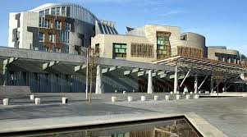
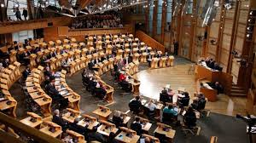

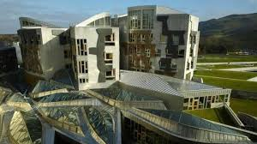
Democracy in Scotland

Slide 7
Democracy in Scotland
Power and decision making
Participation
Influence
Representation
Voting systems

Slide 8
Democracy in Scotland
Assessment:- December 2026
Will also be assessed in January Prelim

Slide 9




World Power: USA

Slide 10
World Powers:- The USA
Political System
Influence on other countries
Social and economic issues (minimum of 3 issues)
Effectiveness in tackling economic issues (minimum of 3 issues)

Slide 11
World Powers:- The USA
Assessment: March 2027
Will also be assessed in Prelim Part 2 –March 2027

Slide 12

Examination Date
Wednesday 26th May 2027
1pm to 3.20pm

Slide 13
QS Assessment
N5 Modern Studies assessment is divided into 2 components for assessment – QS marks both.
Component | Marks | Duration
Component 1: question paper | 80 | 2 hours 20 minutes
Component 2: assignment | 20 | 1 hour

Slide 14
Types of Exam Questions
Knowledge and Understanding Questions– 4, 6 or 8 marks
Describe… or Explain…
Information Handling Questions – 10 marks
Support and oppose, decision making, conclusions

Slide 15
Assignment
Accounts for 20 marks out of a total of 100 marks for the course
Pupils pick a Modern Studies issue for further individual research with very limited teacher guidance / support
Pupils present their findings in a structured manner in a 1-hour internal exam
Planning stage – December 2026 / January 2027
Write up – February 2027

Slide 16

Homework and Class Materials
Homework Assignments and assessment dates are communicated to students via Teams
Materials we use in class are also uploaded to Teams as we work through each part of the course – these can be accessed in the class materials folder which is accessed from the files tab in the general channel of our class team

Slide 17
Study Support
After school 3.15 to 4.15
Mr McCall / Miss Farish - Tuesday
Miss Lee – Wednesday
All welcome!

Slide 18
Success in Modern Studies
Timed question practice
Learning examples
Understanding the questions and knowing how to structure the answers
Structured revision using a range of revision techniques
Check over answers thoroughly and ensure they’re packed with knowledge!

Slide 19
How can you help?
Encourage them to attend after school study classes
Check homework is done on time – Microsoft Teams
Encourage your child to read newspapers and watch the news
Discuss topic related issues with them
Ensure resources are organised at home
Test pupils using core notes and pupil units
Encourage a structured approach to revision
Access the QS website and download past papers and marking instructions
Encourage them to make list of Qs to ask the teacher
Proof-read work

Slide 20
Summary
3 Units
1 Exam – 80 marks
1 Assignment – 20 marks
Exam style homework questions
Timed questions in class
End of topic tests – October, December, early March
January prelim – 1st 2 units
March Prelim – final unit
Assignment write-up – February

