Slide 1



How to Pass
Laboratory Science
SCQF Level 5
Session 2026/2027

Slide 2

Teachers
Laboratory Science will be delivered by the following teachers this academic session:
Miss Johnstone
Miss Caldow
Ms Henry

Slide 3
Laboratory Science level 5 develops techniques that are important in the STEM (science, technology, engineering and maths) sector and is particularly important given the existing and projected shortfall in suitably qualified individuals in these areas'

Slide 4
Specific aims of the qualifications:
Prepare candidates for progression to extended qualifications at SCQF level 5 and above
Develop an understanding of careers in Laboratory Science
Develop an understanding of science health and safety and gain experience in measuring, weighing and handling chemicals in the lab
Practical skills in microbiology, measuring radioactivity, chemical handling and laboratory instrumentation will be developed
Learn how to write a scientific report

Slide 5
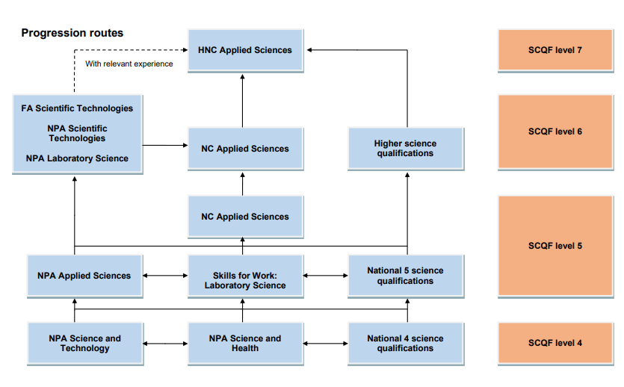

Slide 6
The Skills for Work Laboratory Science course at SCQF level 5 consists of four mandatory Units (24 SCQF credit points)
  Careers Using Laboratory Science
  Working in a Laboratory
  Practical Skills
  Practical Investigation

Slide 7
NPA – Laboratory Science Timeline
  Careers Using Laboratory Science (throughout the year)
Working in a Laboratory (June – Nov)
Practical Skills (Dec – Feb)
Practical Investigation ( Mar – Apr)

Slide 8
Unit 1 - Careers Using Laboratory Science
To pass this unit pupils must:
Write a report on three companies: local, national and global
Research a job for each and be able to state what qualifications, skills and responsibilities are required for the post identified.
Write their own CV
Review their own skills and abilities, set targets for the year and review them.

Slide 9
Unit 2 - Working in a Laboratory
To pass this unit pupils must:
Learn how to do a risk assessment
Be able to state how to categorise hazards and how to store chemicals
Deal with a spill
Be able to carry out four calculations: percentages, ratios, averages and re-arranging formula
Perform chemical handling procedures in a scientific laboratory
Weigh a substance accurately
Pipette an accurate volume of a liquid

Slide 10
Unit 3 - Practical Skills
To pass this unit pupils must:
Be able to pour agar plates
Subculture bacteria and yeast
Prepare a wet mount slide
Prepare a dry mount slide
Measure radioactivity in the lab
Explain the requirements of working safely with radioactivity
Use scientific instrumentation e.g. multimeters and colorimeters
Perform a titration
Perform Chromatography
Perform distillation

Slide 11
Unit 4 - Practical Investigation
Pupils get the choice of several different investigations they can undertake. Some examples are: Energy in Foods, Reaction rates, Enzyme activity and Voltage between metals
A report on this investigation is written where they have to produce:
A plan of the experiment (5 marks)
Carry out the investigation correctly and safely (4 marks)
Present the results on a graph (4 marks)
Write a conclusion and evaluation (3 marks)
Review and evaluate your investigation ( 2 marks)
Have a well structured report (2 marks)
Pupils must score 12 out of 20 to pass

Slide 12
Assessment
External Assessment – No exam in May/June
Internal Assessment – Weekly in class on practical techniques, on numeracy aspects of the course and extended pieces of writing.

Slide 13
OUR RESPONSIBILITIES:
Clear and concise notes
Opportunities to seek help if required
Regular Feedback from assessment
Progress is tracked and monitored
Pupil support/home contacted when concerns arise
Opportunities for study support provided

Slide 14
PUPIL RESPONSIBILITIES:
Attend class to ensure all notes are fully completed
Ensure any notes / work missed is completed in a timely manner.
Be thoroughly prepared for all assessments
Seek help when difficulties arise
Attend study support if required

Slide 15
HOW YOU CAN HELP:
Ensure pupils are in class as much as possible
Encourage and help pupils to prepare for assessments
Encourage pupil to seek help and attend study support if absences are hindering progress

Slide 16
Questions?

