Slide 1






How To Pass
National 5 History

Slide 2

How to pass National 5 History

Slide 3

Section 1

Slide 4
Era of the Great War, 1900-1928
Scots on the Western Front
Domestic Impact of War: Society and Culture
Domestic Impact of War: Industry and Economy
Domestic Impact of War: Politics

Slide 5

Section 2

Slide 6
The Trade in Enslaved African People, 1770-1807
The triangular trade
Britain and the Caribbean
The captives’ experience and enslaved Africans’ attempts to gain their freedom
The abolitionist campaigns

Slide 7

Section 3

Slide 8
Free at Last? Civil Rights in the USA, 1918-1968
The ‘Open Door’ policy and immigration
‘Separate but Equal’, to 1939
Civil Rights Campaigns
The Ghettos and Black American Radicalism

Slide 9
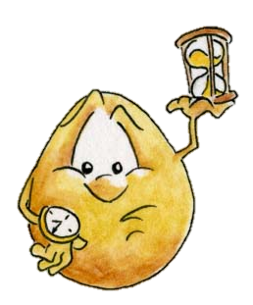
In each section pupils are required to complete four or five questions – approximately 45 minutes per section

Slide 10
In each section pupils are required to complete questions which test their knowledge and understanding
‘Describe…’ questions worth 4 marks
‘Explain the reasons ….’ questions worth 6 marks
‘To what extent…’ questions worth 9 marks

Slide 11
In each section pupils are required to complete questions which test their ability to handle historical sources.
‘Evaluate the usefulness…’ questions worth 5 marks
‘Compare the views….’ questions worth 4 marks
‘How fully…’ questions worth 6 marks

Slide 12
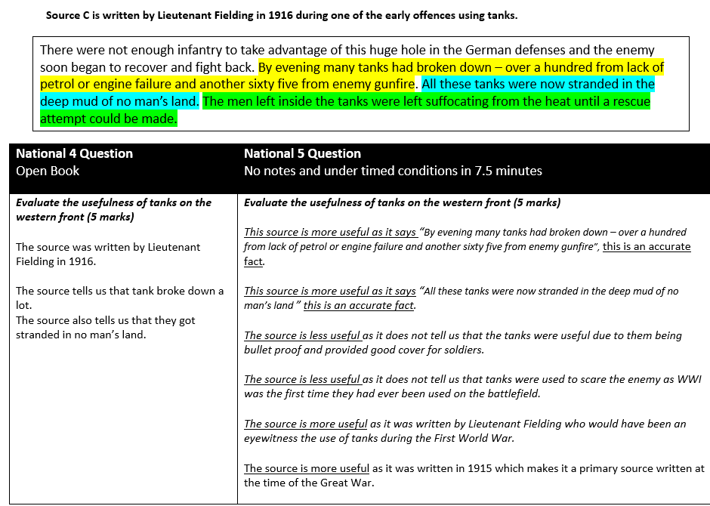

Slide 13

Pupils will normally get at least one Past Paper Question a week as Homework
Notes:
Practice Essays

Slide 14
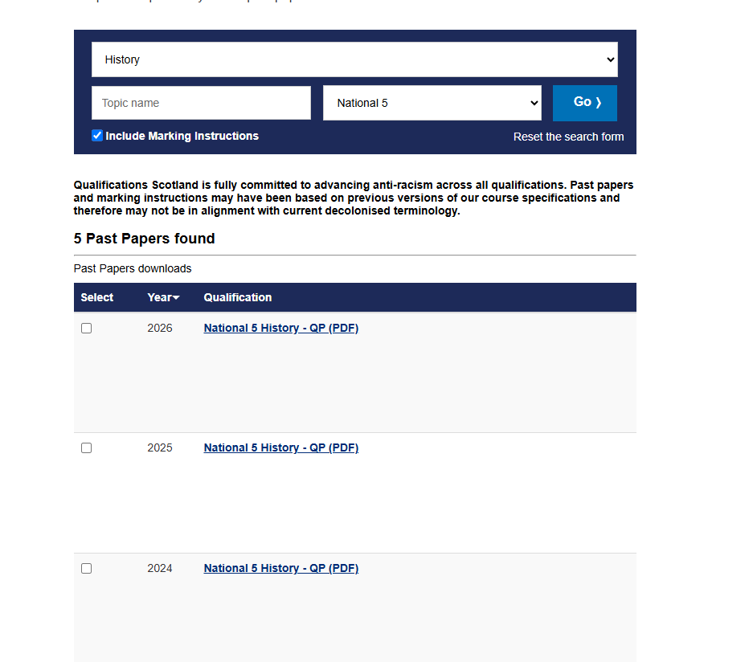
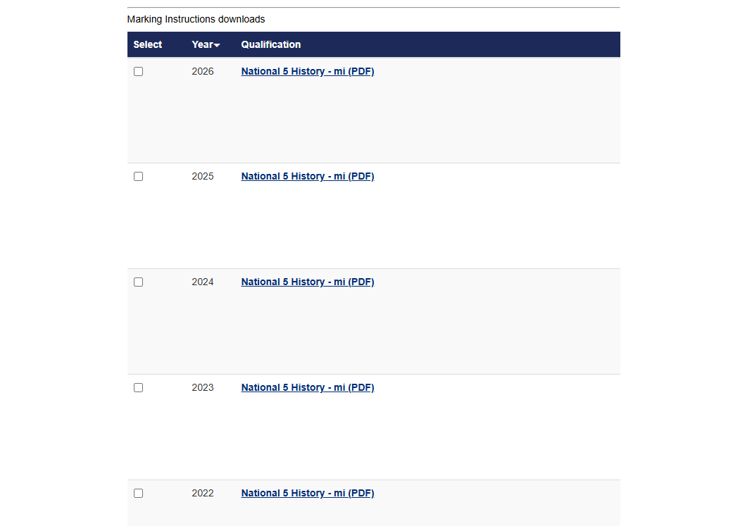
http://www.sqa.org.uk/pastpapers
Qualification Scotland Past Paper Questions
Notes:
All online, no need to buy. We have bundles in the department too.

Slide 15
The Exam
Wednesday 19th May 2027
2 hours 20 minutes
Results Day: Tuesday 10/08/27

Slide 16
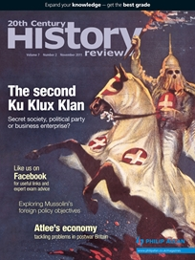
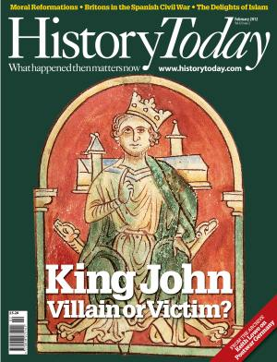
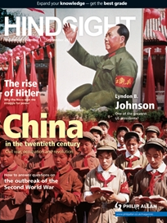
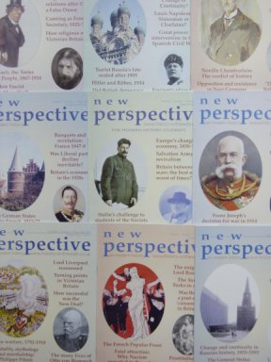
Assignment

Slide 17
The Assignment
The Assignment contributes towards the final grade – 20/100 marks.
Pupils are expected to research and write an essay which is more detailed than the norm.
One hour to write the assignment under timed conditions.
Externally marked by the SQA.

Slide 18
The Assignment
In reality however the Assignment offers pupils an excellent opportunity –
The essay title will be of your child’s choosing.
They will be given time in class to undertake research but ultimately they should be doing most of the work for this essay at home.
We have very good resources in school that pupils have access to.
The teacher is permitted to offer guidance and support but it is limited.

Slide 19
Assignment Success
Get a topic sorted quickly.
Get it looked over by a teacher.
We cannot mark it but can give verbal feedback.
Practice and rote learn at home!
Practice under timed conditions.

Slide 20
How can you help your child pass?
Check homework is done on time
Encourage a structured approach to revision – little and often
Encourage attendance at after school study support especially before assessments!
Proof-read work
If you know of any absences in advance, please let the school / class teacher know

Slide 21
Upcoming Key Dates
October Assessment
The Era of the Great War, 1900-1928
Miss Lee – Tuesday 29th September
Mr McCall- Wednesday 30th September
Miss Brown– Friday 2nd October
Prelims will take place straight after the Christmas break and will include two topics

Slide 22

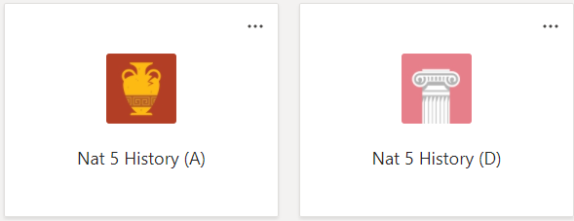
TEAMS
All homework will be set on teams!
Homework is usually submitted in small green HW jotter.
Any piece of homework can be submitted on teams.
Class PPTs & resources will be posted on Teams for pupil use in the ‘Class Materials’ folder after they have been used in class

Slide 23
Summary
3 topics
1 x Question Paper – 80 marks
1 x Assignment – 20 marks
October Assessment
End of Topic Tests
January Prelim
Regular homework
Regular revision of both content and the structure required for each question type
Teams
Study Support –Tuesday (Miss Farish and Mr McCall), Wednesday (Miss Lee) and Thursday (Miss Brown)

Slide 24


