Slide 1






How To Pass
National 5 Health and Food Technology

Slide 2
Component 1 – Question Paper
Tuesday 1st June
(13.00- 14.50)
Marked out of 60
50% of your final mark.
Questions based on the three units covered in class.
Food and Health – Nutrients, Dietary diseases
Contemporary Food Issues – Consumer organisations, fairtrade, food miles
Food Product Development – functions of ingredients, food product development stages

Slide 3
Command Words
There are four types of questions.
State
These words indicate a shorter answer is required.
Name
Short answers.
Identify
Give
Describe
These words indicate a longer answer is needed.
Explain
Fact BATS Impact
Evaluate
Fact Opinion Impact

Slide 4
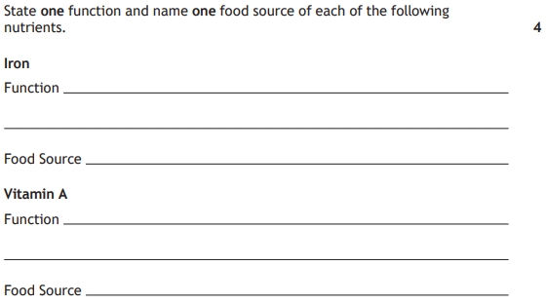
Examples – short answers (state, name, identify, give)
Produces red blood cells
Red meat
Helps you see in dim light
Carrots

Slide 5
Examples – detailed sentences (Describe)
Describe two practical ways to reduce salt consumption in the diet.
Way 1 – One way to reduce salt consumption is to check labels before purchasing foods and opt for options that contain less salt.
Way 2 – Another way to reduce salt is to taste your food before seasoning with salt to determine whether it is needed or not.
FBI structure (Explain)
Explain two benefits to health of reducing salt in the diet.
F – One benefit of reducing salt is that your blood will be less sticky so is less like to clot in the arteries
B- therefore
I – this will reduce the risk of CHD and strokes.

Slide 6
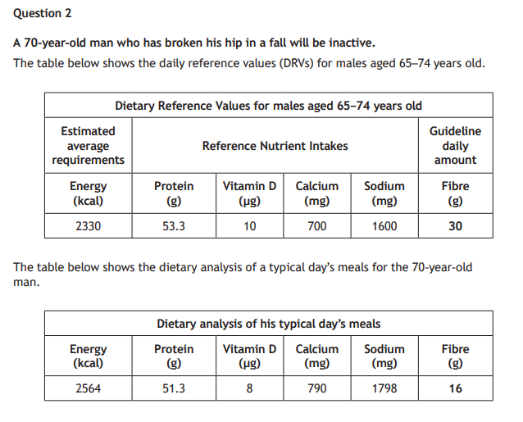
Examples – FOI (Evaluate)
F- The 70 year old man is not having enough Vitamin D in his diet
O- this is not suitable
I- as Vitamin D aids the absorption of calcium which strengthens bones (function). This would have a negative impact on his broken hip as it will not be able to heal as quickly (Short term impact).
Development point – In the long term this may impact the elderly man as he might be suffering from Osteoporosis.
This answer would get two marks as it has been developed.
Taking account of the DRVs for males aged 65–74 years old, evaluate the suitability of the 70-year-old man’s meals on a typical day.

Slide 7
Component 2 – Assignment
Marked out of 60
50% of your final mark.
Briefs are released from the SQA usually end of September/start of October.
2025/26 briefs
  Develop an iron-rich street food dish suitable for a festival.
  Develop a one-pot savoury dish using Scottish ingredients.

Slide 8
Assignment Breakdown
Section 1 – Planning stage (explore the key issues, three investigations, three product ideas) - 27 marks
Section 2 – The product (justifying the product and making it) - 10 marks
Section 3 – Product testing (product is tasted by individuals and they complete a sensory test to give feedback on the product) - 11 marks
Section 4 – Evaluations (evaluating the product using FOC structure based upon the sensory test and investigations) - 12 marks

Slide 9

HOW TO PASS -
Question Paper
Use the command word structures you have been taught.
Complete the homework given to you to a high standard and on time.
Revise and prepare for all assessments (End of unit, October assessments, Prelims)
Complete Past Papers and get these marked.
Look at the mark allocation for an answer.
Continually revise your nutrition work, you need to know this inside out to answer these questions.
Attend Study Support on a Wednesday in HE 15:20-16:20.

Slide 10

HOW TO PASS -
Assignment
Meet the deadlines issued by the teacher for each section. ​​
Use the time effectively in class. Plan beforehand what you are going to achieve in the double period to meet your own deadlines.
Assignment will be completed by end of February.

Slide 11
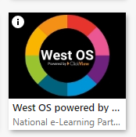
Revision
https://online.clickview.co.uk/libraries/categories/36254447/health-and-food-technology?sort=productionyear
Class PowerPoints are uploaded onto TEAMS
Past Paper questions on the QS website.

Slide 12
Encourage attendance at Study Support (Every Tuesday 15:15-16:15)
Encourage attendance at the masterclass prior to the exam.
Encourage your child to revise little and often.
Get in direct contact with myself if you have any concerns.
How can you support your child.

