Slide 1

National 5 Geography

Slide 2
National 5 – The course content
Human Units
  Population
  Urban landscapes
  Rural landscapes
Physical Units
  Coastal landscapes
  Glaciated landscapes
  Weather
Global Issues Units
  Health
  Climate Change

Slide 3
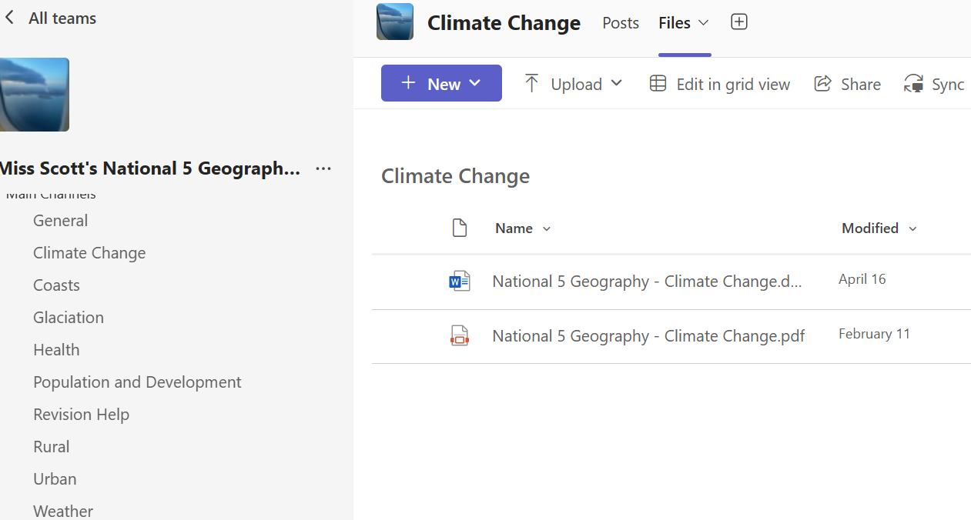
Booklets/Resources

Slide 4
Assessment
There will be formal assessments at various points through the year to determine whether a pupil is National 4 or National 5.
October Assessment – 2nd last week of term (W/B 28th Sept).
Prelim – January - course coverage up end of December.
2nd Prelim- March/April assessing the whole course.

Slide 5
Exam
Thursday 6th May 2027– 1pm-3.20pm
The exam is 2 hours 20 minutes and is out of 80 marks (80% of overall grade).
Some questions ask pupils to describe – where pupils are expected to state factual points. For example, describing trends on a map or graph. They must know some countries/places to get these marks – you can help by quizzing them.
Other questions ask pupils to explain. Explain questions require pupils to use their subject knowledge so say how or why things happen.

Slide 6
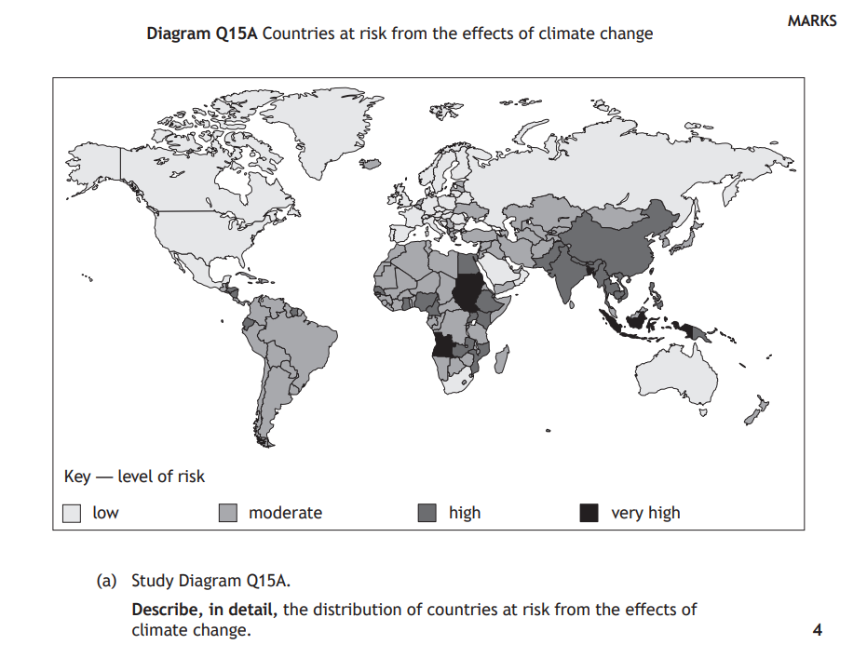
Describe Question

Slide 7
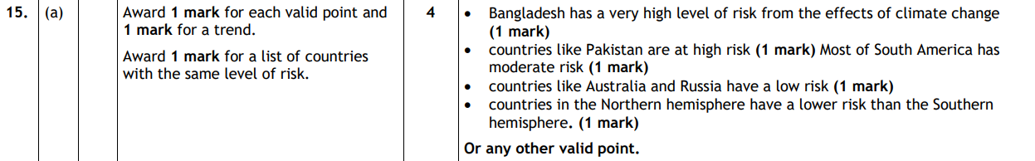

Slide 8
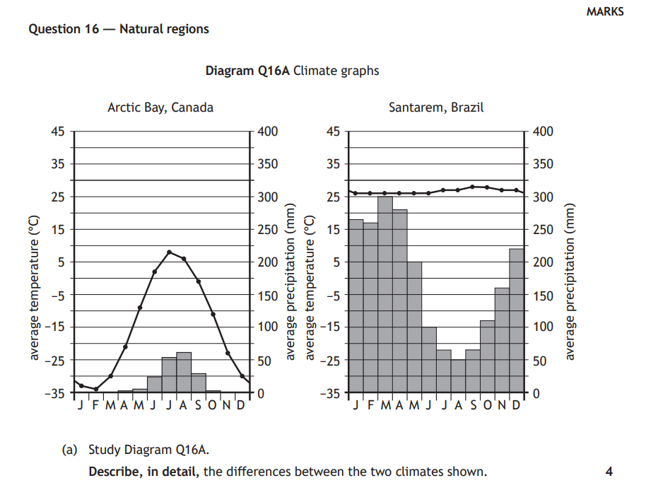
Describe Question

Slide 9
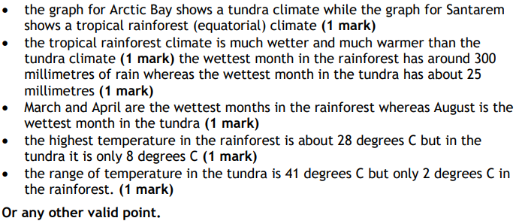

Slide 10
Example of a N5 explain question
Explain the impact of malaria on a country (4 marks)
People’s income may be so low that they cannot afford sufficient food and so malnutrition and hunger can also be a problem (1).
Crops may be left unharvested in the fields because farm workers are too ill to gather them in (1).
The whole economy of a malaria affected country can suffer because of low productivity, as much of the workforce is frequently off sick (1).
Few tourists want to visit the country because of the threat from malaria, further hitting the country economically (1).

Slide 11
Homework
Homework is a vital part of the course – pupils need to ensure they are doing it as routine.
The majority of homework is in the form of targeted revision for timed questions, to help them get in the habit of revision and to give them exam practice.
Pupils should also be studying regularly at home and have a study timetable to keep things ‘ticking over’. They should be studying their notes and practicing questions as part of a year long study plan.

Slide 12
Assignment
Pupils need to complete an assignment on a Geographical Issue worth 20 marks (20% of the overall grade).
We will begin the Assignment in November and pupils will sit their final write-up before the Christmas holidays.
This year the assignment will be research based on a Geographical topic. Mr McCabe and I will guide them and let you know when we are starting this process.
It is important to note that the assignment MUST be the pupil’s own work. We can guide them, give verbal feedback etc but the more work and time they put into it the better mark they will get.
Deadlines for assignments are very important to allow us enough time to feedback to pupils.

Slide 13
Assignment
Pupils need to make graphs/charts/diagrams/tables/maps about their data and put them on two sheets of A4.
Pupils then take the two A4 sheets of paper into the timed assignment.
Pupils get 1 hour to write up their assignment – they do not get a practice in class time.
The assignment is sent away to the SQA to get marked.

Slide 14



Resources
Revision Guide
Practice Papers and Marking Schemes

Slide 15
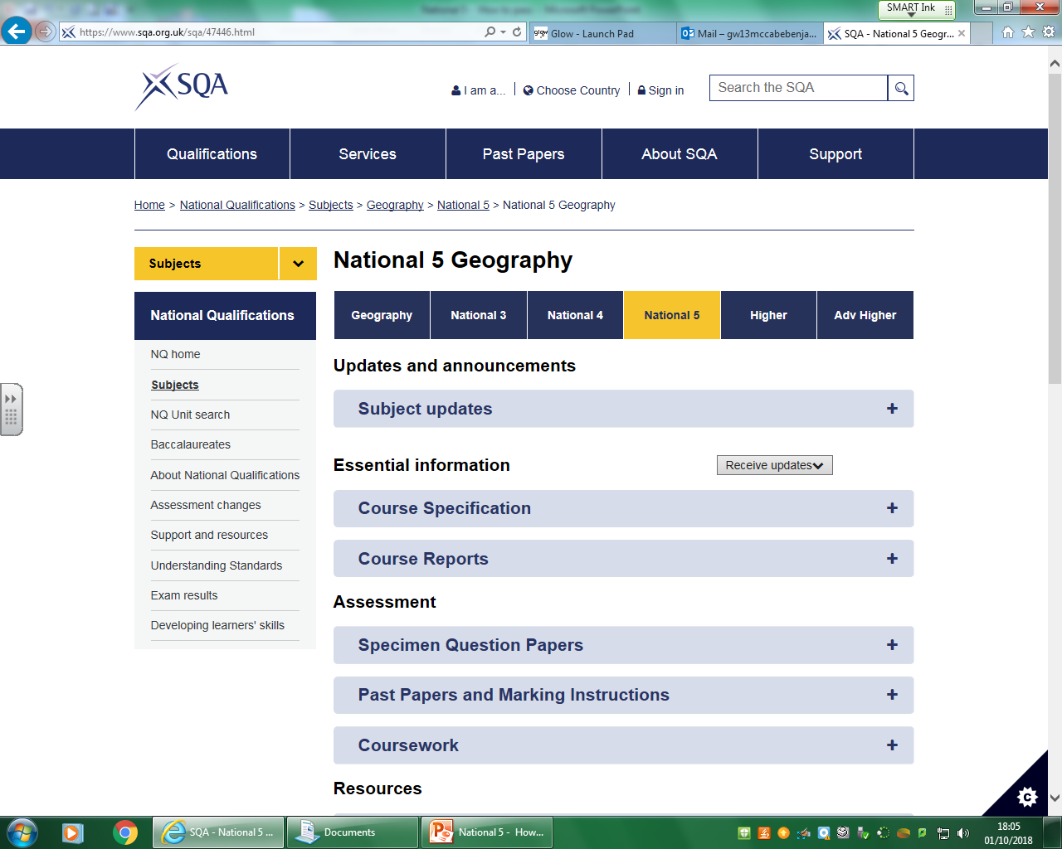
https://www.sqa.org.uk/pastpapers/findpastpaper.htm?subject=Geography&searchText=&level=N5&includeMiVal=

Slide 16
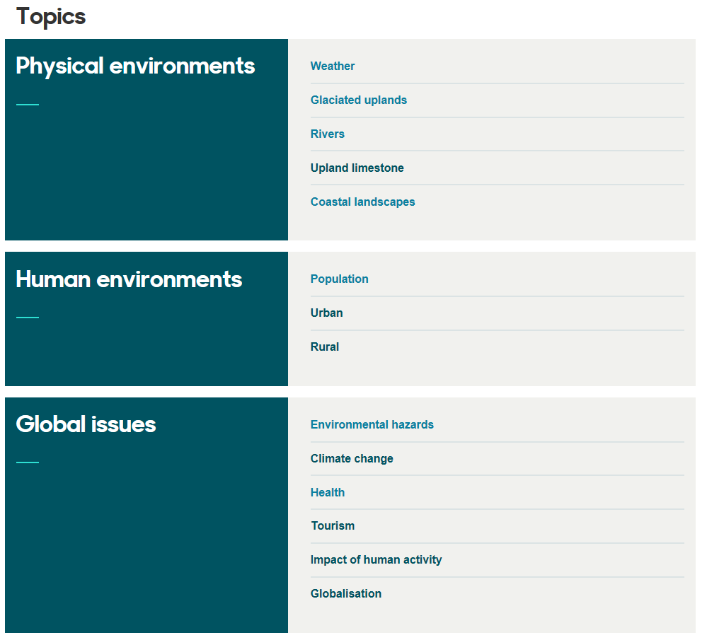
Bitesize

Slide 17
How can you help?
Encourage your son/daughter to study regularly at home (if they have homework or not).
Discuss topic related issues with them.
Read over homework questions and answers.
Ensure resources are organised at home.
Test pupils using core notes and textbooks.
Encourage a structured approach to revision.

Slide 18
Study Support
Tuesday (Miss Scott)
and
Wednesday (Mr McCabe)
3.30pm-4.30pm – pupils encouraged to ‘drop-in’ for help.

