Slide 1






How To Pass
National 5 Chemistry
Equivalent to Standard Grade Credit

Slide 2
DHS Chemistry Department
Miss McLeod
Mrs Earle
Miss Henry

Slide 3
Course content
Rates of reactions
Atomic structure
Bonding
Chemical formulae
Acids and bases
OCTOBER HOLIDAYS
Homologous Series
Everyday consumer products
Energy from fuels
WINTER BREAK
Metals
Plastics
Fertilisers
Nuclear Chemistry
Chemical Analysis

Slide 4

Course assessment
The 3 units are periodically assessed through out delivery with smaller stakes check test as well as 3 larger unit assessments:
Chemical Changes and Structure
Nature’s Chemistry
Chemistry and Society.

Slide 5
Check Tests
Check tests occur roughly every 3 weeks.
There are designed to encourage your child to revise content being delivered and to identify any areas of development

Slide 6
Unit Assessments
These are HIGHER stakes assessments which are used for tracking
These are designed to indicated how your child is likely to perform in the exam based on their current effort level.

Slide 7
Chemistry exam in 240 days
Final assessments
Exam (2 hours) : 80 marks
Section 1 – multi-choice 20 marks
Section 2 – extended response 60 marks
21st May 2027 – 1300 to 1500
Assignment
Conducted in school but marked externally – 20 marks and done under exam conditions

Slide 8
Assignment – 8 hours
Research
Involves doing an experiment and research around the experiment.
Pupils will work in pairs for the practical work but research is done alone.
Reporting – Under exam conditions
Findings from the experiment and the background chemistry are collated in a written report. This is marked by QS.
1hour and 30 minutes
20% of the final grade

Slide 9
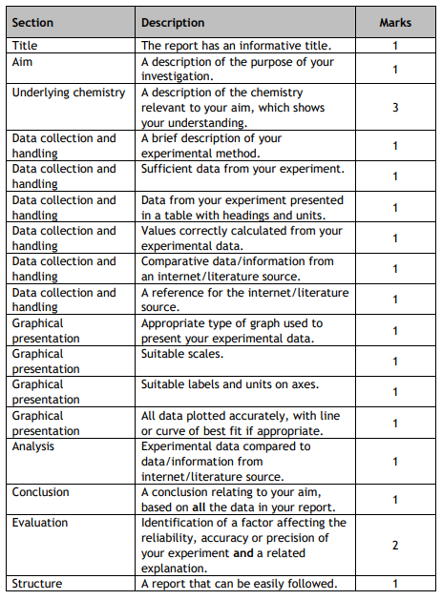

Slide 10
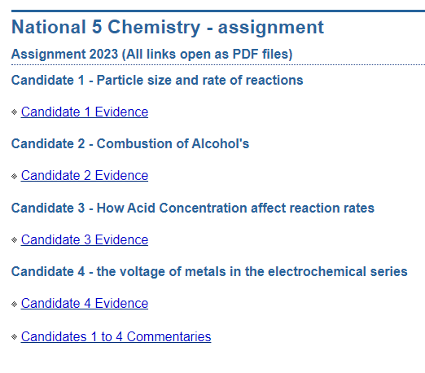

Type in SQA UNDERSTANDING STANDARDS N5 CHEMISTRY

Slide 11
Staff responsibilities
Provided high-quality teaching and notes for the whole course. Paper copies and online materials available.
Address any difficulties that arise
Progress is tracked, monitored and reported.
Pupil support/home contacted when concerns arise
Weekly study support provided (after school)

Slide 12
Pupil responsibility
Ask for help when unsure - ASAP
Ensure all relevant material is brought to class
Ensure any work missed is completed and caught up – the class keeps moving on
Ensure homework is submitted on time
Attend study support if required ; especially in run up to assessments/exams

Slide 13
Pupil responsibility
To be successful at N5 Chemistry pupils MUST invest their time.
Pupils SHOULD be revising for at least 1 hour/week to ensure they are doing the best that they possibly can.
This can be divided up into 10/15-minute intervals.
Closer to exam time this should be at least 2 hours a week.

Slide 14
How can you help?
Encourage pupil to seek help if required
Provide a suitable environment for study
Track homework – Microsoft Teams
Check phone/tablet use during study time- app blockers for social media.
Check on studying status
Encourage pupil to access revision materials (online & books)

Slide 15
Best revision methods
OLD PAST PAPER QUESTIONS – easily accessed online or paper copies available to borrow on request
Using notes to identify issues.
Use of resources of Microsoft Teams
Seeking Support
Flash cards for learning content.

Slide 16

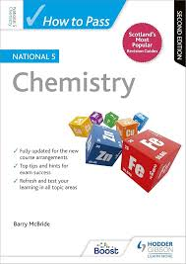
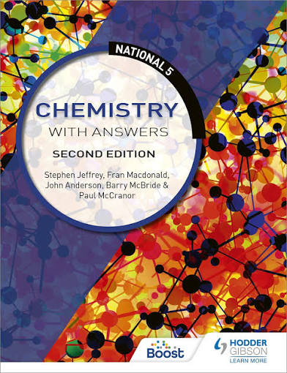

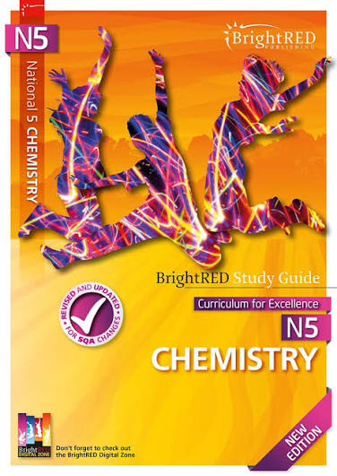
Revision materials
Past Papers
Selected questions only which teachers can direct at this current time

Slide 17
Supported study
3.20pm – 4.20pm
Tuesday with Miss Henry in (F-28) or Miss McLeod (F-30) on a rota
Or can drop in at the end of a school day for a quick chat with either teacher

Slide 18
Check points!
October Assessment (4 days time)
Prelims start in January
Assignments in late January
Second Prelim just before Easter

Slide 19
Any Additional Questions?

