Slide 1
How to Pass
National 5 Business

Slide 2

Unit Topics
Understanding Business
Marketing and Operations
People and Finance

Slide 3
QS Exam
1.5 hours to complete the paper
Section 1 has 20 marks based on a piece of stimulus material (case studies). Questions range in value from 1-5 marks.
Section 2 has 50 marks (consisting of five 10-mark questions). Each question may range in value from 1–4 marks. The questions assess the application of knowledge and understanding of all topic areas.
Worth 78% of overall grade

Slide 4

Exam Date 2026
Thursday 13 May 2027
9:00-10:30

Slide 5
QS Assignment
Worth 30 marks (22% of the overall grade)
Pupils independently choose their topic
Pupils have 5 hours for this project
Begin writing it in February 2027
Will be due March 2027

Slide 6
Assignment
The assignment gives pupils the opportunity to demonstrate their ability to:
Select an appropriate business topic
Research & gather suitable business information from a range of sources
Apply knowledge and understanding of business concepts to explain and analyse key features of their topic
Draw valid conclusions and/or recommendations
Produce an appropriately formatted business report

Slide 7
Class Assessment
Pupils will be assessed in class by the following methods:
End of Unit assessments
Weekly exam style starter questions
15 Minute Thursday/Friday
October assessment and prelim

Slide 8
Homework
Bi-Weekly homework issued to pupils via Teams (printed copy can be requested from teacher)
Pupils should complete homework in their Jotters
Pupils have a week to complete the homework
Pupils should take time to read over teacher feedback

Slide 9
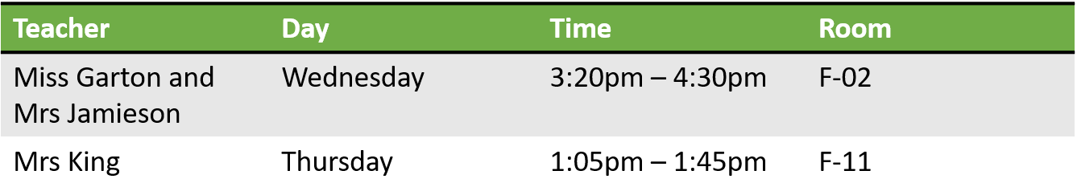

Supported Study
Supported study will be available to pupils on a weekly basis with all teachers
Pupils should try to attend as often as they can

Slide 10
What will help?
Consolidating notes at home regularly (through Teams/One Drive)
Watching/reading the news – to put what we are learning into context
Create key terminology flashcards/posters/graphic organisers as they go through the course
Use a study timetable
Past Paper questions (hand in for marking)
Timed practice

Slide 11
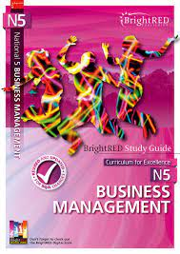

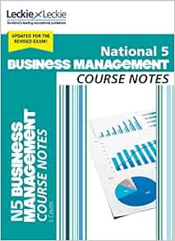
Course Textbooks
Pupils can gain access to these through teacher and have access to a wealth of notes and information on teams

Slide 12

Useful Links
BBC Bitesize
Quizlet
QS Past Paper
Two Teacher YouTube Channel
Business as Usual Podcasts
Clickview and WestOS videos

Slide 13
How can you help?
Encourage pupils to apply their learning to real life situations on the news etc.
Encourage attendance at supported study
Remind pupils about homework requirements
Assist pupils to create a study timetable

