Slide 1


How to Pass
National Biology
September 2026

Slide 2
DHS Biology Department
Miss Caldow
Miss Johnstone
Mrs Downie
Miss McLeod
Miss MacPherson

Slide 3
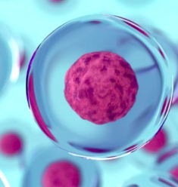
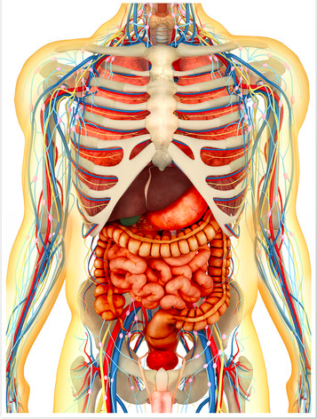

Course Content
The National 5 Biology course consists of 3 units:
Unit 1 – Cell Biology
Unit 2 – Multicellular Organisms
Unit 3 – Life on Earth

Slide 4

What the students will be doing in class…
Covering the course content using a variety of methodologies.
Carrying out experiments to reinforce coursework.
Undergoing research tasks.
Past paper questions and analysis of data.
Revision and exam preparation.

Slide 5

Assessment Timeline
End of unit tests (September 26, December 26 and March 27)
October Assessment
N5 Prelim (January 2027 – unit 1 and 3 content)
N5 Exam - (Wed 12 May 2027)
N5 Assignment – (Nov/Dec 2026)

Slide 6
Qualifications Scotland Assessment
N5 Biology Exam - 2 hours (80% of course grade)
multiple-choice questions
structured and extended response questions
N5 Biology Assignment - 1 hour 30 minutes (20% of course grade)
an individually produced piece of work from each candidate
started at an appropriate point in the course
conducted under controlled conditions
Both marked by Qualifications Scotland

Slide 7

Pupil Responsibility
Revise notes on a regular basis
Ensure homework is submitted on time.
Read homework feedback thoroughly to learn from mistakes.
Seek help when difficulties arise – be active in learning.
Attend study support if required; especially in the run up to assessments and exams.
Ensure all relevant materials are brought to class.
Biology department use Microsoft Teams – where all resources will be uploaded for any student to catch up with work missed due to absence.

Slide 8

Teacher Responsibilities
Homework will be marked in a timely manner with feedback given.
Offer study support sessions weekly.
Monitor and track progress for each individual.
Pupil support/home contacted when any concerns arise – most likely following October assessment.

Slide 9
How can you help at home?
Encourage students to ask for help if they are struggling with any of the work.
Assist with revision before assessments – help create a revision timetable or test their knowledge by asking questions from their notes.
Encourage students to access revision materials (BBC Bite size, Microsoft Teams, Revision books etc.)

Slide 10
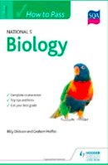
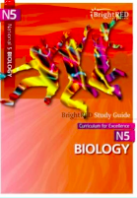
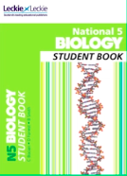
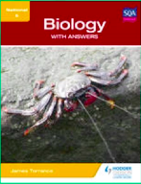
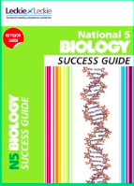

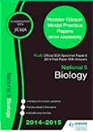
Revision Materials

