Slide 1
How to Pass
N5 Admin & IT

Slide 2

Theory Unit Topics
Pupils can also be assessed on practical topics as theory questions
Role of Administrative Assistant
Customer service
Health & safety
Security of people property & information
Sources of information from the internet
File management
Corporate image
Electronic communication

Slide 3
Practical Topics
Word processing
Spreadsheets (Excel)
Database (Access)
Presentations (PowerPoint)
Communication (email, e-diary, internet research)

Slide 4
QS Exam
2 hours to complete the paper
The question paper gives candidates the opportunity to demonstrate:
using IT functions in spreadsheet and database applications to produce and process information
problem-solving
administration theory
Worth 50 marks

Slide 5

QS Exam
The mark allocation is:
  20 marks (+/- 3) for spreadsheet
  20 marks (+/- 3) for databases
  10 marks (+/- 3) for theory
42% of overall grade!

Slide 6
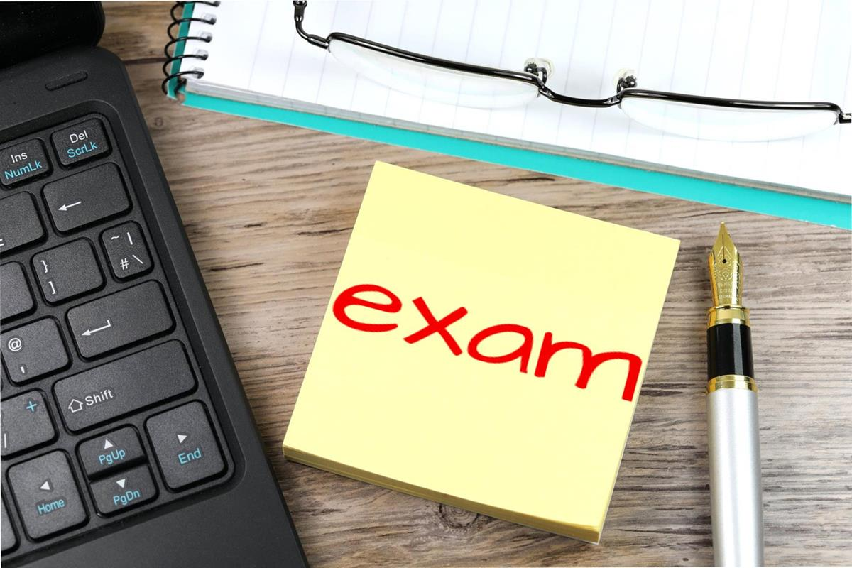
Exam Date
Tuesday 27 April 2027
13:00-15:00
Will be in a computer room!

Slide 7
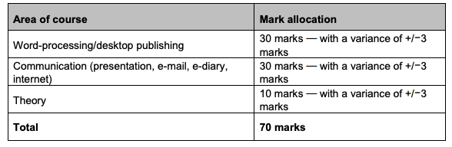
QS Assignment
58% of overall grade
3 hours to complete the paper
Will be completed in February 2027 – date tbc

Slide 8
Class Assessment
Pupils will be assessed in class by the following methods:
End of Unit assessments – both practical and theory
Practice assignment/exam papers
October Assessment and Prelim

Slide 9
Homework
Bi-Weekly homework issued to pupils via Teams (printed copy can be requested from teacher) and should be completed in hand in jotter!
Pupils have a week to complete the homework
Pupils should take time to read over teacher feedback

Slide 10

Supported Study
Supported study will be available to pupils on a weekly basis
Teacher | Day | Time | Room
Miss Garton and Mrs Jamieson | Wednesday | 3:20pm – 4:30pm | F-02
Mrs King | Thursday | 1:05pm – 1:45pm | F-11
Miss Hamblin | Monday | 1:05pm – 1:45pm | F-18

Slide 11
What will help?
Consolidating notes at home on theory (through Teams/One Drive)
Create key terminology flashcards as they go through the course
Completing past papers under timed conditions
Use a study timetable
Attend supported study on a frequent basis for extra practice

Slide 12
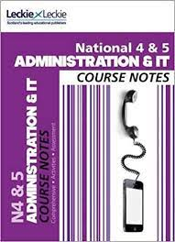
Course Textbook
No requirement to buy as pupils have access to all notes/help sheets on class Team

Slide 13
How can you help??
Encourage pupils to attend supported study
Remind pupils about homework requirements
Encourage pupils to revisit notes/practice practical tasks at home if possible
Encourage use of a study timetable to incorporate studying early

Slide 14

Any Questions?

