Slide 1
How to pass
Higher biology

Slide 2
Overview of the course
Three units
- mid unit assessment
- end of unit assessment (counts towards estimate grade)
- Exam (80%) and assignment (20%)
- October assessment (skills)

Slide 3
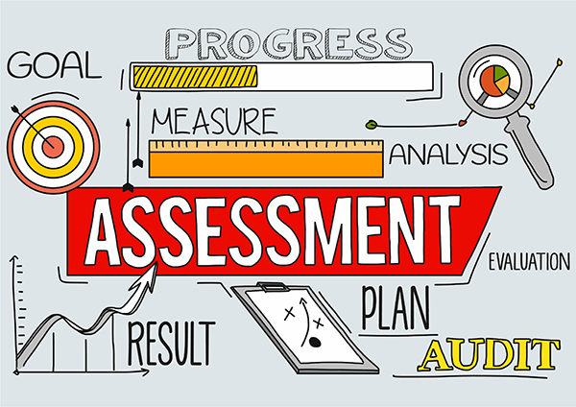
Assessments
Key dates:
Prelim (January 2024)
Exam: Wednesday 15th May (9-12.30)
Multiple choice – 25 marks
Written section – 95 marks
Essay questions - within written section (approx. 15 marks)

Slide 4
assignment
Completed in class time (around January 2024)
Involves an experiment and write up
Practice possible areas throughout year and given feedback
Must be completed independently with no feedback provided
Marked by SQA

Slide 5
Student’s responsibilities
Attending class
Catching up on missed work if absent
Asking questions
Completing homework on time
Reading feedback
Regular revision of work every week

Slide 6
Teachers responsibilities
Covering
Covering all examinable material and providing notes
Providing
Providing regular homework and feedback
Providing
Providing regular updates on progress (parents evenings and reports)
Contacting
Contacting home when concerns arise

Slide 7
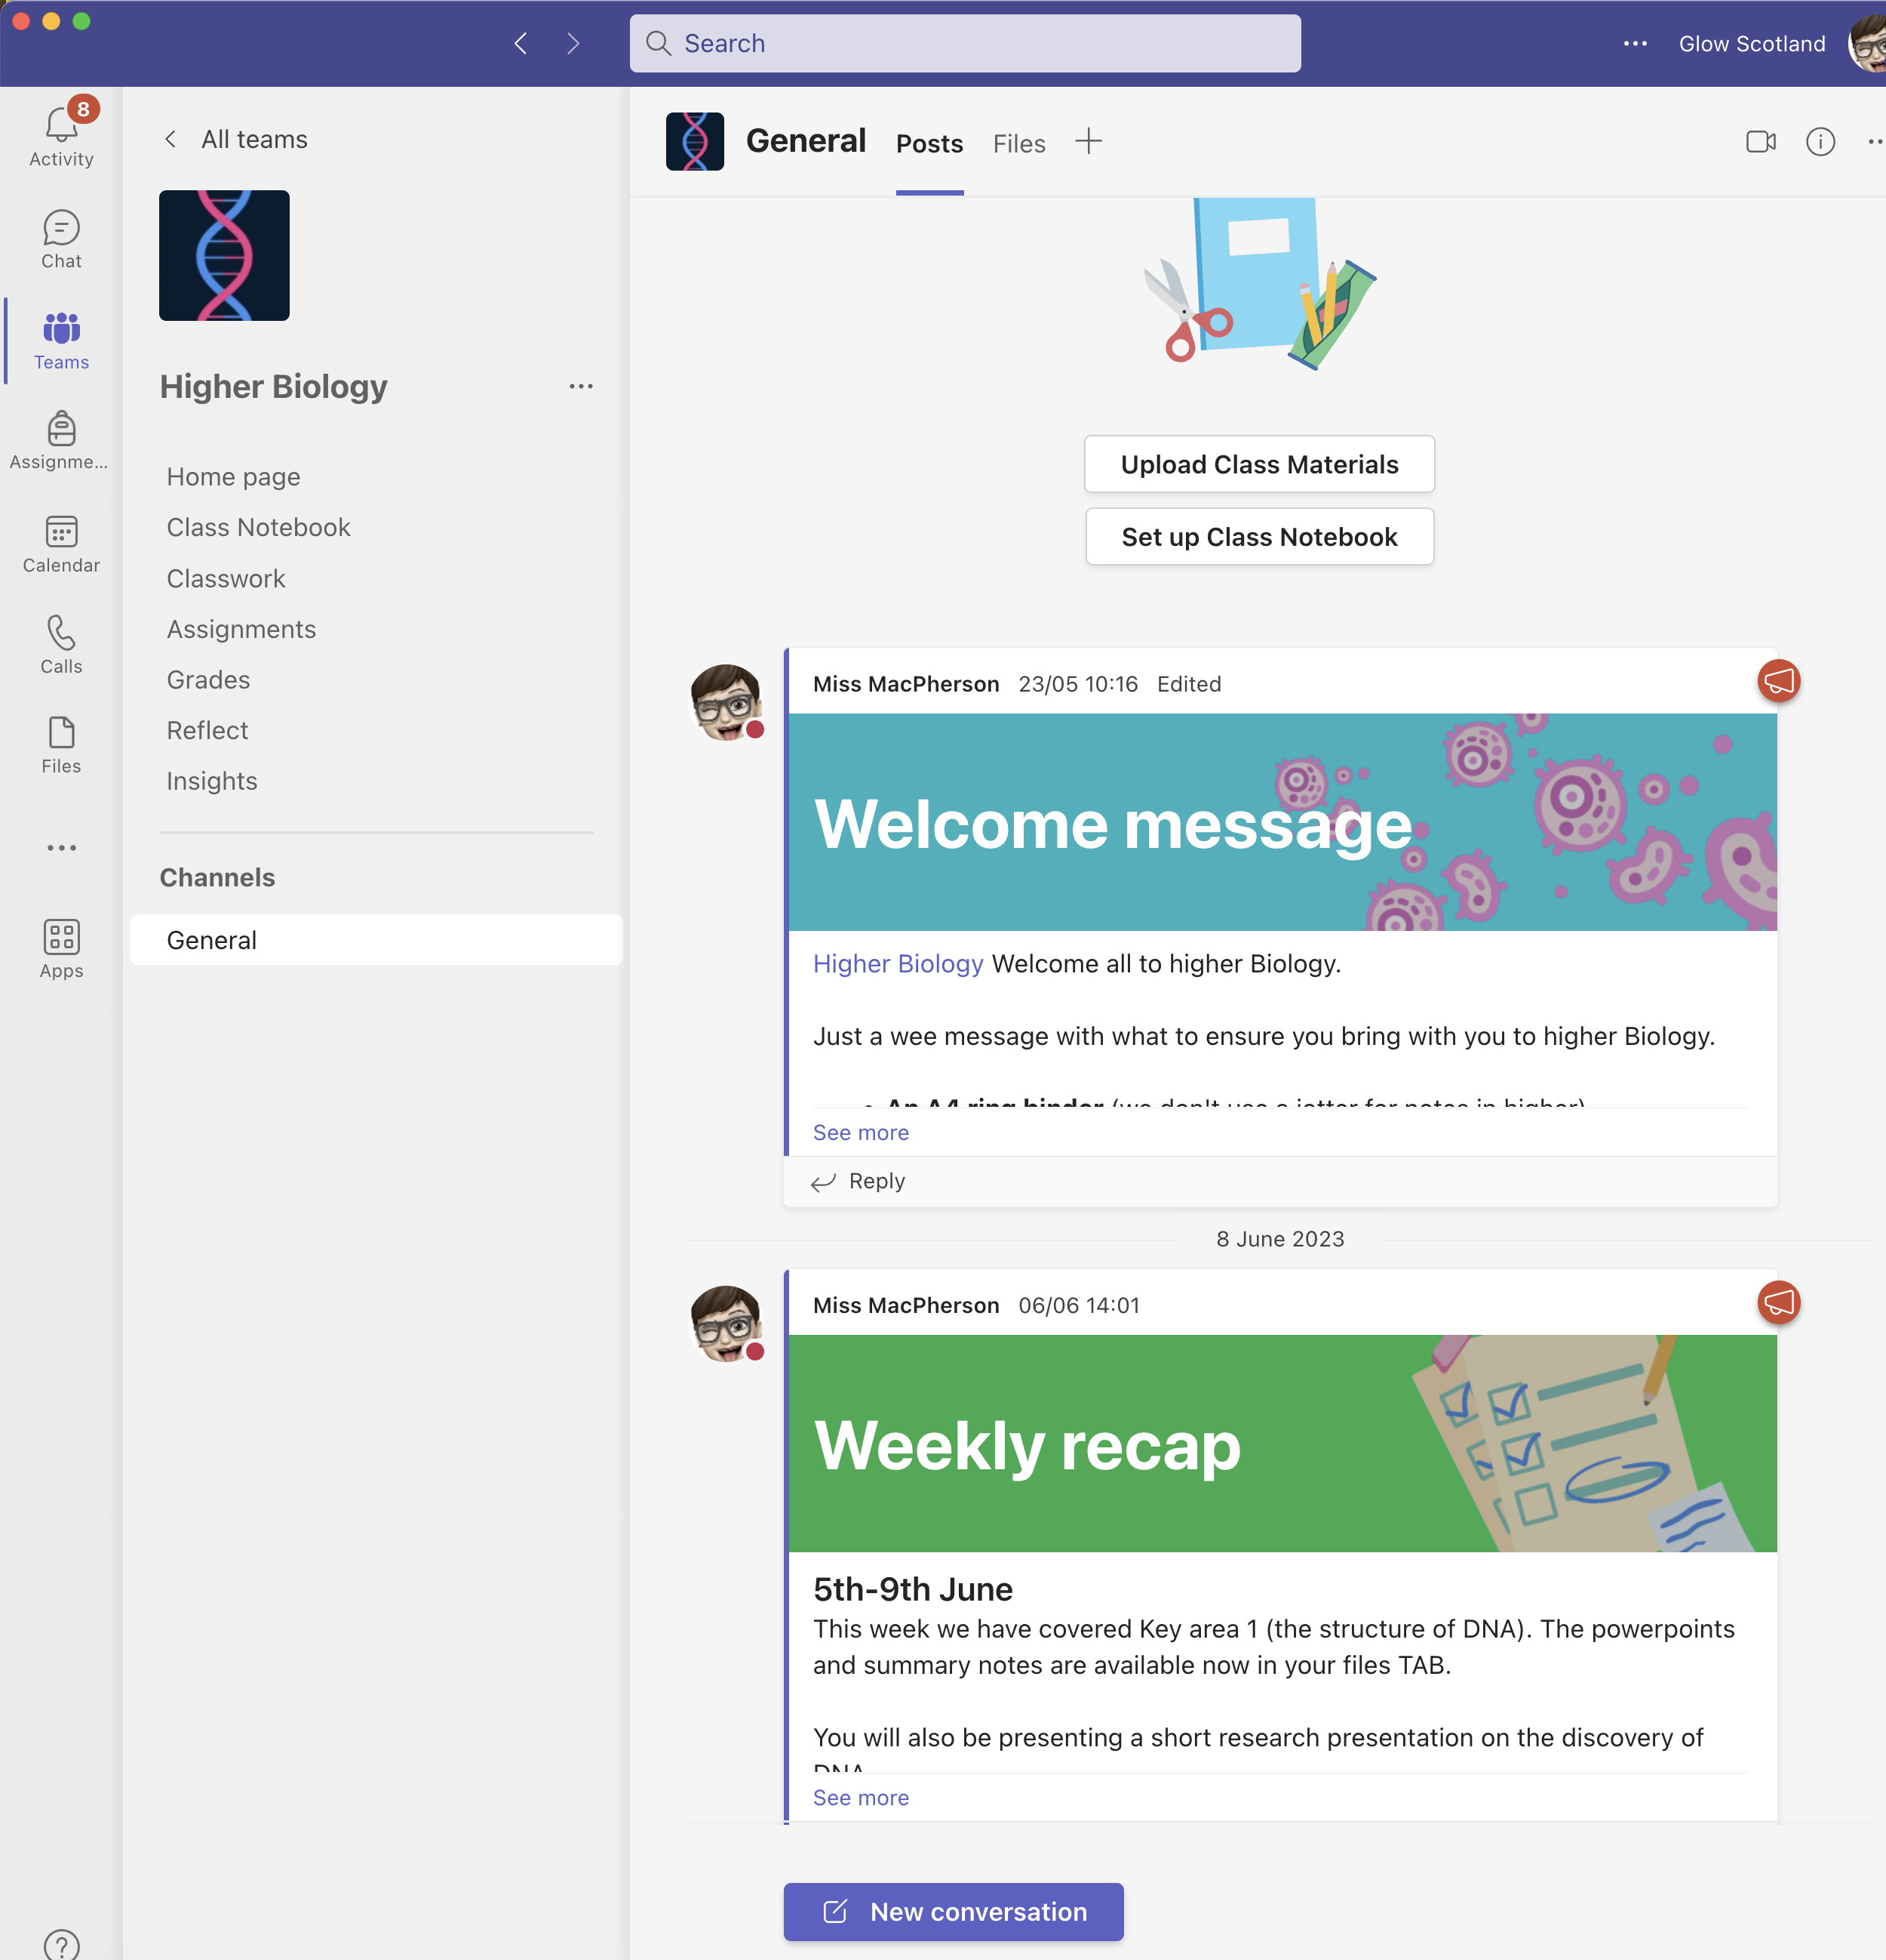
Accessing materials at home
All powerpoints and notes found in files tab
Weekly recap on work completed
Assignment tab for homework and class tests
Ability for students to communicate with me out with class time.

Slide 8
Homework and feedback
Homework issued at end of each key area (approx. 1 per week) – these are past paper questions
Research given sometimes when need arises to increase research skill
IF COMPLETED ON TIME, written feedback on incorrect questions are given via email and score uploaded to assignment tab
Students should be reading all feedback AND asking for help or clarification if required

Slide 9
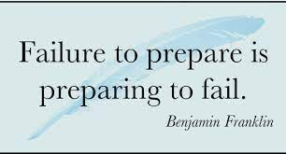
Preparing for success
Read over your notes at home and identify issues
Ensure you have definitions of vocabulary memorise
The memory game
Practice your application
Reflect and clarify

Slide 10
Useful resources

Slide 11
Useful resources

Slide 12
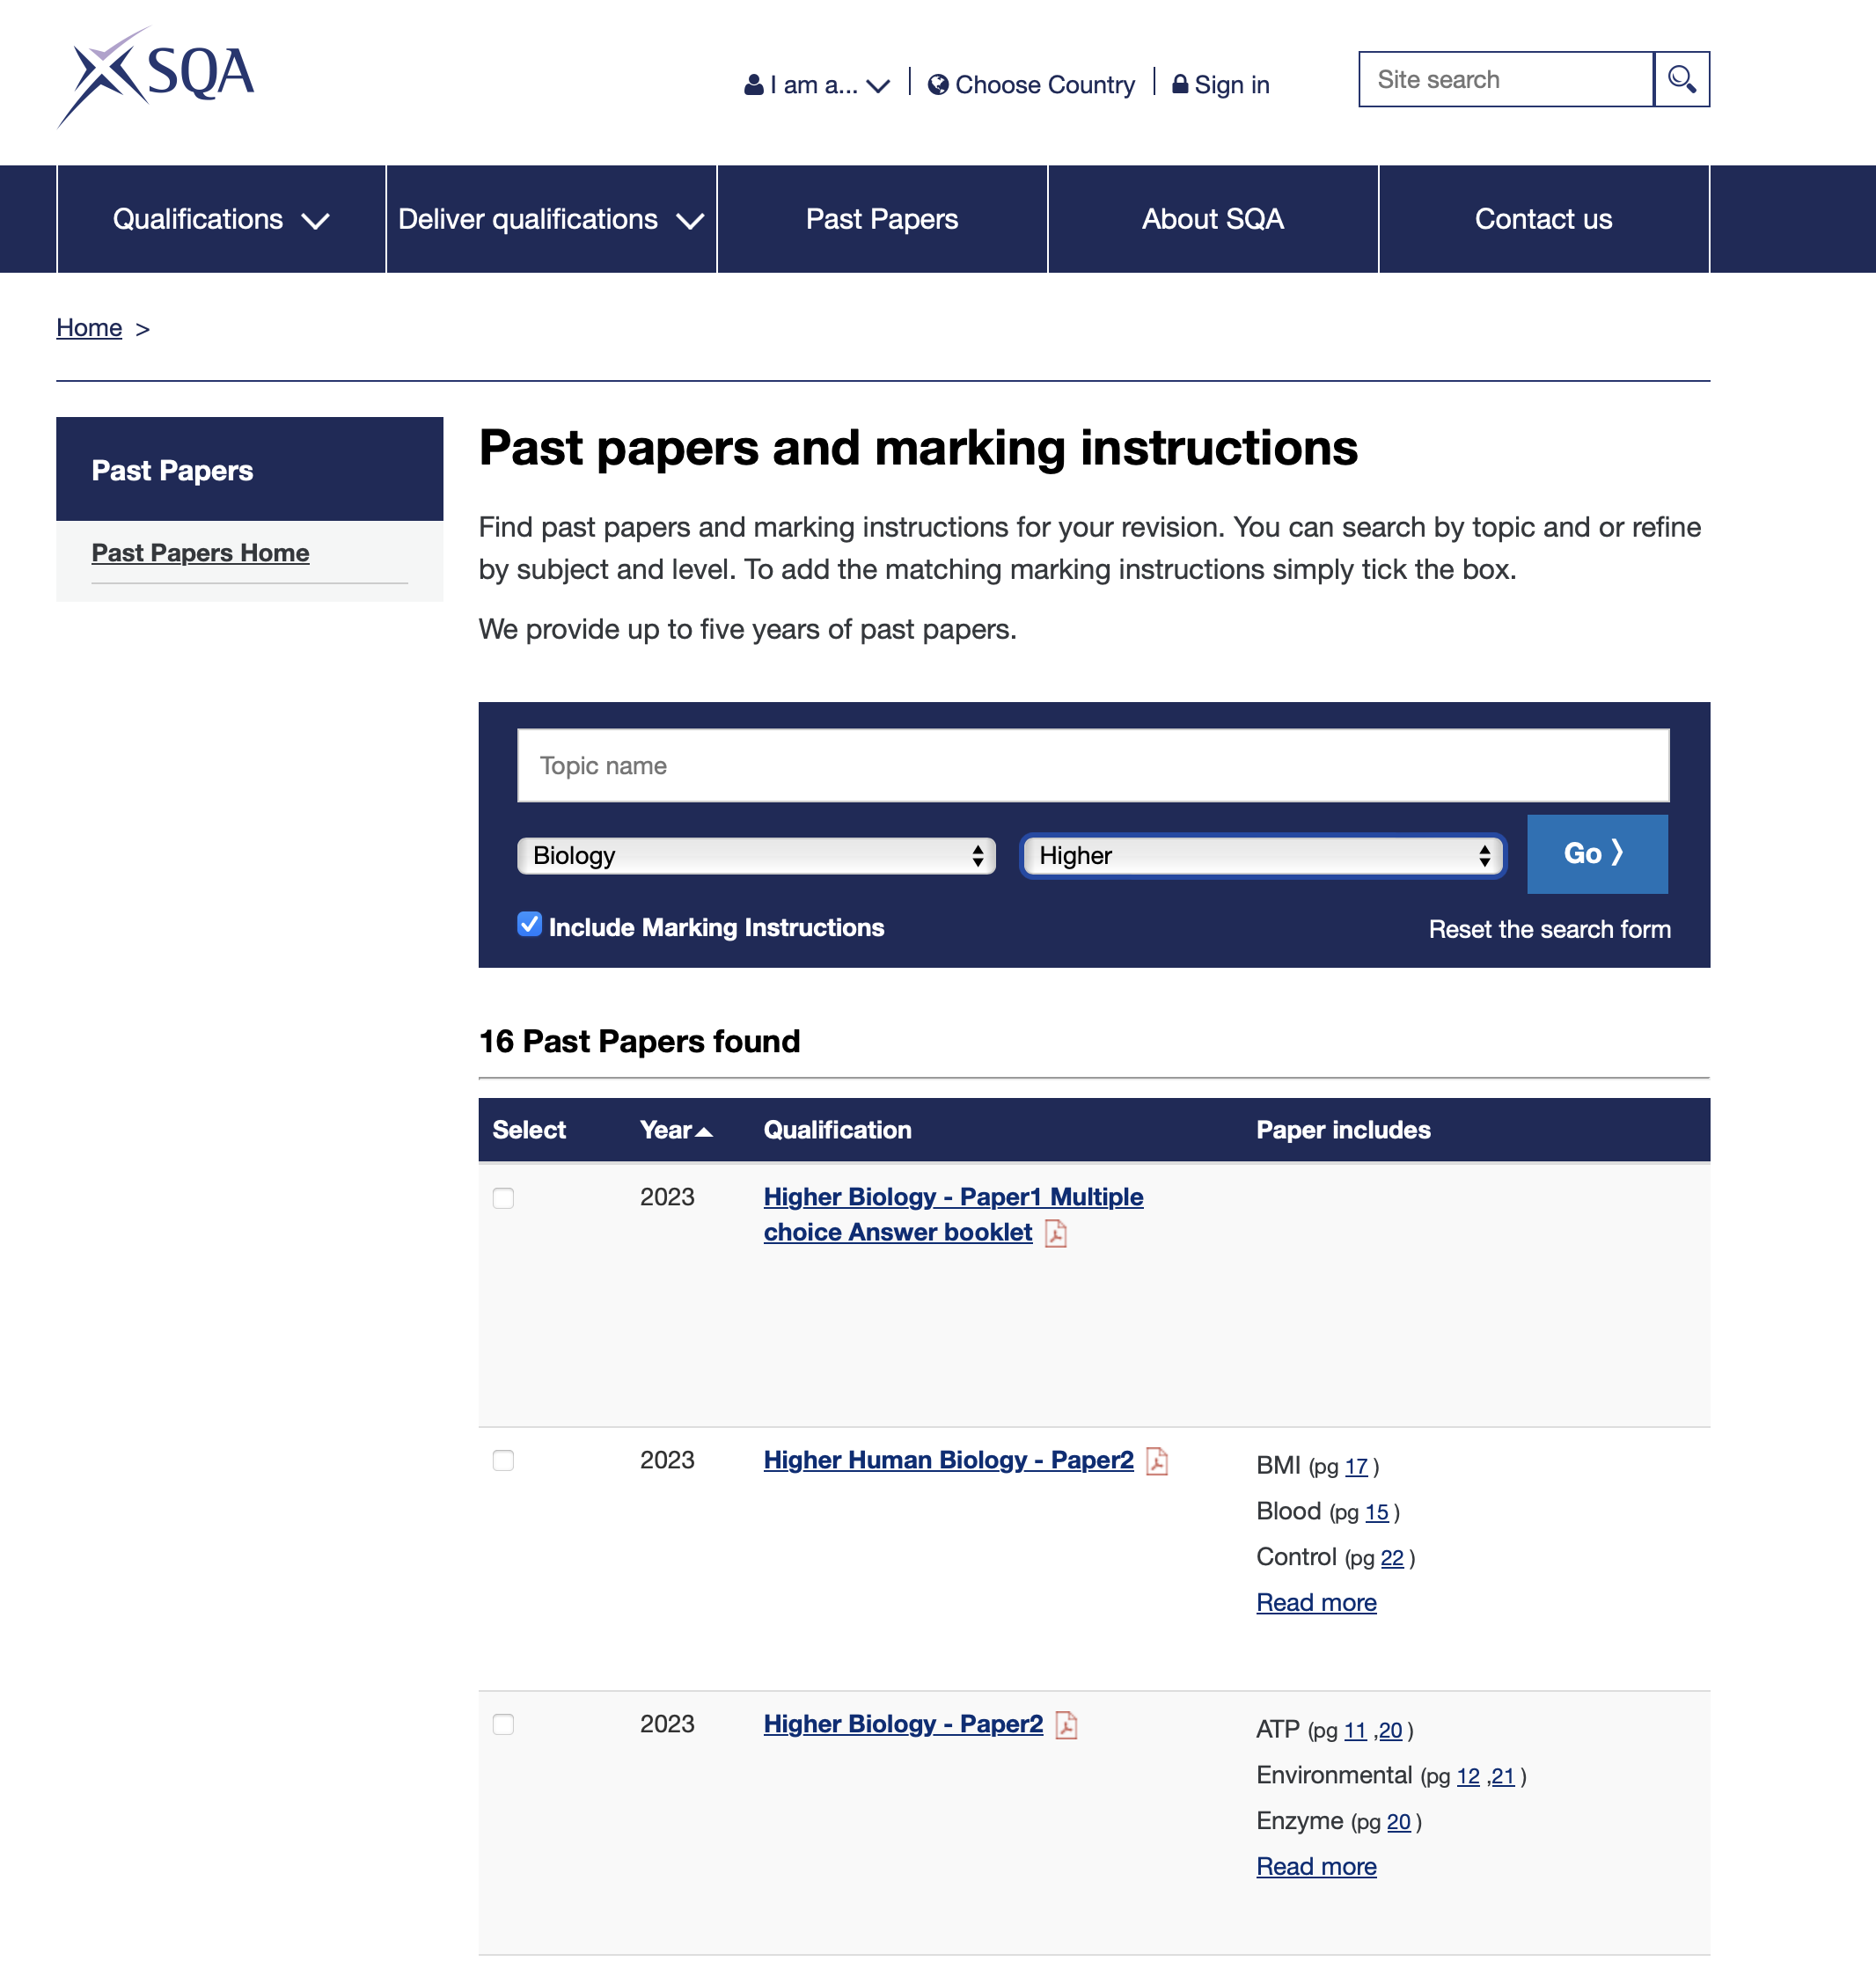
Useful resources

Slide 13
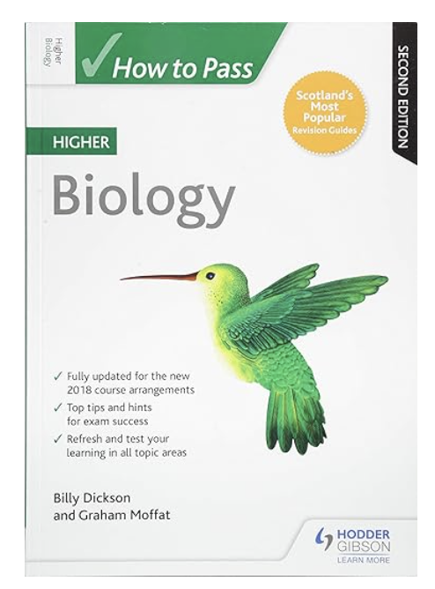
Useful resources

