Slide 1
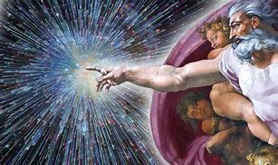
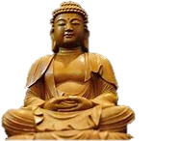
RMPS
Mrs Snailham

Slide 2
Units /Course Content
World Religion: Buddhism | Morality & Belief: Justice | Religious & Philosophical Questions: Origins
Notes:
or Christianityor Medical Ethics or Conflictor Evil & Suffering

Slide 3
Units /Course Content
World Religion: Buddhism
*The impact, relevance and significance of a Religion e.g. the Buddha’s impact on the world *Key beliefs and practices of a world religion e.g. Kamma; law of cause and effect *The religious lives of the followers e.g. meditation; seeing of the true nature of things

Slide 4
Units /Course Content
Morality & Belief: Justice
*One major contemporary moral issue e.g. capital punishment debate *Implications of and responses to that issue e.g. Purposes of punishment ; moral questions *Religious and Non-religious perspectives e.g. Christian responses to sentencing; forgiveness

Slide 5
Units /Course Content
Religious & Philosophical Questions: Origins
*Issues raised by religious/philosophical questions e.g. what is origin of the Universe / Life? *Implications of and responses to those questions e.g. compatibility of religion and science? *Religious and Non- religious perspectives E.g. Genesis and the Big Bang Theory

Slide 6
DHS Assessments
formal assessments and timed questions at several times each month (Thursday lessons) to determine pupil progress and level they are achieving.
October assessment
January Prelim.
Assignment write-ups early March
There may be a 2nd Prelim to assess the whole course.
N4 AVU write up is early April

Slide 7
Higher Exam
The exam has 2 question papers
There are 80 marks available.
Paper 1 is 2 hours 15 mins and has 2 sections, covering Morality and World religions units, with 2 essays per section.
Paper 2 is 45 mins and covers the philosophical unit. There is one essay to complete.

Slide 8
Assignment: higher - 2000+ word count
There is an opportunity for individual research of a religious, moral or philosophical assignment – worth 30 marks – personalised question/title
essay written under exam conditions in school; 8 hours + 1 hour 30 minutes

Slide 9
N5 Exam
The exam has 1 question paper
There are 80 marks available.
The Paper is 2 hours 20 mins and has 3 sections, covering Morality, World religions philosophical units
Each section has a series of approx. 6 questions to complete, covering the KU, AE skills

Slide 10
Assignment: N5 –20 marks/ 20% of your overall grade Word Count 1000 to 1200
There is an opportunity for individual research of a religious, moral or philosophical assignment – personalised question/title
You must complete this report within 1 hour under exam conditions

Slide 11
N4 Unit assessments
To achieve the National 4 Religious, Moral and Philosophical Studies Course, pupils must pass all of the required Units, including the Added Value Unit
The first Formal Assessment will be October
Each unit is assessed separately
Individual pupils may sit assessments as and when they are ready in order to achieve their best outcome

Slide 12
N4 AVU: pass or fail (teacher marked)
There is an opportunity for individual research of a religious, moral or philosophical assignment – the question is a personal choice
pupils must complete this report and log book by a TBC deadline

Slide 13
Homework
vital part of the course – pupils should complete it and meet deadlines.
extended questions / AE Essays , including past paper questions to give pupils exam practice.
important that homework is done with full effort at all times to allow me, and the pupil, to assess their strengths and weaknesses, and offer help and guidance where it’s needed.
Pupils must also review topics regularly and keep their work and notes orderly, which will help to nip any issues in the bud asap..

Slide 14
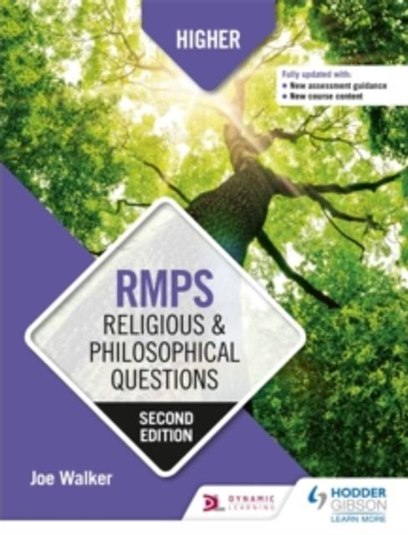
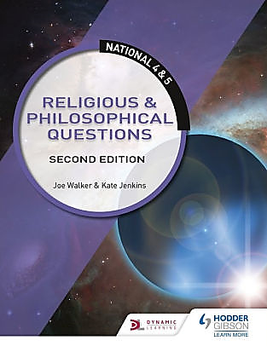
more on course content and Past Papers practice
Religious, Moral and Philosophical Studies – SQA
https://www.sqa.org.uk/sqa/47421.html

Slide 15
Additionally, there are a number of interesting and useful resources to access.
RMPS Resources Youtube channel
– Learning RMPS website
https://learningrmps.com/tag/national-5/
RMPS Bitesize page
https://www.bbc.co.uk/bitesize/subjects/z782fg8

Slide 16
How you can help
Encourage your son/daughter to review their class notes regularly at home whether they have homework or not.
Ensure resources are organised and your son/daughter has access to Teams and email
Discuss topic related issues with them –
Read over homework questions and answers –
Test your son/daughter using core notes and textbooks so they become ever more familiar with the topics.
Please do contact me (Mrs Snailham) if you need clarification of any subject work related issue

Slide 17
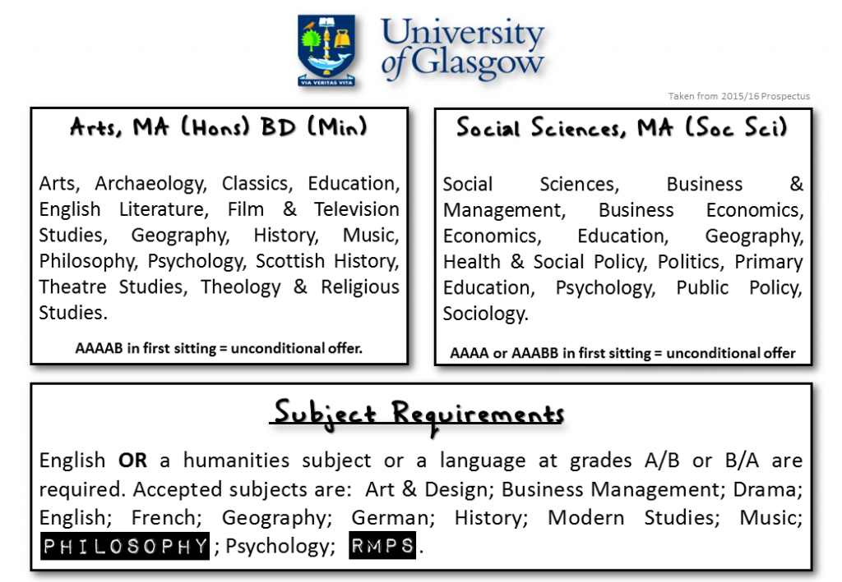

Slide 18
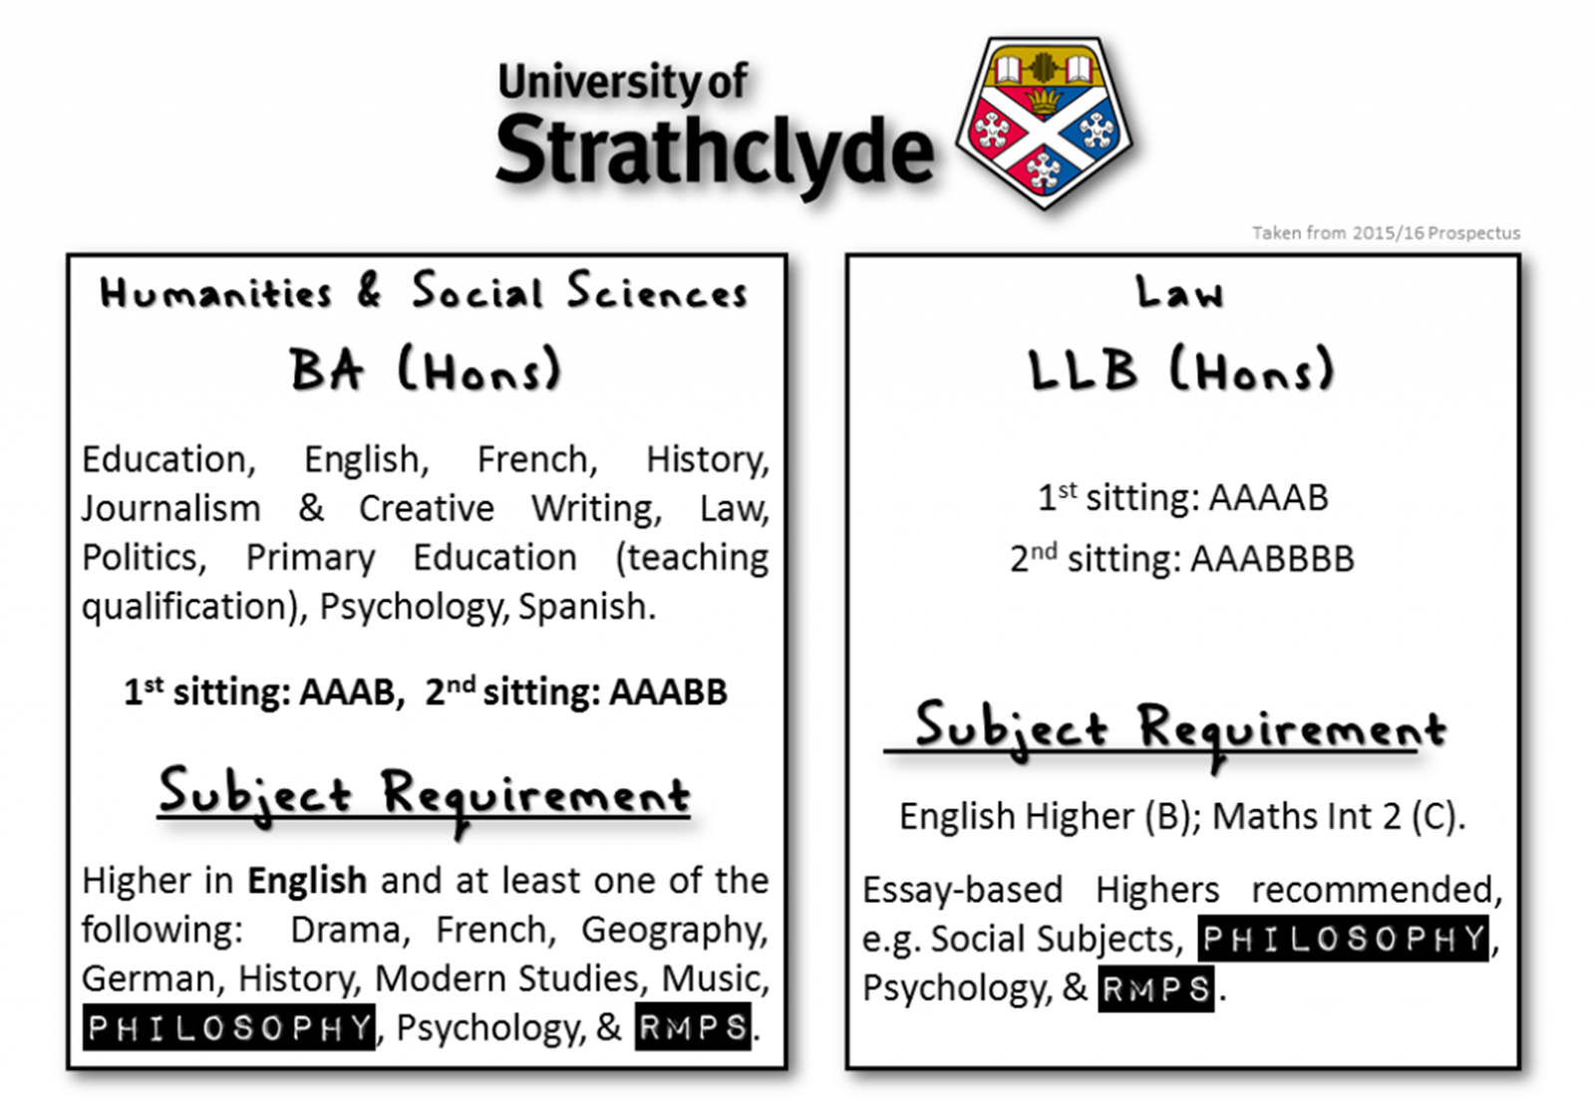

Slide 19
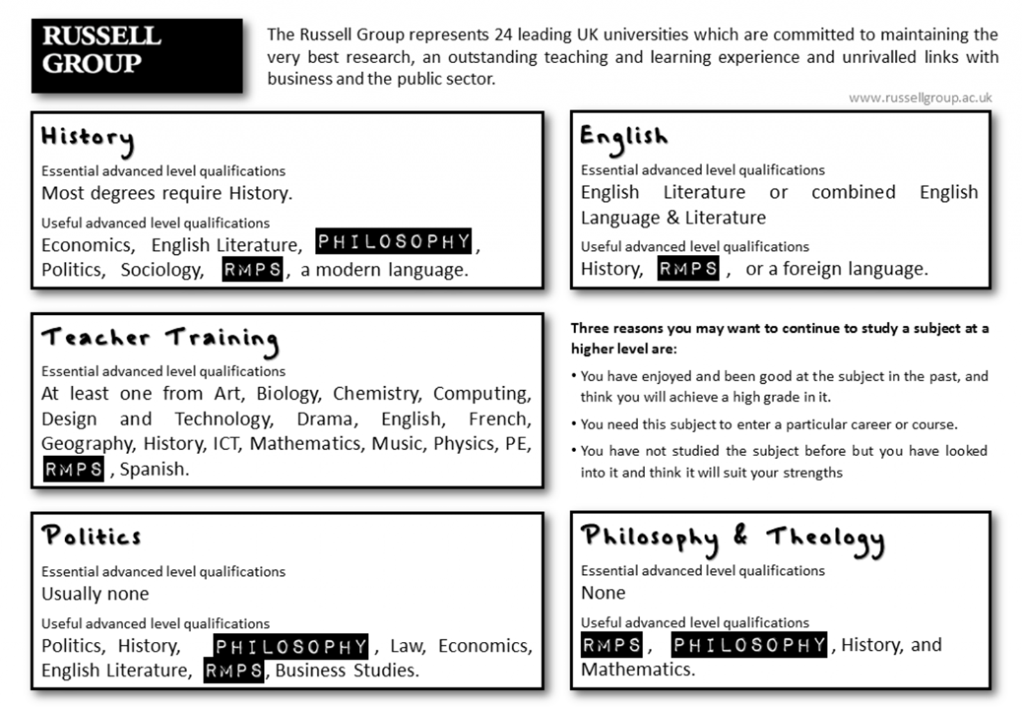

Slide 20
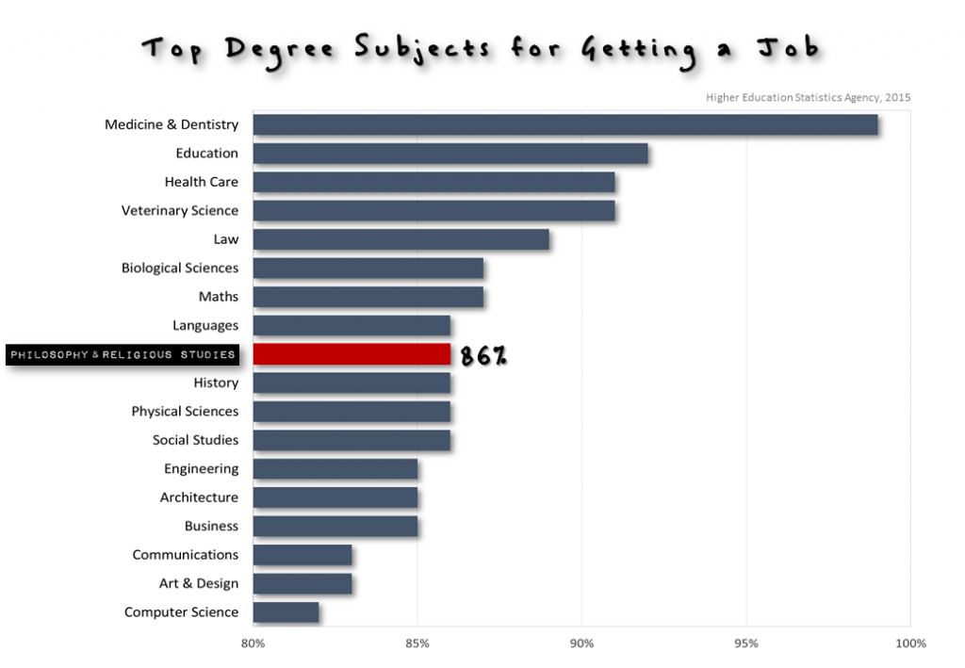
Careers
Information, Culture and Heritage
Law
Social, Caring and Advisory Services

Slide 21
RMPS

Slide 22
handouts
RMPS Timeline planner – schedule of topics and assessment dates
SQA Exam papers
ASSIGNMENT/AVU guidance booklets
Any Q&As?

