Slide 1
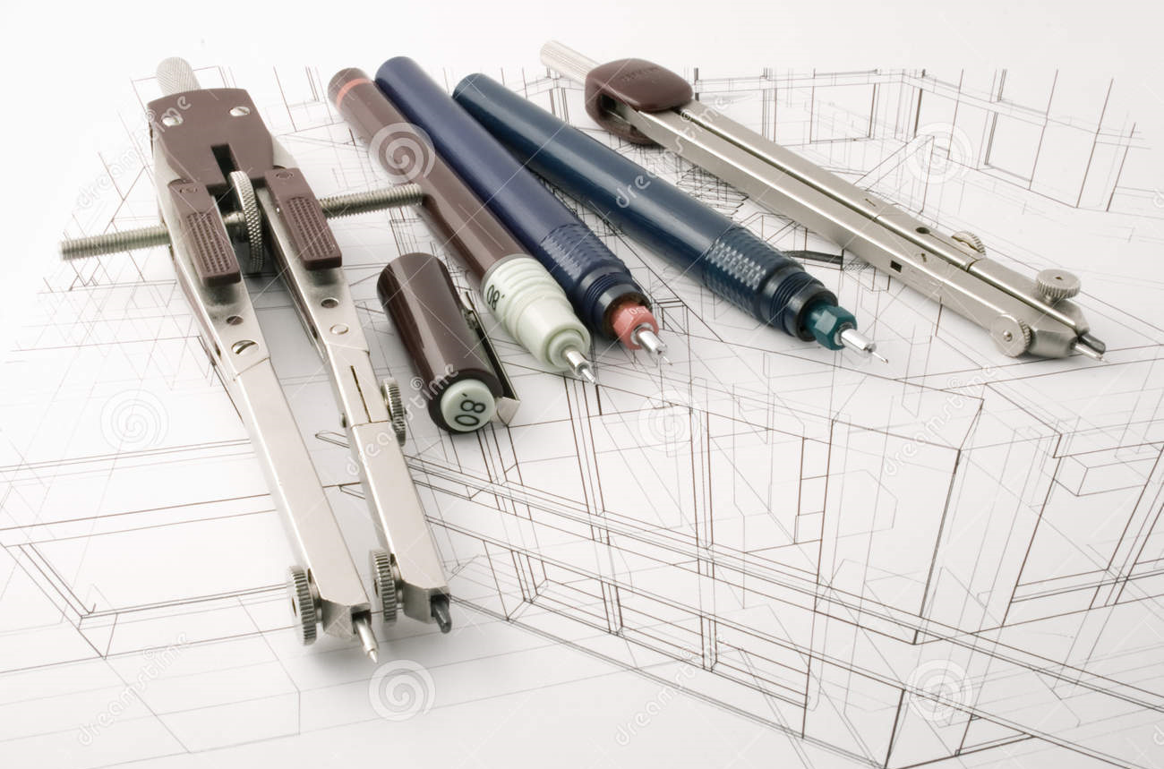
Graphic Communication
National 4&5 - How To Pass Evening

Slide 2
National 4 & 5 - Coursework
National 4 | National 5 | Time Allocation*
2D Graphic Communication | 2D Graphic Communication | 60hours
3D and Pictorial Graphic Communication | 3D and Pictorial Graphic Communication | 60hours
Added Value Unit | Assignment (closed book, under exam conditions) | Nat 4 – 20hours * Nat 5 – 8hours *
 | Final Exam | 2hours
* All work must be completed within this allocated time.

Slide 3
National 4 - Units and Outcomes
2D Graphic Communication
Outcome 1
Candidates will:
  Produce and interpret 2D sketches and drawings
Outcome 2
Candidates will:
  Produce preliminary 2D colour designs and illustrations for single page promotional displays
Outcome 3
Candidates will:
  Create 2D promotional graphic layouts

Slide 4
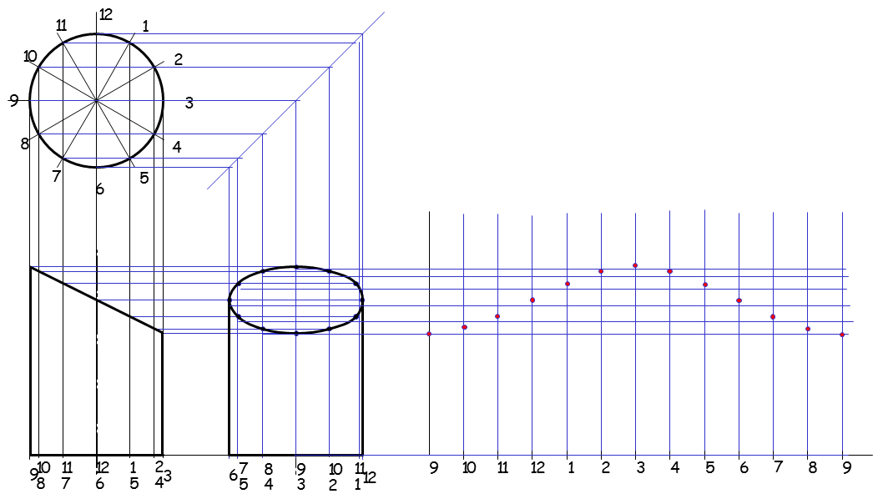
Examples of work covered so far.

Slide 5
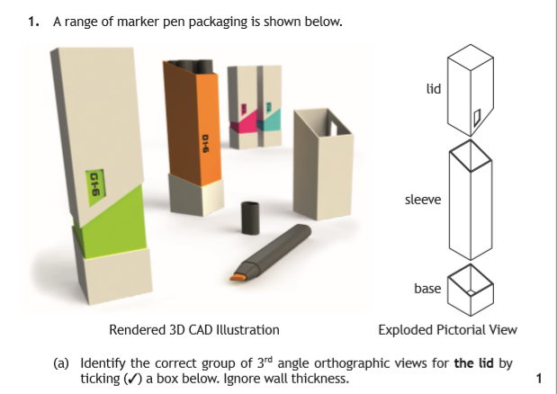

Slide 6
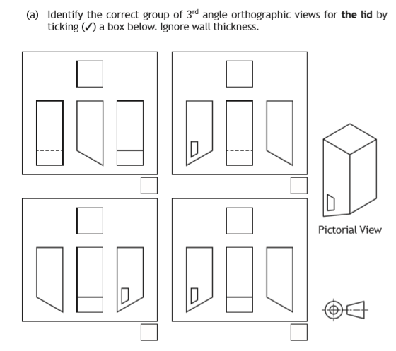
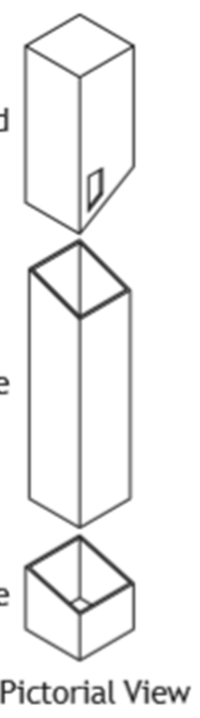

Slide 7
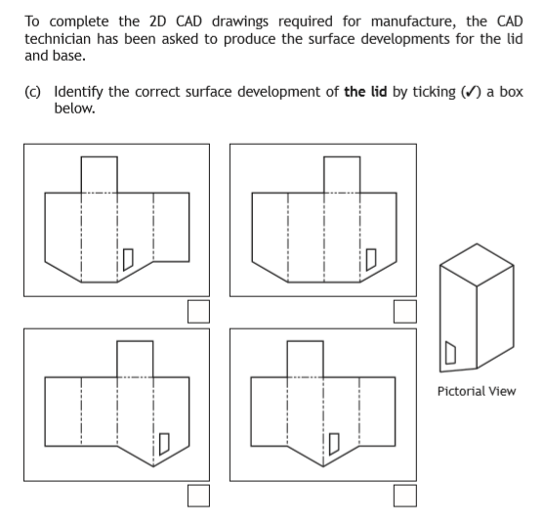

Slide 8
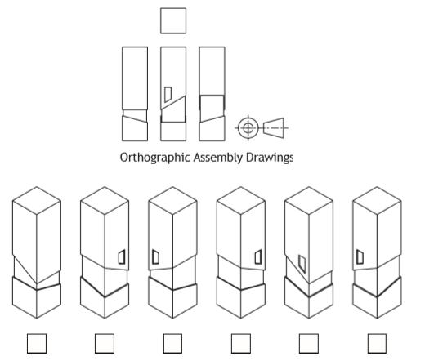

Slide 9
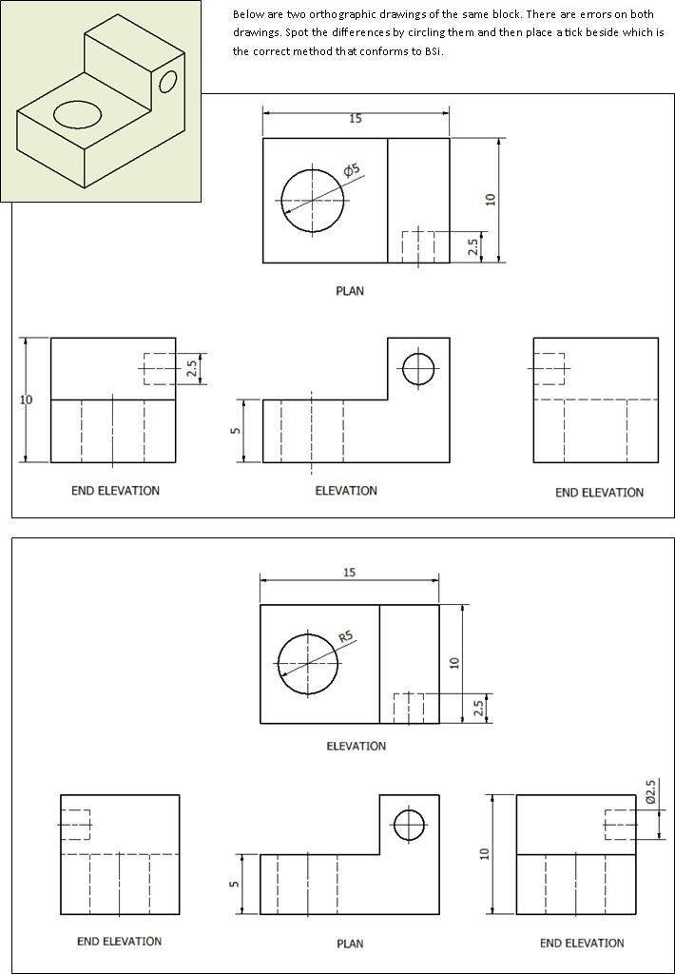

Slide 10
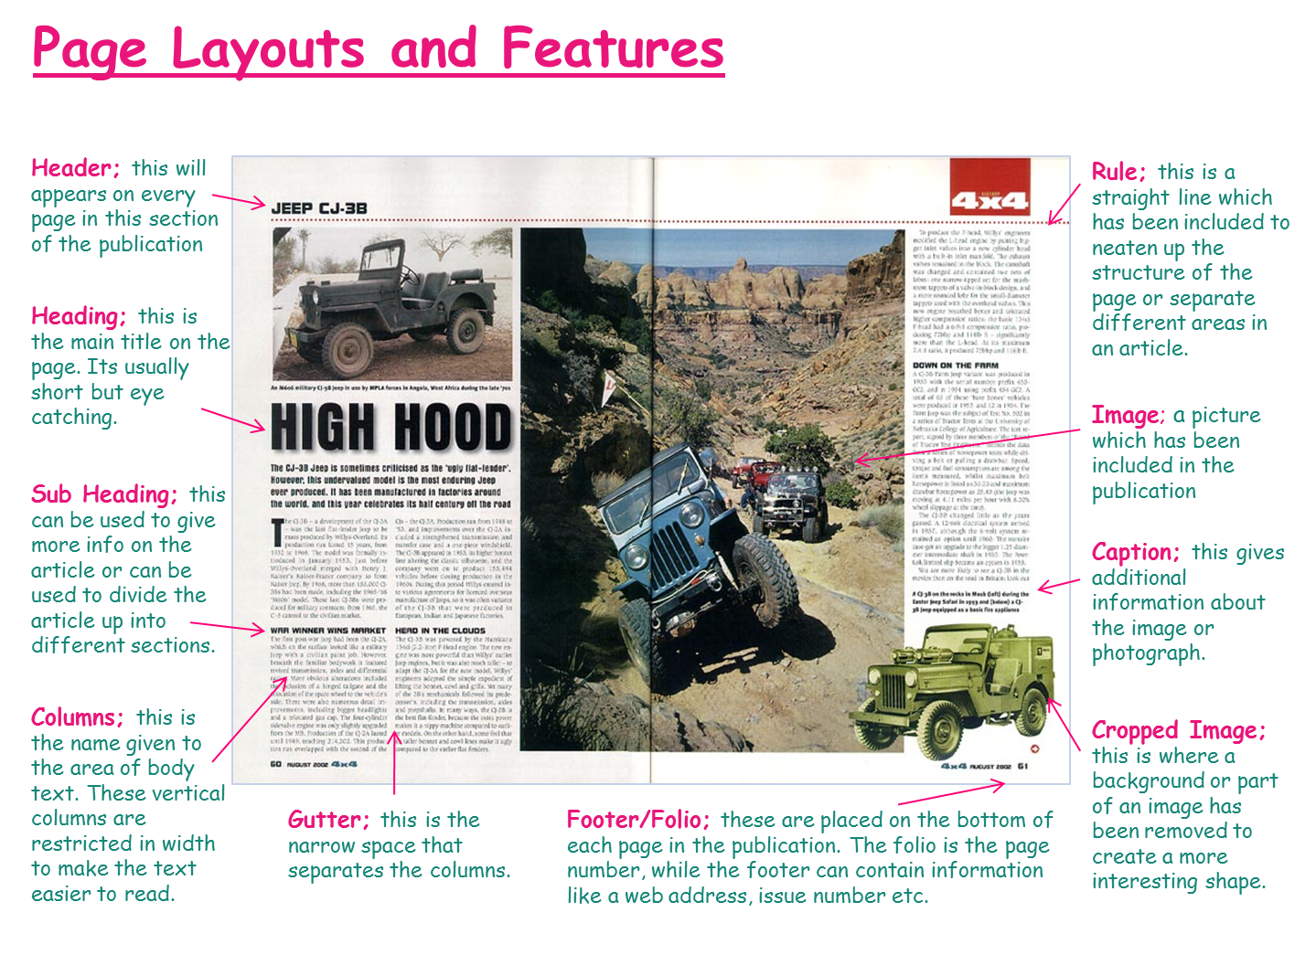

Slide 11
National 4 - Units and Outcomes
3D and Pictorial Graphic Communication
Outcome 1
Candidates will:
  Produce and interpret pictorial sketches, pictorial drawings and 3D models
Outcome 2
Candidates will:
  Produce pictorial and 3D colour illustrations
Outcome 3
Candidates will:
  Create pictorial or 3D promotional displays

Slide 12
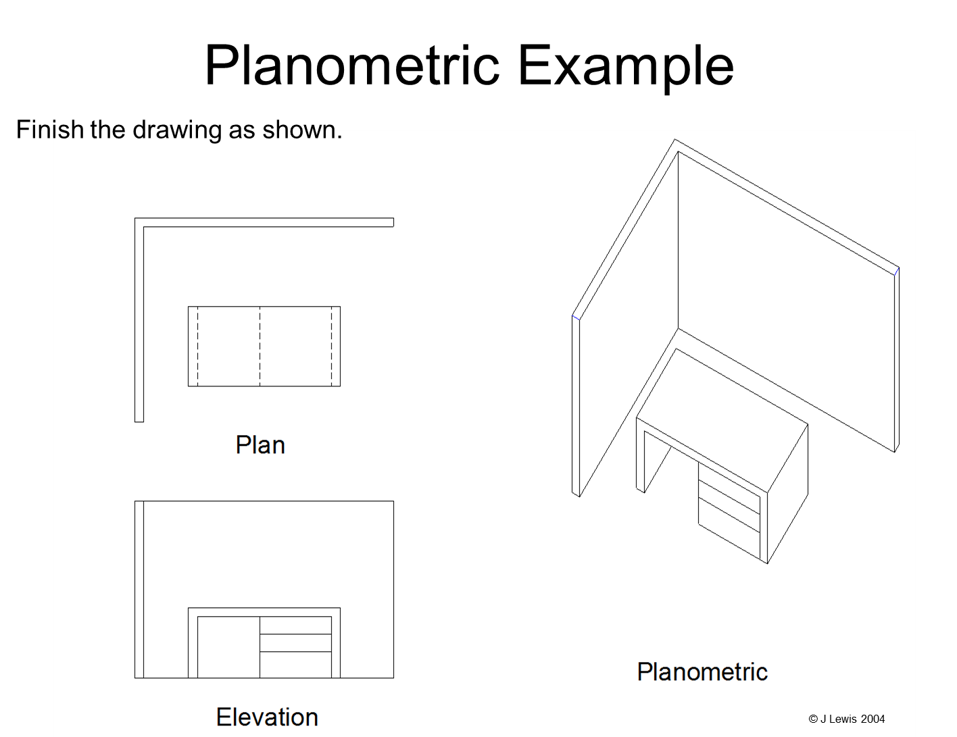

Slide 13
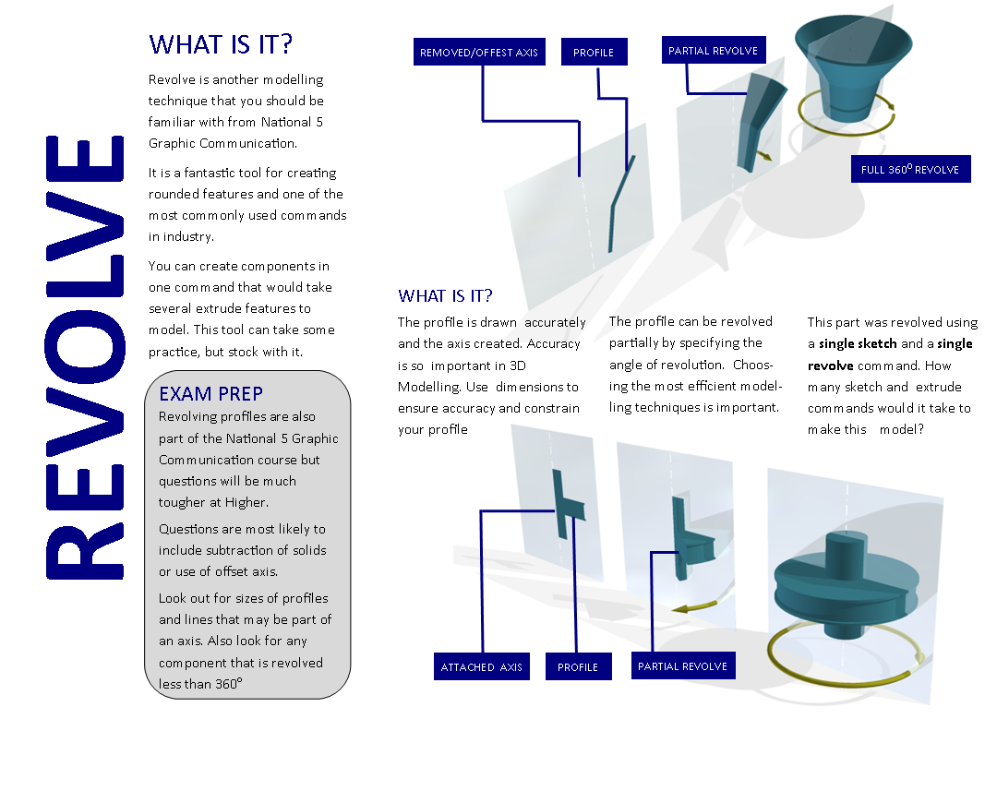

Slide 14

As well as learning various 3D modelling software techniques, processes and edits, pupils learn how to turn their models into realistic images, adding lighting, shadows, colours, materials, textures etc.

Slide 15
Unit Assessment
3 ways to approach assessment:
  Unit-by-Unit Approach – Standard
  Combined Approach – 5 Assessment tasks
  Portfolio Approach – Open, less directed approach
            Projects may have to first be verified by SQA

Slide 16
Assessment of Units – Combined Approach
Assessment evidence can be gathered from the following 5 tasks. These tasks cover all outcomes required:
  3D cinema glasses case
  Mobile phone wall charging device
  Child’s toy
  Wall display
  Healthy living statistical graph
These tasks can be completed in any order and usually finished by
End of November.

Slide 17
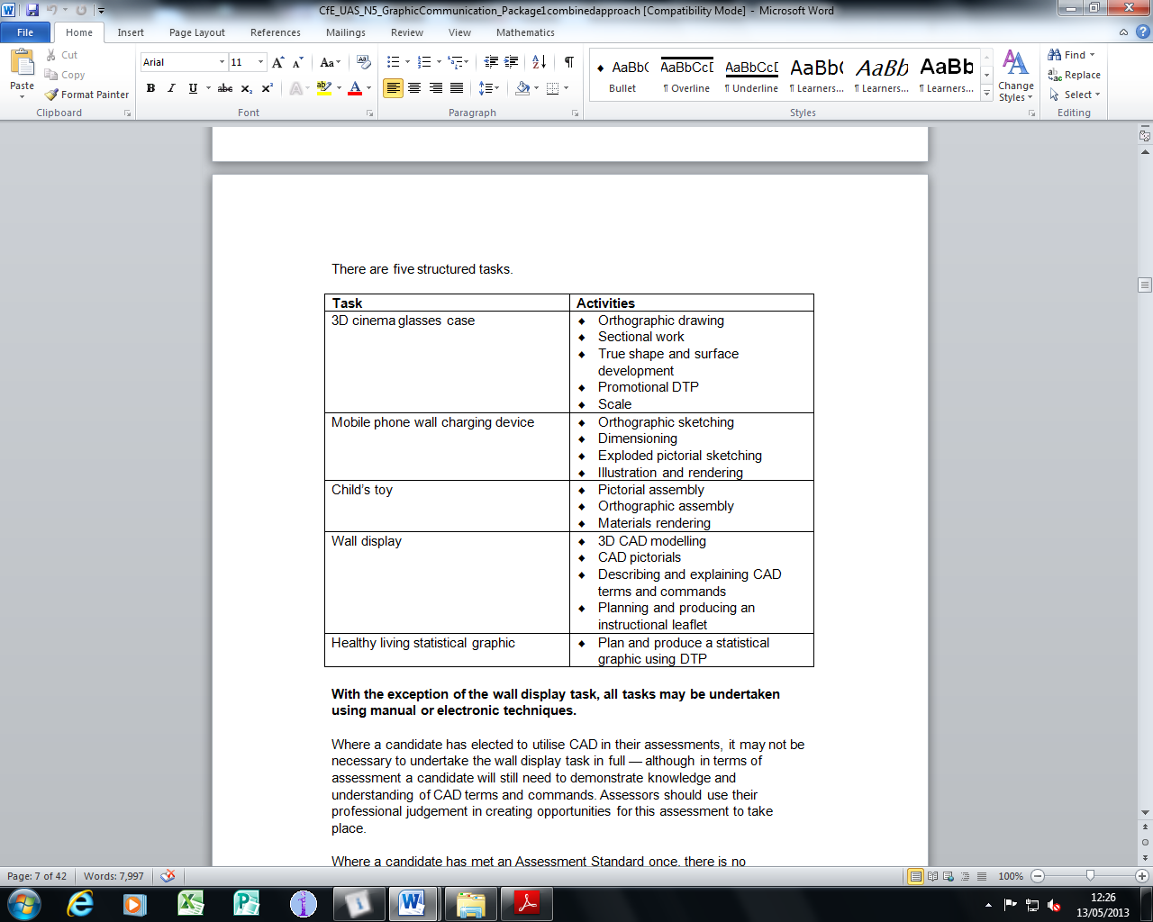

Slide 19
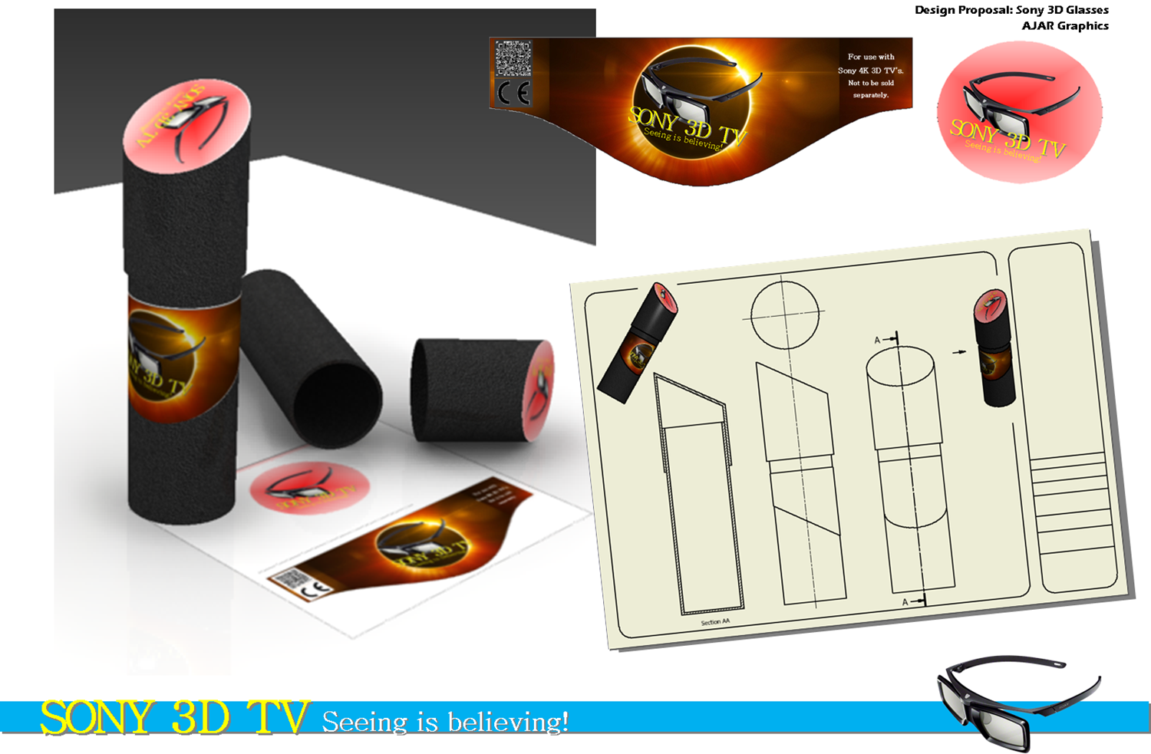

Slide 21
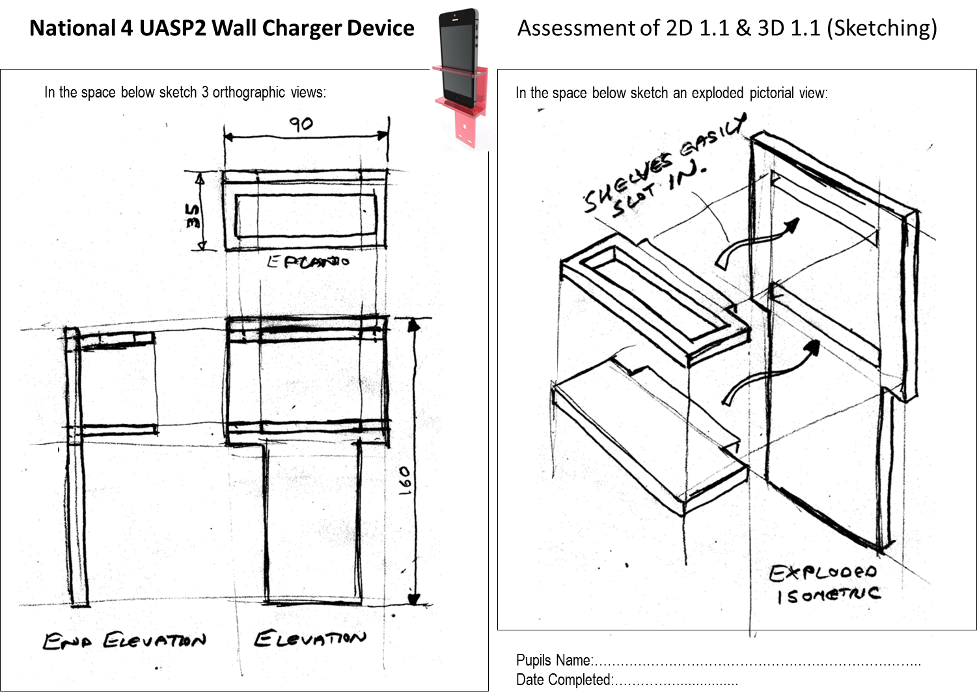

Slide 23
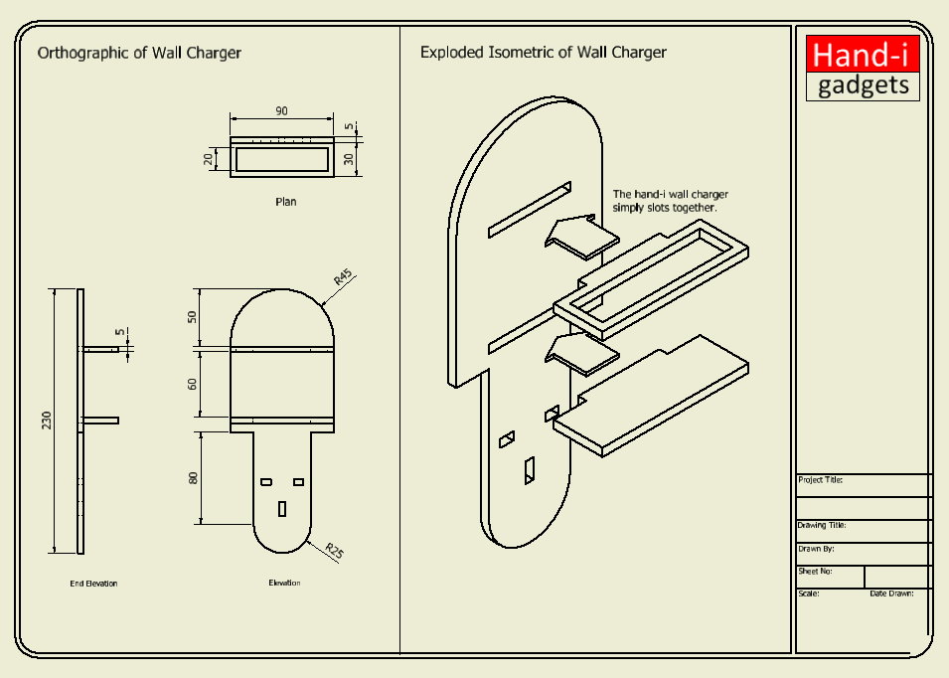

Slide 24
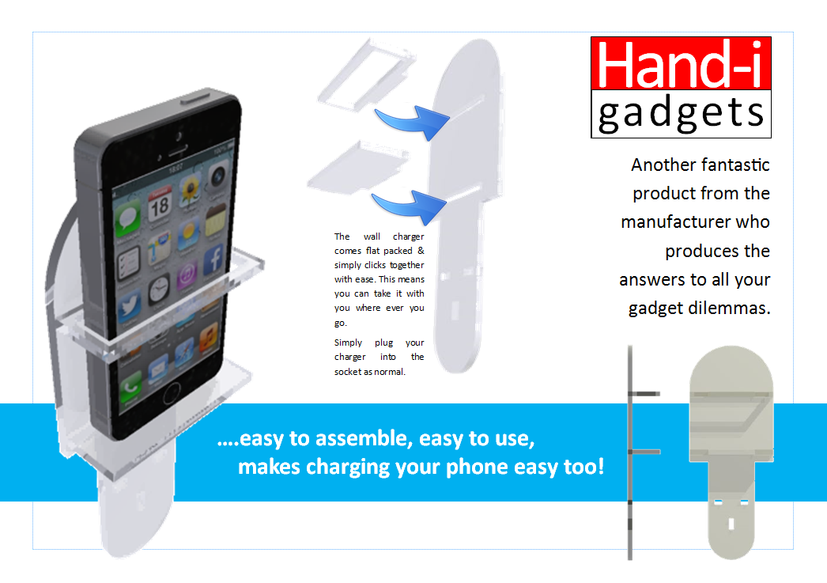

Slide 26
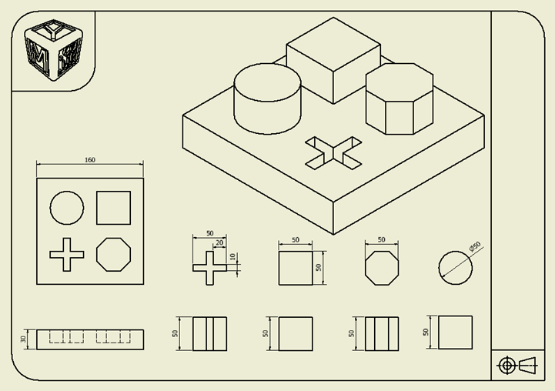

Slide 27
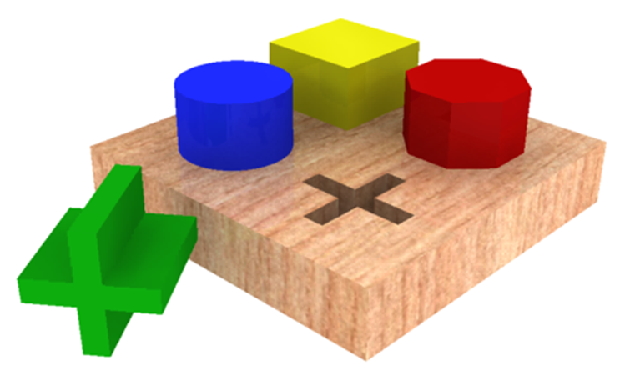

Slide 28
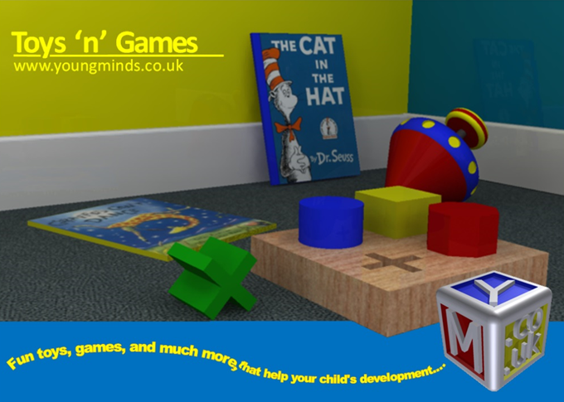

Slide 29
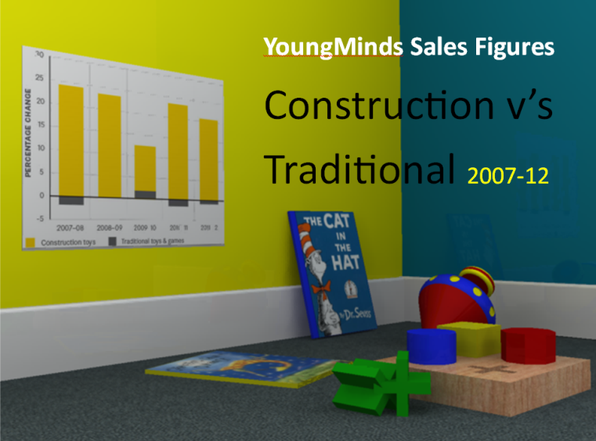
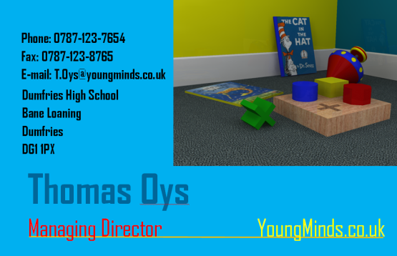
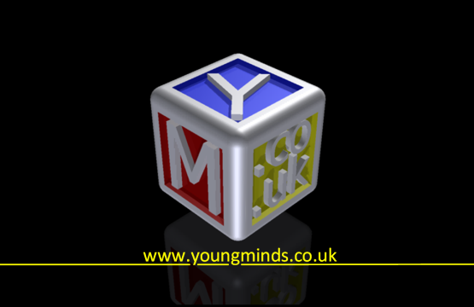
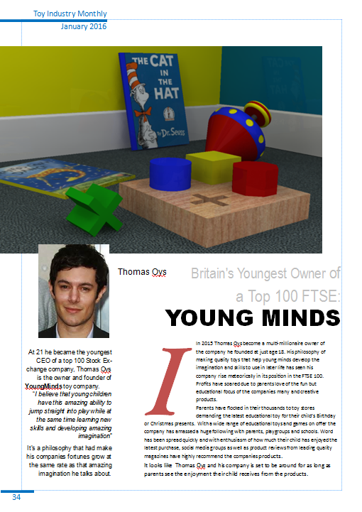
Business Card
Sales Charts
Magazine article
Poster

Slide 31
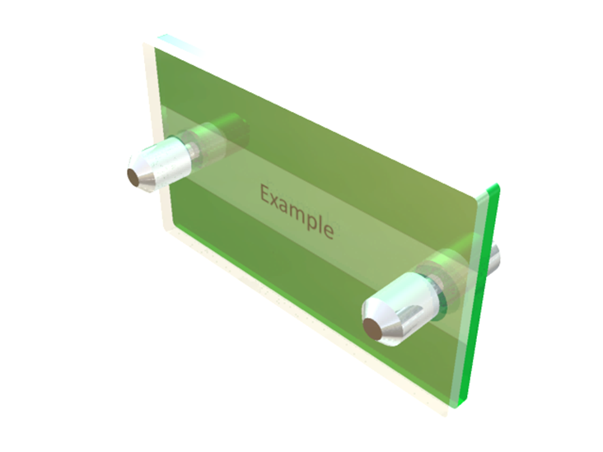

Slide 32
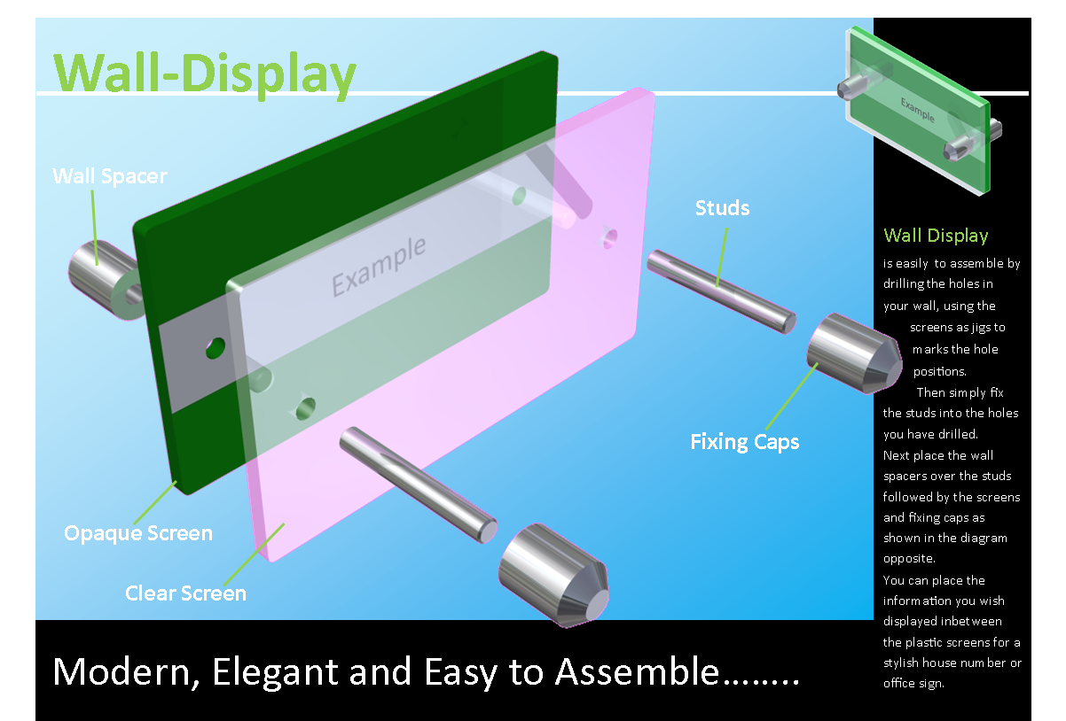

Slide 33
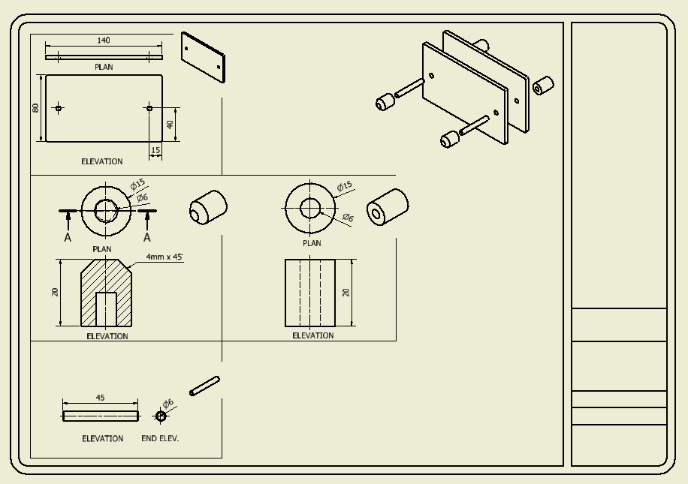
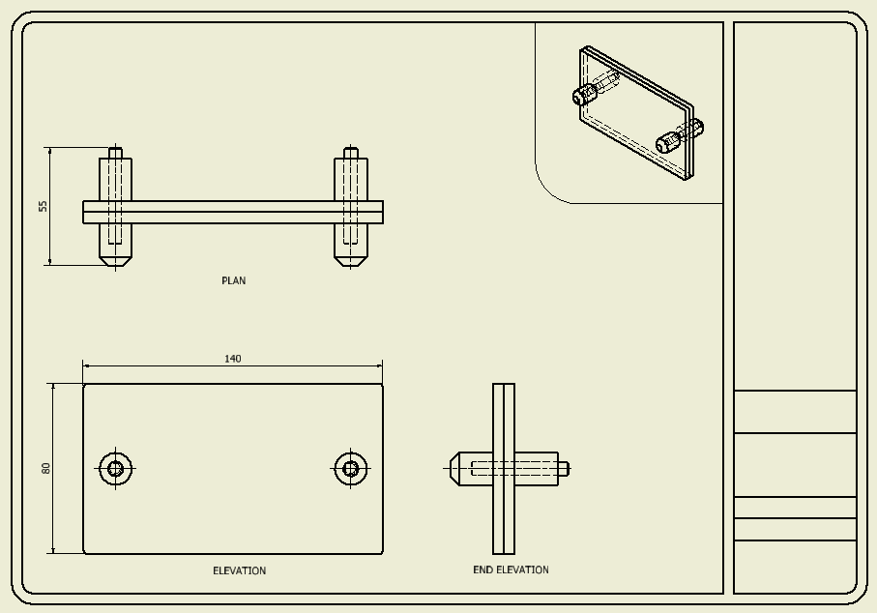
Components
Assembled
DTP advert/instructions

Slide 35
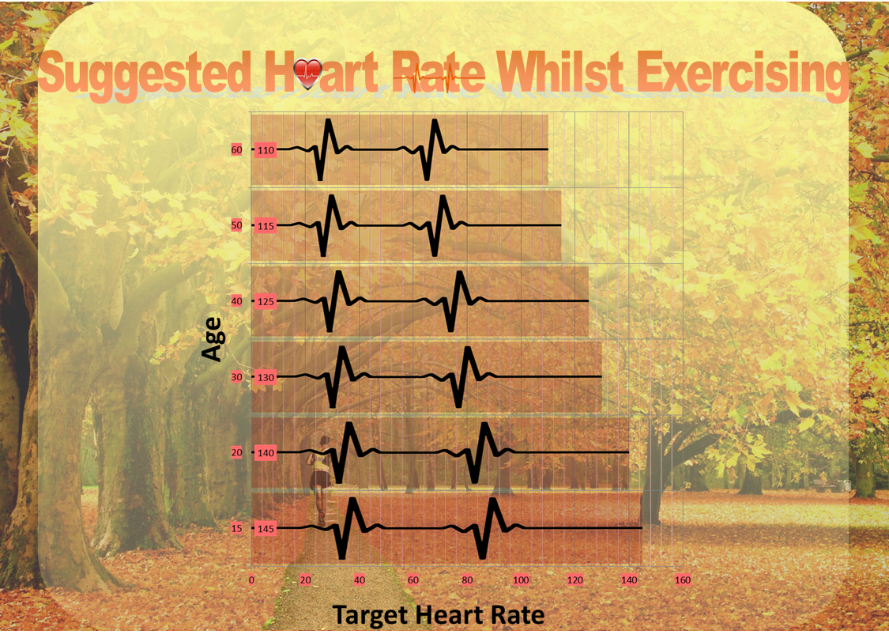

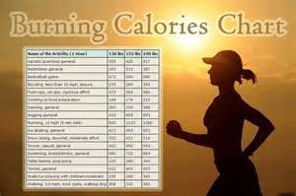

Slide 36
National 4 – Added Value Unit
Added Value Unit
Individual assessment, assessed internally.
Open book assessment – Electronic and/or Manual (amount of help considered during marking)
Brief set by SQA
Pupils analyse the brief, conduct research and produce ‘meaningful graphic items’ over a period of time.
Pupils evaluate their work afterwards against the original brief.

Slide 37
N4 Added Value -
Folio of evidence must contain:
No more than nine A3 pages (including the evaluation):
  Confirming and developing the requirements of the brief and investigations (one A3 page)
  Idea generation and producing preliminary graphics (1–2 A3 pages)
  Developing preliminary ideas into preliminary, production and promotional graphics (4–5 A3-sized pages)
  Identifying strengths and weaknesses of the final presentation relative to the brief (one A4-sized page)

Slide 38
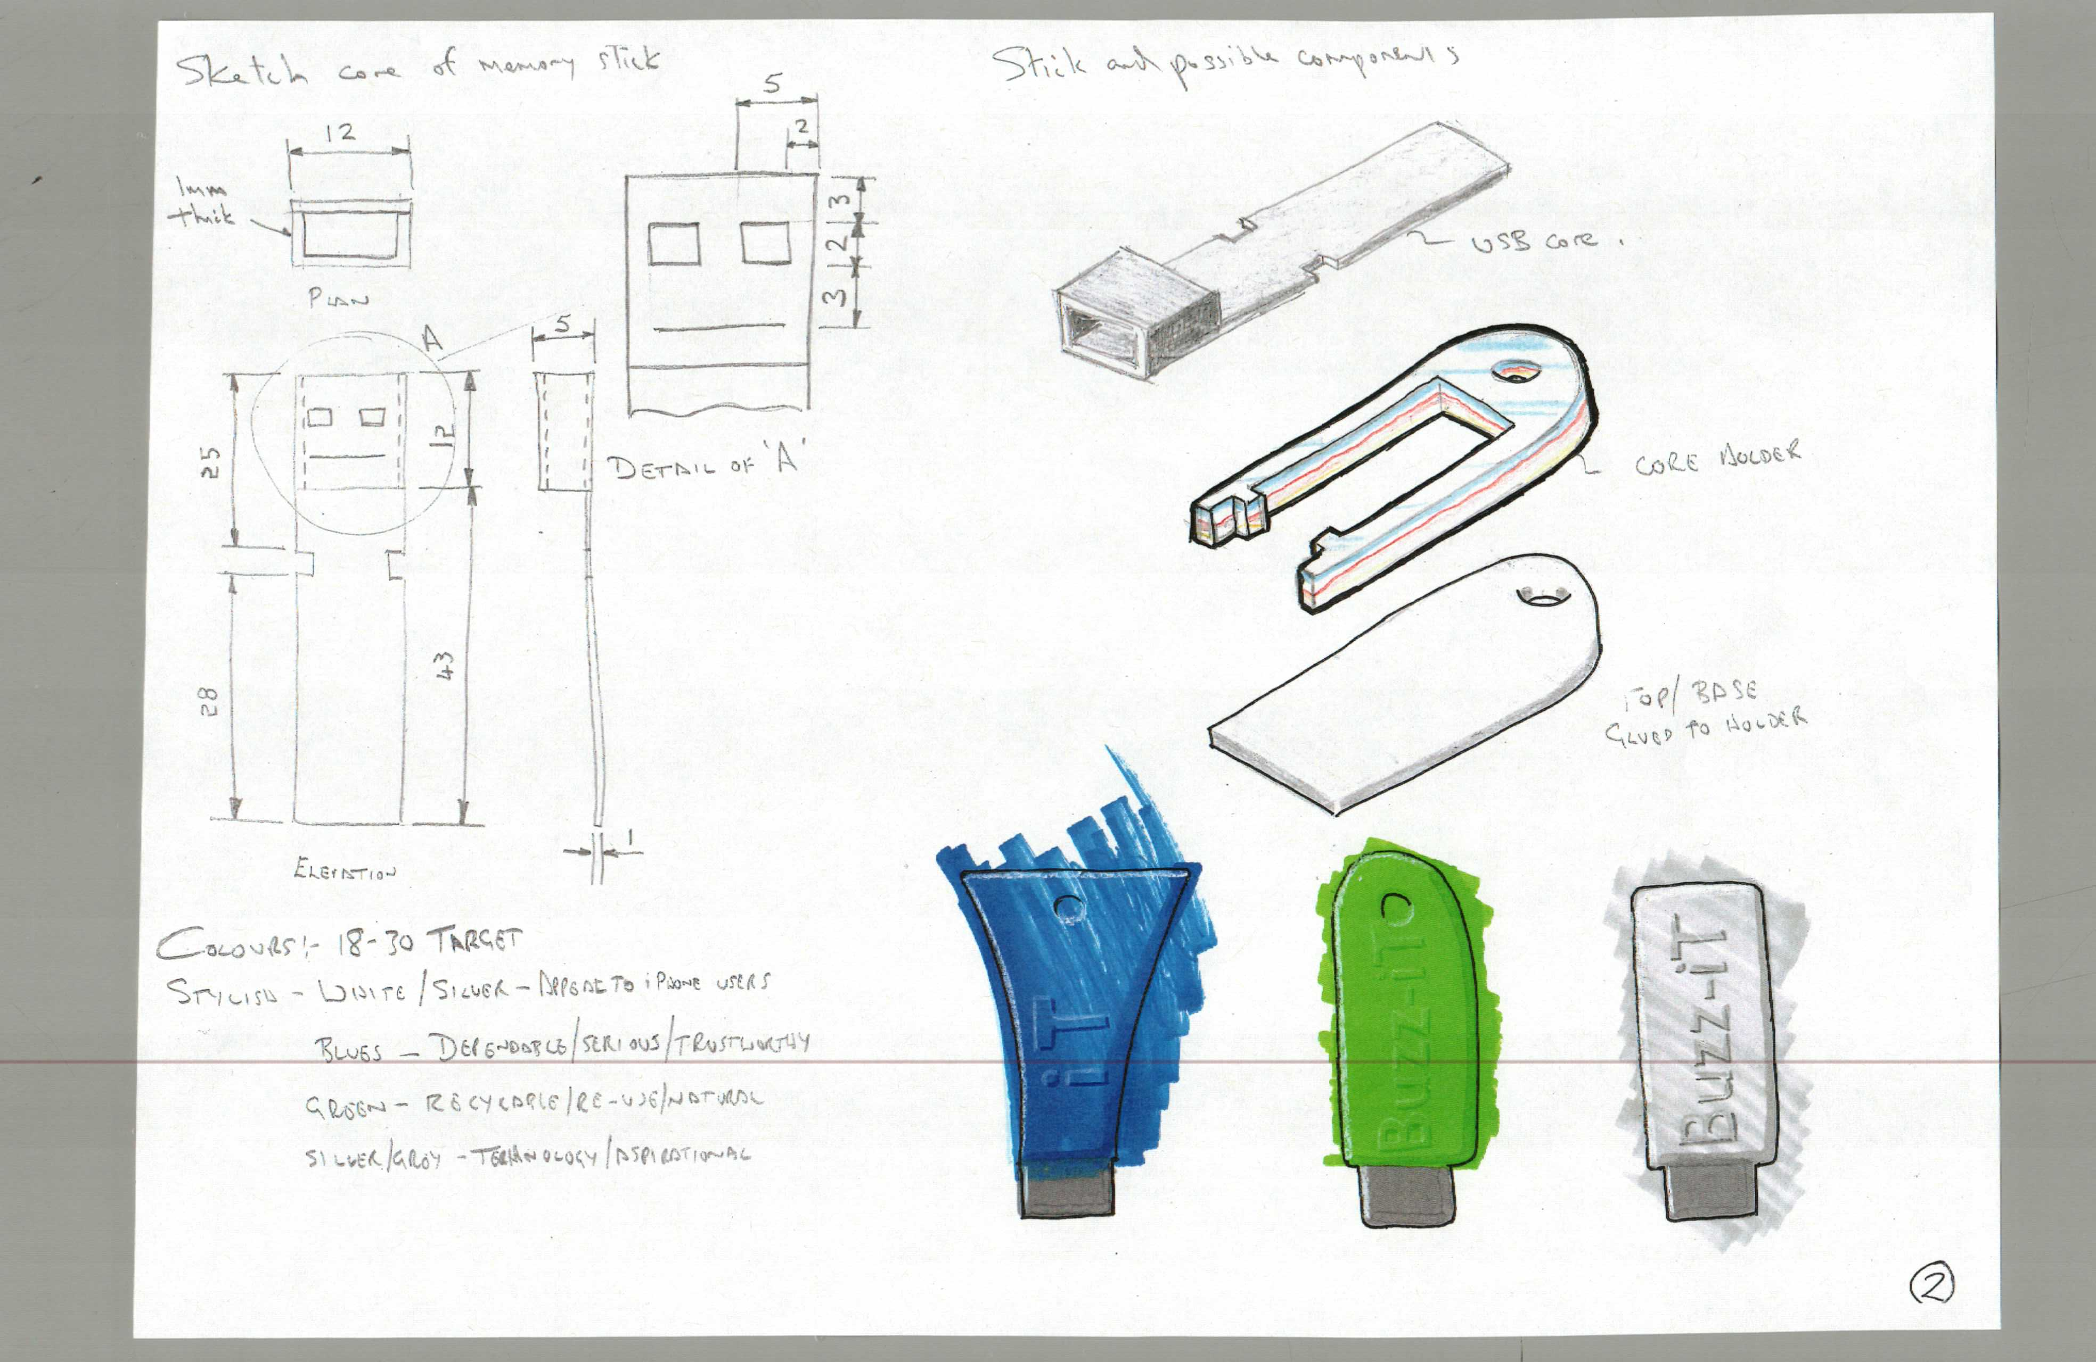
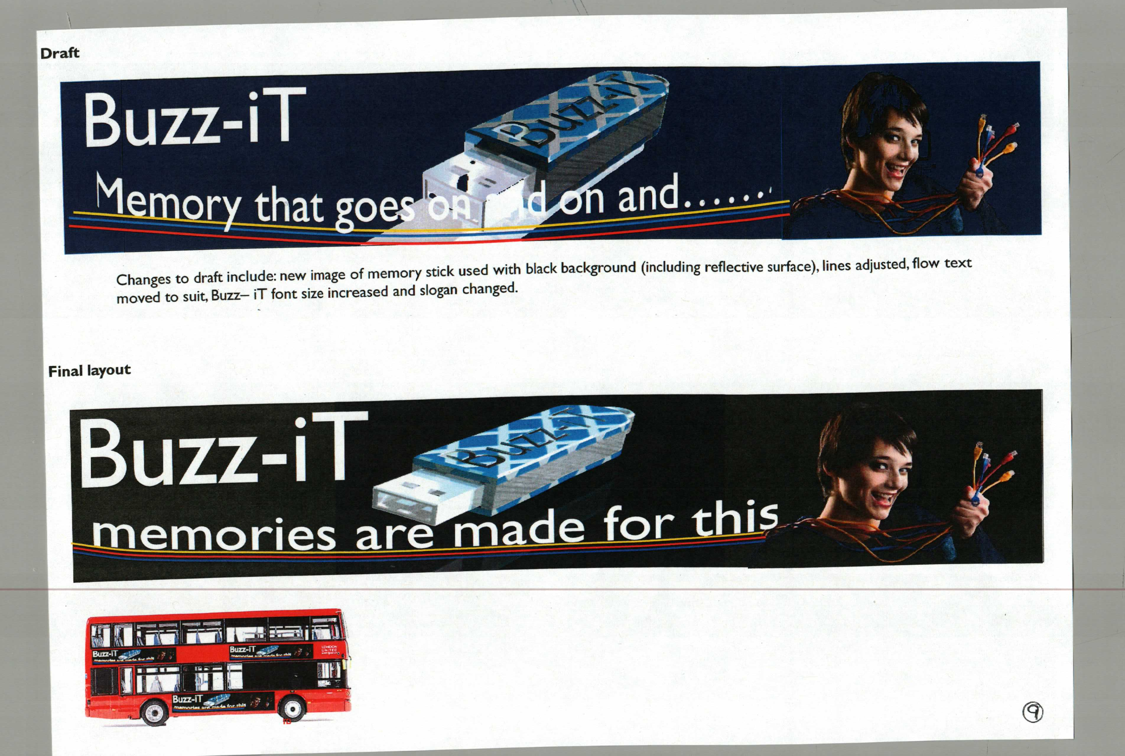

Slide 39
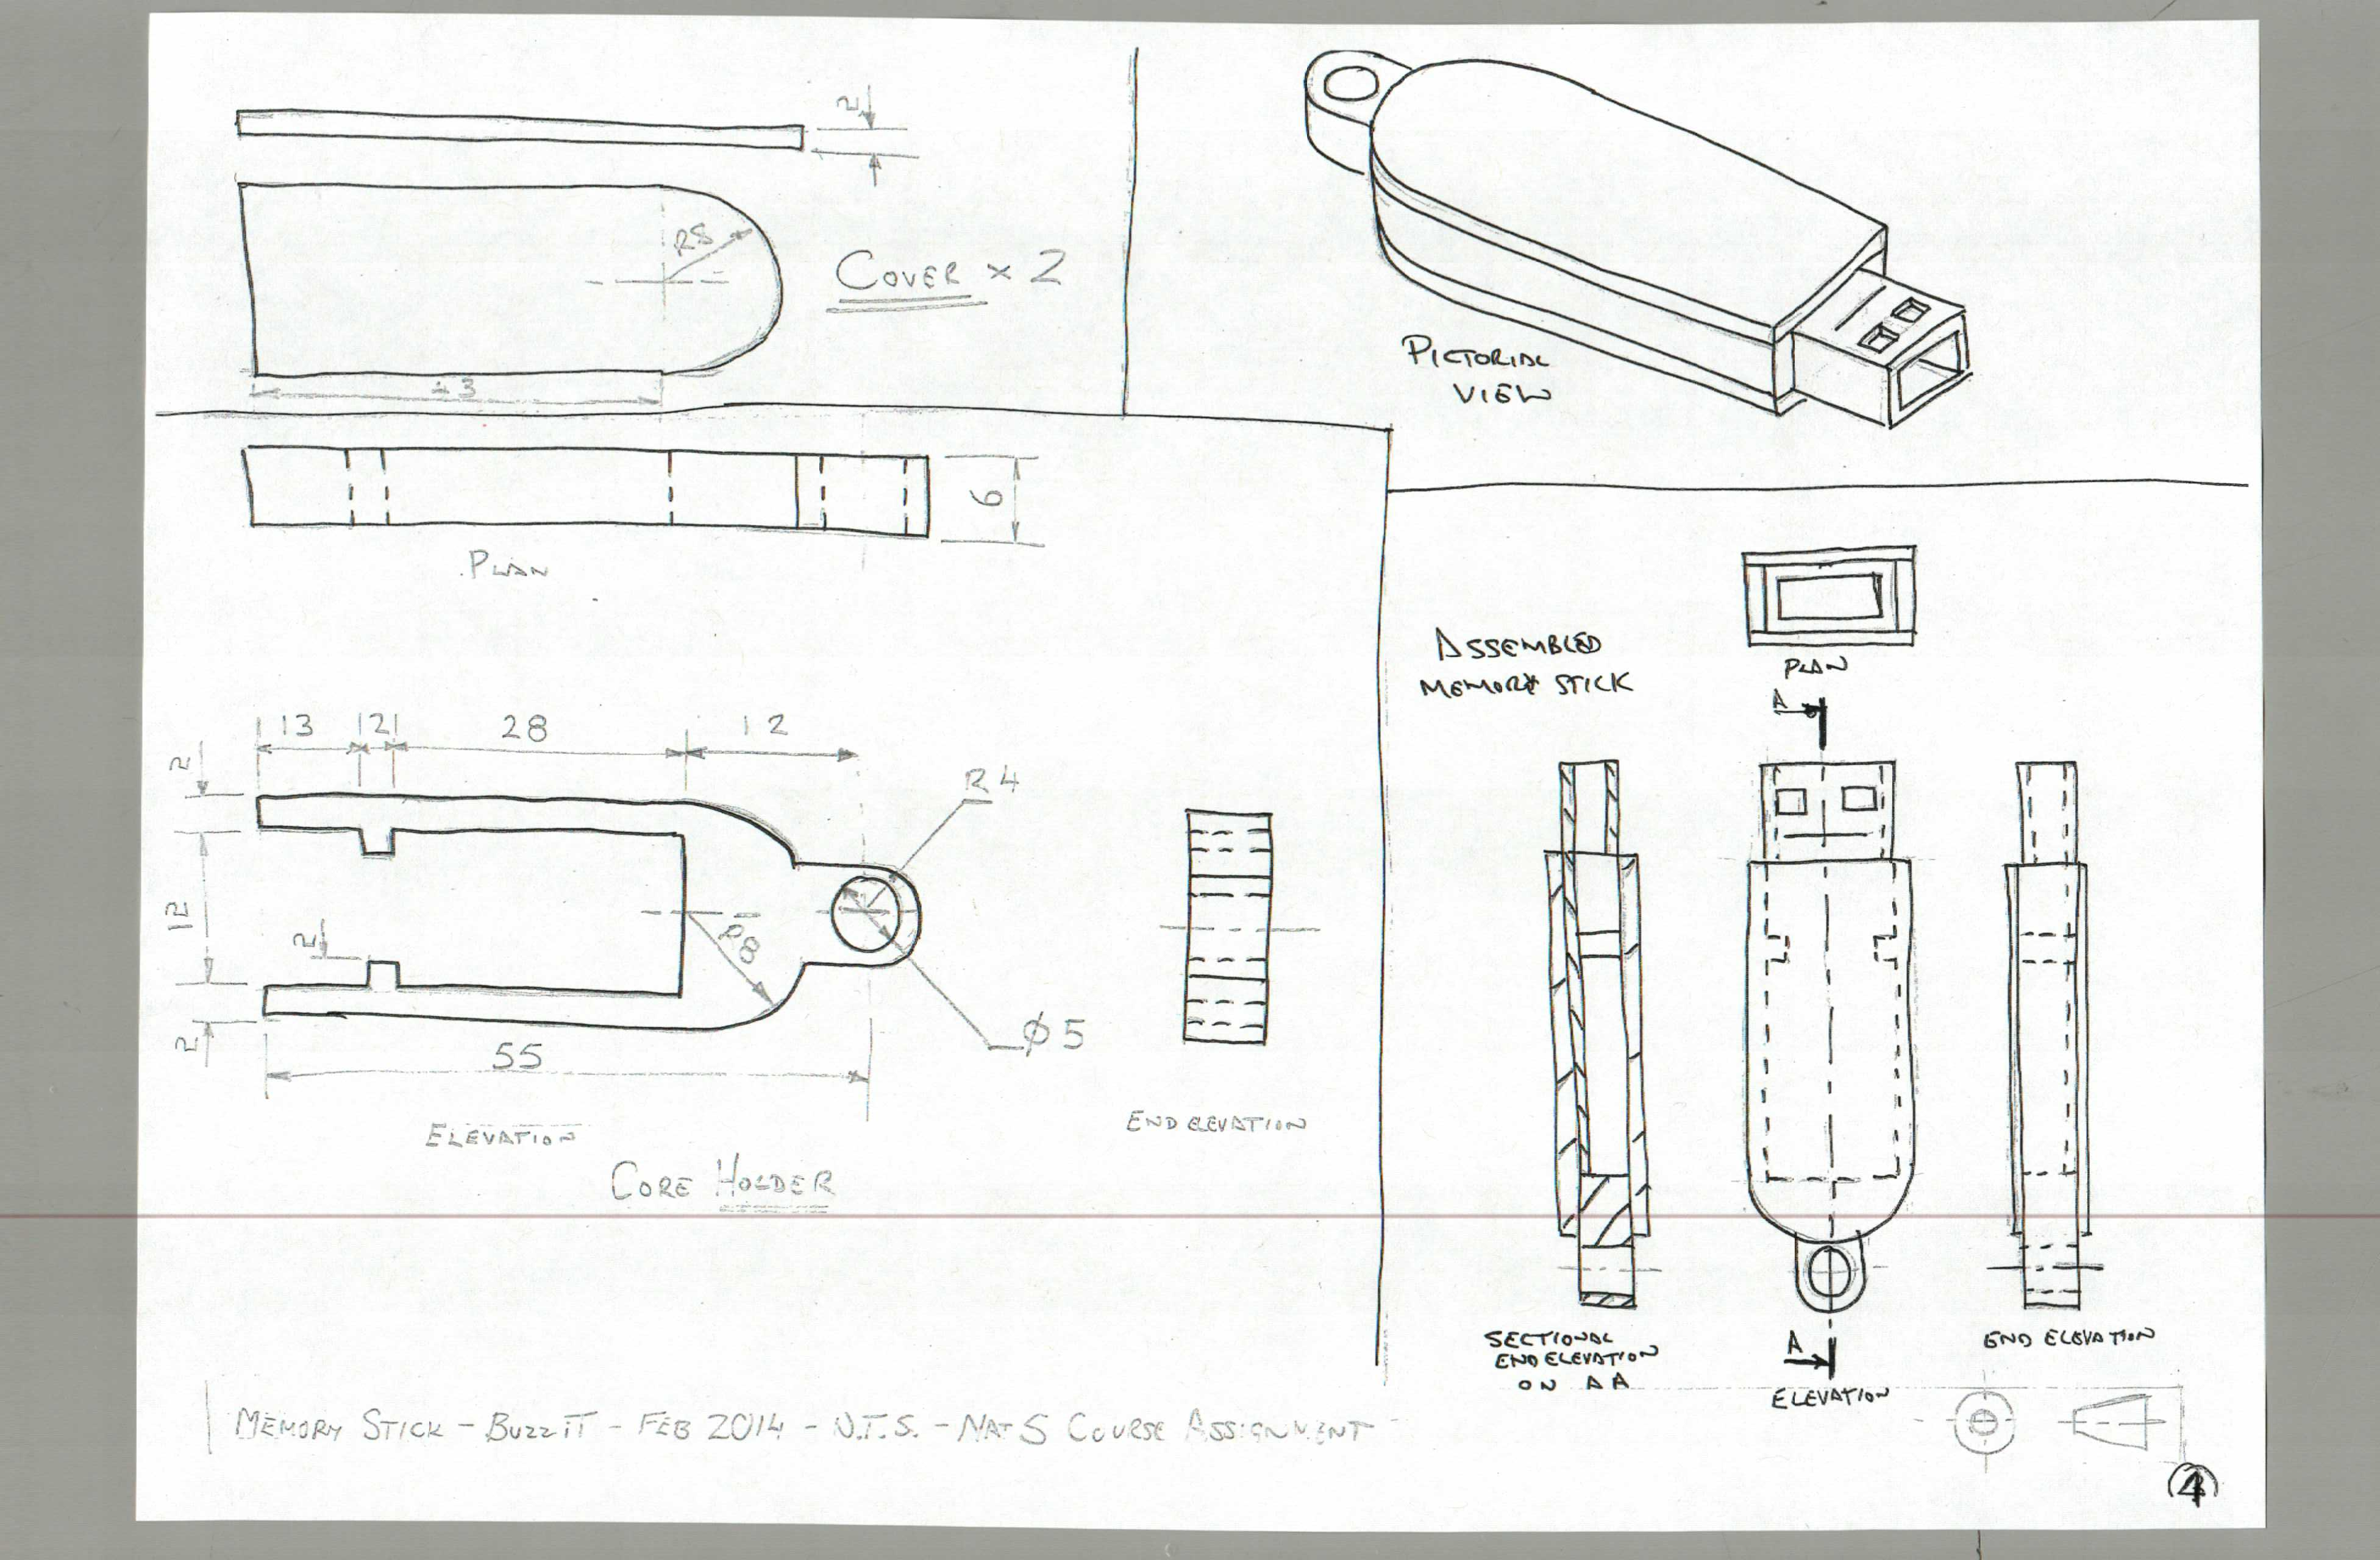

Slide 40
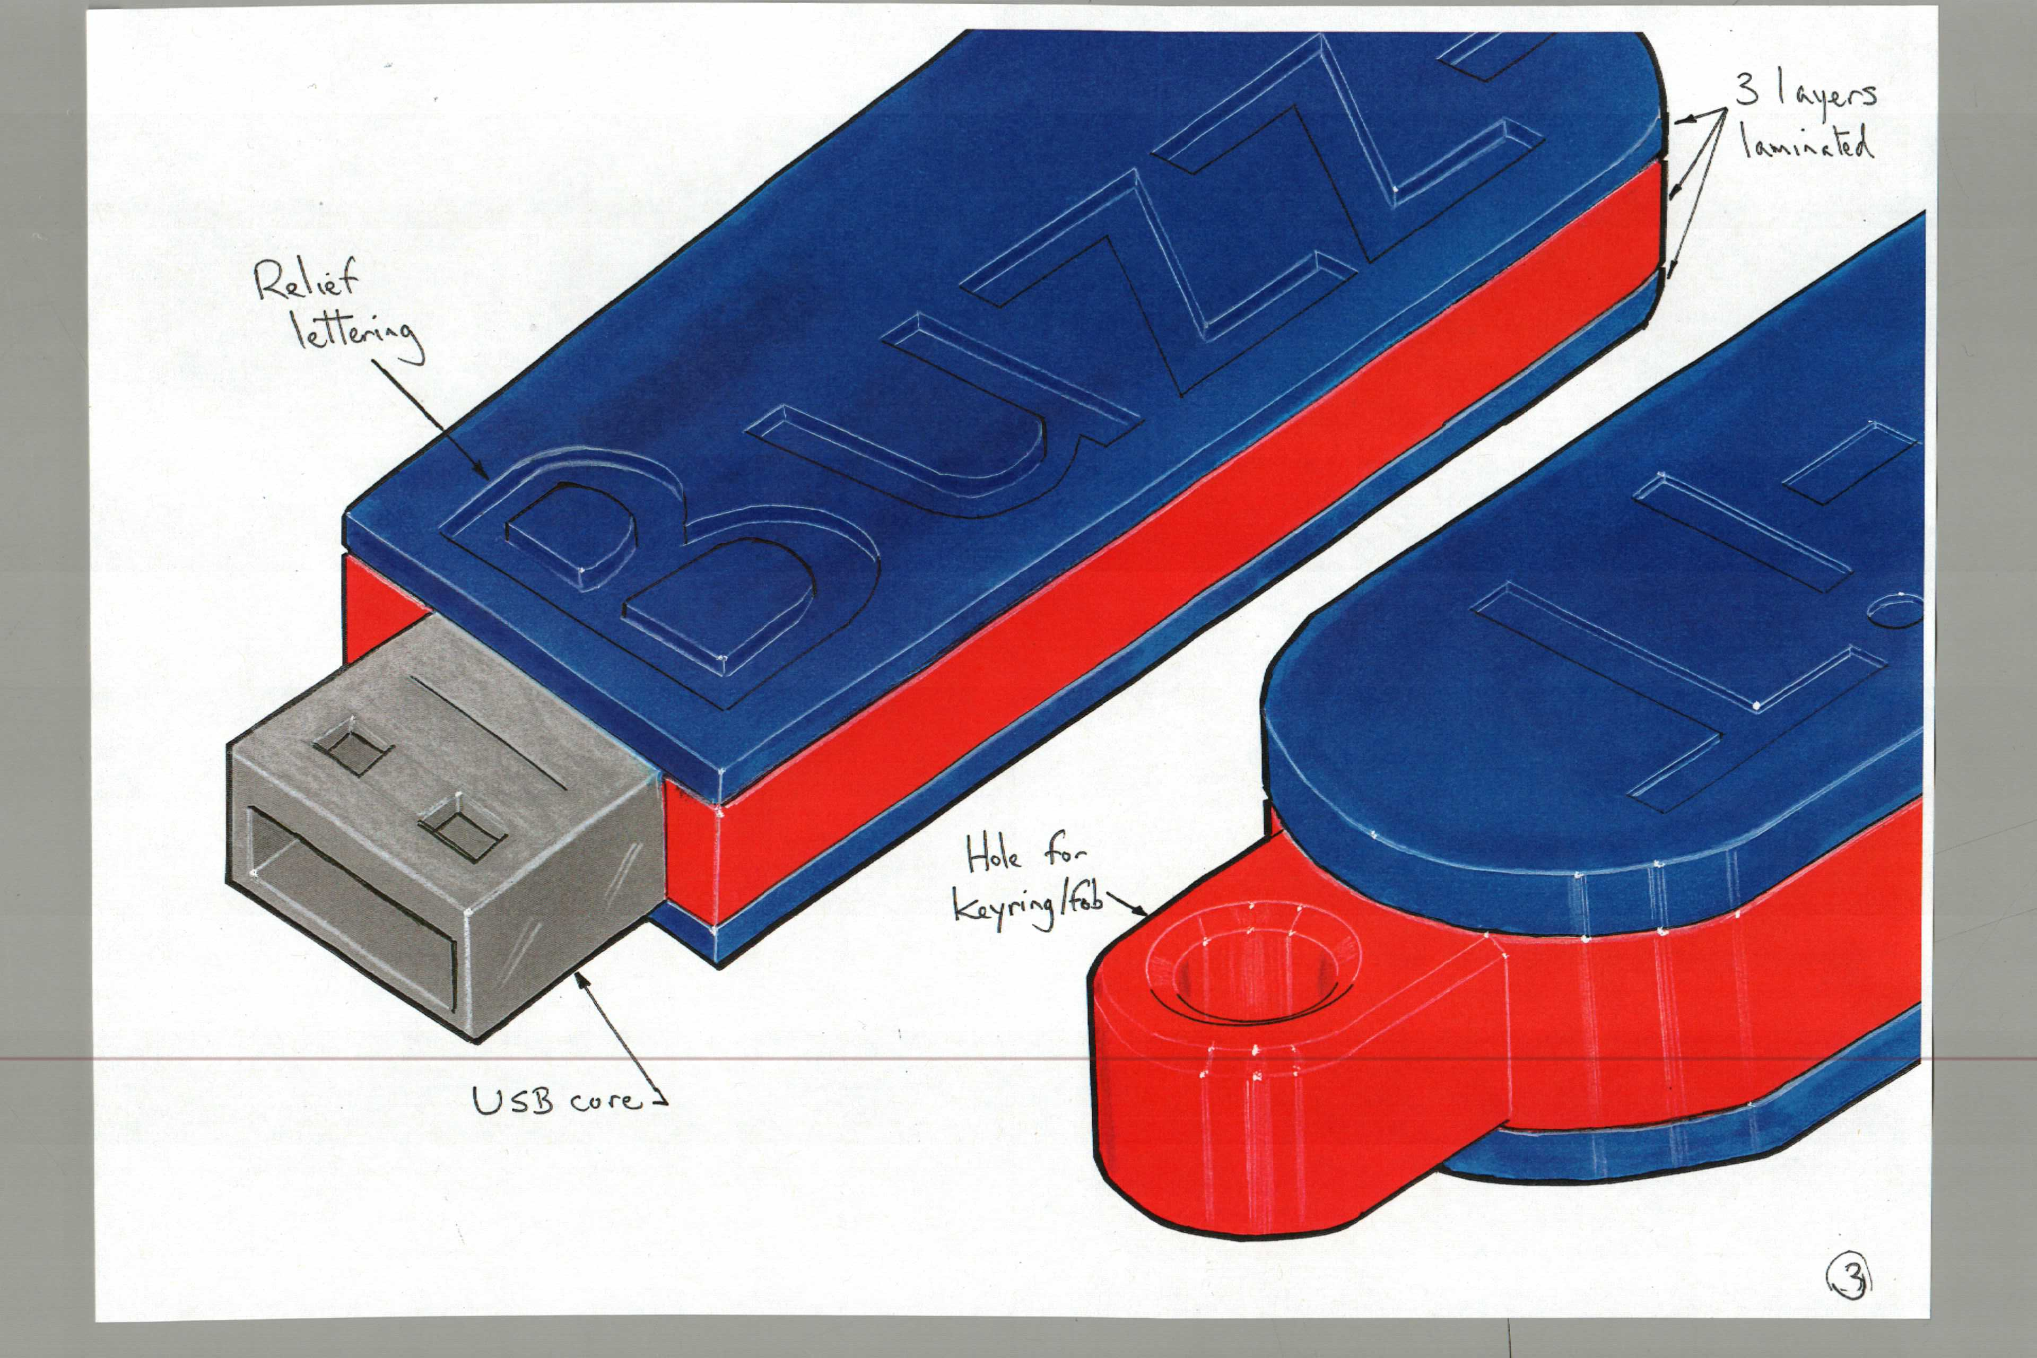

Slide 41
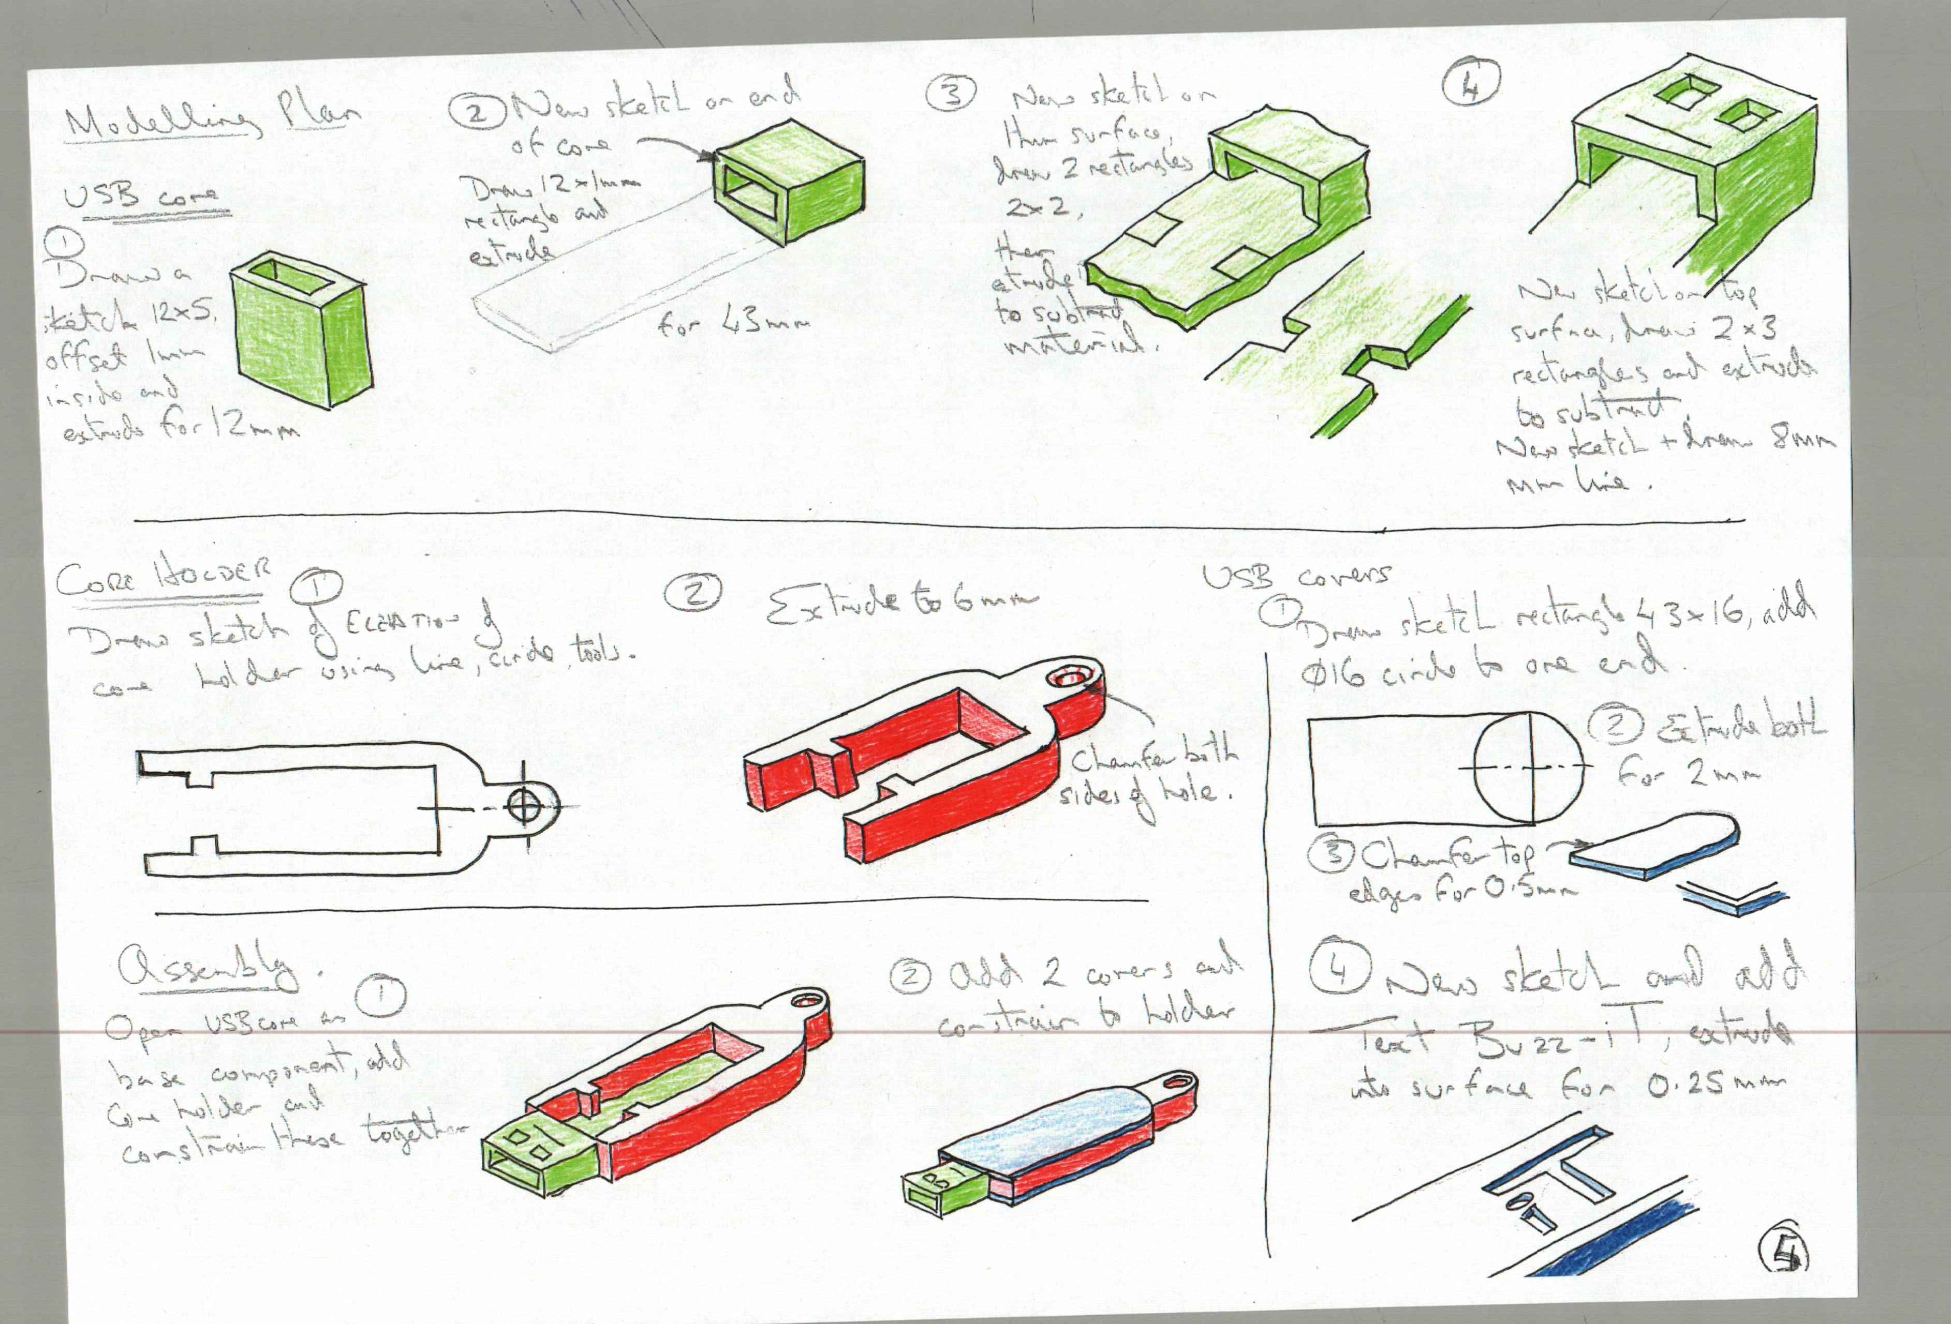

Slide 42
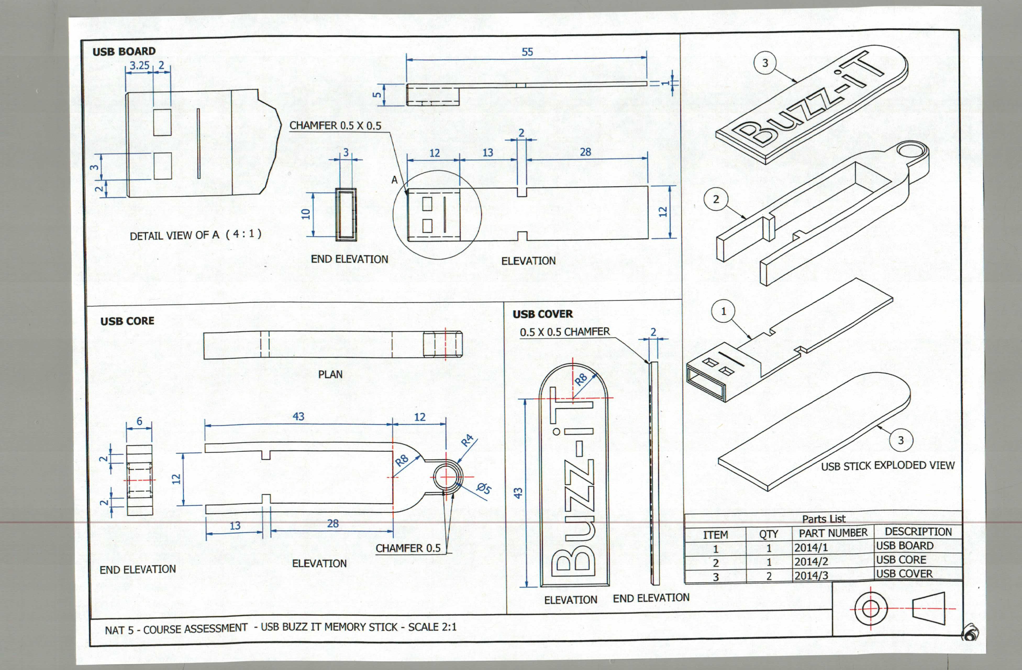

Slide 43
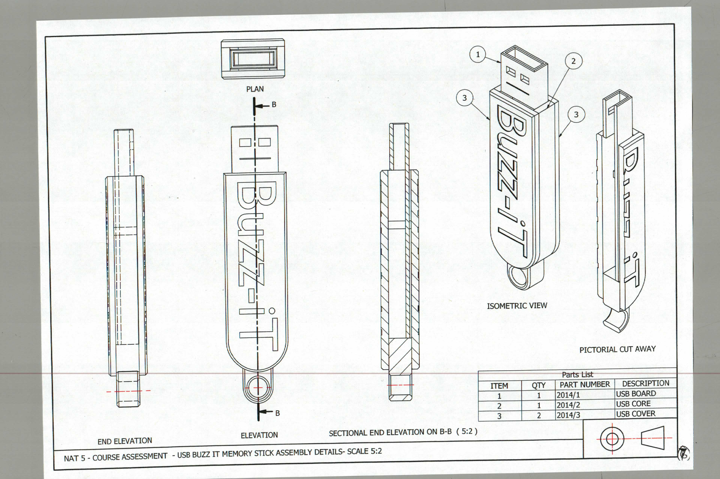

Slide 44
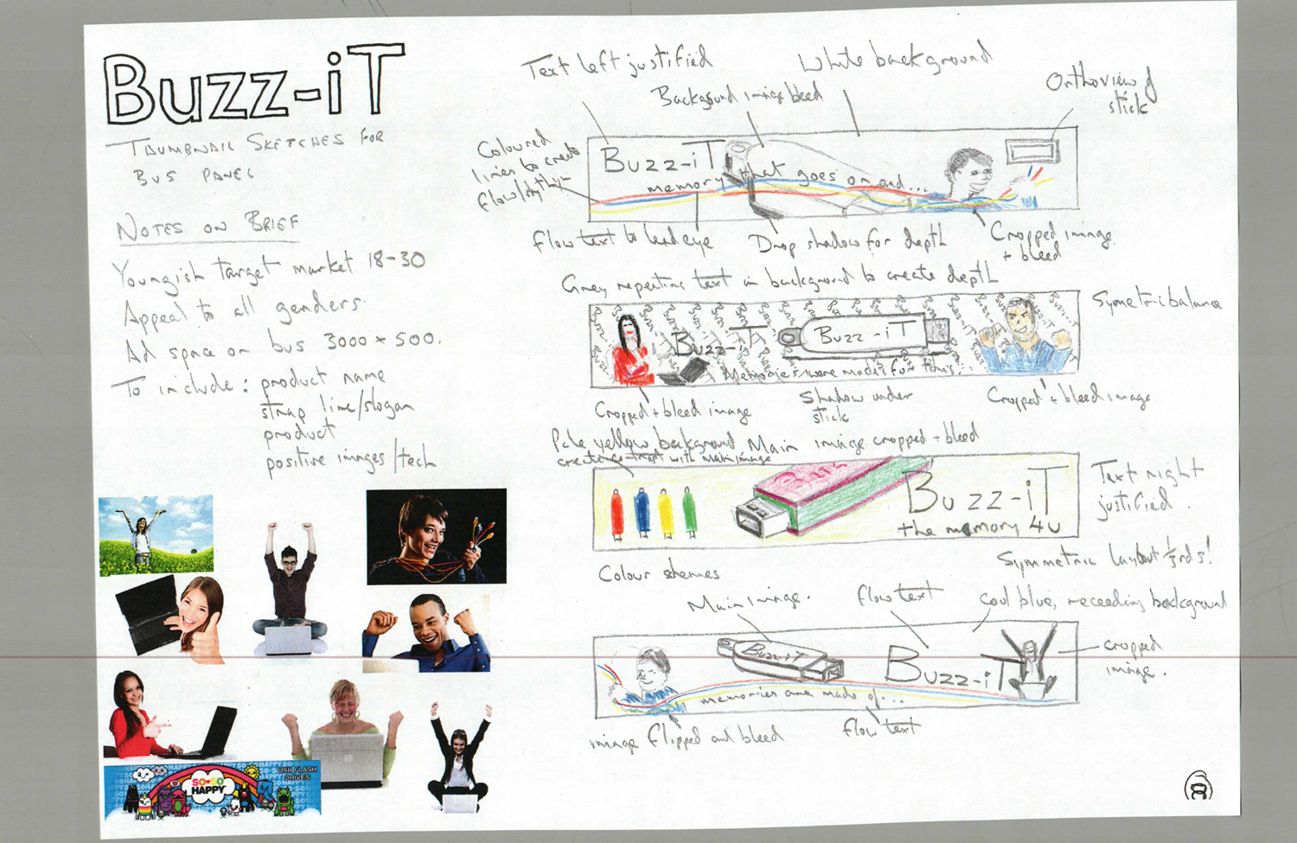

Slide 45


Slide 46
National 5 – Assignment & Exam
Assignment 40marks (End Jan till Mid March)
8 Hours in total, closed book exercise.
Assessed externally by the SQA.
Brief set by SQA, different every year.
Pupils analyse the brief, research and produce ‘meaningful graphic items’.
Pupils evaluate their work afterwards against the original brief.
Exam 80 marks (10th May 2018)
Knowledge/ Theory – based exam paper (no technical drawing).

Slide 47
N5 Assignment -
3 sections:
  Production Graphics (Computer 3D Modelling and Drawings) 15 marks
  Promotional Graphics (DTP and Illustration) 15 marks
  Manual Graphics (sketching and rendering) 10 marks

Slide 48
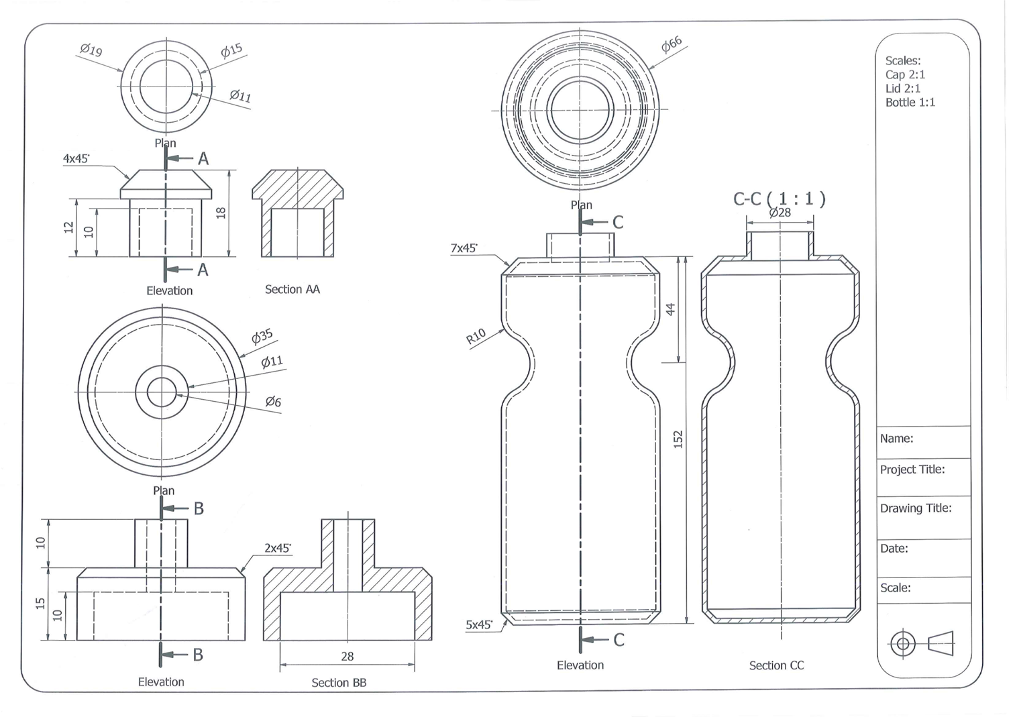

Slide 49
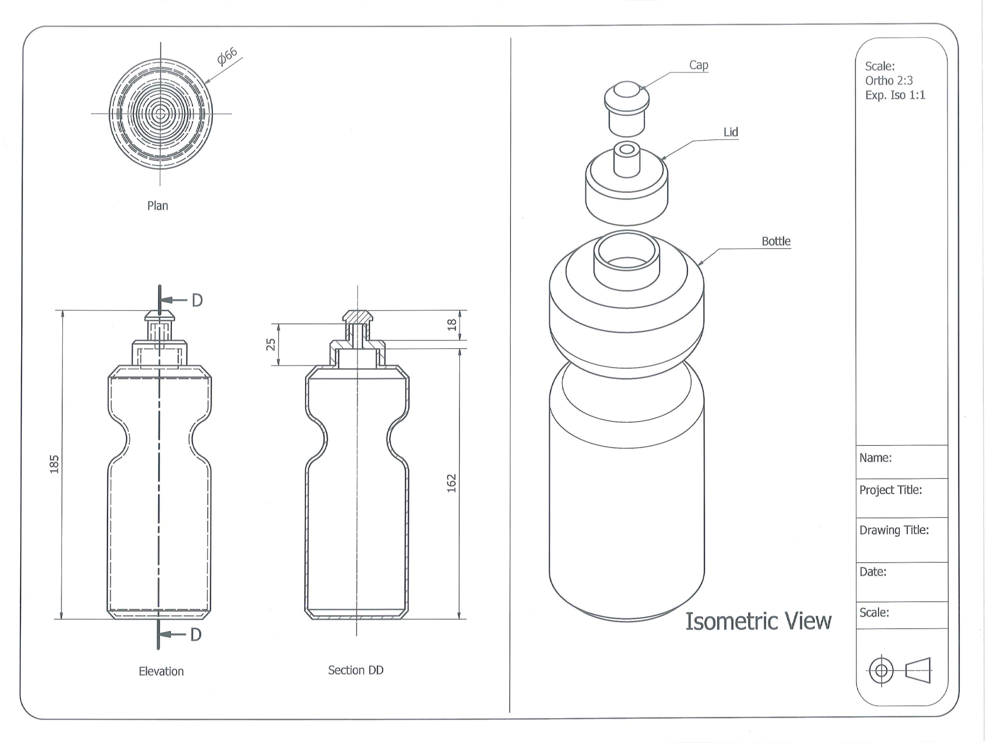

Slide 50
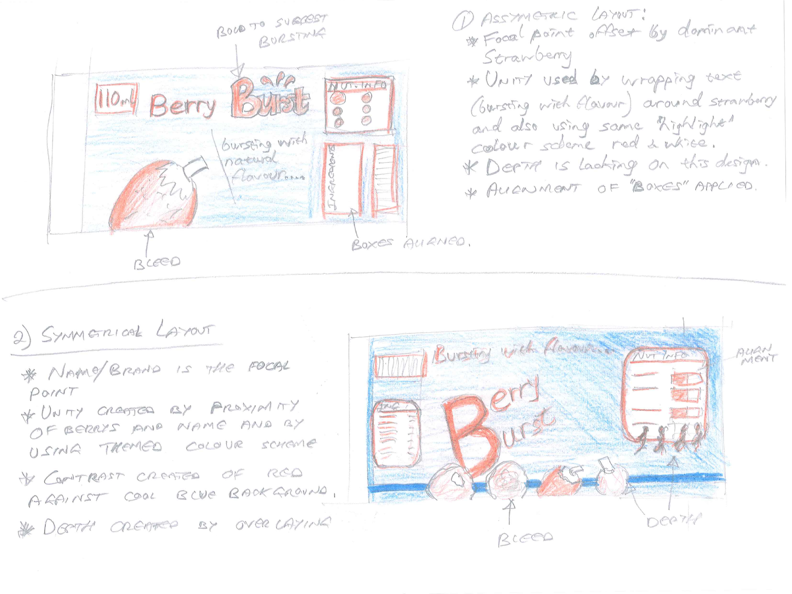

Slide 51
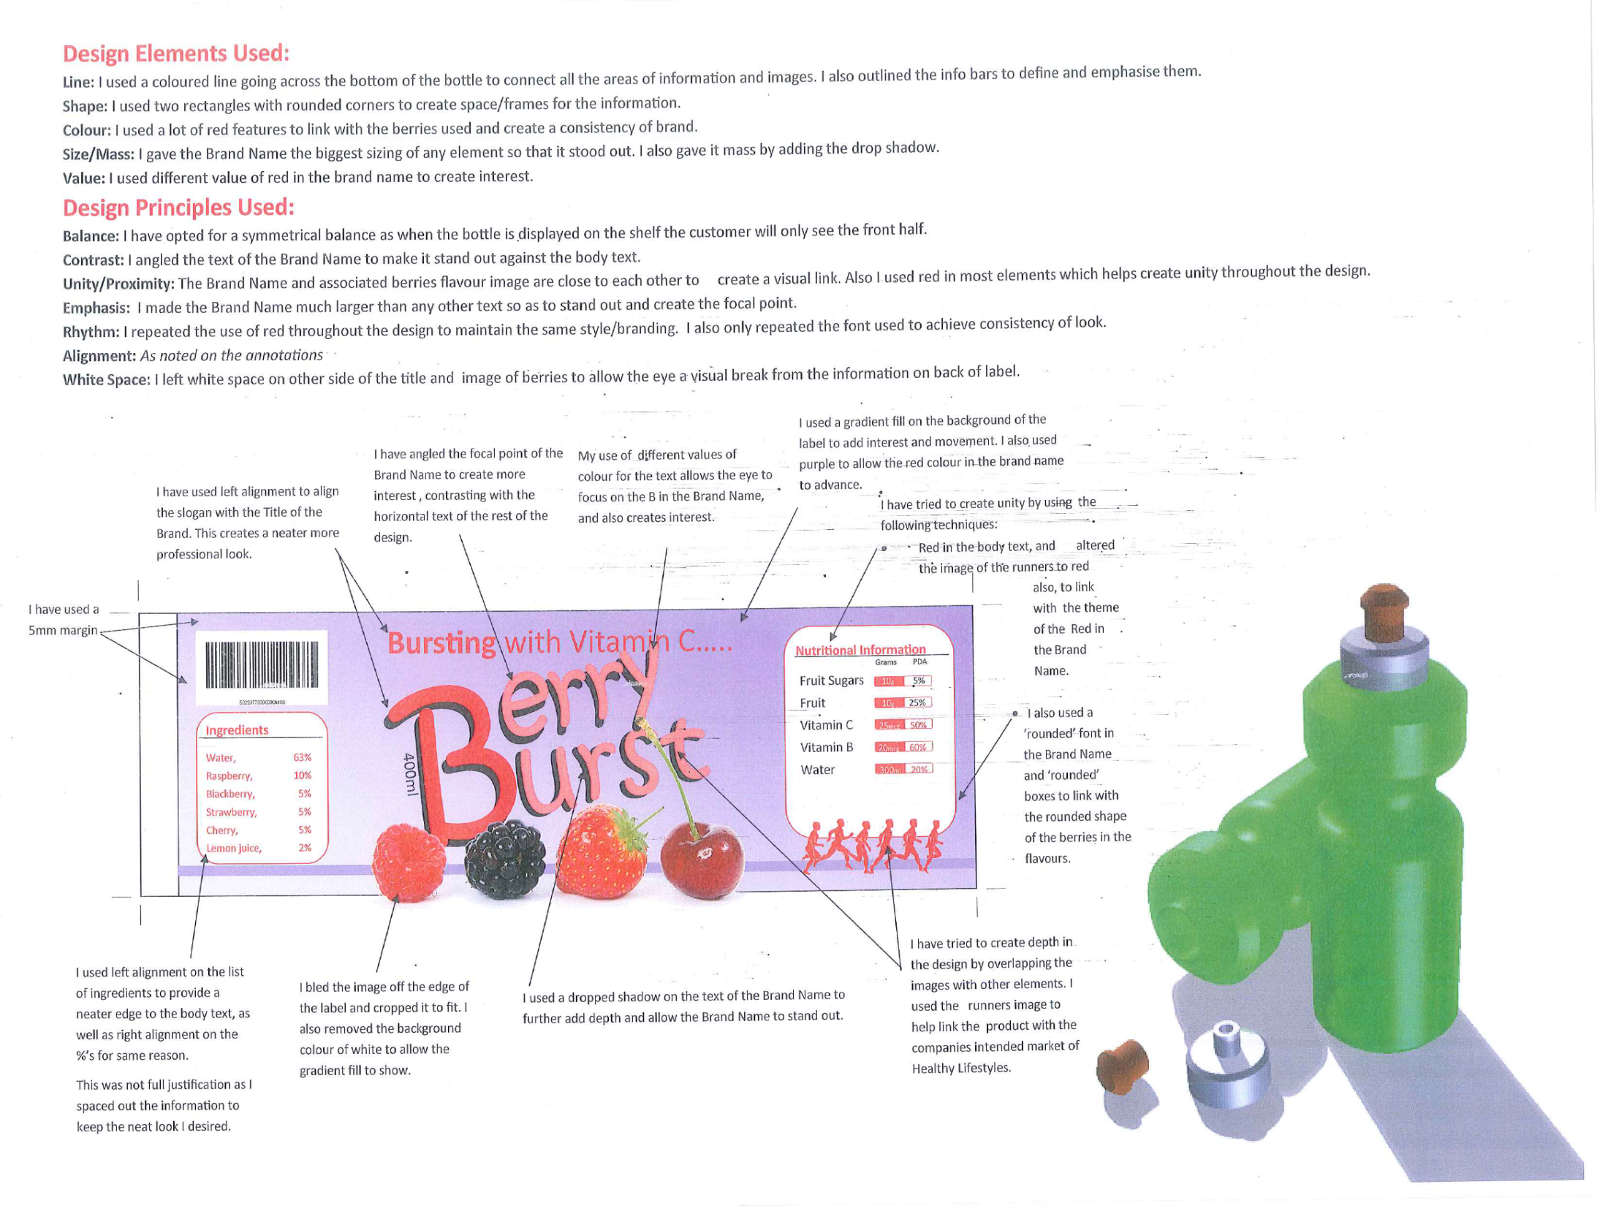

Slide 52
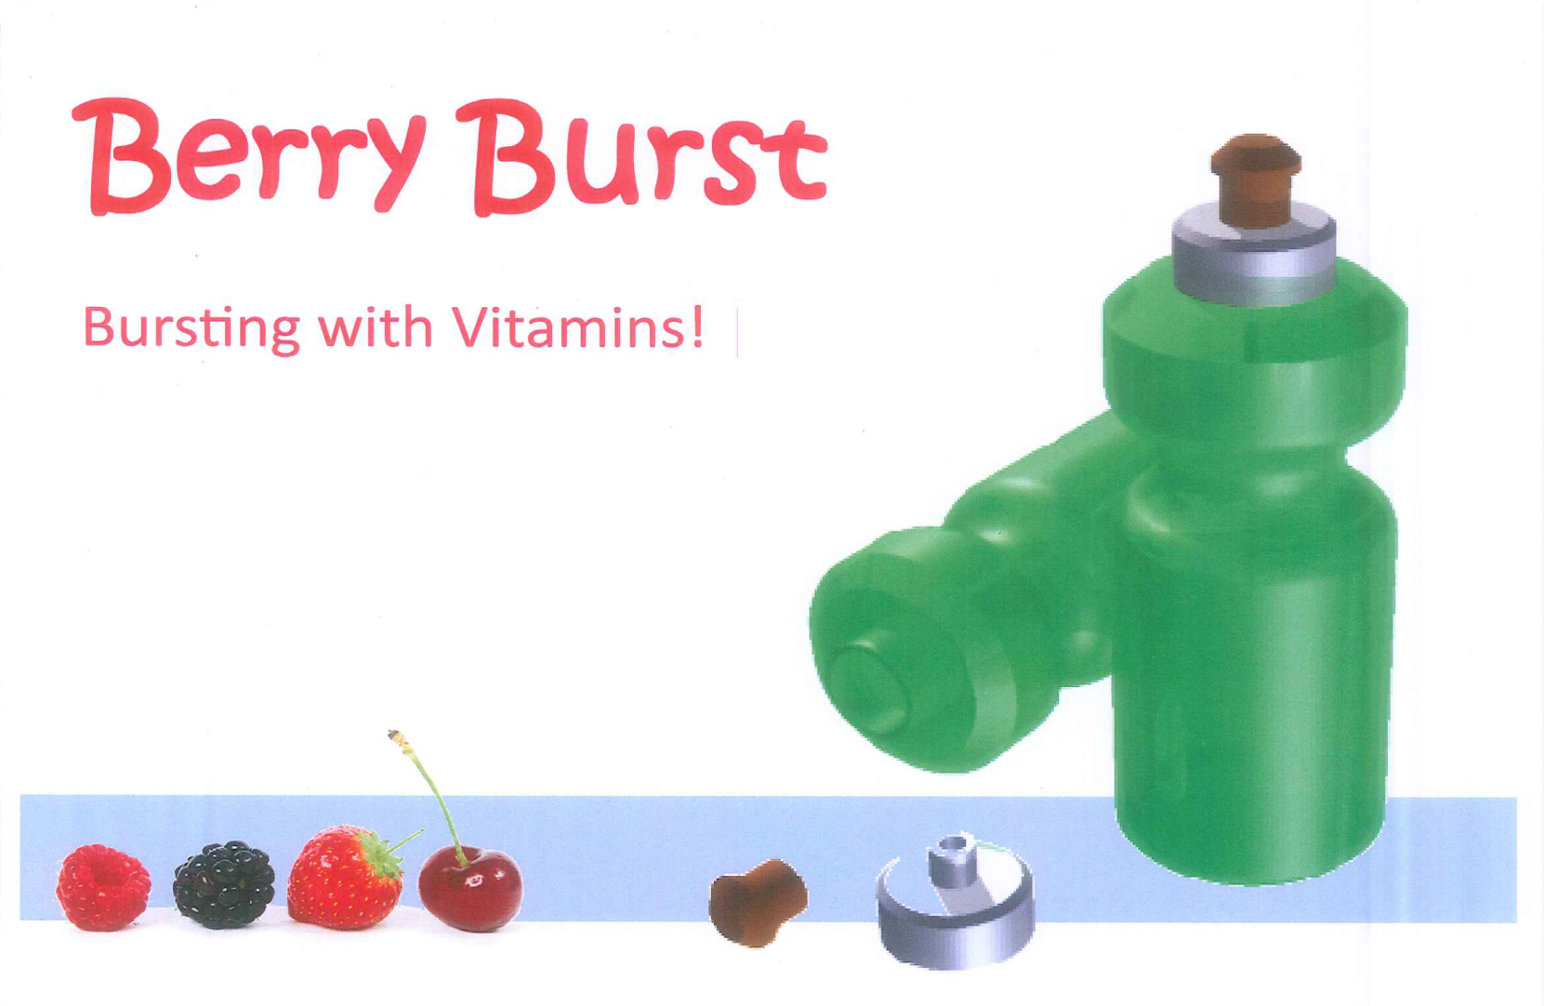

Slide 53
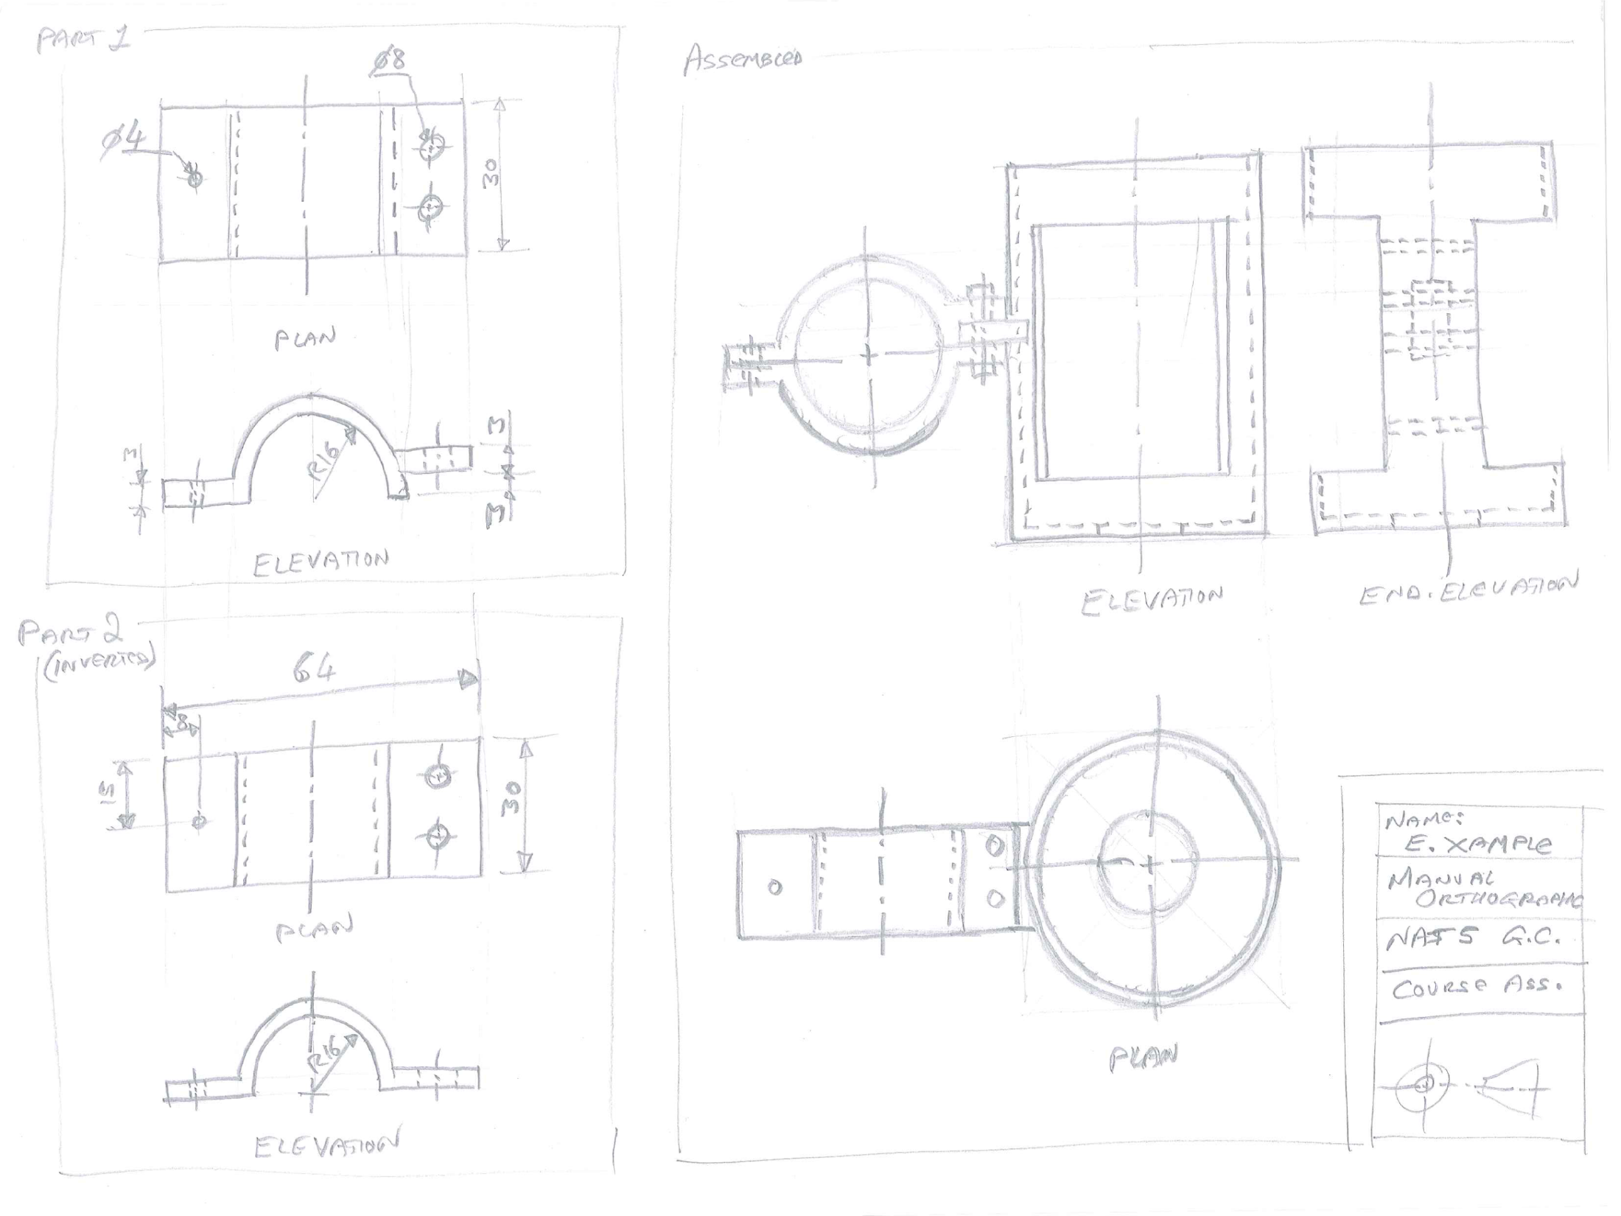

Slide 54
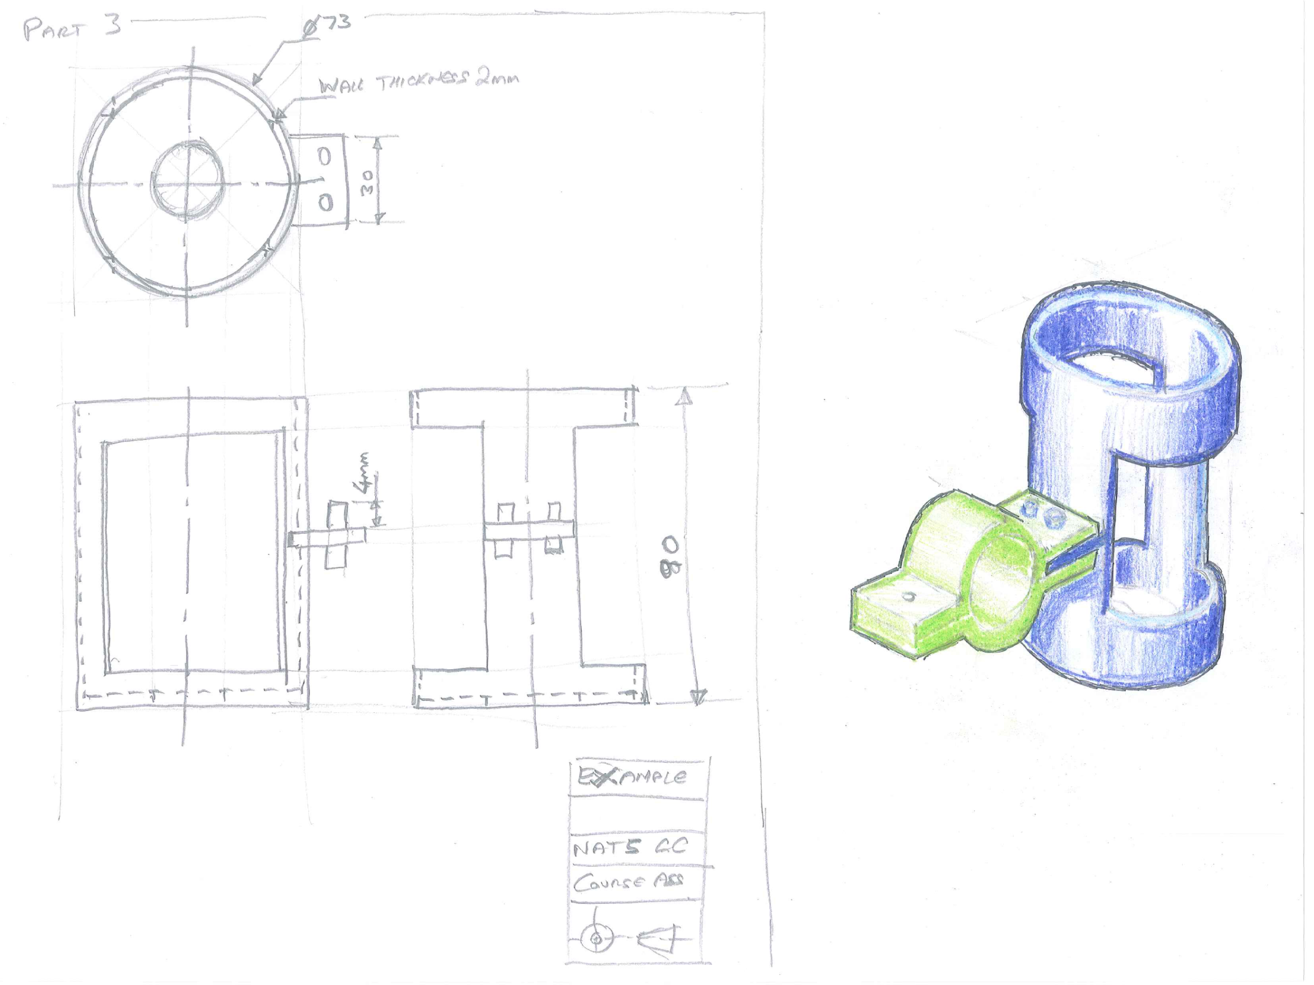

Slide 55
Exam 80 marks
Knowledge/ Theory – based exam paper (no technical drawing).
Area Range of marks
Computer-aided design techniques 15–20
Graphic items in specific situations 8–10
Manual and electronic methods of graphic communication 6–14
Spatial awareness 12–17
Drawing standards, protocols and conventions 10–17
Use of colours, layout and presentation techniques 15–20

Slide 56
What you as parents/guardians can do to help…… a summary!
Ensure any homework/revision is done using the checklist in their folder
Read pupils notes and ask them questions about the various terms/words/topics
Get pupils to make flash cards of topics and information. Then test them on the flash cards.
Whenever you see a graphic in a magazine or newspaper etc., ask your child to explain what the various bits that make it up are and what their job is or how and why the designer used them
Regularly discuss what they have done in class and ask them questions about it

Slide 57
How To Pass Evening
Graphic Communication
National 4/5 - Theory/Knowledge
Course content:
The course covers various aspects and can be divided into the following areas.

Slide 58
The 3 P’s – Preliminary, Production and Promotion
The importance of graphics worldwide and how its used in industry and construction.
Selecting the right type of graphic.

Slide 59
Drawing Standards – British & International Standards, Dimensioning
Symbols
Conventions
Projection Methods
Styles
Rules
Application

Slide 60
2D Drawing Techniques
Geometry – inc. tangency
Specialised views – surface developments, true shapes, sectional drawing.
2D drawing using CAD
3D Drawing Techniques
Styles of Pictorial Drawing – Isometric, planometric, oblique, perspective.

Slide 61
Construction Drawing
Main Drawing Types – location, site and floor plans, elevations.
Standards and Conventions – scales, symbols, sections.
Illustrations - marketing

Slide 62
Computer Graphics – Hardware, Software and Safety
Benefits – specs, uses, types of computer
Computer technology– hardware, software, applications
File management - storage and security
Glossary – useful terms, understanding the language

Slide 63
Computer Graphics – 2D CAD
2D CAD – applications, who uses it
Drawing Method– grid and snap, layers, drawing tools, editing, commands etc.

Slide 64
Computer Graphics – 3D CAD
CAD in industry – applications, manufacturing, testing, illustrations
3D Modelling – extrude, revolve, shell, array, chamfer fillet and other commands etc.
Glossary – useful terms, tools, editing commands.
Assemblies – components, constraints
Advanced 3D modelling – helices, tapers, lofts

Slide 65
Computer Illustration
Applications – who does it?
Resolution – pixels, bitmaps, raster, vectors
Illustration features – Materials, colours, lights, decals
Glossary – useful terms
2D CAD illustration – tools, effects, layers.

Slide 66
DeskTop Publishing, DTP
Benefits – publishing, printing, the graphic designer
Page structure and layout – terminology
DTP tools, effects and features – transparency, drop shadow, flow text, cropping, bleed, text wrap, glossary
Typeface – serif, sans serif, target markets
File types – vector, BMP, JPEG, PNG

Slide 67
Design Elements and Principles
Creative Skills and Techniques – alignment, balance, contrast, depth, dominance, harmony, line, shape, unity
Colour
Colour Theory – colour wheel, warm & cool, advancing & receding, contrast & harmony, tints & Shades
Colour and Mood – colour families, moods & feelings

