Slide 1
How to Pass
National 5 Business

Slide 2
Unit Topics
Understanding Business
Marketing and Operations
People and Finance

Slide 3
SQA Exam
2 hours to complete the paper
Section 1 has 40 marks (consisting of two 20-mark questions) based on two pieces of stimulus material (case studies).
Section 2 has 50 marks (consisting of five 10-mark questions). Sub-questions may range in value from 1–4 marks. The questions assess the application of knowledge and understanding of all topic areas.
Worth 75% of overall grade

Slide 4
Exam Date
Thursday 2 May 2024
1.00pm – 3.00pm

Slide 5
SQA Assignment
Worth 30 marks (25% of the overall grade)
Pupils independently choose their topic
Pupils have 5 hours for this project
Begin writing it in February 2024
Will be due March 2024

Slide 6
Assignment
The assignment gives pupils the opportunity to demonstrate their ability to:
Select an appropriate business topic
Research & gather suitable business information from a range of sources
Apply knowledge and understanding of business concepts to explain and analyse key features of their topic
Draw valid conclusions and/or recommendations
Produce an appropriately formatted business report

Slide 7
Class Assessment
Pupils will be assessed in class by the following methods:
Completing Microsoft Forms at the end of each topic
End of Unit assessments
Weekly exam style starter questions

Slide 8
Homework
Bi-Weekly homework issued to pupils via Teams (printed copy can be requested from teacher)
Pupils should complete homework in their Hand-in Jotters
Pupils have a week to complete the homework
Pupils should take time to read over teacher feedback

Slide 9
Supported Study
Supported study will be available to pupils on a weekly basis with all teachers
Friday Lunch – Miss Hamilton
Wednesday Afterschool – Miss Garton or Miss Martin
Pupils should let their teacher know when they are attending (lunch/after school) to ensure they are available
Pupils should try to attend as often as they can

Slide 10
What will help?
Reading over notes at home regularly (through Teams/One Drive)
Watching/reading the news – to put what we are learning into context
Create key terminology flashcards/posters as they go through the course
Talking to people who own their own businesses
Watching documentaries (BBC, Nexflix, YouTube)
Use a study timetable

Slide 11
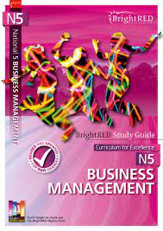
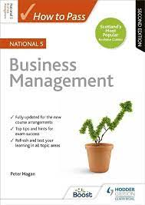
Recommended Textbooks
Pupils can gain access to these through teacher and have access to a wealth of notes and information on teams

Slide 12
Useful Links
BBC Bitesize
Quizlet
Brightred Digital Zone
SQA Past Paper
Two Teacher YouTube Channel
Business as Usual Podcasts

Slide 13
Useful News Links
Marketing Week
BBC News
Personnel Today
Independent
The Guardian
Insider
Retail Week

Slide 14
How can you help?
Encourage pupils to apply their learning to real life situations on the news etc.
Encourage attendance at supported study
Remind pupils about homework requirement
Assist pupils to create a study timetable

