Slide 1






How To Pass
National 5 Chemistry

Slide 2


Course assessment
3 units
Chemical Changes and Structure
Nature’s Chemistry
Chemistry and Society.

Slide 3

Course content
Rates of reactions
Atomic structure
Bonding
Chemical formulae
Acids and bases
Homologous Series
Everyday consumer products
Energy from fuels
Metals
Plastics
Fertilisers
Nuclear Chemistry
Chemical Analysis

Slide 4
External Assessment
Exam (2½ hours) : 100 marks
Section 1 – multi-choice 25 marks
Section 2 – extended response 75 marks
Assignment
Conducted in school but marked externally – 20 marks

Slide 5
Assignment – 8 hours
Research
Plan and carry out an experiment – pairs / small groups
Record results in an appropriate format
Background chemistry research – individual
Reporting – Under exam conditions
Findings from the experiment and the background chemistry are collated in a written report.
1hour and 30 minutes

Slide 6

Pupil responsibility
Ask for help when unsure - asap
Ensure all relevant material is brought to class
Ensure any work missed is completed in a timely manner.
Ensure homework is submitted on time
Attend study support if required ; especially in run up to assessments/exams

Slide 7

Our responsibilities
Address any difficulties that arise
Progress is tracked and monitored
Pupil support/home contacted when concerns arise
Opportunities for study support provided (after school)

Slide 8
How you can help
Encourage pupil to seek help if required
Provide a suitable environment for study
Track homework – Microsoft Teams
Assist with revision before assessments
Encourage pupil to access revision materials (online & books)

Slide 9

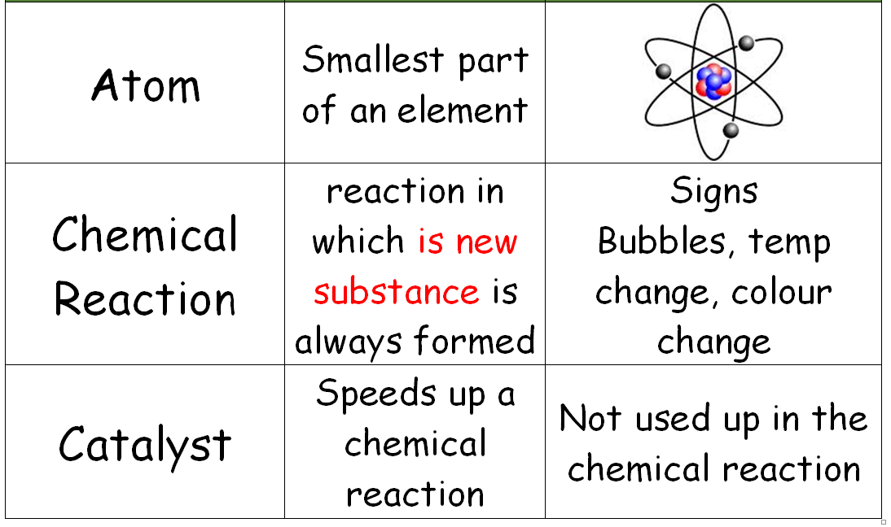
Flash Cards

Slide 10
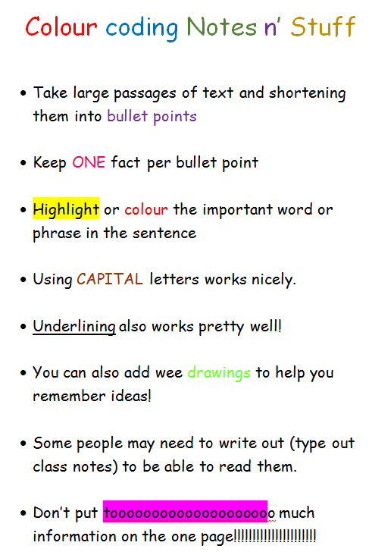
Revision Notes

Slide 11

Mind Maps

Slide 12

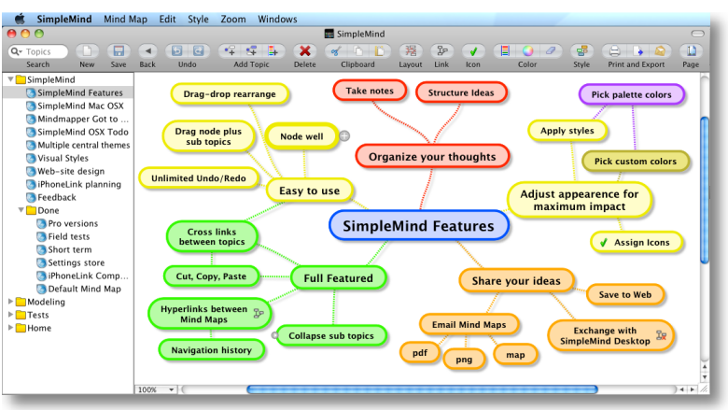
Simple Mind - APP

Slide 13
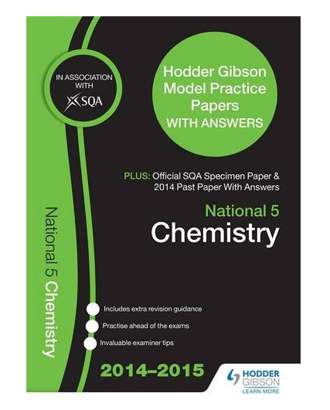
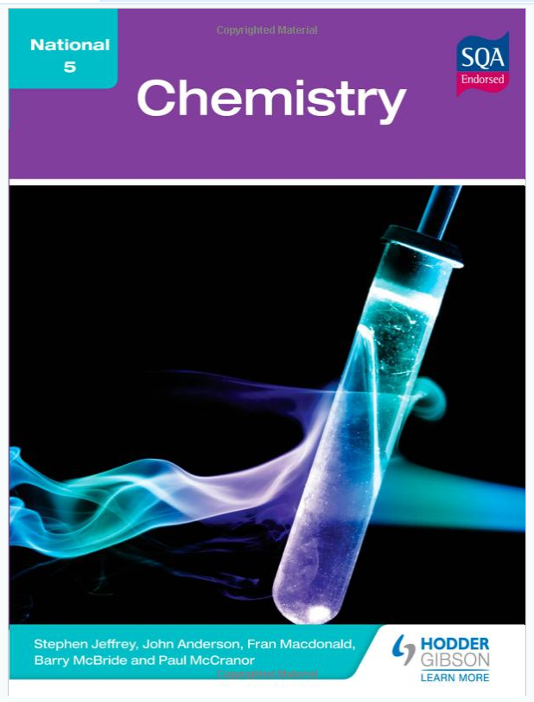
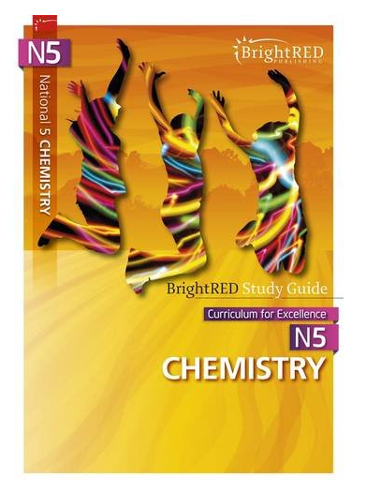
Revision materials
Past Papers
Selected questions only

Slide 14

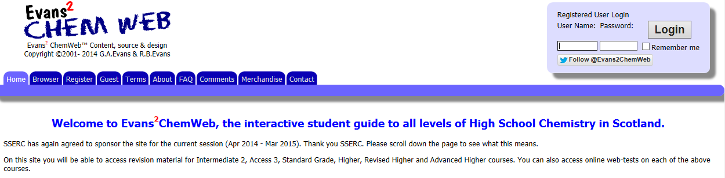
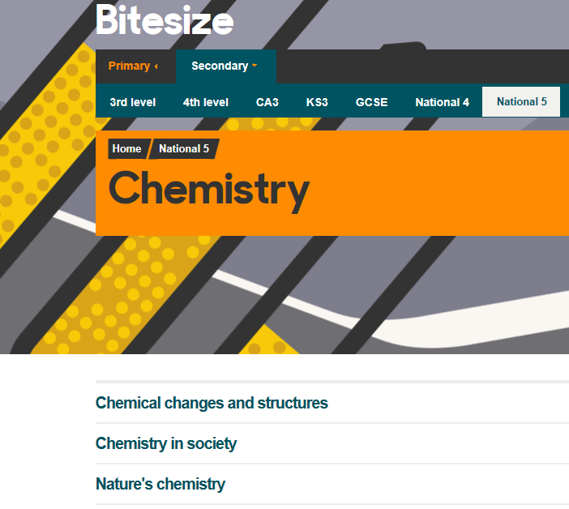
Revision websites
Username: dumfries
Password: chemdhs
Revision Notes
Revision Questions
Short videos

Slide 15
Supported study
3.15pm – 4.30pm
Tuesday with Mrs Earle or Ms Henry
Or drop by at the end of the day.

Slide 16
Check points!
October Assessment
Prelims start in January
Second Prelim just before Easter

Slide 17
End point!
National 5 Chemistry
Exam 24th May 2024

