Slide 1
How to pass National 5 Modern Languages
Mr D Thorburn & Mrs N Blackwell
Plan for this session:
Course content
Exam content
Tips for success
Resources

Slide 2
Course content

Slide 4
Course content
4 Contexts:
Society
Culture
Learning
Employability
4 Skills
Reading
Listening
Talking
Writing
+ Grammar**

Slide 5
The 4 contexts
SOCIETY
Family, Relationships, Friends
Lifestyle / Health & Fitness
Technology & Media
Town/country
Environment
CULTURE
Importance of Languages
Holidays
Special Events/Culture
EMPLOYABILITY
Advantages and disadvantages of jobs
Ideal jobs
Talking about part time work
Earning your own money/pocket money
LEARNING
School life (difference between France and Scotland)
Subjects (reasons for subject choice)
Future Learning plans
Notes:
Society – does not need to be true – opinions, reasons
Learning – future plans, time, subjects opinions reasons
Culture – holidays – past tenses, weather, activities
Employability – job app, pros/cons, future plans

Slide 6
Exam content & Key dates
Before October break
January
March/April TBC
March – in school
Exam diet
Exam diet
Exam diet
October Assessment
Prelim
Writing Assignment
Talking
Reading
Writing (job application)
Listening
Notes:
On hand out

Slide 7
Study support
In school
After school sessions with Mrs Blackwell/Mr Thorburn
Feb/March talking support
At home
Look over your vocab jotter at least 3 times in the week
Use Quizlet every week to practise for listening
Memorise all written and corrected work- build this up for talking assessment
Review your job application bullet points

Slide 8
Course assessment
Question paper 1: Reading and Writing
50 marks
Pupils demonstrate breadth, challenge and application in the skills of reading and writing
The question paper is subdivided into two components:
Reading 30 marks
Writing 20 marks

Slide 9
Question paper 1
Paper 1 ‘Reading’
30 marks
Read three texts of equal length in French
Each text is from a different context: society, learning, employability or culture, and is followed by questions in English.
Answer questions in English. You can use a bilingual dictionary.
1 hour and 30 minutes.

Slide 10
Question paper 1
Paper 2 ‘Writing’ (job application)
20 marks
Write a text of 120–150 words in French in response to a job advert
There are six bullet points to address.
Four of the bullet points are common and are predictable but there are two additional bullet points that are linked to the specific context.
Candidates may use a bilingual dictionary.

Slide 11
Question paper 2
Question Paper 2 ‘Listening’
20 marks
Listen to one monologue and answer questions worth 8 marks.
Then listen to one conversation and respond to questions worth 12 marks.
The texts are linked thematically.
Candidates may not use a dictionary.
Questions are in English.

Slide 12
Assignment- Writing
Candidates will be assessed on one of three contexts: society, learning or culture.
Note: candidates already have the opportunity to write on the context of employability in the job application.
Candidates produce a piece of writing of 120–200 words in the modern language, using detailed, varied, mainly factual language. Teachers provide feedback on areas for improvement via the use of a writing improvement code.
The assignment–writing has a total mark allocation of 20 marks, which is scaled to 15 marks. The assignment is externally marked by SQA.

Slide 13
Talking
Carry out a spoken presentation and conversation in French from at least two of the contexts: society, learning, employability or culture.
30 marks total
There are 2 parts to the Talking exam:
‘Presentation’, 10 marks.
‘Conversation’, 20 marks

Slide 14
Talking- presentation
Spoken presentation in French, using detailed language on a topic chosen from at least one of the following contexts: society, learning, employability or culture.
Candidates choose the topic and develop this into a short presentation.
The presentation should last approximately 1–2 minutes

Slide 15
Talking- conversation
After the presentation and any related questions, take part in a conversation using detailed language on a different topic or context and to respond to some questions in French on that topic.
The information to be exchanged is mainly of a factual nature and also includes some ideas and opinions. Candidates may also ask questions where appropriate during the conversation.
15 marks are awarded for the conversation and 5 marks for the ability to sustain the conversation
The conversation should last approximately 5–6 minutes (total time 6-8 minutes)
This is a one-off assessment

Slide 16
Tips for success: vocab learning
Read over class work
Correct errors, check areas to practise
Look, say, cover, write, check!
Review vocab and verbs – read aloud and write down to practise pronunciation and recognising vocab – use Quizlet
Categorise your vocab into topics- make mind-maps!
Revise the BASICS:
Numbers, times, dates
Temperatures, distances and prices
Days, months, weeks and years

Slide 17
Tips for success: reading
Read the information in English about context
Read the questions – look for clue words in the question which will show you where the answers are to be found
Look at the text. Skim read to get an idea what it is about without using a dictionary
Questions follow the same order as the text ☺

Slide 18
Tips for success: reading
Only look up what you have to!
Remember there may be several entries for one word because it may be both verb and noun, with different meanings.
Because French verbs have endings, you will often not find the exact word you are looking for: you need the ‘infinitive’
un avocat — an avocado un avocat — a lawyer

Slide 19
Tips for success: listening
Read all the questions carefully- understand the context
Highlight the key words in the questions- number, opinion, place, name? You are not expected to understand everything ☺
Try to predict what answers might be (roughly)
Don’t leave blanks- make a sensible guess
If the answer asks for 2 things, just give two things. Writing more than necessary takes up valuable time

Slide 20
Tips for success: talking
Record your presentation and repeat back
Make flashcards, practise with someone
Speak loudly, clearly and enjoy it!
Prepare lots of ways of giving your opinion
Don’t hesitate to ask the teacher to repeat a question or say: ‘Je suis désolé. Je ne comprends pas’

Slide 21
Tips for success: writing
Make sure your work is structured- introduction, development, conclusion, paragraphs, starters & connectives.
Use all resources available to you – dictionary, grammar notes, vocab lists.
Build up a variety of structures and tenses

Slide 22
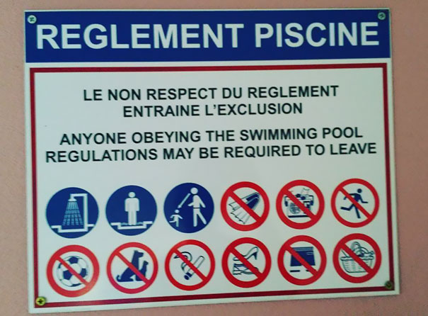
Tips for success: writing
Make flashcards – either on paper or Quizlet
Beware of Google translate- you have a good level of French/Spanish, you do not need to rely on Google. You risk making mistakes like…

Slide 23
Other Resources
Microsoft Teams:
All class materials posted on Teams/ Class Notebook
Study support
Quizlet – French N5
Vocab per context for practise
Bright Red Publications- create a free log-in
https://www.brightredbooks.net/subjects/
Notes:
On hand out + linguascope log on

Slide 26
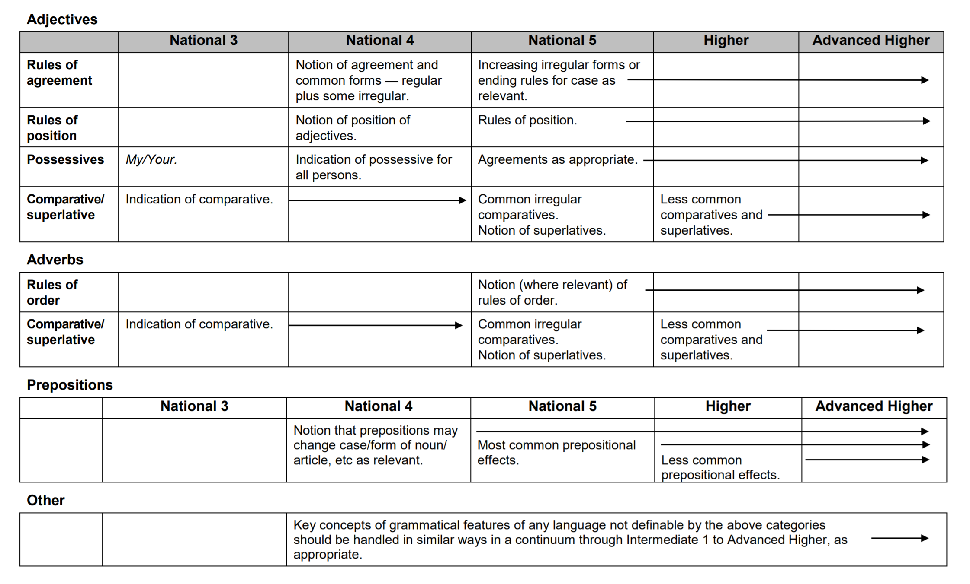

Slide 28
