Slide 1
How to Pass
National 4/5 Biology
September 2023

Slide 2
DHS Biology Department
Miss Johnstone
Mrs Downie
Miss MacPherson

Slide 3
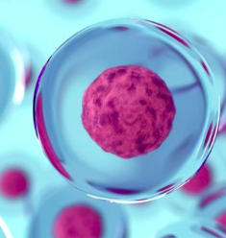
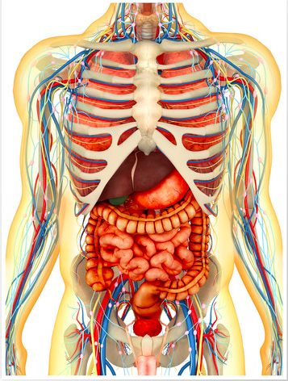
Course Content
The National 4/5 Biology course consists of 3 units:
Unit 1 – Cell Biology
Unit 2 – Multicellular Organisms
Unit 3 – Life on Earth

Slide 4
What the students will be doing in class…
Making notes of the course content.
Conducting experiments relevant to the course.
Undergoing research tasks.
Practice questions and analysis
Revision

Slide 5
Assessment Timeline
End of unit tests (October 23, December 23 and March 24)
N5 Prelim (January 2024 – unit 1 and 3 content)
SQA N5 Exam - (May 2024)
SQA N5 Assignment – (Jan/Feb 2024)

Slide 6
SQA Assessment
N5 Biology Exam - 2 hours 30 minutes (80% of course grade)
multiple-choice questions
structured and extended response questions
N5 Biology Assignment - 1 hour 30 minutes (20% of course grade)
an individually produced piece of work from each candidate
started at an appropriate point in the course
conducted under controlled conditions
Both marked by SQA

Slide 7
Pupil Responsibility
Revise notes on a regular basis
Ensure homework is submitted on time.
Read homework feedback thoroughly to learn from mistakes.
Seek help when difficulties arise.
Attend study support if required; especially in the run up to assessments and exams.
Ensure all relevant materials are brought to class.
All the Biology department use Microsoft Teams – where all resources will be uploaded for any student to catch up with work missed due to absence.

Slide 8
Teacher Responsibilities
Homework will be marked in a timely manner with feedback given.
Offer study support sessions weekly. On a 3-week rotation.
Monitor and track progress for each individual.
Pupil support/home contacted when any concerns arise.

Slide 9
How can you help at home?
Encourage students to ask for help if they are struggling with any of the work.
Assist with revision before assessments – help create a revision timetable or test their knowledge by asking questions from their notes.
Encourage students to access revision materials (BBC Bitesize, Microsoft Teams, Revision books etc.)

Slide 10
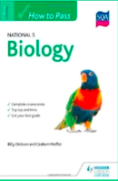
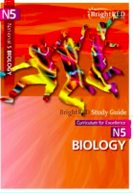
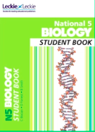
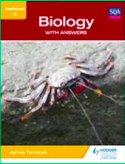
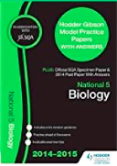
Revision Materials

