Slide 2
How to Pass
Skills for Work Laboratory Science
SCQF Level 5
Session 2023/2024

Slide 3
‘Lab skills at SCQF level 5 develops techniques that are important in the STEM (science, technology, engineering and maths) sector and is particularly important given the existing and projected shortfall in suitably qualified individuals in these areas'

Slide 4
Specific aims of the qualifications:
Develop skills in good laboratory practice
Prepare candidates for progression to extended qualifications at SCQF level 5 and above
Develop an understanding of science health and safety
Develop five Core Skills which are communication, numeracy, ICT, problem solving and working with others

Slide 5
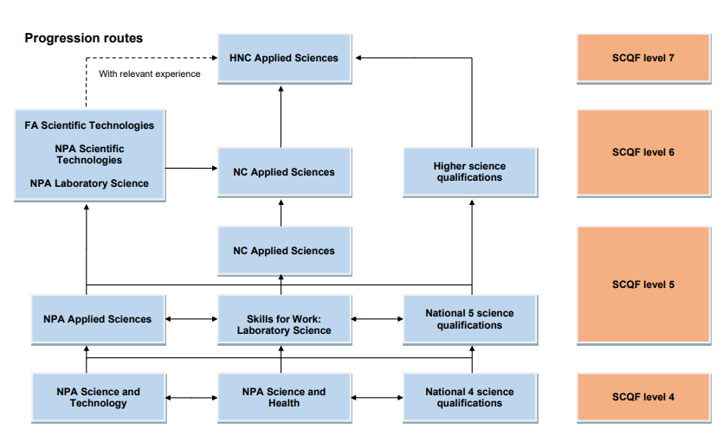

Slide 6
Laboratory Science at SCQF level 5 consists of four mandatory Units (24 SCQF credit points)
Careers using Laboratory Science
Working in a Laboratory
Practical Skills
Practical Investigation

Slide 7
Assessment
External Assessment – No exam in May/June
Internal Assessment – During every class this is ongoing and certain criteria have to be achieved. Attendance is vitally important to passing this course.

Slide 8
OUR RESPONSIBILITIES:
Clear and concise notes
Opportunities to seek help if required
Regular feedback from assessments
Progress is tracked and monitored
Pupil support/home contacted when concerns arise

Slide 9
PUPIL RESPONSIBILITIES:
Attend class to ensure all booklets are fully completed
Ensure any notes / work missed is completed in a timely manner.
Seek help when difficulties arise
Attend class

Slide 10
HOW YOU CAN HELP:
Ensure pupils are in class as much as possible as all assessment takes place in class time
Encourage pupils to have a ‘can do’ attitude towards their work

Slide 11
Questions?

