Slide 1
How to Pass
Higher Classical Studies

Slide 2
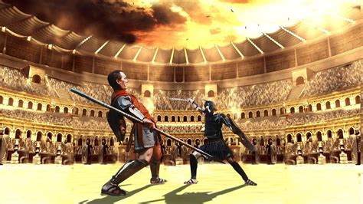
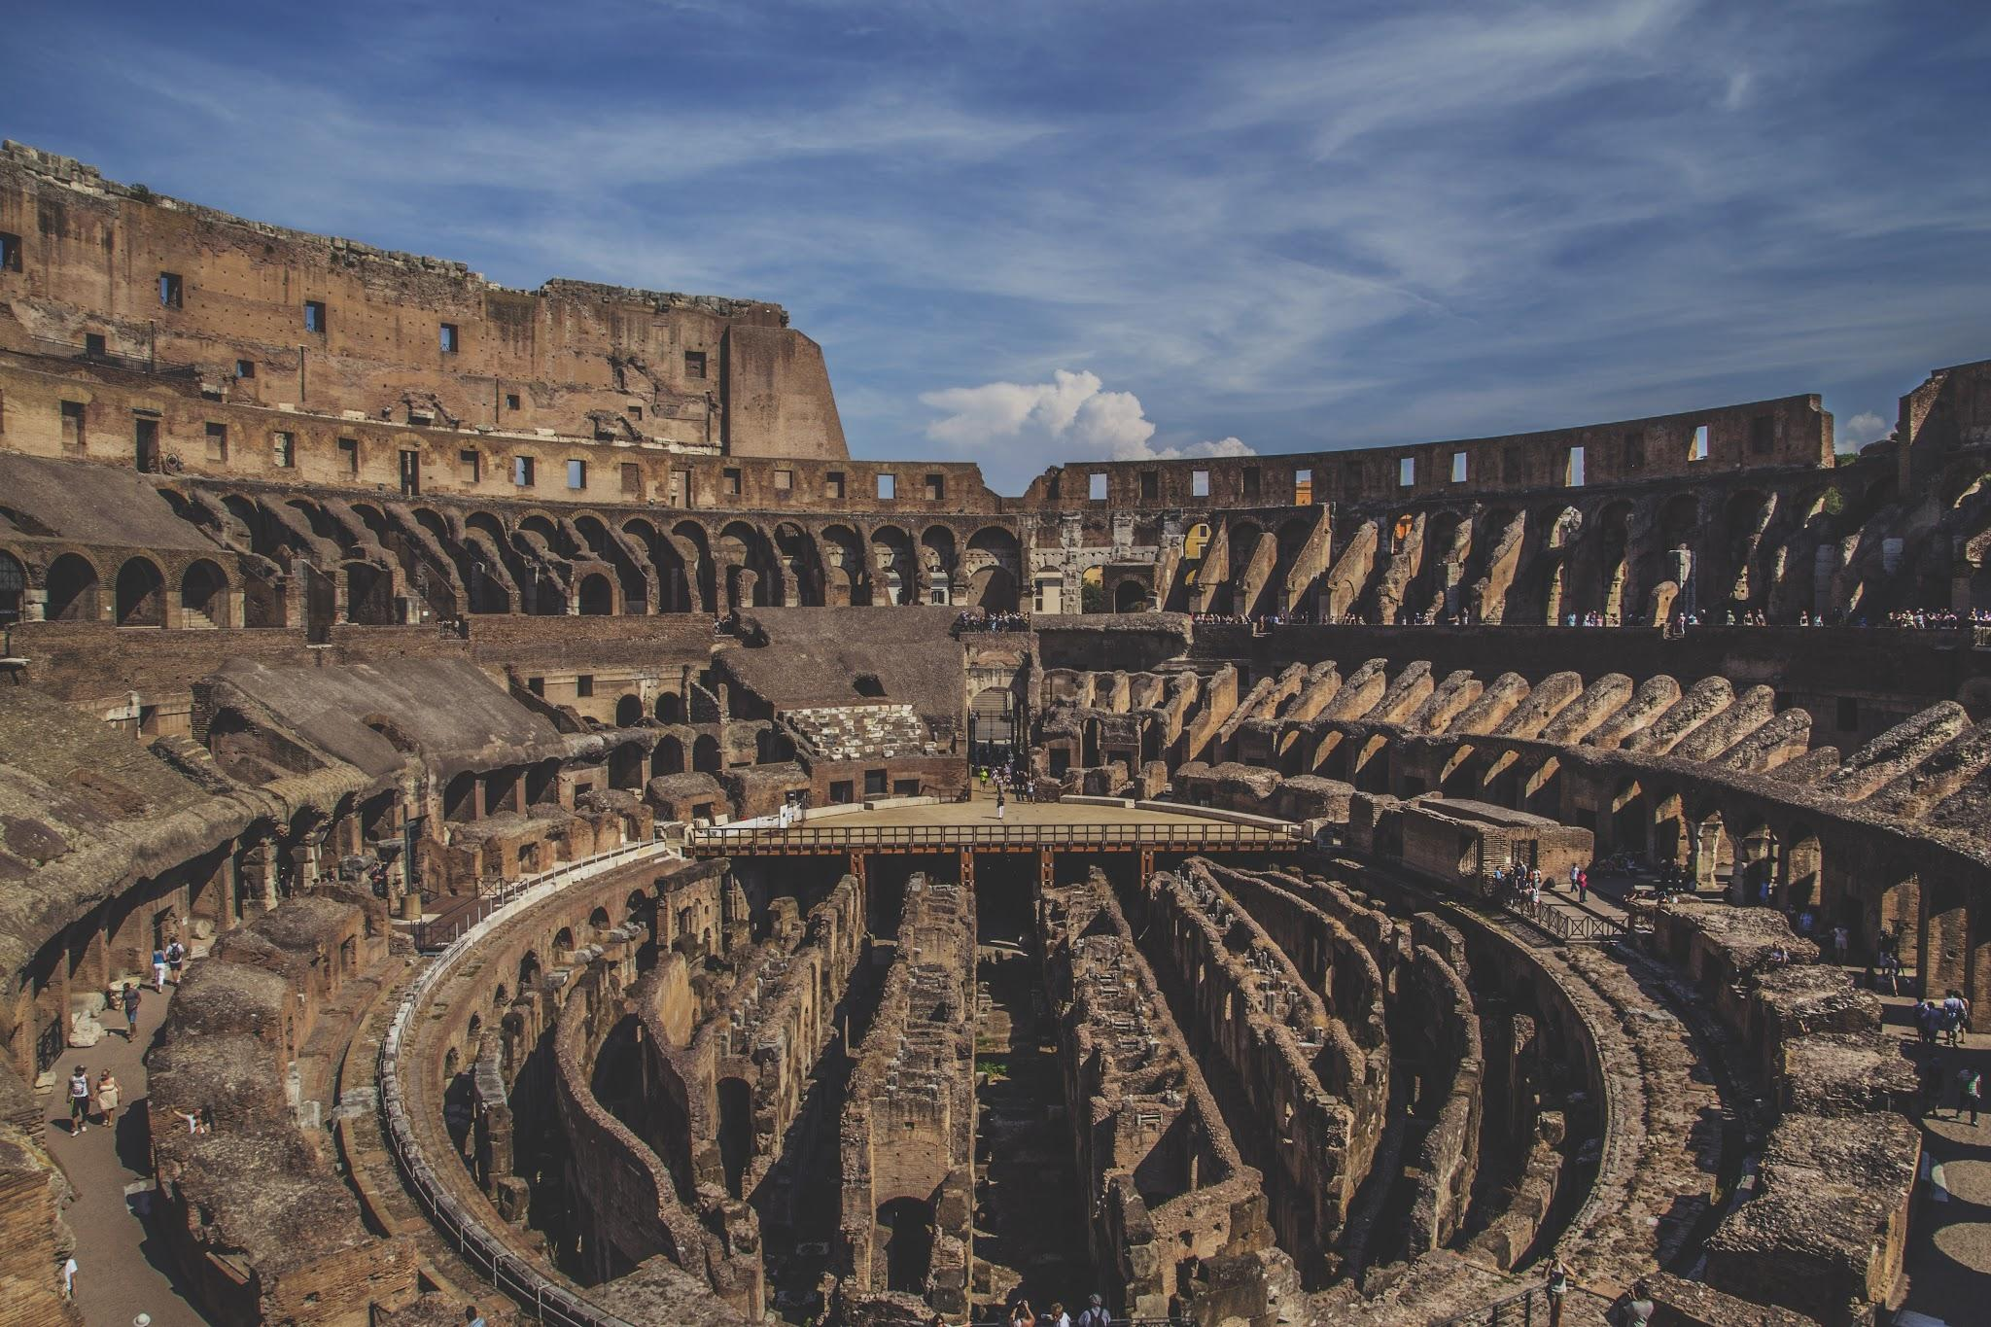
Course Outline
The Higher Course is designed to develop students knowledge and understanding of the Classical Greek and Roman Civilisations by comparing and contrasting these societies to the modern world.

Slide 3
knowledge and understanding of public and private religious ideas and practices:
the interaction between religion, personal morality and identity in classical societies or of the political and social structures of classical societies the ability to evaluate complex sources of evidence from classical societies
awareness of universal ideas, themes or values raised by classical texts
the capacity to compare and contrast the classical world with modern society

Slide 4
Components of the Course
Component | Marks | Duration
Component 1: Classical Literature paper | 30 | 1 hour and 10 minutes
Component 2: Classical Society paper | 50 | 1 hour and 50 minutes
Component 3: Assignment | 30 | 1 hour 30 minutes

Slide 5
Component 1
This aspect of the course covers Classical Texts including:
Homer’s Iliad
Homer’s Odyssey Book 9
Euripides - Medea
Sophocles - Oedipus Rex
Students are not required to purchase any of the texts, they are available to them on Sparknotes; a very useful site with summary notes and exam revision questions.
They will also have access to digital copies of the 3 out of the 4 texts on Teams.

Slide 6
Component 1
Students are required to demonstrate their knowledge and understanding of the texts in relation to 5 Themes any of which can be sampled in the final exam.
Heroism
Leadership
Fate vs Freewill
Conflict
Women and society

Slide 7
Component 1
Students will complete a 20 mark essay question and a 10 mark comparative so
urce question for this paper.
They will have the opportunity to choose between 2 essay titles for the 20 mark question.

Slide 8
Component 2
In this section students as assessed by responding to different styles of source questions.
There are 5 question types each will be sampled in the final exam.
There are two distinct units:
- Life in Ancient Greece
- Life in Ancient Rome
Student will answer either 3 of the 5 questions in the Greek section and 2 in the Roman or vise versa, this is at the discretion of the SQA, one of the question types is a floating question, we never know if it will be in the Greek Section or the Roman Section until the day of the exam.

Slide 9
Component 3
Assignment - this element has been reintroduced this year. This element give the student optionality as they can choose their area of study.
They will be given time to research their chosen topic and prepare a resource sheet containing 250 to help them during their assessment.
This element is an extended version of the 20 mark questions and should also incorporate sources.

Slide 10
Accessing work
Students will have their classroom notes to use
Summary mind maps to aid with revision
All resources are available to students on Teams
They also have access to Class Notebook on Teams which allows them to access topics in more detail and contains exemplars of work.
SQA site is invaluable for access to past papers and marking instructions.

Slide 11
Ms Glen
Please do not hesitate to contact me if you have any concerns or questions regarding the course.
Phone - 01387 263061
Email - gw15glenmarion@ea.dumgal.sch.uk

