Slide 1
How to Pass
Higher Human Biology

Slide 2
DHS Biology Department
Miss Johnstone
(Higher Human)
Mrs Downie
(Higher Human)
Miss MacPherson
(Higher Biology)

Slide 3
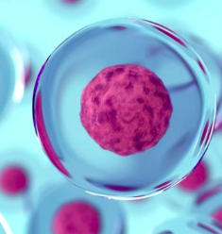
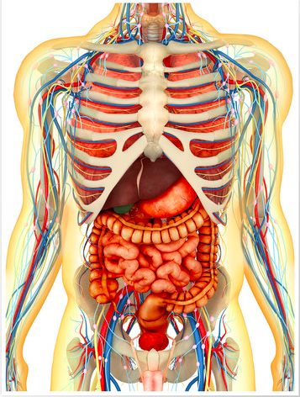
Course Content
The Higher Human Biology course consists of 3 units:
Unit 1 – Human Cells
Unit 2 – Physiology and Health
Unit 3 – Neurobiology and Immunology

Slide 4
What the students will be doing in class…
Creating notes/glossaries of the key terminology from each key area.
Conducting experiments relevant to the course – in preparation for the assignment.
Undergoing research tasks.
Exam style questions and technique.
Revision of notes.

Slide 5
Assessment Timeline
Mid-Unit assessments
U1 – Aug/Sept 2023
U2 – Nov/Dec 2023
U3 – Feb/Mar 2024
End of Unit assessments
U1 – October (assessment week) 2023
U2 – December 2023
U3 – March 2024
Assignment – Jan/Feb 2024
SQA Higher Human Biology Exam - 15th May 2024
Multiple choice – 40 minutes & structured & extended response questions (2 hrs 20 minutes)

Slide 6
Component Marks
SQA Assignment – 20% of overall grade.
The assignment assesses the application of skills of scientific inquiry and related human biology knowledge and understanding.
It allows assessment of skills that cannot be assessed by a question paper; for example, handling and processing data gathered through experimental work and research skills.
SQA Exam – 80% of overall grade.
Section 1 – Multiple Choice (25 marks)
Section 2 – Written Section (95 marks)
Including – 8/9 mark extended response and 3/4 mark mini-extended response

Slide 7
Pupil Responsibility
Ensure homework (past paper questions) is submitted on time.
Read homework feedback thoroughly to learn from mistakes.
Seek help when difficulties arise.
Attend study support if required; especially in the run up to assessments and exams.
Ensure all relevant materials are brought to class.
All the Biology department use Microsoft Teams – where all resources will be uploaded for any student to catch up with work missed due to absence.

Slide 8
Teacher Responsibilities
Homework will be marked in a timely manner with feedback given. Unless Homework is submitted late.
Offer study support sessions weekly. On a 3-week rotation.
Monitor and track progress for each individual.
Go over assessments thoroughly and allow pupils to reflect on their performance.
Pupil support/home contacted when any concerns arise.

Slide 9
How can you help at home?
Encourage students to ask for help if they are struggling with any of the work.
Assist with revision before assessments – help create a revision timetable or test their knowledge by asking questions from their notes.
Encourage students to access revision materials (BBC Bitesize, Scholar, Microsoft Teams, Revision books etc.)
Encourage pupils to attempt past paper questions regularly and attend study support if needed extra help.

Slide 10
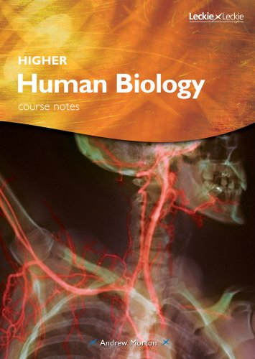
Revision Materials

