Slide 1
Higher Geography

Slide 2
Higher Geography – Course Content
Physical Topics
Human Topics
Lithosphere
Hydrosphere
Biosphere
Atmosphere
Urban
Rural Land Degradation
Population

Slide 3
Higher Geography – Course Content
Global Issues
Climate Change
Development and Health
Geographical Skills

Slide 4
Class Assessment
There is now no formal SQA Unit Assessment in Higher Geography.
Pupils will undertake topic tests set by the class teacher to track progress and identify areas for development.

Slide 5
Exam
The exam is divided into two papers
Paper 1
Physical and Human Environments (100 marks)
1 hour and 50 minutes
100 marks
Paper 2
Global Issues (40 marks) Geographical Skills (20 marks)
1 hour and 10 minutes
60 marks
The exam is out of 160 marks.

Slide 6
Assignment
The Assignment is externally assessed by the SQA.
Before the Assignment, pupils will complete fieldwork and they will use gathering and processing techniques to prepare information for their Assignment.
Pupils will have 1 hour and 30 minutes to write-up their Assignment, in exam conditions.
The class teacher can help with fieldwork and with the Processed Information but they have no input into their write-up.
The Assignment is worth 30 marks and is 27% of the course.

Slide 7
This back to ‘or
This is back to ‘pre-covid’ arrangements.

Slide 8
Prelims
The first prelim for Higher Geography will be in January.
It will include all of the topics that pupils have covered so far in the course.
Pupils will get a further full prelim in March once the course has been completed.

Slide 9
ICT
There is a Microsoft Team for the class which they should be using regularly.

Slide 10
Organisation
There are 10 topics in Higher Geography and an assignment.
Pupils work on paper and we have provided them with dividers for their folders.
Please encourage your child to keep their folder in order – it will benefit them hugely when it comes to revision.

Slide 11
How can you help?
Encourage your son/daughter to study regularly at home (if they have homework or not).
Encourage your son/daughter to attend study support – on a Wednesday (Mr McCabe) or Thursday (Miss Scott).
Ensure resources are organised at home.
Encourage a structured approach to revision.
Encourage the use of timed questions (weekly) to help with content, exam technique and timings.

Slide 12
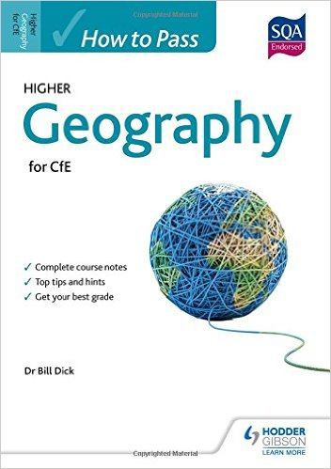
Resources
.

Slide 13
Exam Date 2024
Tuesday 23rd April

