Slide 1


Higher
Chemistry:
How to pass!

Slide 2


Course content
Unit 1
Chemical changes and Structure:
Structure and bonding
Periodicity
Oxidising and reducing agents
Unit 2
Nature’s Chemistry:
Systematic carbon chemistry
Alcohols, carboxylic acids and esters
Fats and oils, soaps, detergents and emulsions, proteins
Oxidation of food
Fragrances and skincare
Unit 3
Chemistry in Society:
Getting the most from reactants
Equilibria
Chemical Energy
Controlling the rate
Chemical analysis
Unit 4
Researching Chemistry:
Research a topic
Investigate topic through experimentation

Slide 3
External assessment
Exam on the 24th May
(3 hours) : 120 marks
Section 1 – multi-choice 25 marks (40 minutes)
30 minutes break between section 1 and 2
Section 2 – extended response 95 marks
Assignment : 20 marks (worth 20% of final mark)

Slide 4
Assignment – 8 hours
Research
Plan and carry out an experiment – pairs / small groups
Record results in an appropriate format
Background chemistry research – individual
Reporting – Under exam conditions
Findings from the experiment and the background chemistry are collated in a written report.
1hour and 30 minutes

Slide 5

Unit tests
Sat at end of each section
Allows us to get an idea of progress and understanding
Can be an indicator of early difficulties with the course

Slide 6

Our responsibilities
Regular homework with feedback
Opportunities to seek help if required
Progress is tracked and monitored
Pupil support/home contacted when concerns arise
Opportunities for study support provided (lunch and after school)

Slide 7

Pupil responsibility
Ensure homework is submitted on time
Attend study support if required ; especially in run up to assessments/exams
Regular revision undertaken at home
Ensure all relevant material is brought to class
Ensure any work missed is completed in a timely manner.
Seek help when difficulties arise

Slide 8
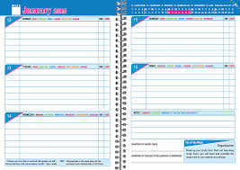
How you can help
Check pupils are completing homework
Provide a suitable environment for study
Encourage pupil to seek help if required
Assist with revision before assessments (flash cards & revision questions)
Encourage pupil to access revision materials (online & books)

Slide 9

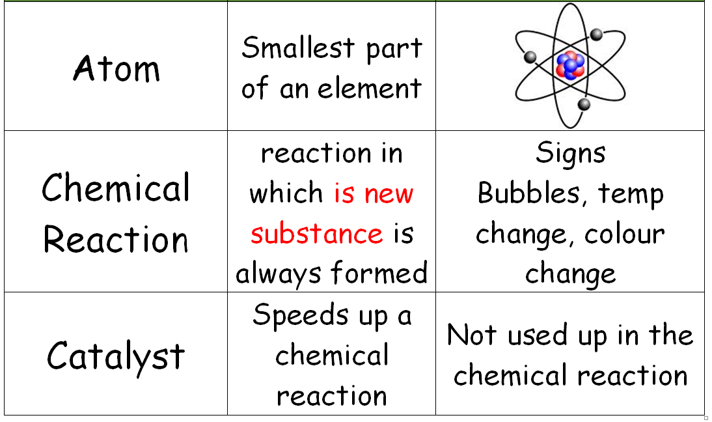
Flash Cards

Slide 10
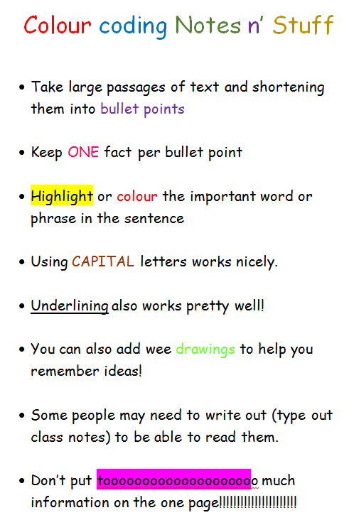
Revision Notes

Slide 11

Mind Maps

Slide 12

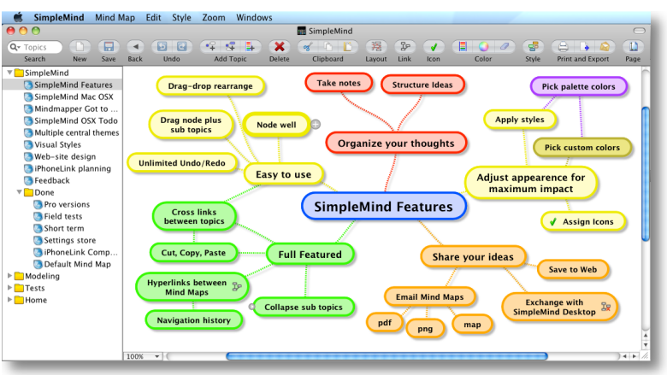
Simple Mind - APP

Slide 13
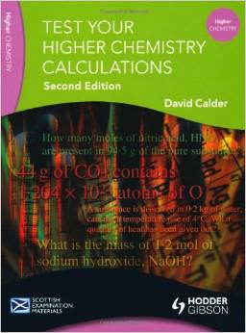

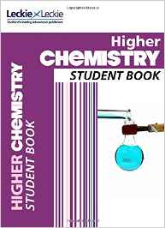
Revision materials

Slide 14
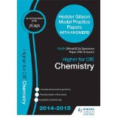

Revision materials
Past Papers
Selected questions only
From about £9

Slide 15

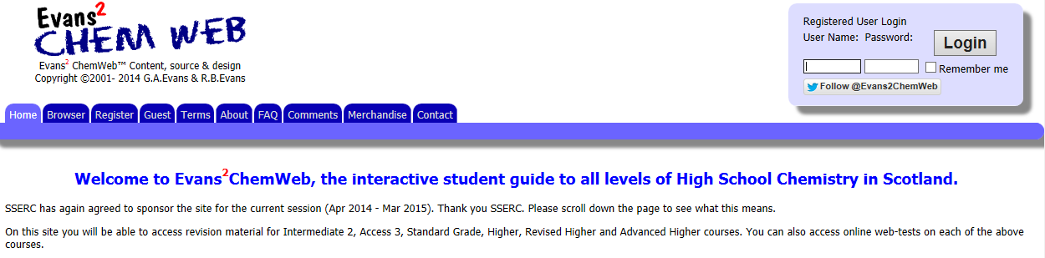
Revision websites
Username: dumfries
Password: chemdhs

Slide 16
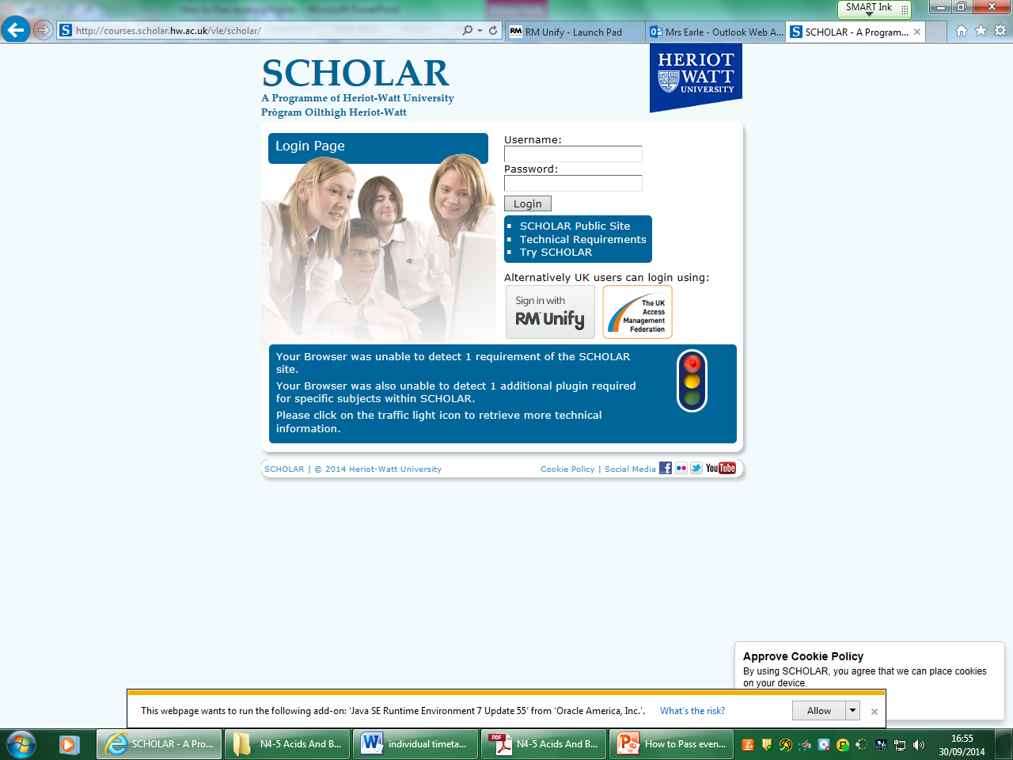
Revision websites
SCHOLAR http://courses.scholar.hw.ac.uk/vle/scholar/
Revision Notes
Revision Questions
Sample tests

Slide 17
Supported study
3.15pm – 4.30pm
Tuesdays after school with Mrs Earle in Lab 10
or with Ms Henry in Lab 2
Or by appointment

Slide 18
Check points!
October Assessment
Prelims start in January
Second Prelim just before Easter

Slide 19



How you can help
Get in touch if concerned about progress or have any queries at all

Slide 20

Any questions?

