Slide 1
How to Pass
Higher Admin & IT

Slide 2
Exam Unit Topics
Role of Administrative Assistant
Strategies for effective time & task management
Effective teams
Workplace legislation
Impact of ICT
Customer care
Meetings
Methods of communication

Slide 3
SQA Exam
Section 1 is worth 10 marks and contains of a set of questions based on a piece of stimulus material. The questions generally relate to the stimulus, although some questions may be based on topics surrounding the stimulus material. They assess problem solving, the application of knowledge and understanding, and may range in value from 1–6 marks.
Section 2 is worth 40 marks and contains questions that assess the application of knowledge and understanding. Questions may range in value from 1–6 marks.
1 hour and 30 minutes to complete the paper

Slide 4
SQA Assignment Topics
Word processing
Spreadsheets (Excel)
Database (Access)
Presentations (PowerPoint)
Digital technology (email, e-diary, internet research)

Slide 5
SQA Assignment
2 hours to complete the paper
The assignment gives candidates the opportunity to demonstrate:
using advanced functions in word processing, spreadsheets and presentation software to produce, process and manage information, and solve problems in unfamiliar contexts
electronic research skills to source complex information
effective communication skills, taking account of context, purpose and audience The assignment has a total mark allocation of 70 marks.
The assignment is 58% of the overall marks for the course.

Slide 6
Microsoft Office
Can be downloaded through GLOW for FREE
Each pupil is permitted multiple downloads of all MS packages eg Excel, Access, Word, PowerPoint
Hugely useful tool
Can be used by the whole family
Download onto PC, laptop, tablet, phone

Slide 7
Class Assessment
Pupils will be assessed in class by the following methods:
Completing Microsoft Forms at the end of each topic
End of Unit assessments
Weekly exam style questions

Slide 8
Homework
Bi-weekly homework issued to pupils via Teams (printed copy can be requested from teacher)
Pupils have a week to complete the homework
Pupils should take time to read over teacher feedback

Slide 9
Supported Study
Supported study will be available to pupils on a weekly basis
Friday Lunch – Miss Hamilton
Wednesday Afterschool – Miss Garton or Miss Martin
Pupils should let their teacher know when they are attending (lunch/after school) to ensure they are available
Pupils should try to attend as often as they can

Slide 10
Exam Date
Wednesday 1 May 2024
10.00am – 11.30am

Slide 11
What will help?
Reading over notes at home (through Teams/One Drive)
Create key terminology flashcards as they go through the course
Completing SQA past papers under timed conditions
Use a study timetable
Attend supported study on a frequent basis

Slide 12
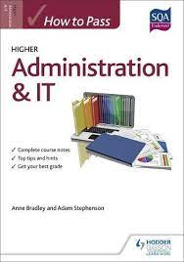
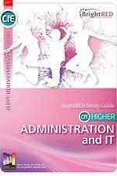
Recommended Textbooks

