Slide 1
How To Pass
National 5
Practical Cookery

Slide 2
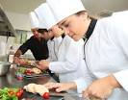
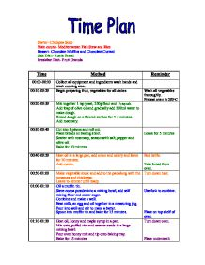
3 Components
Practical Assignment
Marked out of 82
62% of your final mark.
2 hours 30 minutes.
Assignment
Marked out of 18
13% of your final mark.
1 hour 45 minutes
Question Paper
Marked out of 30
25% of your final mark.
1 hour, during SQA exam diet.

Slide 3
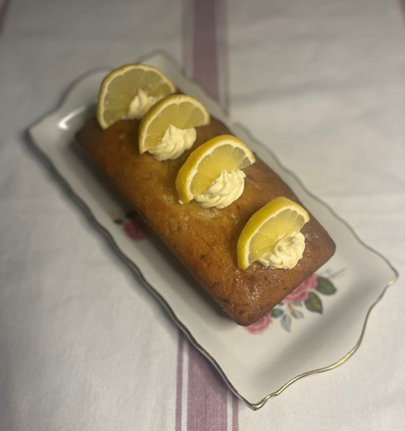
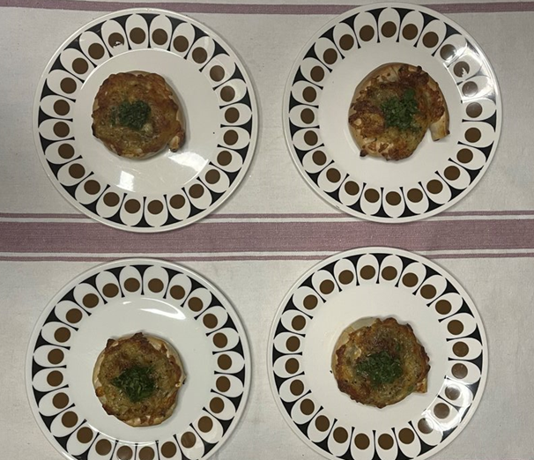
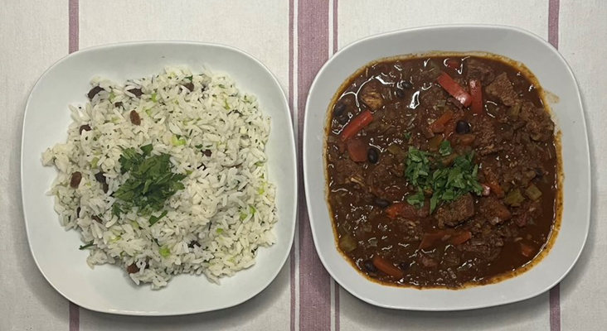
Practical Assignment
62%
Produce a 3 course meal for 4 people in 2 hours 30 minutes.
2023: Practical Assignment
Three Cheese Filo Swirls
Brazilian Chicken with Savoury Rice
Courgette and Lemon Bar Cake.

Slide 4
Assignment
13%
Section 1: Time plan
Section 2: Equipment Requisition
Section 3: Service Details

Slide 5
Date of Practical Exam and Assignment
Both will be completed internally before the Easter holidays.
SQA release recipes for the exam in January.
Practical Exam will be in my kitchen, pupils will work at the station they are familiar with.
Assignment will be completed in a computer suite.

Slide 6
Question Paper
25%
There are five types of questions.
List
1. These words indicate a shorter answer is required.
Name
Identify
2. Describe
These words indicate a longer answer is needed.
3. Explain
4. Calculate
5. Evaluate

Slide 7
January Prelim
This will be based on the written paper only.
Pupils should ensure they are completing past paper questions in preparation for this.
Mind maps can be an effective form of revision also.
Pupils will be given targeted areas to revise which I will post on TEAMS nearer the time.

Slide 8
Supporting your child
Encourage them to cook at home and help prepare meals.
Ensure they are completing their homework and encourage them to ask me if they are unsure.
Complete past paper questions as revision
Access TEAMS where I put past paper questions/PowerPoints and Homework tasks.
WEST OS: https://online.clickview.co.uk/libraries/categories/36254448/practical-cookery?sort=productionyear

