Slide 1
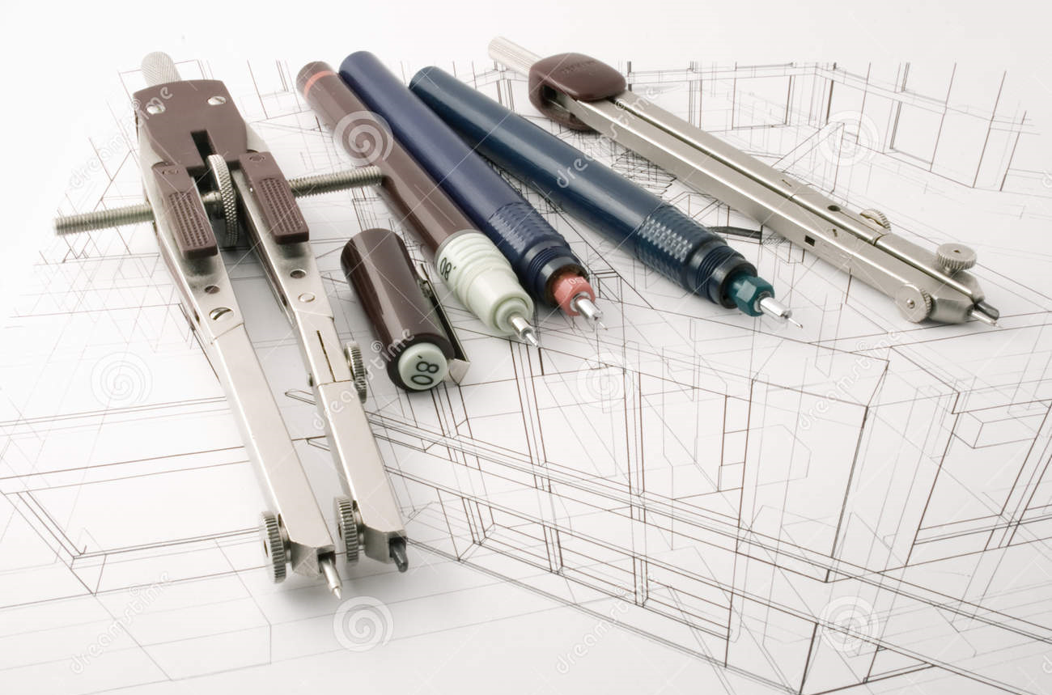
Graphic Communication
Higher - How To Pass Evening

Slide 2
Higher- Units
Units | Time Allocation*
2D Graphic Communication | 60hours
3D and Pictorial Graphic Communication | 60hours
Assignment (50marks) | 8Hours
Final Exam (90marks) | 2hours 30mins
* All work must be completed within this allocated time.

Slide 3
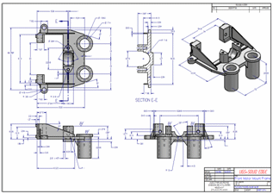
Higher- Learning Outcomes
2D Graphic Communication
Produce and interpret 2D orthographic sketches1 and drawings
Produce 2D computer-aided designed production drawings
Produce preliminary 2D designs and illustrations for a multi-page promotional document
Create a multi-page 2D promotional publication and a project set of promotional publications

Slide 4
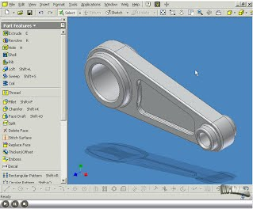
Higher – Learning Outcomes
3D and Pictorial Graphic Communication
Produce and interpret pictorial sketches1 and drawings
Produce 3D computer-aided designed models and associated production drawings
Produce pictorial and 3D illustrations of everyday objects
Plan and produce promotional publications incorporating pictorial and/or 3D models

Slide 5
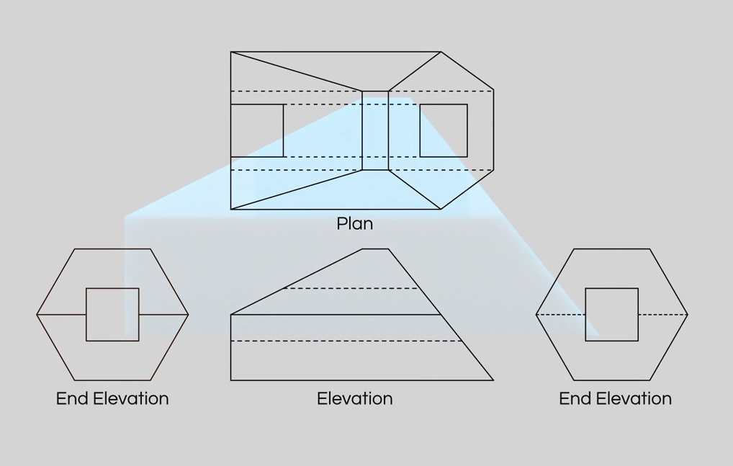
Coursework Orthographic Drawing

Slide 6
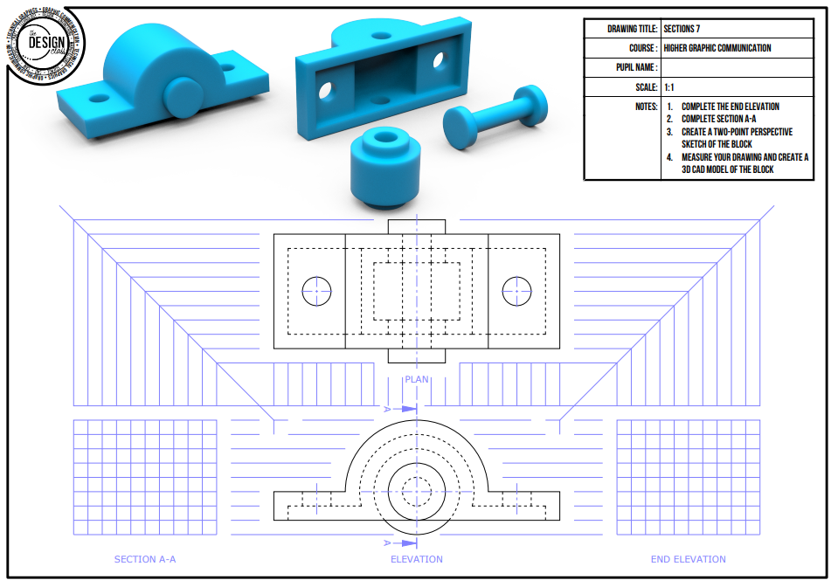
Coursework

Slide 7
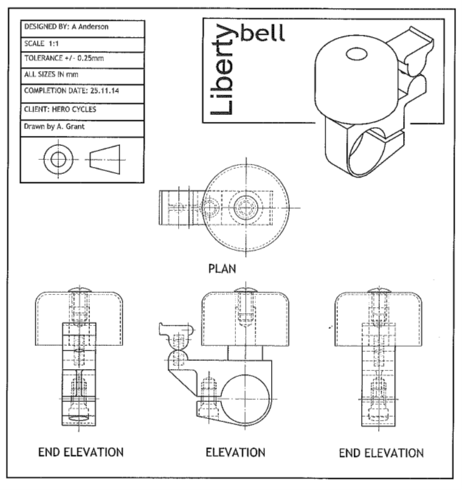
Coursework

Slide 8
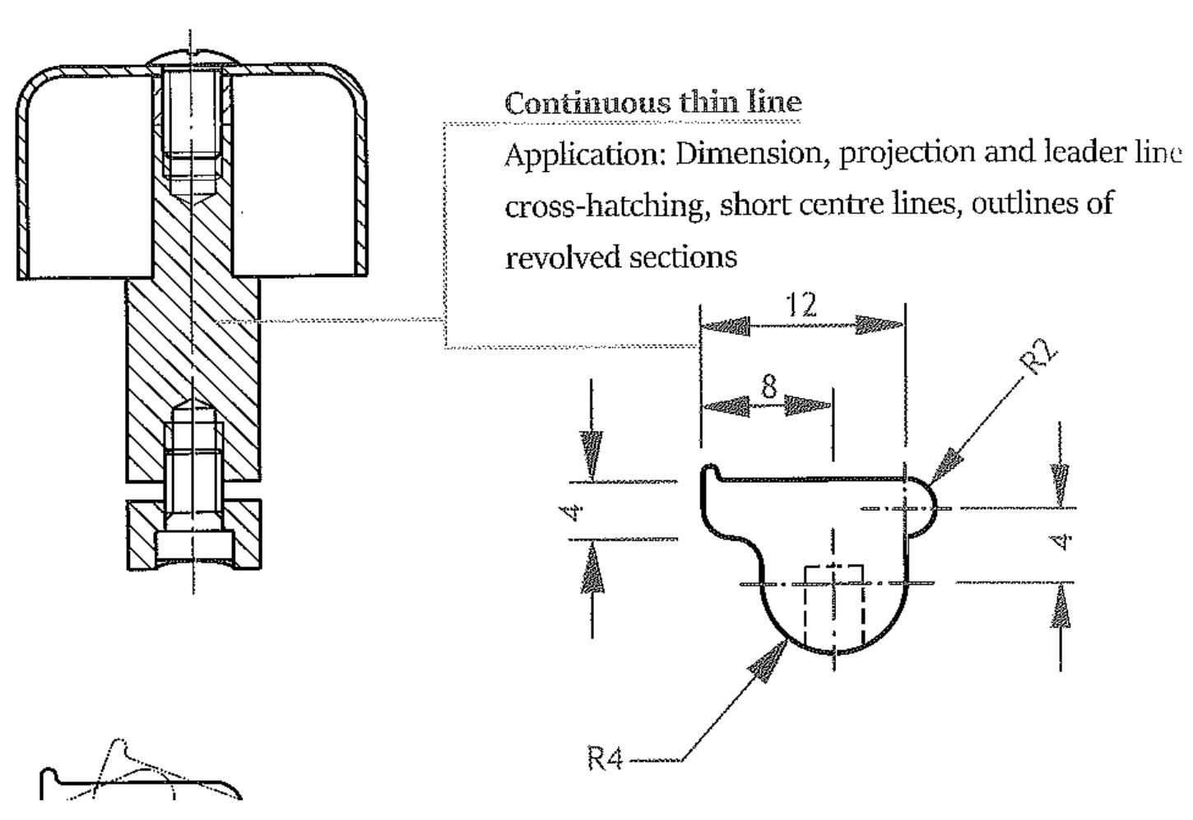
Coursework

Slide 9
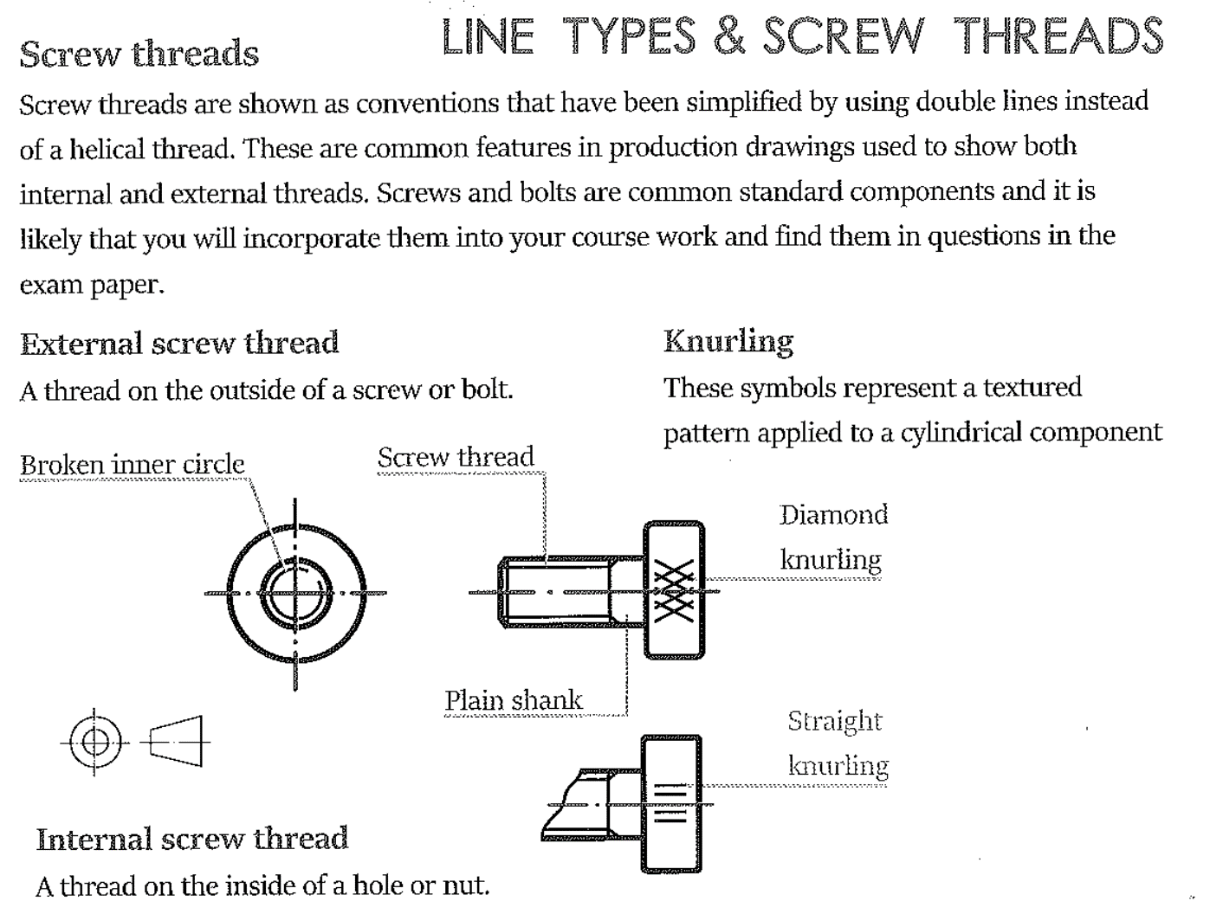
Coursework

Slide 10
Coursework

Slide 11
Coursework

Slide 12
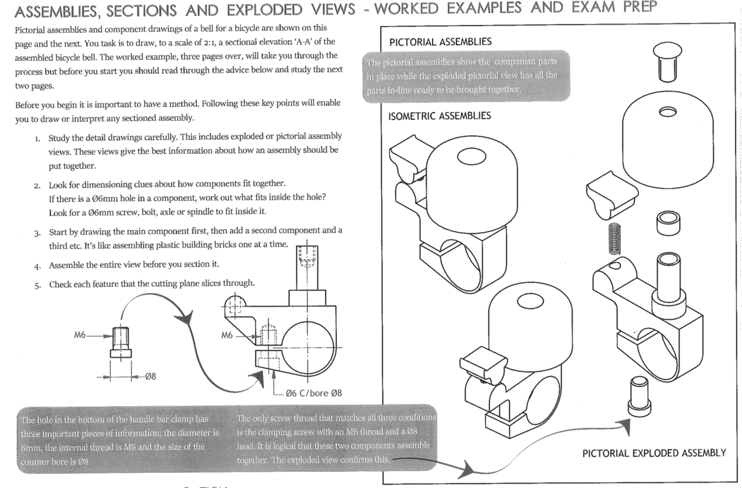
Coursework

Slide 13
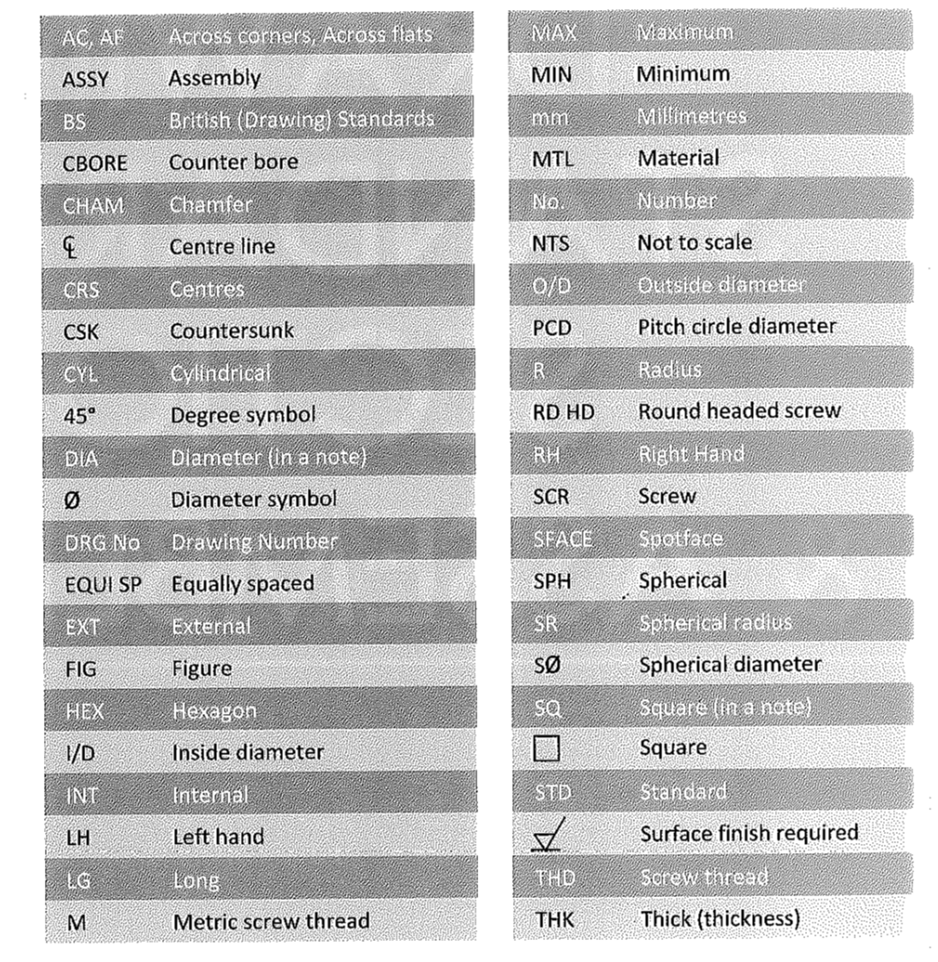
Coursework Drawing Terminology

Slide 14
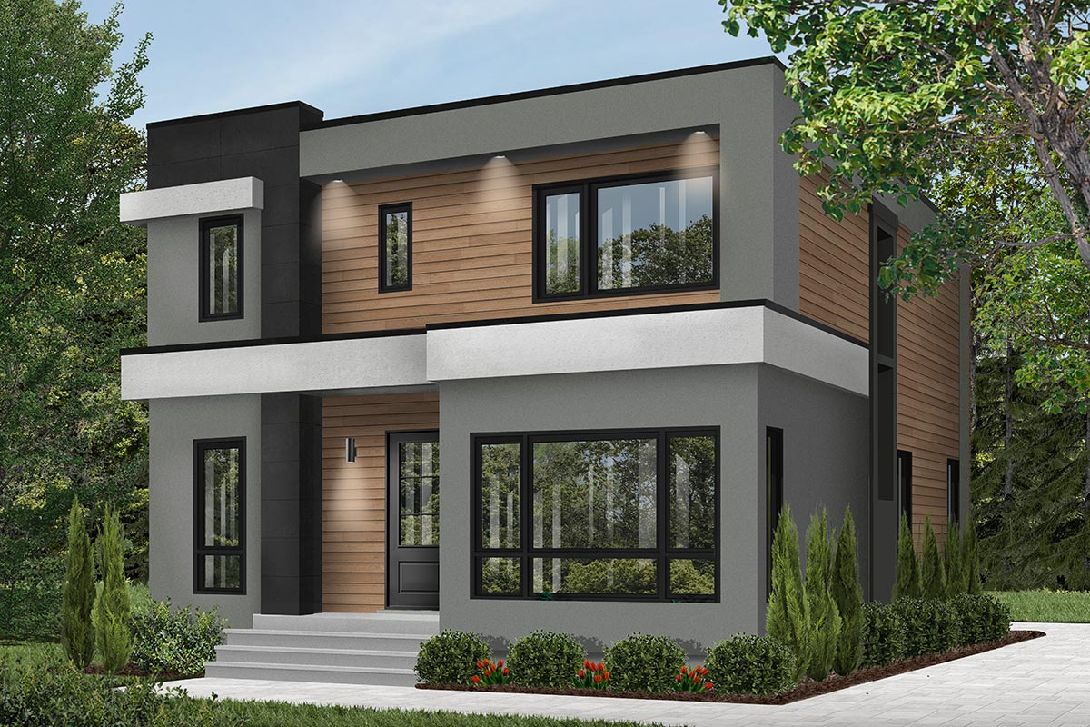
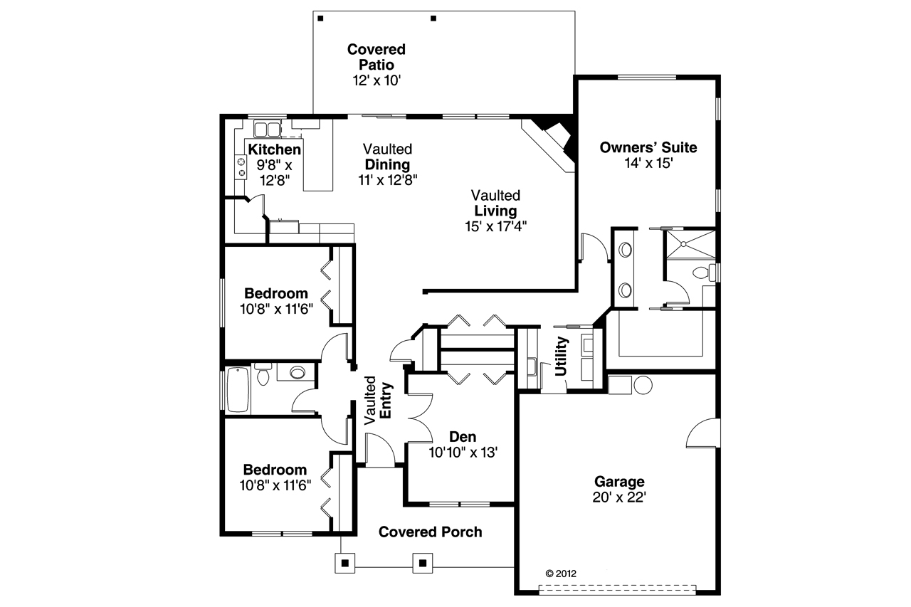
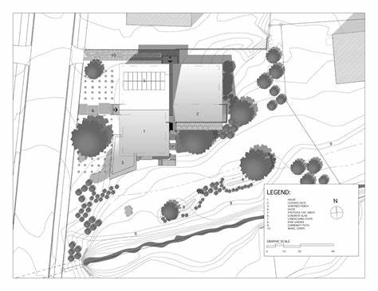
Coursework Building Drawings

Slide 15
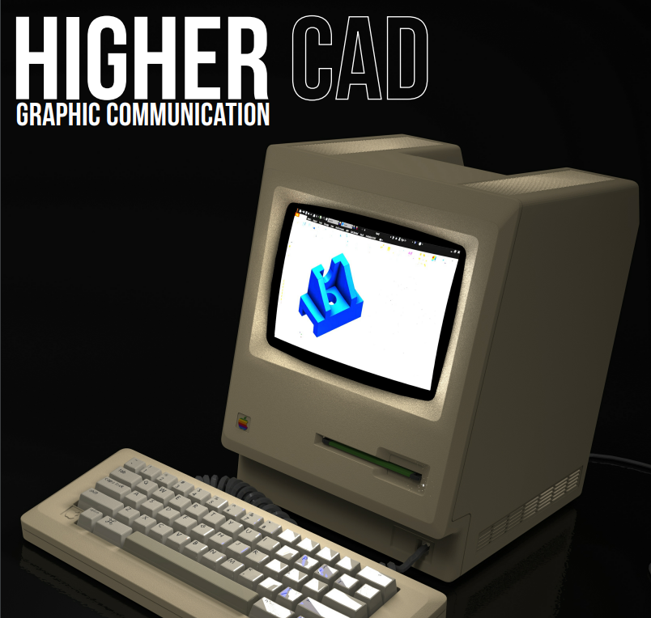
Coursework CAD

Slide 16
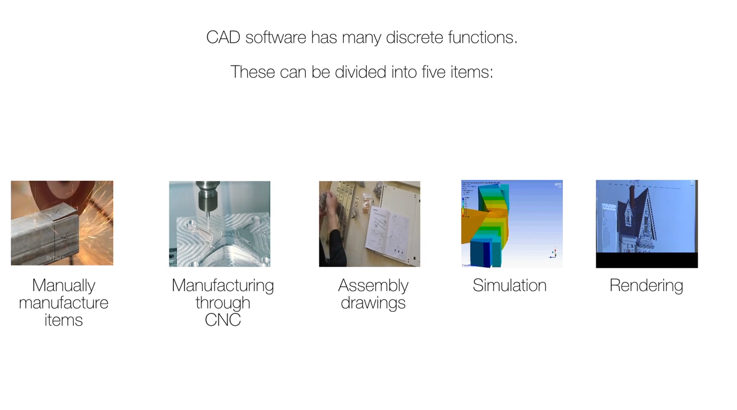
Coursework CAD CAM

Slide 17
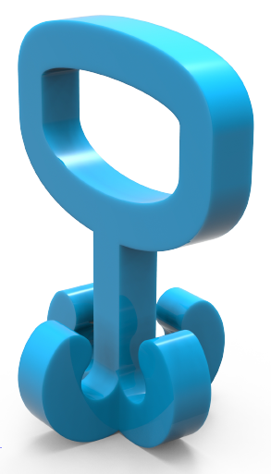
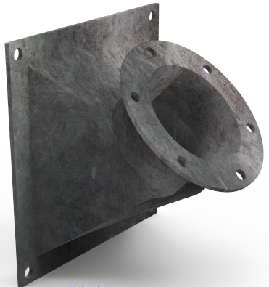
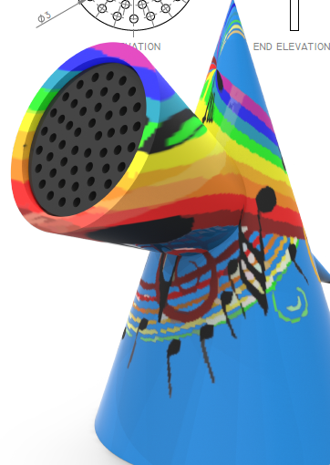
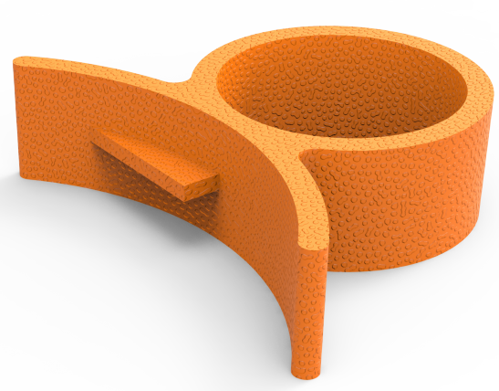
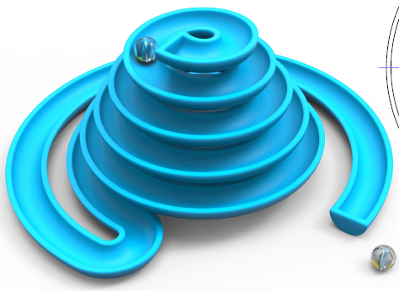
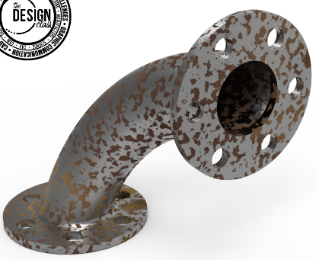
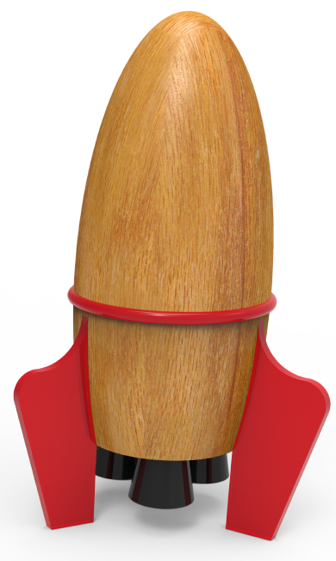
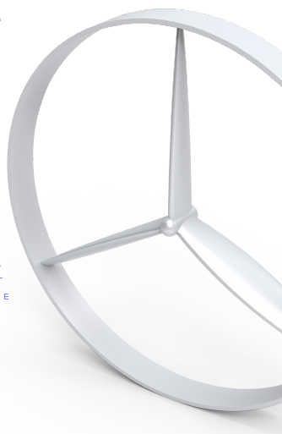
Coursework 3D Modelling

Slide 18

Coursework CAD Drawings

Slide 19
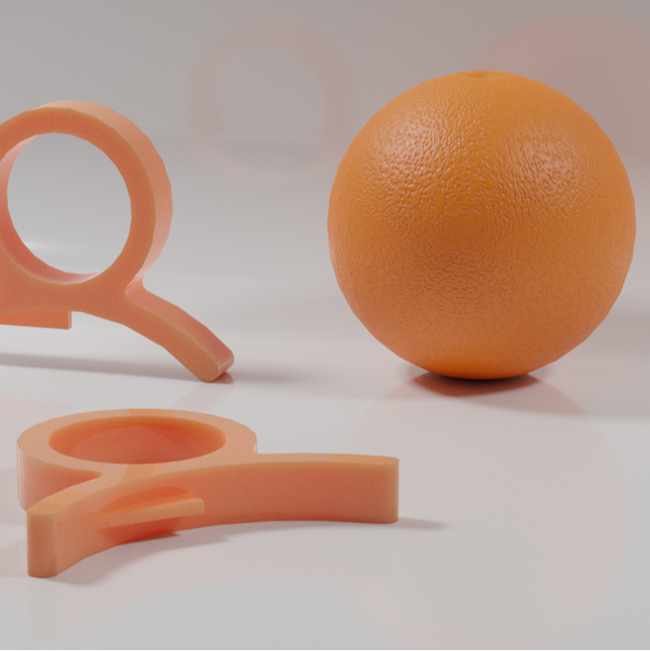
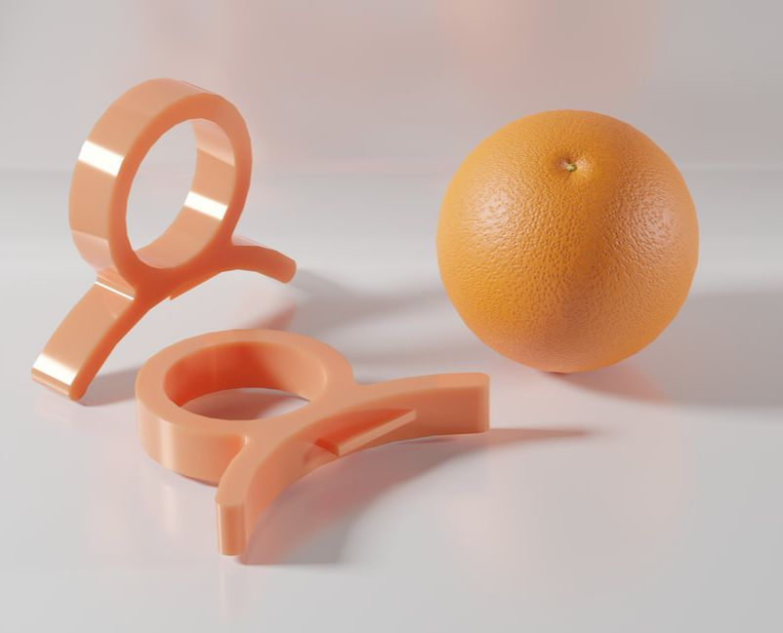
Coursework CAD Illustration

Slide 20
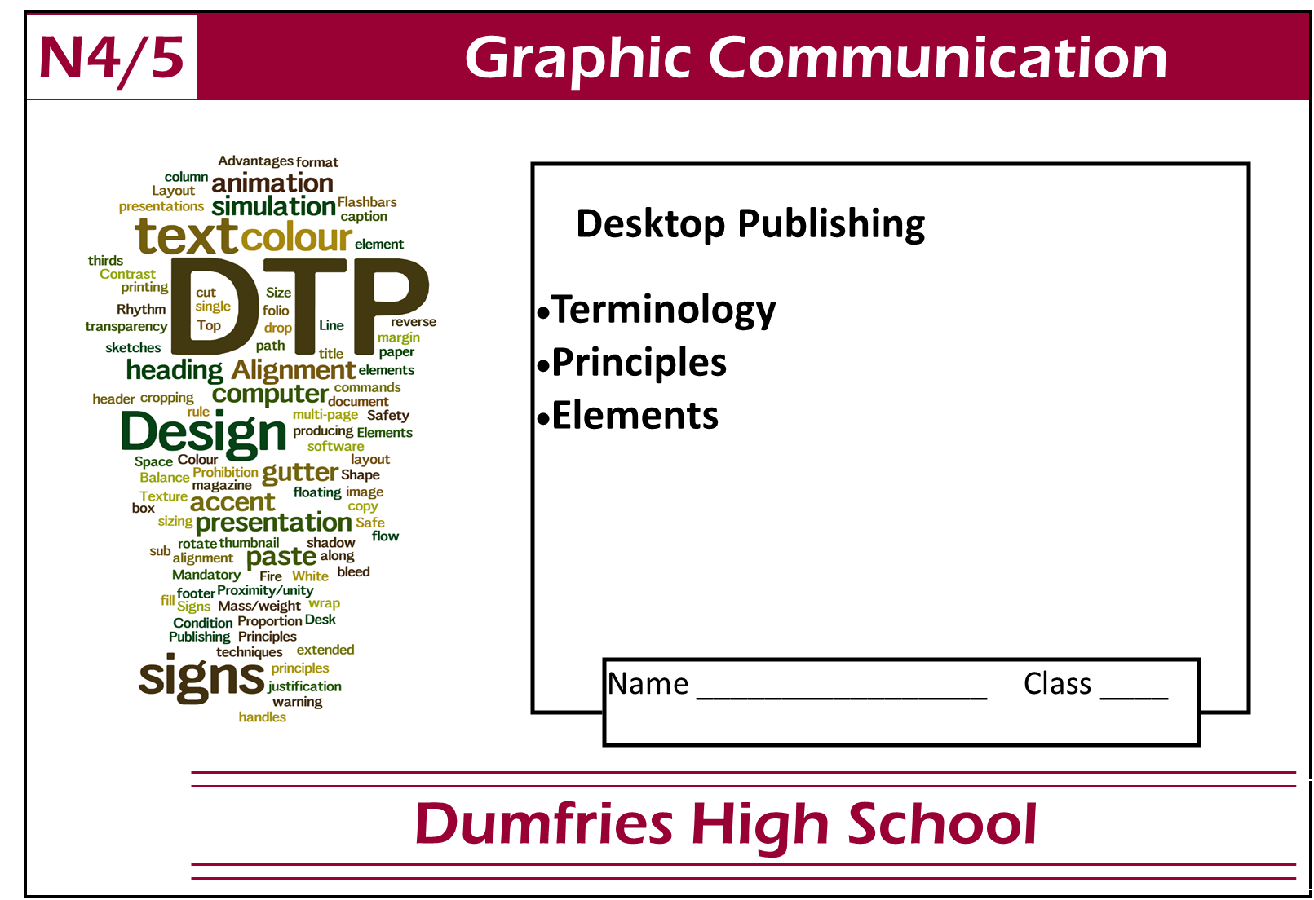
Coursework Graphic Design

Slide 21
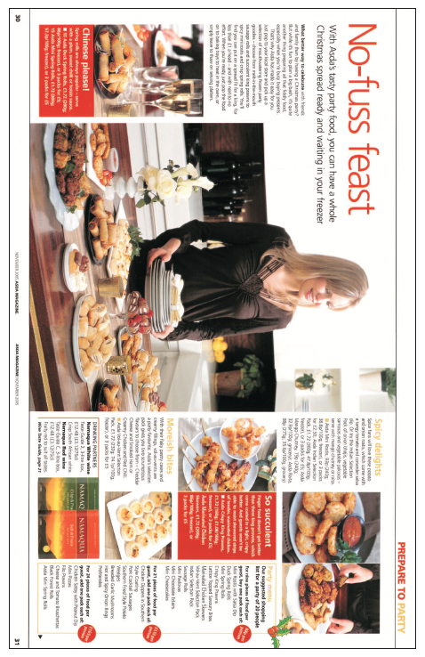
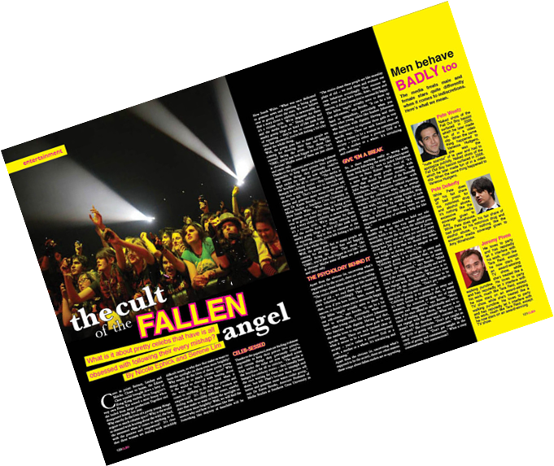
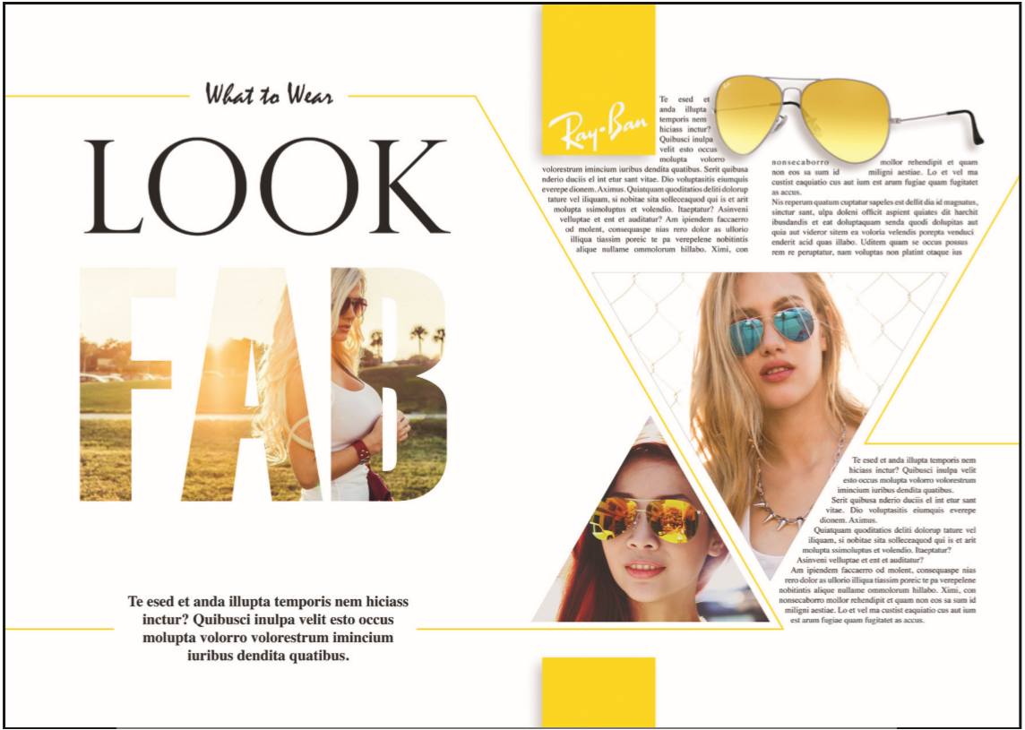
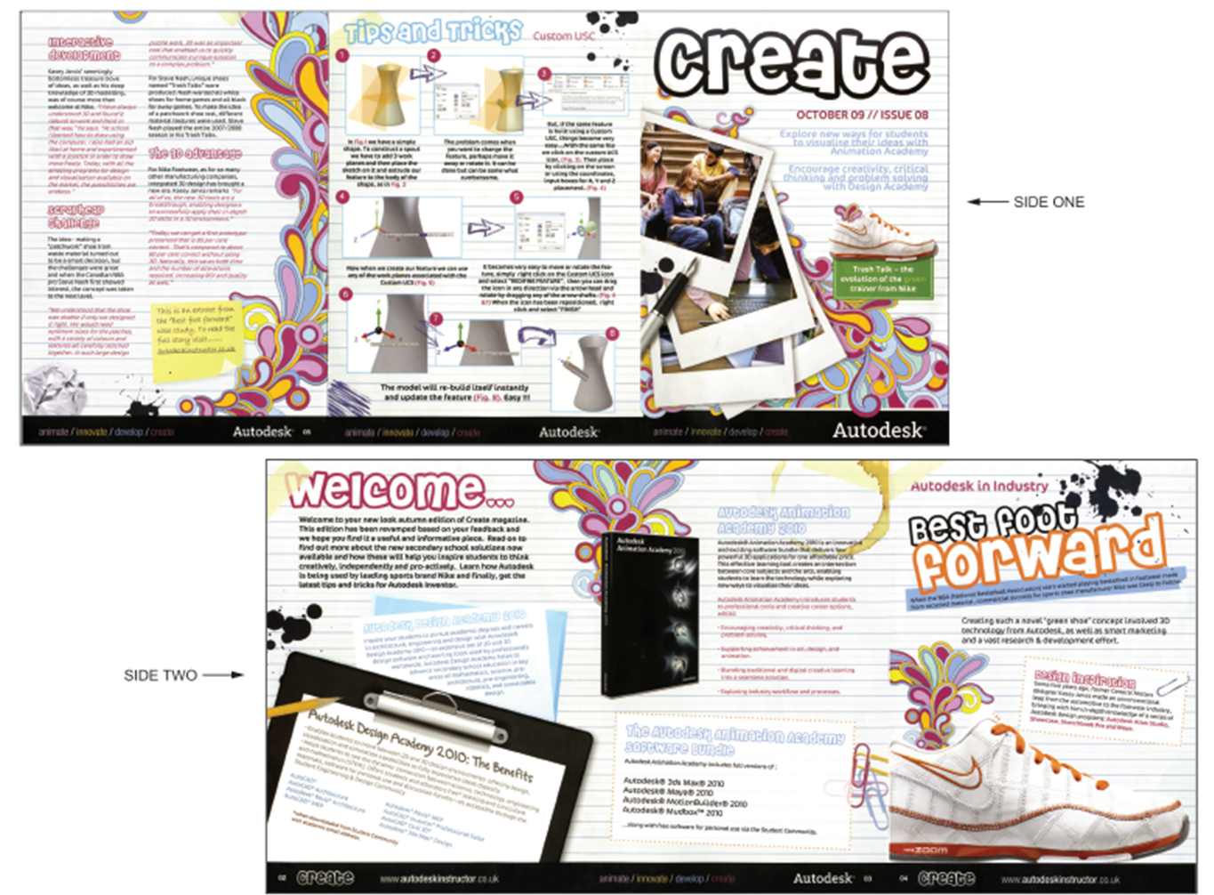
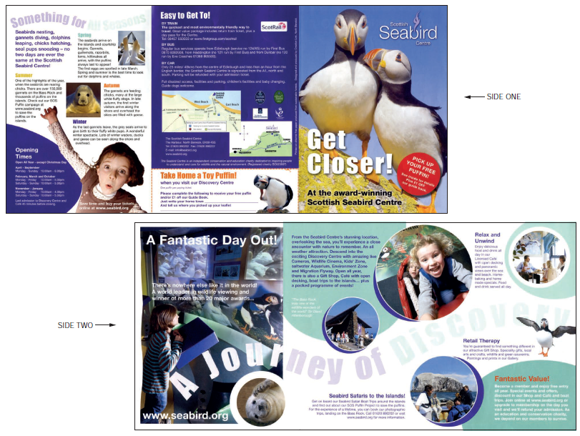
Coursework Graphic Design

Slide 22
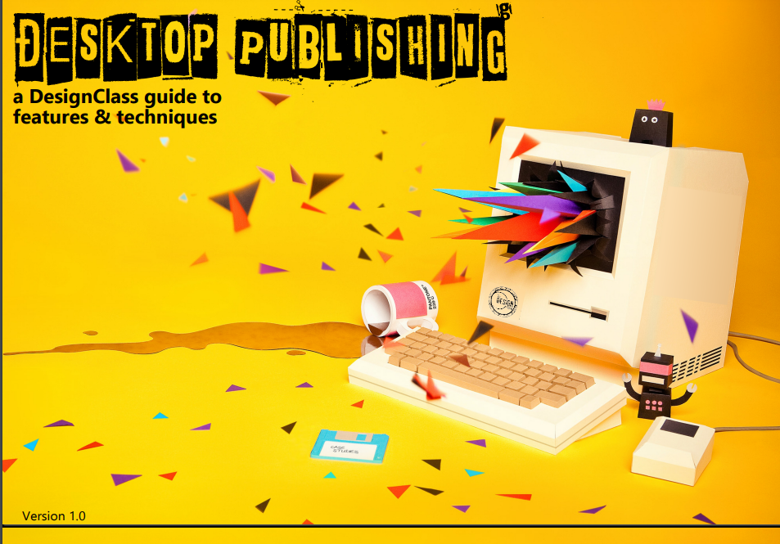
Coursework Graphic Design

Slide 23
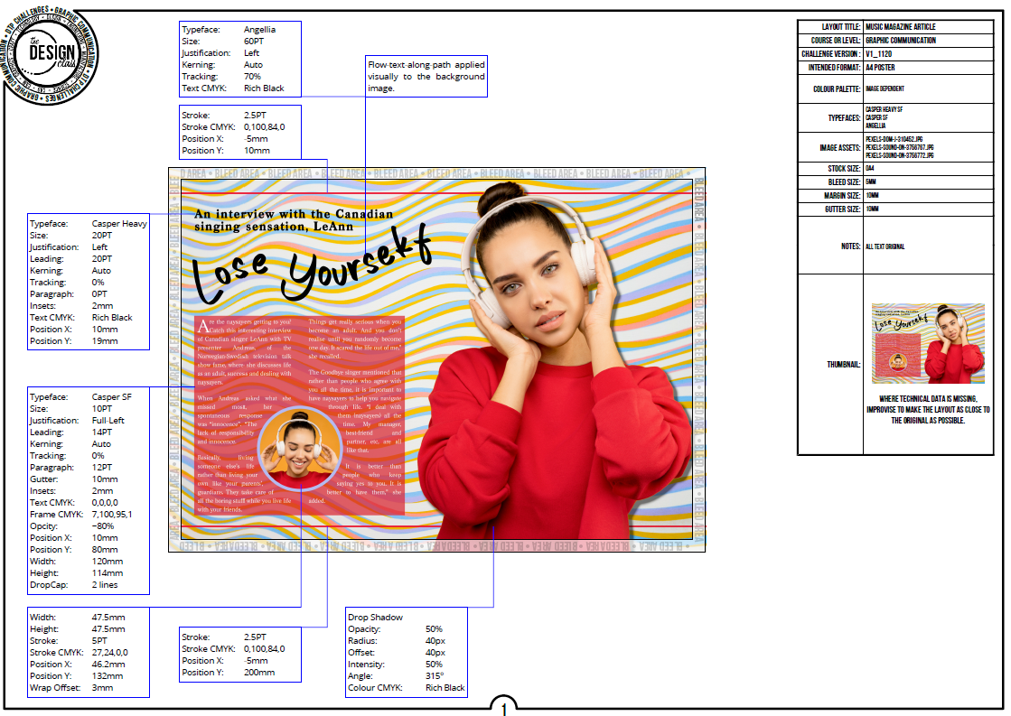
Coursework Graphic Design

Slide 24
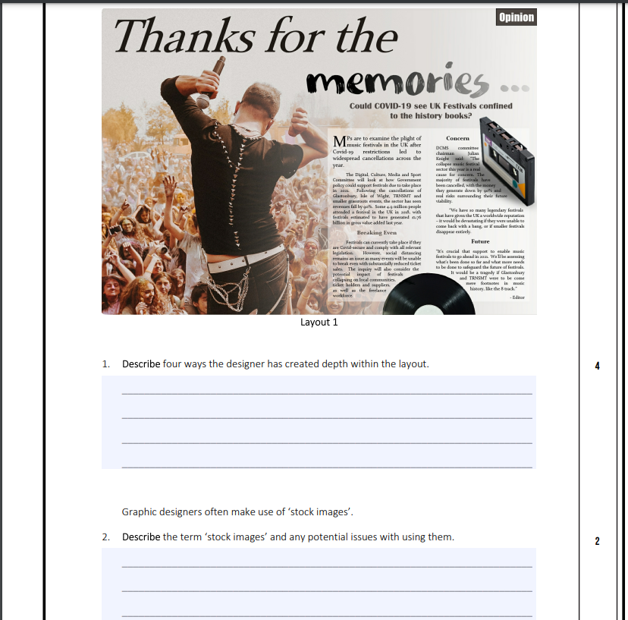
Coursework Graphic Design

Slide 25
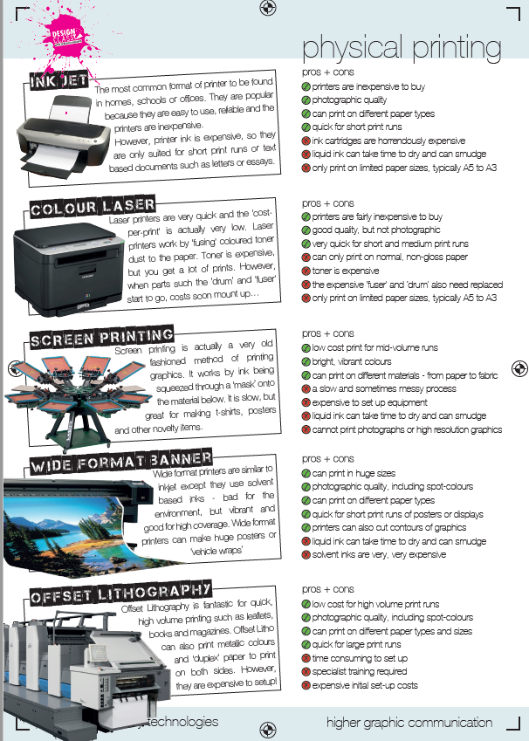
Coursework Graphic Design

Slide 26
Higher– Assignment & Exam
Assignment 50marks (Feb till Mid March)
8 Hours in total, sat under exam conditions.
Assessed externally by the SQA.
Brief set by SQA.
Pupils analyse the brief, and then respond to the tasks asked of them.
Exam 90 marks (May 2024)
Knowledge/ Theory – based exam paper (no technical drawing).

Slide 27
Higher Assignment -
3 sections:
  Production Graphics (Computer 3D Modelling and Drawings)
  Promotional Graphics (DTP and Illustration)
  Manual Graphics (sketching and rendering)

Slide 28
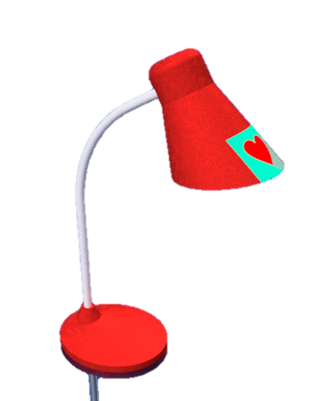
Graphic Communication brief
A new tabletop study lamp is being proposed by the company NRG.
NRG is hoping to attract students and young professionals to purchase their new study lamp. Initial market research has identified that people are looking for a lamp that is inexpensive and brightly coloured.
As part of the graphic proposal, NRG has asked you to create:
production drawings to manufacture the table lamp
a 3D promotional display item, with relevant desktop published graphics for display at point of sale:
— you have a company logo, font and colours, and some copy text for this purpose
— you cannot alter the company name, logo, font, and logo colours
a simple, realistic, illustrated scene of the proposed lamp and promotional display item
You have data sheets to guide you through the assignment.

Slide 29
Task 1: table lamp
A graphic artist has prepared a series of sketches to aid the manufacture of the table lamp.
Using the preliminary sketches and information shown on data sheets 1, 2, 3, 4 and 5, model the lamp components using 3D CAD software.
From these models, produce production drawings based on the lamp shown.
You may use top-down modelling or bottom-up modelling in your work.
1a Produce a sectional elevation, a plan and an end elevation of the base (part 1) and the shade (part 3).
Your drawings must be complete with hidden detail, appropriate dimensions for manufacture, annotations and to a suitable scale. (6 marks)
1b Produce a sectional elevation and an end elevation of the assembled lamp, to a suitable scale. Include a nut, washer, and machine screws in these views.
Your drawings should include detail views to show assembly:
at the base of the lamp — how parts 1, 2 and 3 fit together
◻ at the lampshade — how parts 2, 3 and 4 fit together (8 marks)
1c Produce an exploded isometric view of the assembled lamp. Include the nut, washer, and machine screws in this view. (3 marks)
1d Include correct British Standard conventions and line types on all of your drawings.
(3 marks)

Slide 30
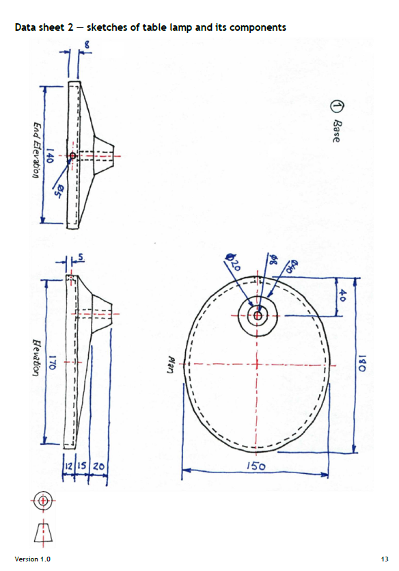
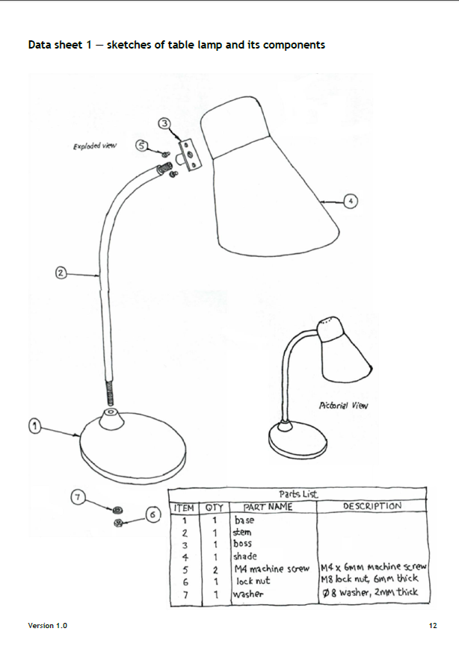
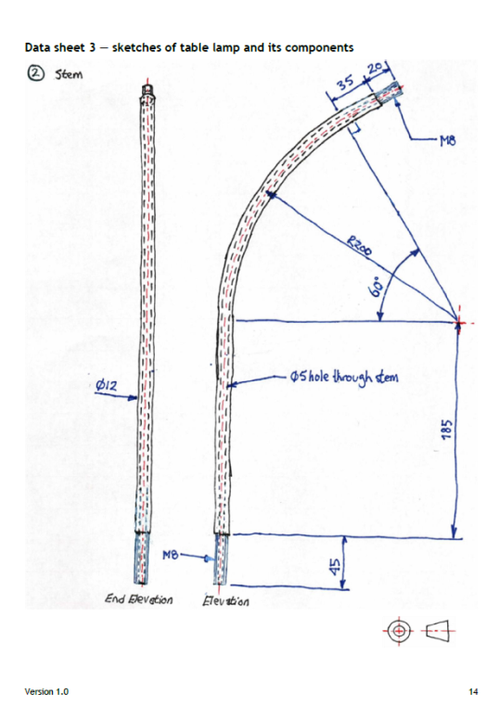
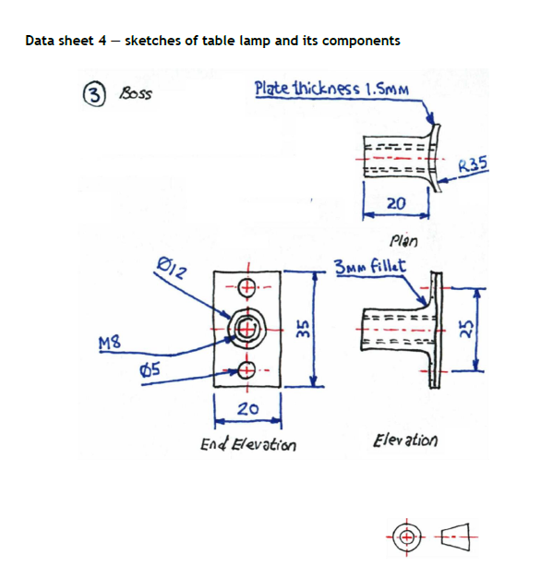
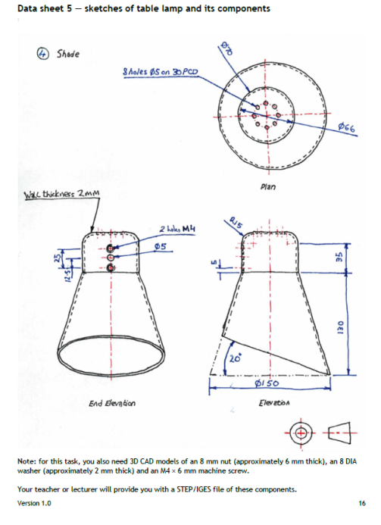

Slide 31
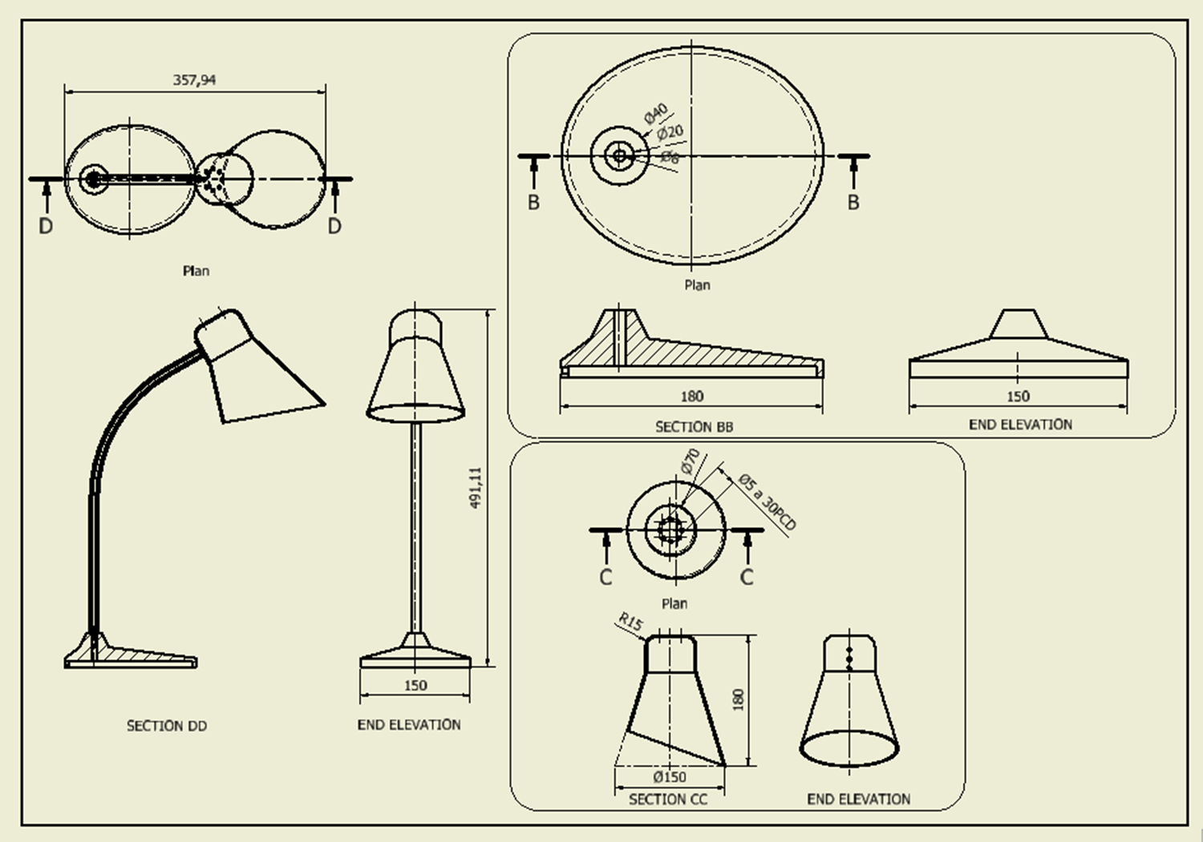

Slide 32
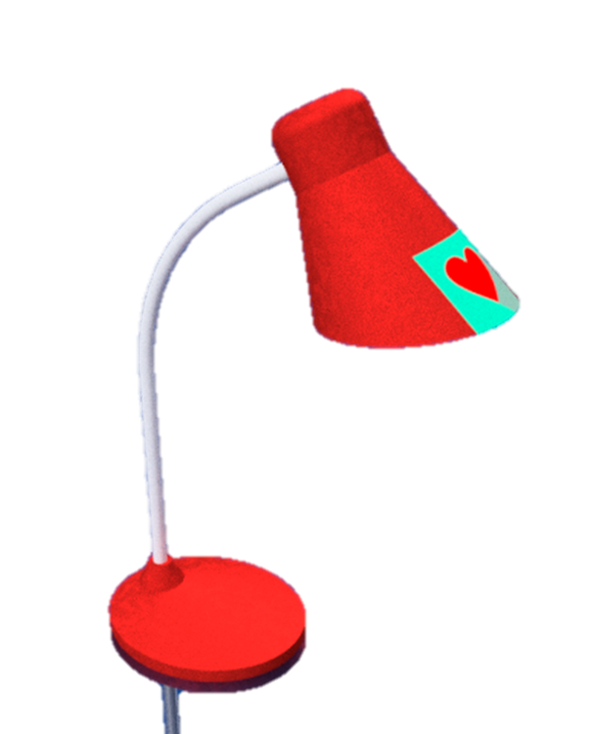
Task 2: table lamp and promotional display item
NRG is hoping to attract students and young professionals to purchase their new study lamp. Initial market research has identified that people are looking for a lamp that is:
brightly coloured
has memorable branding and a positive product identity
Produce preliminary and promotional
graphics for the lamp, using the information
on data sheets 6, 7 and 8, and the
following instructions.

Slide 33
2a Using the assembled table lamp you created in task 1, produce and print off a 3D CAD rendered pictorial illustration of your lamp.
Your lamp must:
be complete with appropriate colours, materials, highlights, shadows, reflections and textures
have the logo from data sheet 6 attached to at least one component part (4 marks)
2b Produce two preliminary layouts/thumbnails of a trifold table talker, using data sheets 6, 7 and 8.
Your layouts/thumbnails must include:
the design principles of rhythm and emphasis
the assembled lamp from task 1
the company name, logo, colours and copy
at least one image from data sheet 7
You must label, annotate and justify where you
have used rhythm and emphasis in your
layouts/thumbnails.
You can add any other graphic items you wish, however you must create them within the 8 hours of this assignment.
You can use the images on data sheet 7 as they are, or you can edit them to suit your design. (7 marks)

Slide 34
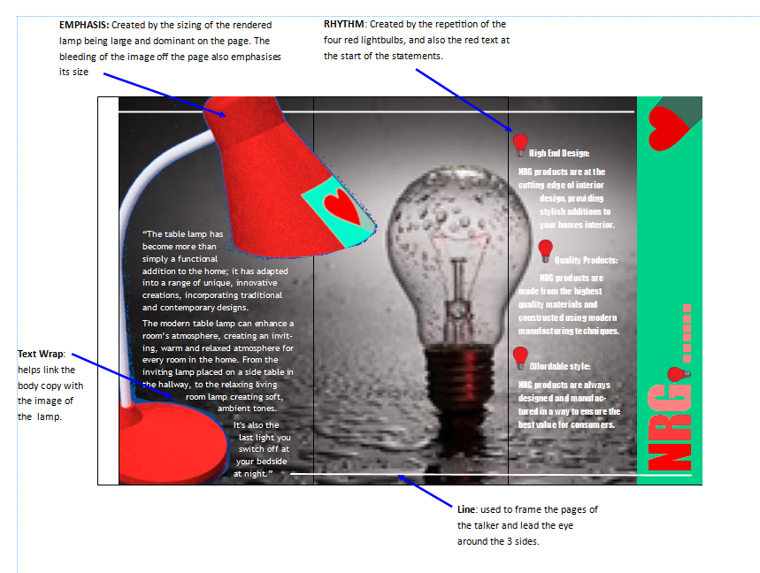
2c Produce and print off a full-size version of your trifold table talker chosen from your preliminary layouts/thumbnails.
This must be complete with the assembled lamp, company name, logo, copy text and your chosen image(s).
You must use:
the design features given on data sheet 6 — company name, font style, logo, colour scheme and copy text
at least one image from data sheet 7
your lamp
the sizes shown on data sheet 8
Label your printout to identify where
you have used rhythm and emphasis.
(10 marks)

Slide 35
Task 3: table lamp scene
3a Sketch a 2-point perspective view of a simple scene.
Your view should include two walls and a flat surface, a counter or a tabletop that displays and includes your assembled table lamp and the trifold table talker. (3 marks)
3b Using the table lamp you created in task 2a and the trifold table talker you created in task 2c, produce a promotional 3D CAD rendered pictorial illustration of your simple scene.
Your illustration should include:
the lamp and table talker placed in a suitable simple scene, based on your sketches from task 3a
two walls and a flat surface, a counter or a tabletop with appropriate materials attached to them
appropriate colours, materials, highlights, shadows and textures
(6 marks)

Slide 36
Prelim Jan
The prelim covers most of the Theory of the course.
Pupils will be given a study checklist of all topic areas and knowledge they should know and can be asked about in the exam.

Slide 37
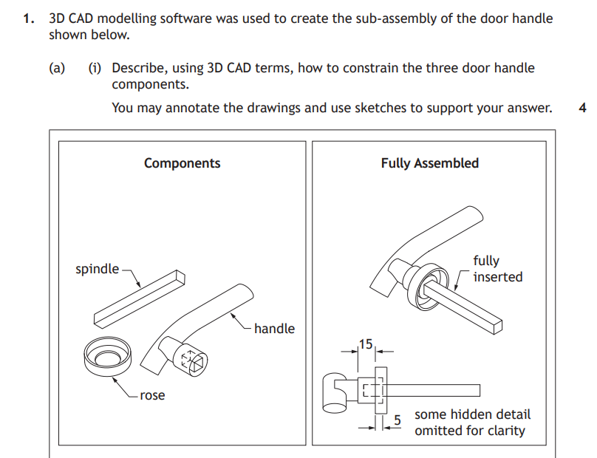

Slide 38
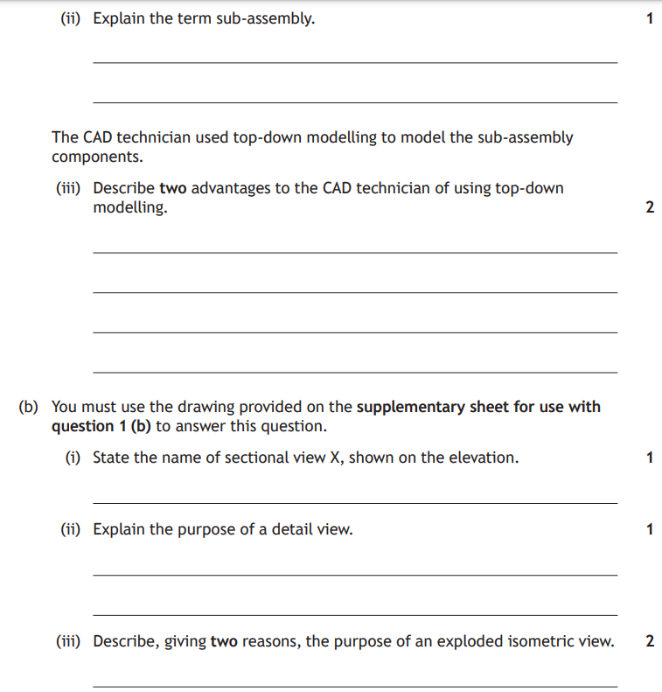

Slide 39
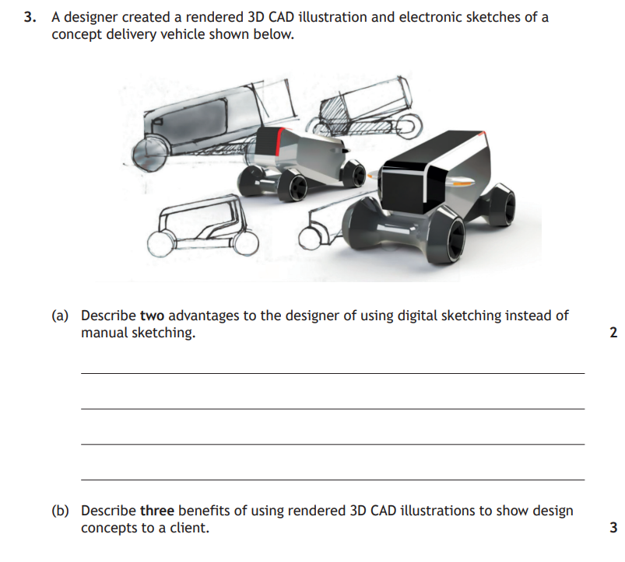

Slide 40
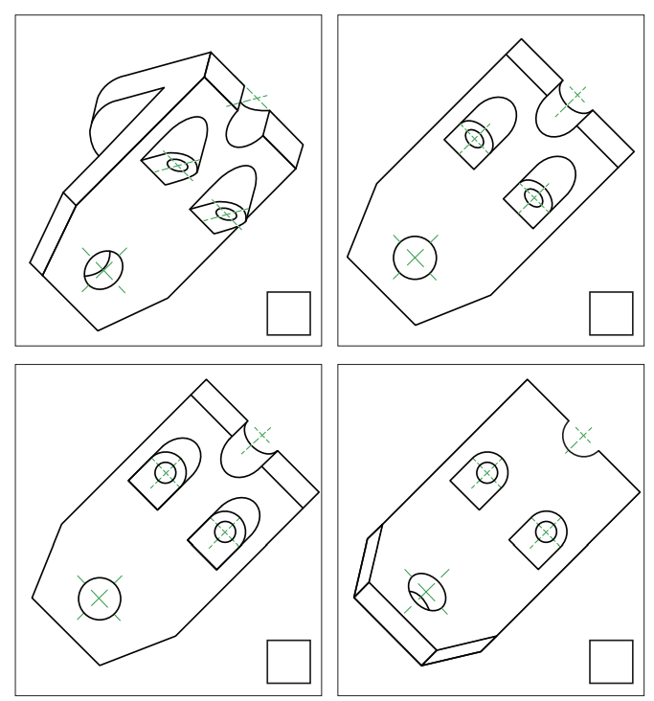
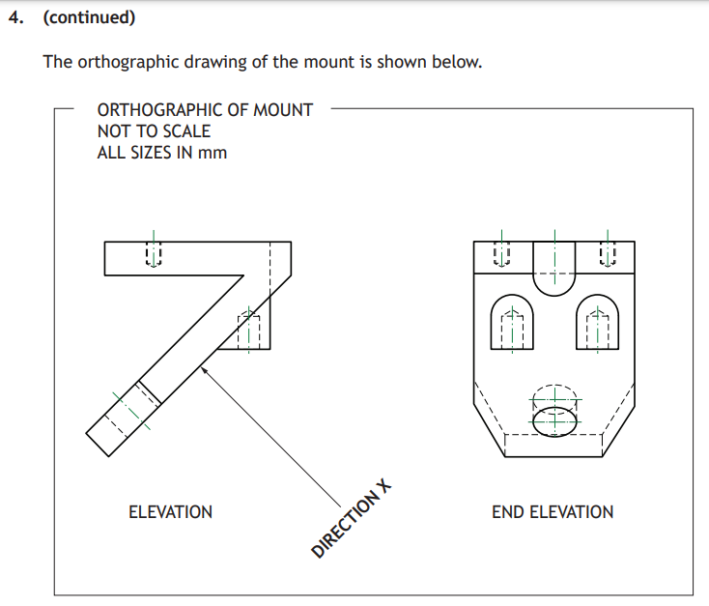

Slide 41
What you as parents/guardians can do to help…… a summary!
Ensure any homework/revision is done using the checklist in their folder.
Read pupils notes and ask them questions about the various terms/words/topics.
Get pupils to make flash cards of topics and information. Then test them on the flash cards.
Whenever you see a graphic in a magazine or newspaper etc., ask your child to explain what the various bits that make it up are and what their job is or how and why the designer used them.
Regularly discuss what they have done in class and ask them questions about it.
www.designclass.co.uk

