Slide 1
How to pass…
National 5
Art and Design

Slide 2
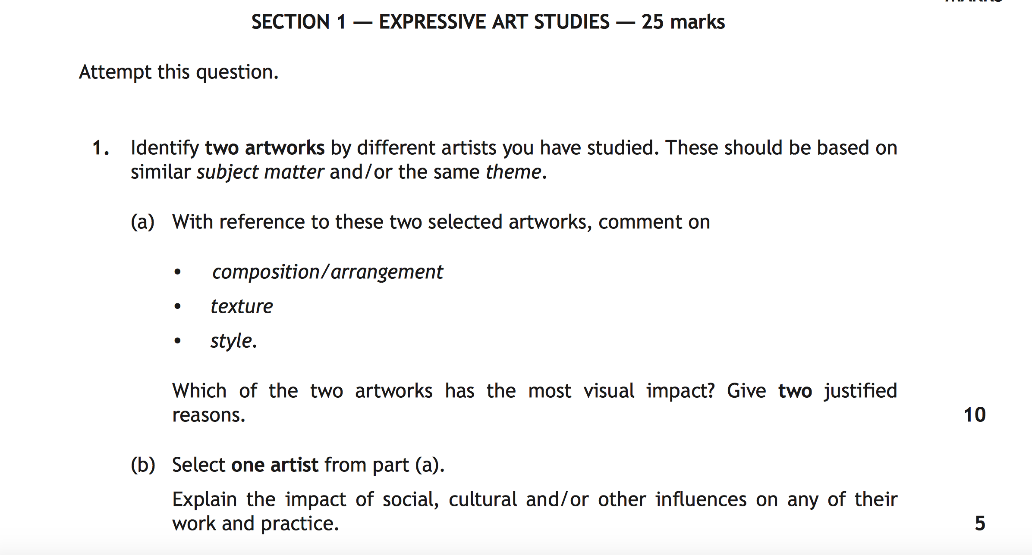
Mandatory Question
Expressive

Slide 3
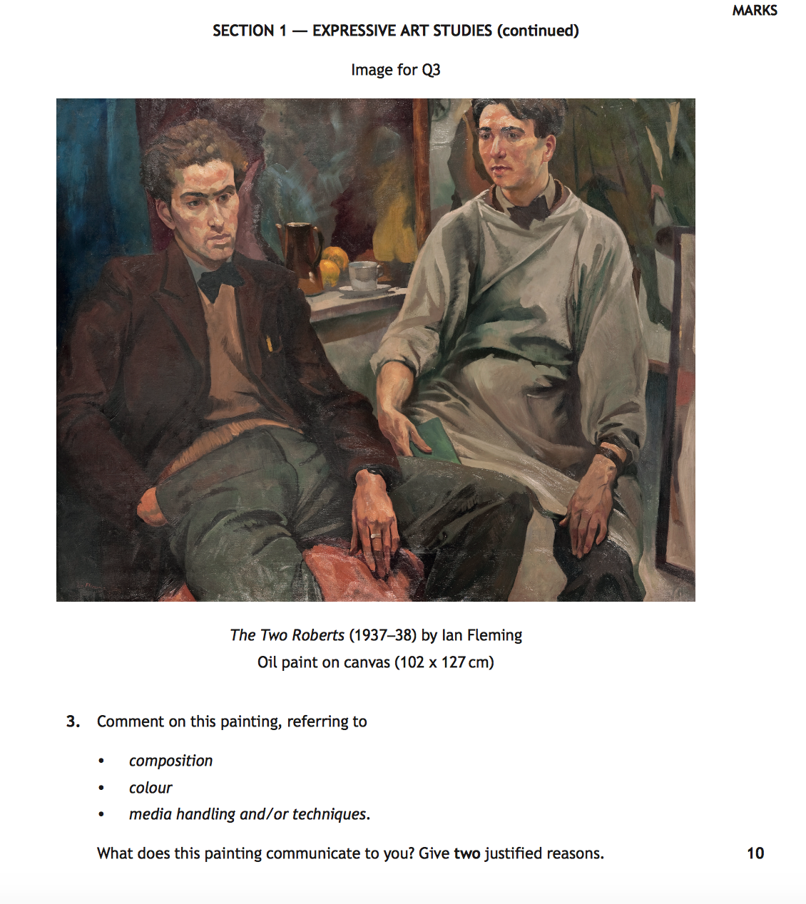
Unseen
Question
Expressive

Slide 4
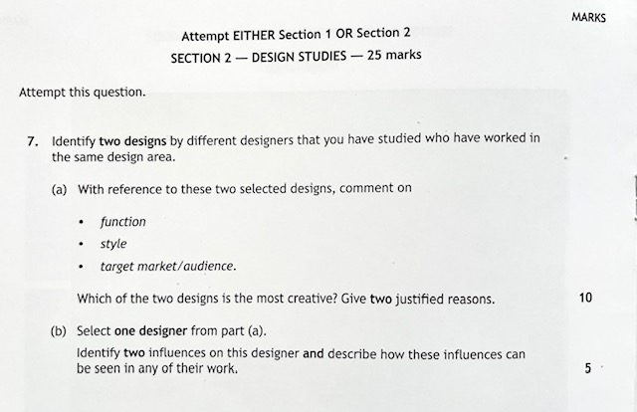
Mandatory Question
Design

Slide 5
Unseen
Question
Design

Slide 6
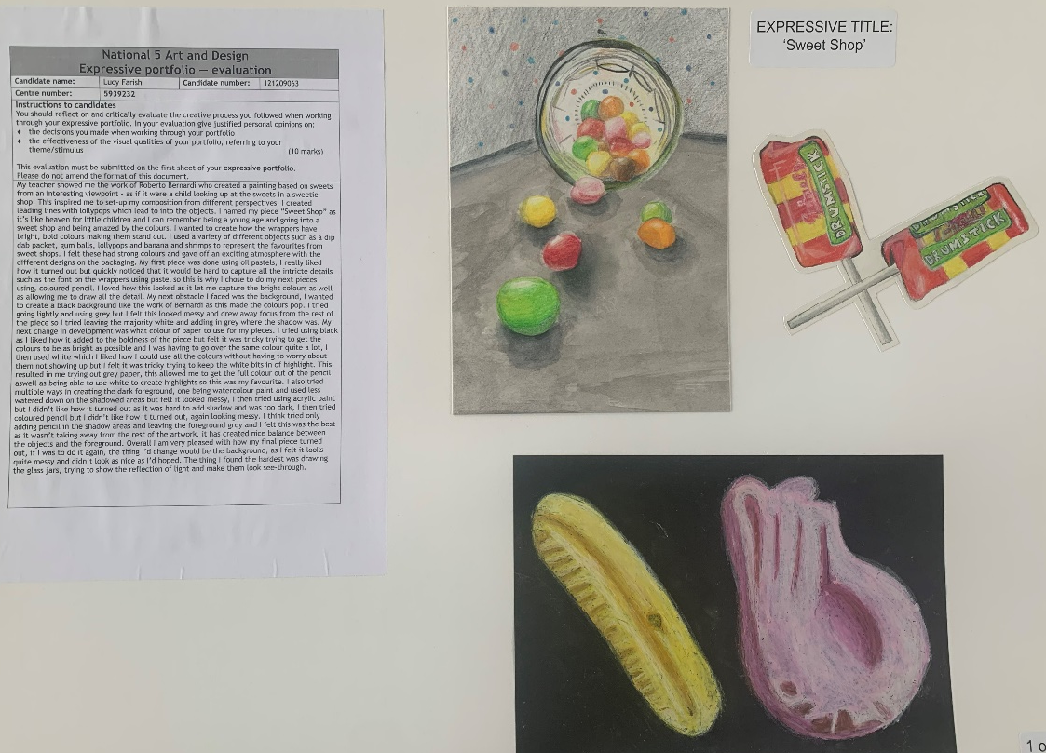
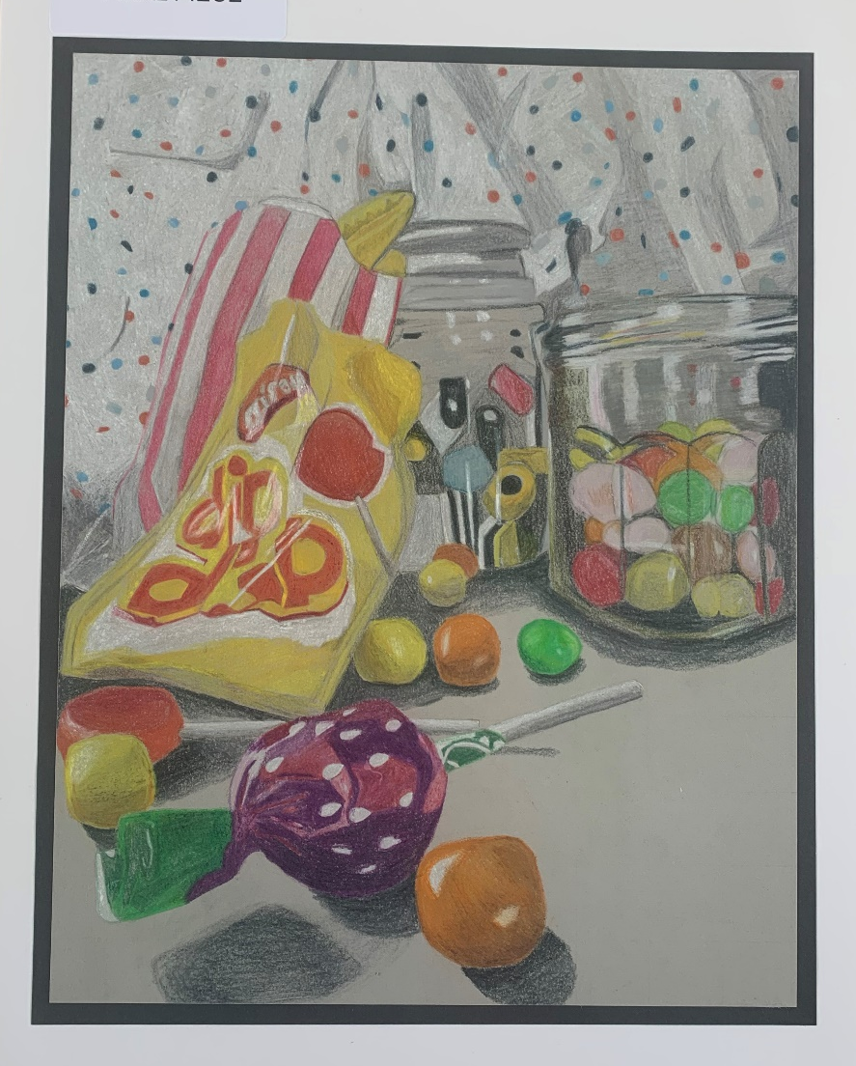
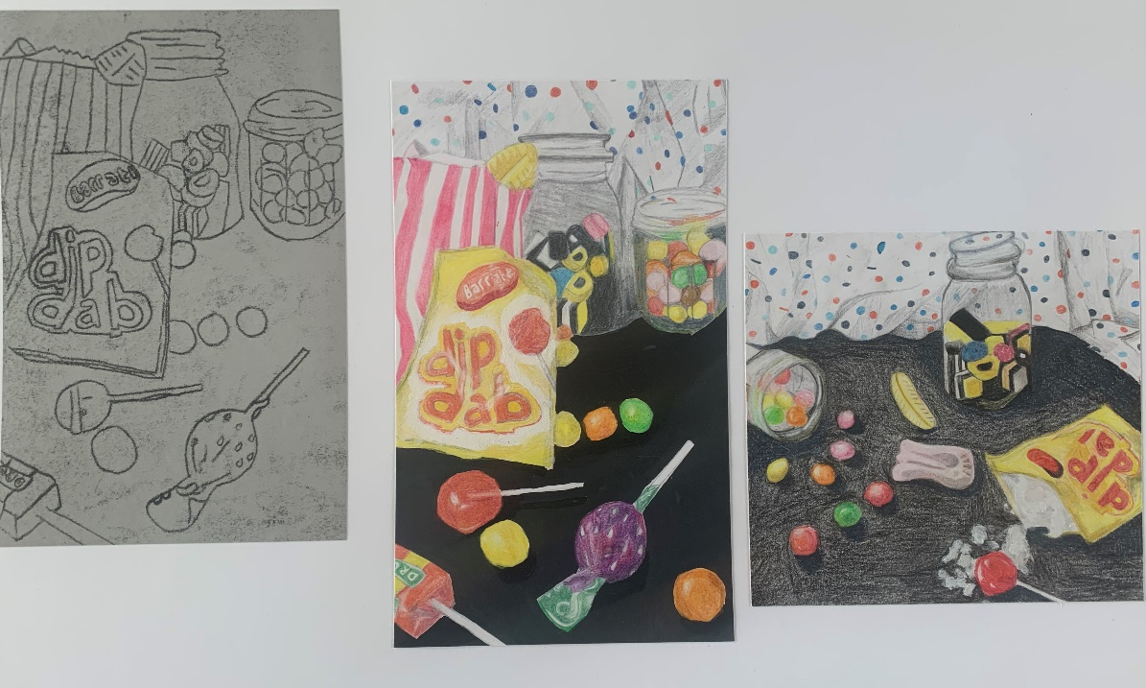
N5 'A' PASS
Investigation
Final Piece
Development

Slide 7
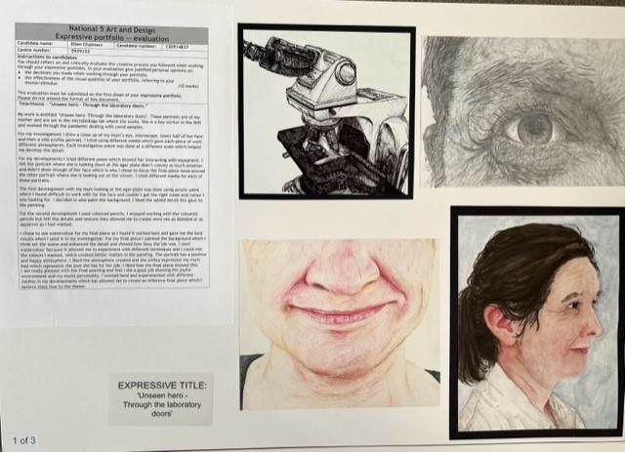
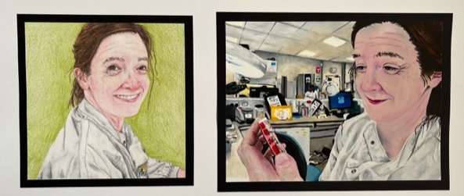
N5 'A' PASS
Investigation
Development
Final Piece

Slide 8
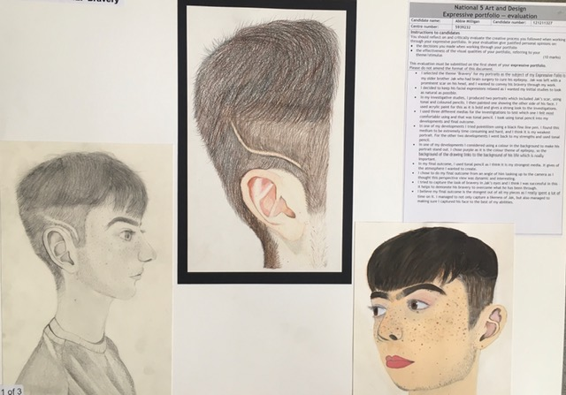
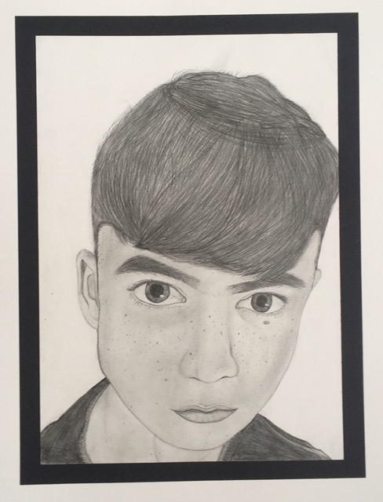
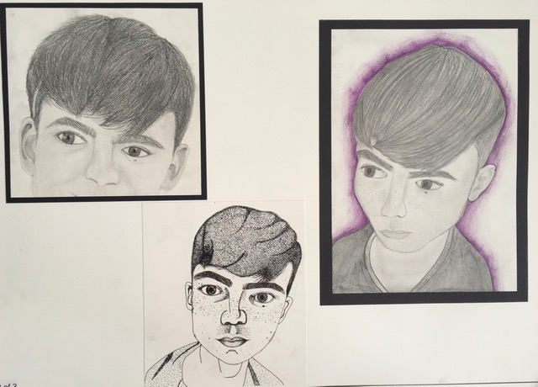
N5 ‘B' PASS
Investigation
Final Piece
Development

Slide 9
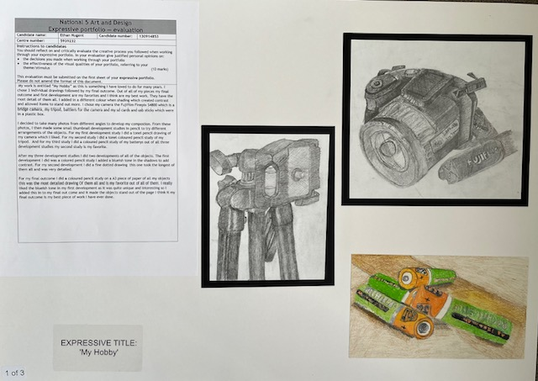
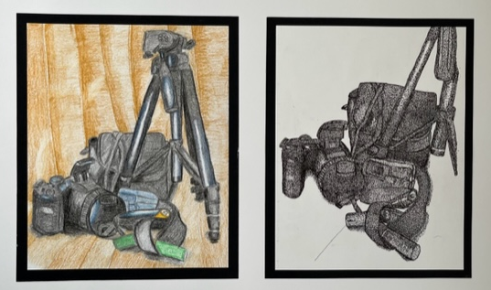
N5 ‘B' PASS
Investigation
Final Piece
Development

Slide 10
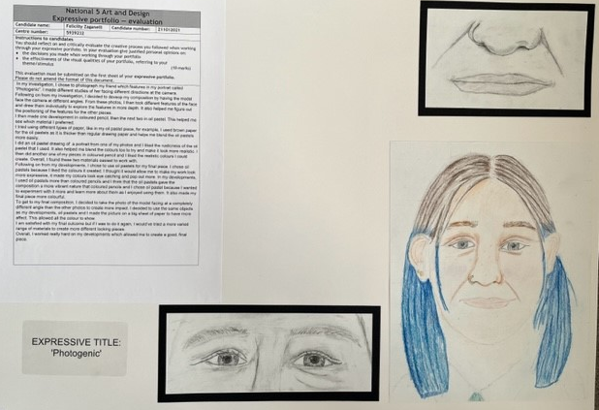
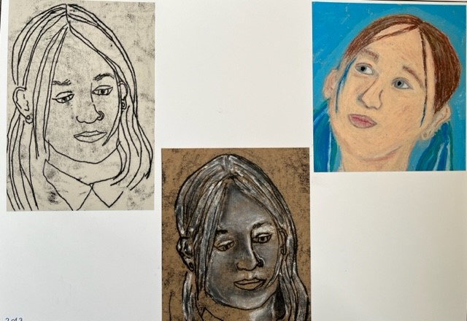
N5 ‘C' PASS
Investigation
Development
Final Piece

Slide 11
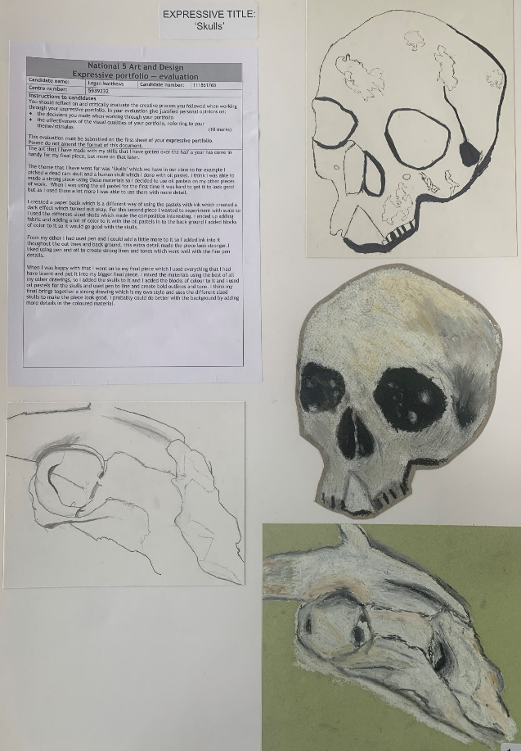
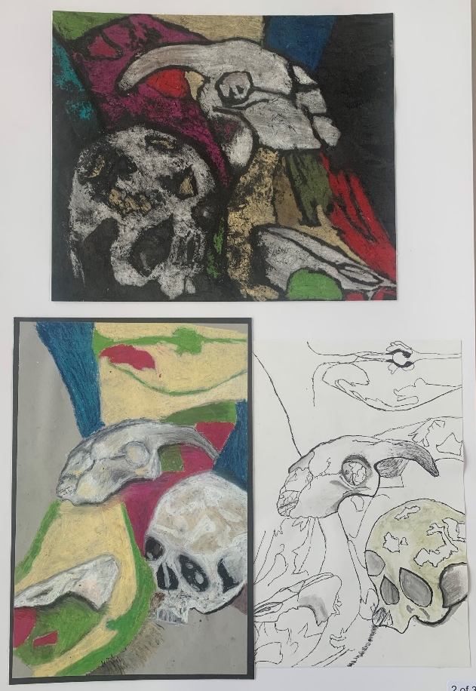
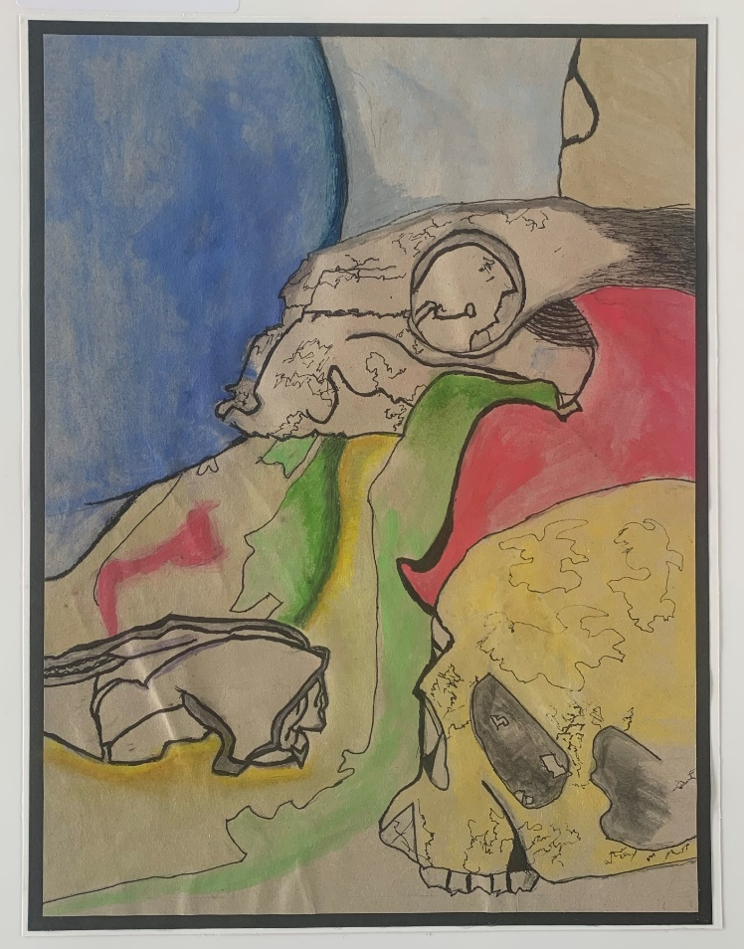
N5 ‘C' PASS
Investigation
Development
Final Piece

Slide 12
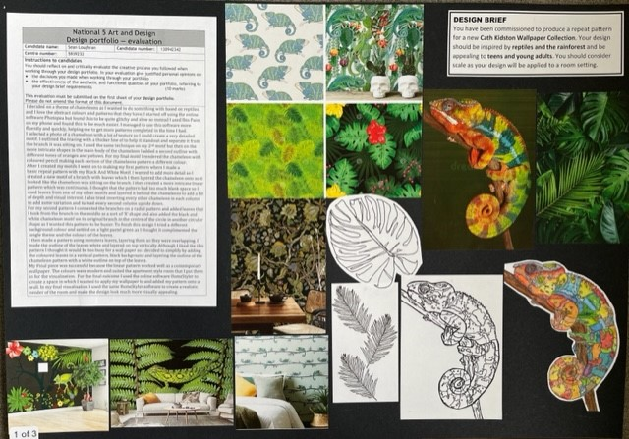
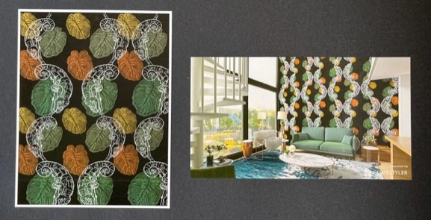
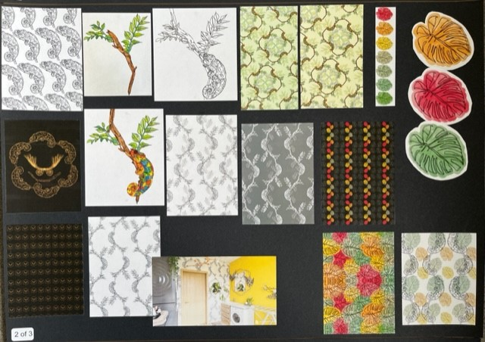
DIGITAL TEXTILES DESIGN FOLIO
Investigation
Final Design
N5 'A' PASS
Development

Slide 13
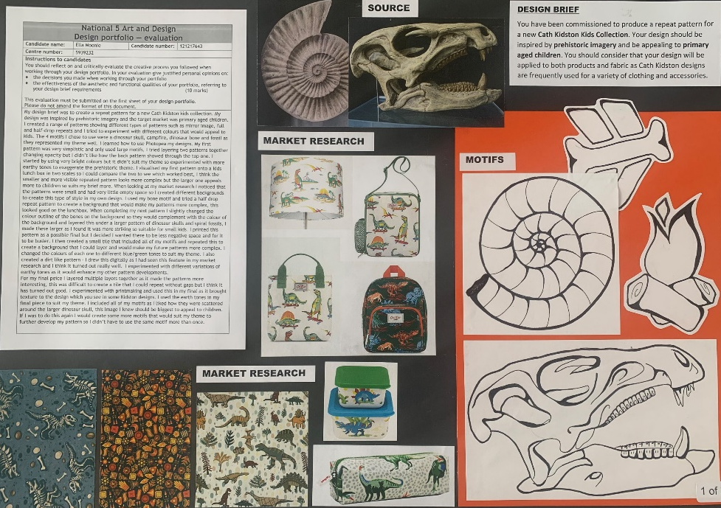
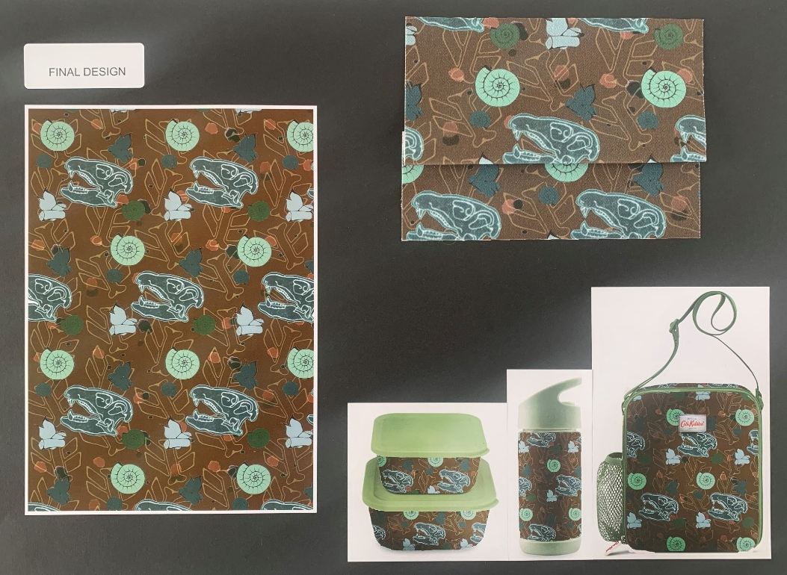
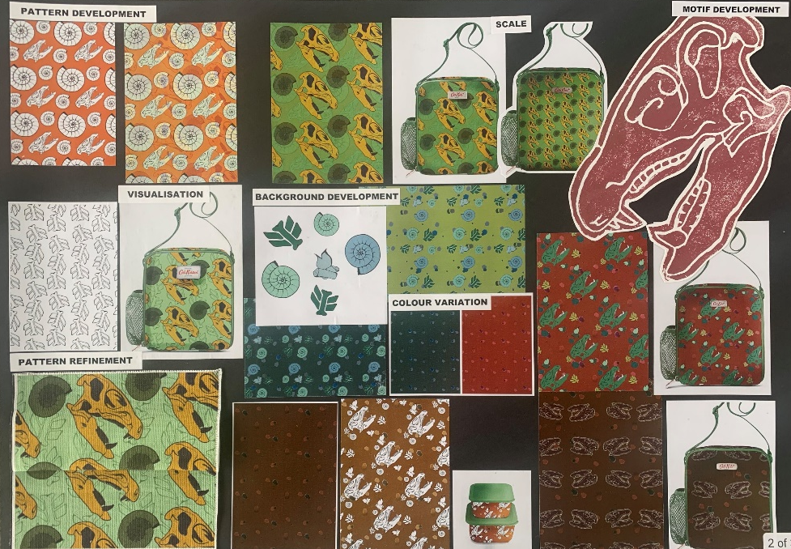
DIGITAL TEXTILES DESIGN FOLIO
Investigation
Final Design
N5 'A' PASS
Development

Slide 14
Overview
Expressive
sheet 1 & 2
October Assessment
(Written Exam)
Expressive
sheet 3
Design
sheet 1
Design
Sheet 2 & 3
Written Exam
Prelim
Exam: Written
Aug - Nov
October
Nov-Dec
December
January
Jan-Mar
May

Slide 15
Our Responsibilities
Pacing of Teaching and Learning
Issue homework with realistic deadlines
Opportunities to seek help if required
Progress is tracked and monitored
Pupil support/home contacted when concerns arise
Opportunities for study support provided

Slide 16
Pupil Responsibilities
Ensure homework is submitted on time
Seek help when difficulties arise
Attend study support; especially in run up to assessment deadlines/exams
Ensure all relevant material is brought to class
Ensure you are working at the pace of the class and use other opportunities to catch-up if needs be

Slide 17
How you can help…
Encourage pupils to talk about, and work on artwork at home
Encourage pupils to come to supported study
Encourage pupils to seek help if required
Help create a revision timetable to factor in time to work on
portfolio or written work at home.
Get in touch if you are concerned about progress

Slide 18
Lasting thought…
HARD WORK
BEATS TALENT
WHEN TALENT
DOESN’T WORK HARD - Tim Notke

