Slide 1
How to pass Higher Modern Studies

Slide 2
3 essay questions in total
2 x 20 mark responses
1 x 12 mark response
Notes:
Link to specimen paper - https://www.sqa.org.uk/files_ccc/ModernStudiesSQPRN5.pdf

Slide 3
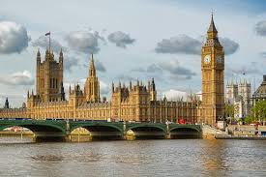
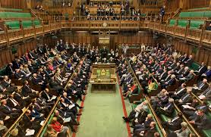
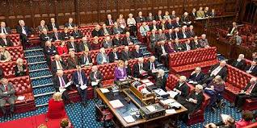
Section 1

Slide 5
Democracy in Scotland and the United Kingdom
October Assessment Date:
Thursday 12th October 2023
Will also be assessed in January Prelim

Slide 6
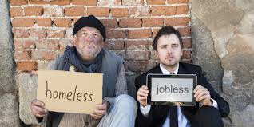
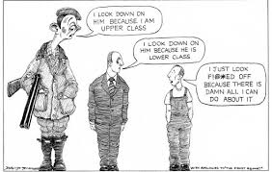
Section 2

Slide 8
Social Inequality in the UK
Timed essay practice – October to December
Will also be assessed in January Prelim

Slide 9
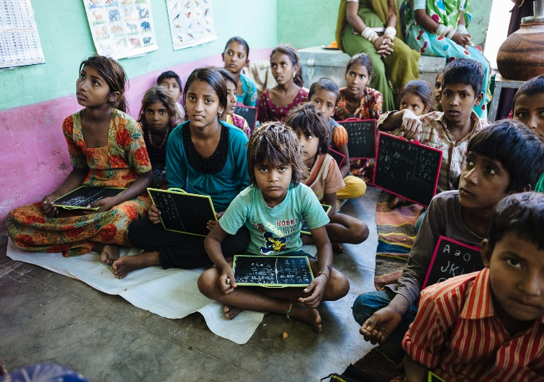
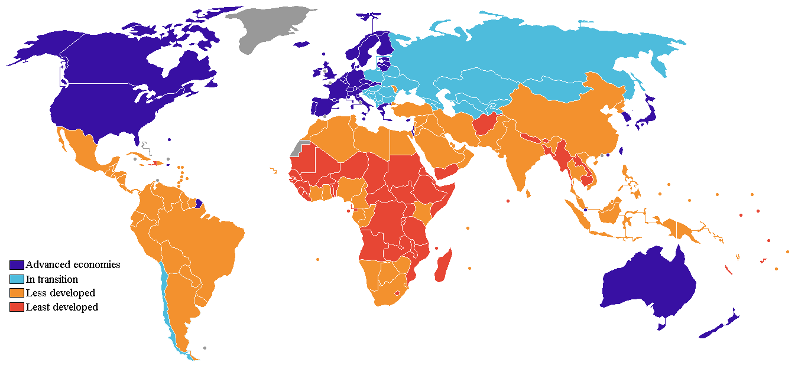
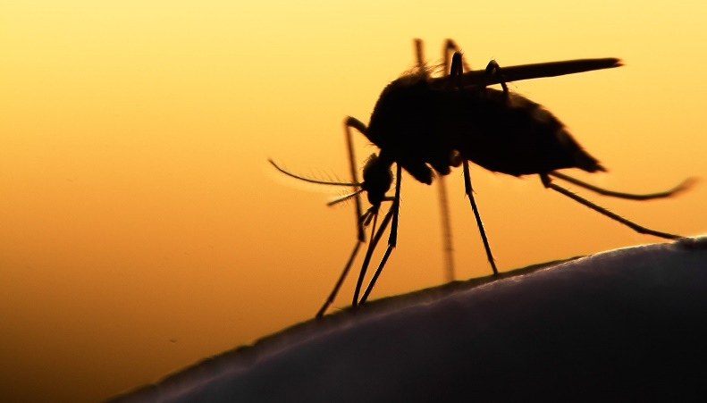
Section 3
Malaria 2020
240 million Cases
627,000 Deaths
Africa Represents 95% of Worlds Cases & Deaths
<5s Represent 80% of African Malaria Deaths

Slide 10
Malaria 2020
240 million Cases
627,000 Deaths
Africa Represents 95% of Worlds Cases & Deaths
<5s Represent 80% of African Malaria Deaths

Slide 11
World issues: Global Underdevelopment
Timed essay practice – January to March
Will also be assessed in March Prelim
Malaria 2020
240 million Cases
627,000 Deaths
Africa Represents 95% of Worlds Cases & Deaths
<5s Represent 80% of African Malaria Deaths

Slide 12
3 source questions in total
2 x 10 mark Qs
1 x 8 mark Q
No choice!
All answers are on the page – testing skills

Slide 13
6 marks N5 6/20 H essay p/graph
One type of crime in Scotland is fire raising and vandalism. This is when people deliberately start fires. For example, in May 2023 a 12 year old boy was arrested in connection with setting fire to the old convent in Dumfries.
Another type of crime in Scotland is crimes of dishonesty, This is when people don’t act honestly which can have an impact on other people. For example, Sean Adams is a past offender who committed a crime of dishonesty by embezzling £39,000 form the accounts of two elderly customers when he worked in a bank.
One of the effective ways that Parliamentary Representatives can hold the government to account is through actions in the debating chamber. In the chamber MPs can do a number of things to scrutinise the work of government by participating in debates, voting and taking part in ministerial question time. This is when MPs can submit questions to ministers, including the PM, as a part of a debate or in a scheduled question time, this puts them under pressure to defend themselves and look competent. For example, in 2021 Boris Johnson was forced to defend his and his government’s actions in the “Cash for Curtains Scandal” and government friends seeking support. Question time is one of the most high-profile events in parliament, attracting a lot of media attention so it really puts the pressure on the government making it a good way of holding them to account and letting voters make up their mind about the government. On the other hand, it can be argued that this tool is only partially effective. This is because many MPs will belong to the same political party as the government and so are not very likely to ask difficult or negative questions of the government, additionally, there isn’t enough space for all 650 MPs in the House of Commons. For example, in 2021 while Boris Johnson was under a lot of pressure from opposition MPs like the Labour and SNP leaders, Conservative MPs stood up and asked questions like “Will the Prime Minister thank vaccine volunteers?“ despite the electoral commission announcing a plan to investigate the PM for a possible criminal offence that day. Clearly, with the government often having a large number of its supporters in parliament outnumbering the opposition, question time is only partly effective as those loyal MPs will try to defend and help out the government meaning this is not the most effective time to scrutinise the government.
*ALSO NEEDS AN EVALUATIVE COMMENT LINKING BACK TO THE Q FOR AN EVALUATION MARK – WILL DIFFER DEPENDING ON WORDING OF SPECIFIC Q ASKED*

Slide 14
Types of Exam Questions
Extended Response Questions – 12 or 20 marks
20 marks – To what extent…? or “statement” Discuss.
12 marks – Analyse… or Evaluate…
Information Handling Questions – 8 marks
To what extent is it accurate to state that…
What conclusions can be drawn about…
To what extent are Sources A, B and
C reliable?

Slide 15
Accounts for 30 marks out of a total of 110 marks for the course
Pupils pick a Modern Studies issue for further individual research with very limited teacher guidance / support
Pupils present their findings in the form of a report in a 90 minute internal exam
Preparation will start in January 2024
Write-up will be March 2024

Slide 16
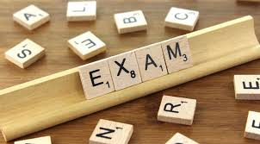
Exam Date Tuesday 30th April 2024
Paper 1: 9am – 10.45am
Paper 2: 11.15am – 12.30pm

Slide 17
Success in Modern Studies
Structured revision using a range of revision techniques
Understanding the questions and knowing how to structure the answers
Timed question practice
Check over answers thoroughly and ensure they’re packed with knowledge!

Slide 18
Each class has their own team which will have all power points, resources, practice papers and homework posted onto it on a regular basis
SQA website is also available to use for past papers and marking schemes

Slide 19
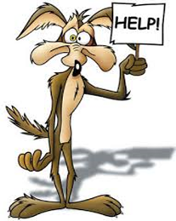
How can you help?
Encourage your son/daughter to read newspapers and watch the news
Discuss topic related issues with them
Check homework is done on time – Teams
Ensure resources are organised at home
Test pupils using core notes and pupil units
Encourage a structured approach to revision
Access the SQA website and download past papers and marking instructions
Proof-read their work
Encourage them to attend after school study classes in the run up assessments
Encourage them to use Teams

Slide 20
Summary
2 exam papers, 1 assignment
Paper 1 – 52, Paper 2 – 28 marks
Assignment - 30 marks
Timed questions in class
October Assessment
January prelim & Prelim Part 2 in March
Assignment write up - March

Slide 21
Exam Date Tuesday 30th April 2024
Paper 1: 9am – 10.45am
Paper 2: 11.15am – 12.30pm

Slide 22
Notes:
Practice Essays

Slide 24
