Slide 1
How To Pass
National 5 History

Slide 2
How to pass National 5 History

Slide 3
Section 1

Slide 4
Era of the Great War
Scots on the Western Front
Domestic Impact of War on Society and Culture
Domestic Impact of War on Industry and Economy
Domestic Impact of War: Politics

Slide 5
The Devils Porridge Museum Trip After October Holidays TBC
Covers exam content such as: suffragettes, trench warfare, home front, DORA, Rationing and Industry work.

Slide 6
Section 2

Slide 7
The Atlantic Slave Trade
The Triangular Trade
Britain and the Caribbean
The Captives Experience and Slave Resistance
The Abolitionist Campaigns

Slide 8
Section 3

Slide 9
Free at Last? Civil Rights in the USA, 1918-1968
The ‘Open Door’ policy and immigration
‘Separate but Equal’, to 1939
Civil Rights Campaigns
The Ghettos and Black American Radicalism

Slide 10
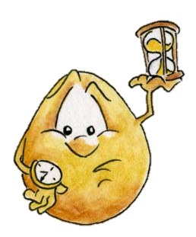
In each section pupils are required to complete three or four questions – approximately 35 minutes per section

Slide 11
In each section pupils are required to complete questions which test their knowledge and understanding
‘Describe…’ questions worth 4 marks
‘Explain the reasons ….’ questions worth 6 marks
‘To what extent…’ questions worth 9 marks

Slide 12
In each section pupils are required to complete questions which test their ability to handle historical sources.
‘Evaluate the Usefulness…’ questions worth 5 marks
‘Compare the views….’ questions worth 4 marks
‘How fully…’ questions worth 6 marks

Slide 13
Pupils will normally get at least one Past Paper Question a week as Homework
Notes:
Practice Essays

Slide 14
http://www.sqa.org.uk/pastpapers
Past Paper Questions from school any time
Notes:
All online, no need to buy. We have bundles in the department too.

Slide 15
The Exam
The Exam is on
Tuesday 21st May 2024
13:00-15:20
2 hrs 20 mins

Slide 16
Alterations to the Exam 2023
Alterations from 2022 also apply to 2023.
Nat 5 History this means there will be a choice of questions in section 2 and 3 allowing them to play to their strengths.
No other changes will be made.

Slide 17
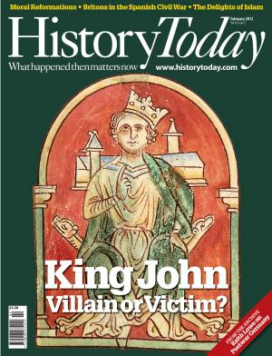
Assignment

Slide 18
The Assignment
The Assignment accounts for 20 marks that contributes toward the final grade.
Pupils are expected to research and write an essay which is much more detailed than the norm. They will be given one hour to write the assignment under timed conditions.

Slide 19
The Assignment
In reality however the Assignment offers pupils an excellent opportunity –
The essay title will be of your child’s choosing.
They will be given time in class to undertake research but ultimately they should be doing most of the work for this essay at home.
We have very good resources at the school that pupils have access to.
The teacher is permitted to offer guidance and support but it is limited.

Slide 20
Mark Allocation
Introduction – 2
Using information from sources – 2
Acknowledging other factors – 3
Analysing other factors - 4
Overall impact of factors – 3
Organising information - 3
Conclusion - 3

Slide 21
Assignment / 20
Candidate 1 20
Candidate 2 17
Candidate 3 19
Candidate 4 19
Candidate 5 19
Candidate 6 17
Candidate 7 20
Candidate 8 20
Candidate 9 18
Candidate 10 19
Candidate 11 18
Candidate 12 19
Candidate 13 20
Candidate 14 14
Candidate 15 18
Average Grade
A
(18/30)

Slide 22
Assignment Success
Get a topic sorted quickly.
Get it looked over by a teacher.
We cannot mark it but can give verbal feedback.
Practice and rote learn at home!
Practice under timed conditions.

Slide 23
How can you help your child pass?
Check homework is done on time.
Encourage a structured approach to revision.
Encourage them to attend after school study support especially before assessments!
Proof read their work

Slide 24
Study Support
After school 3.15 to 4.15
Starting post October holidays
Mrs Sibley – Monday
Miss Lee - Tuesday
Miss Smithard - Wednesday
All welcome!

Slide 25
Upcoming Key Dates
October Assessment
Mrs Sibley – Wednesday 12th October
Miss Smithard- Thursday 13th October
Miss Lee – Friday 14th October
First Formal Assessment Piece on Era of the Great War

Slide 26
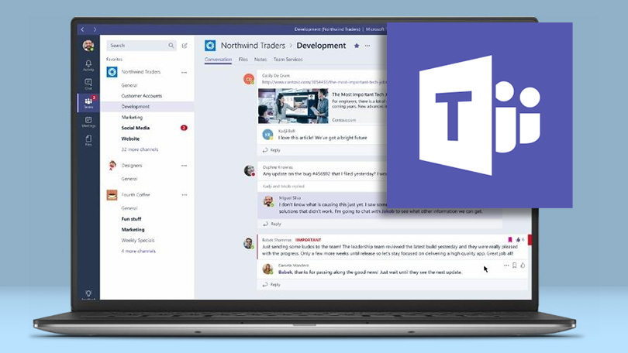
TEAMS
All homework will be set on teams!
Any piece of homework can be submitted on teams.
Lots of revision materials will be posted on teams for pupils use in the ‘Class Materials’ folder

