Slide 1
How to pass Higher History

Slide 3
Section 1

Slide 4
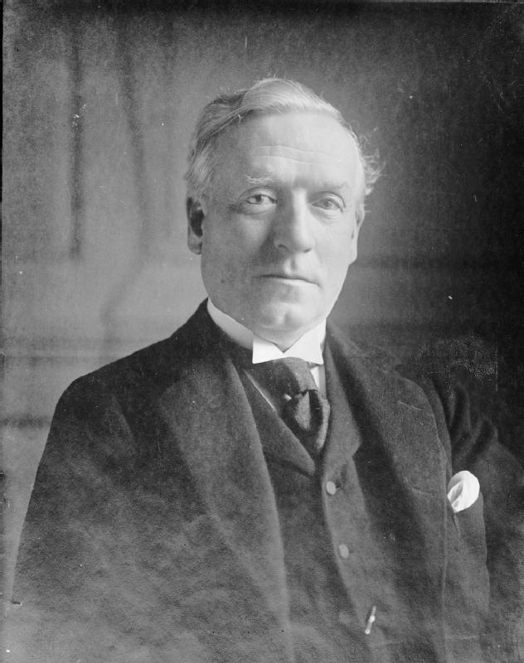
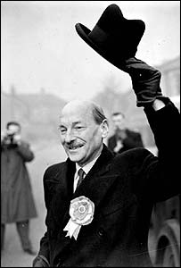
Pupils must learn all four essays
Britain 1851 – 1951
The reasons why women gained the vote in 1918.
The reasons for the Liberal Welfare Reforms of 1906 – 1914.
How effective were the Liberal Welfare Reforms of 1906 - 1914?
How effective were the Labour Welfare Reforms of 1945 – 51?

Slide 5
OCTOBER ASSESSMENT WEEK
Miss Smithards class Tuesday 10th Oct
Mr Davidsons class Wednesday 11th Oct
Pupils will be expected to revise for all 4 essays learnt this term and write one 50 minute essay for their first assessment.
No structures or notes permitted
Mirroring an SQA essay section

Slide 6
2019
2022

Slide 7
Section 2

Slide 8
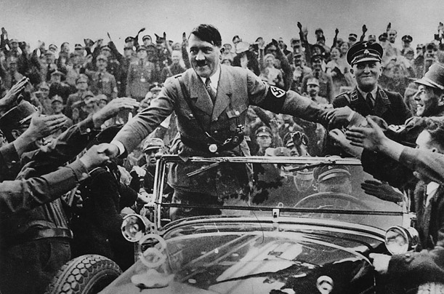
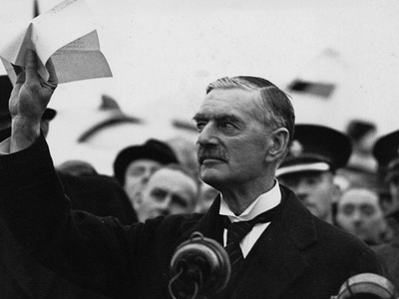
Pupils must learn all four essays
Germany 1815 – 1939
The reasons for the rise to power of the Nazis, 1919 – 1933
The reasons why the Nazis were able to maintain control of Germany, 1933 - 1939
Appeasement
The reasons for the British policy of appeasement, 1936 – 1938.
How effective was British Foreign Policy, 1935 1938?

Slide 10
MIGRATION AND EMPIRE
Key Issue 1
The Migration of Scots
Key Issue 2
The Experience of Immigrants in Scotland
Key Issue 3
The Contribution of Scots Abroad
Key Issue 4
The effects of migration and empire on Scotland, to 1939

Slide 11
Source Answer Comparison
Nat 5 HIGHER
This source is more useful because it says “British Summertime was introduced to give more daylight working hours”. This is an accurate fact.
This source is more useful because ”the pub opening hours were limited to prevent drunkness” this is an accurate fact.
The source is less useful as it does not mention that people were not allowed to light bonfires or fireworks.
The source is less useful as it does not mention that you could not buy binoculars.
The source is more useful as it was written by a historian who has researched the topic and will be an expert in the field.

Slide 12
Assignment

Slide 13
The Assignment
The Assignment accounts for 30 marks of a total of 110 that contribute toward the final grade
Pupils are expected to research and write an essay which is much more detailed than the norm. They will be given one and a half hours to write the assignment under timed conditions.

Slide 14
The Assignment
In reality however the Assignment offers pupils an excellent opportunity –
The essay title will be of your child’s choosing (good idea to choose one we have already studied in class – workload)
They will be given time in class to undertake research but ultimately they should be doing most of the work for this essay at home.
We have very good resources at the school that pupils have access to.
The teacher is permitted to give a degree of guidance and support.

Slide 15
Assignment / 30
Overall Grade
Candidate 1 22
Candidate 2 22
Candidate 3 18
Candidate 4 25
Candidate 5 22
Candidate 6 22
Candidate 7 30
Candidate 8 29
Candidate 9 26
Candidate 10 24
Candidate 11 19
Candidate 12 25
Candidate 13 21
Candidate 14 22
Candidate 15 25
B
C
C
B
C
A
A
A
A
B
B
A
B
B
B
Average Grades (All Candidates)
Extended Essay A (22/30)
Overall Grade B

Slide 16
Study Support will be offered from October until the exam for one hour a week after school or by appointment
Wednesday Miss Smithard 3:15-4:15pm
Notes:
Practice Essays

Slide 17
Each class has their own team which will have all power points, resources, practice papers and homework posted onto every week
SQA website is also available to use for past papers and marking schemes

