Slide 1
How To Pass
National 4 Social Subjects

Slide 2
3 subjects – History, Geography and Modern Studies
3 units per subject
Aiming to achieve a N4 award in all of the above subjects
Miss Scott – Monday
Miss Smithard – Wednesday & Friday

Slide 3
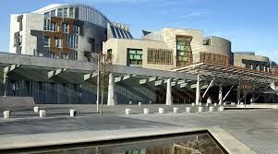
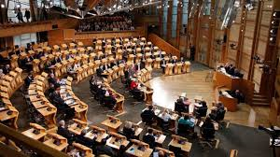
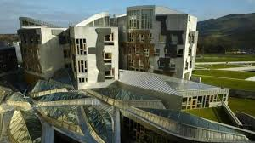
Democracy in Scotland

Slide 4
Democracy in Scotland
Power and decision making *
Participation *
Influence
Representation
Voting systems

Slide 5
Democracy in Scotland
3 x Unit Assessment Questions
(2 based on KU, 1 based on source skills)
Assessments cannot be taken home

Slide 6
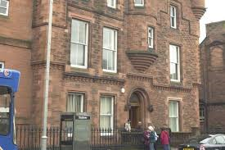
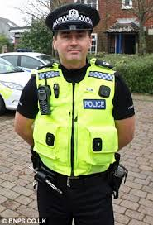
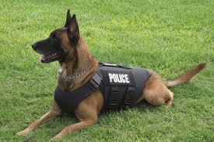
Crime and the Law

Slide 7
Crime and the Law
Nature of Crime *
Causes of crime *
Consequences of crime
Criminal Justice System
Responses to crime:- government responses, police, prisons

Slide 8
Assessment
3 x Unit Assessment Questions
(2 based on KU, 1 based on skills)
Assessments cannot be taken home

Slide 9
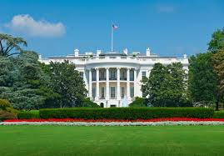
World Power: USA

Slide 10
World Powers:- The USA
Political System *
Influence on other countries *
Social and economic issues (minimum of 3 issues)
Effectiveness in tackling economic issues (minimum of 3 issues)

Slide 11
World Powers:- The USA
3 x Unit Assessment Questions
(2 based on KU, 1 based on skills)
Assessments cannot be taken home

Slide 12
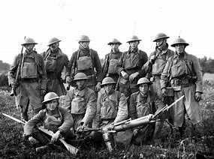
Era of the Great War: 1900-1928

Slide 13
Era of the Great War: 1900-1928
Scots on the Western Front
Domestic Impact of the war on Scotland
Political Impact of the War on Scotland

Slide 14
Era of the Great War: 1900-1928
3 x Unit Assessment Questions
(2 based on KU, 1 based on skills)
Assessments cannot be taken home

Slide 15
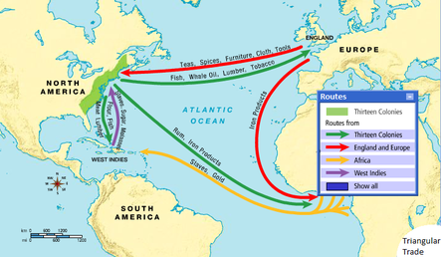
Atlantic Slave Trade: 1760-1807

Slide 16
Atlantic Slave Trade: 1760-1807
Triangular Trade
Impact of Slavery on Britain and the Caribbean
The Slave Experience

Slide 17
Atlantic Slave Trade: 1760-1807
3 x Unit Assessment Questions
(2 based on KU, 1 based on skills)
Assessments cannot be taken home

Slide 18
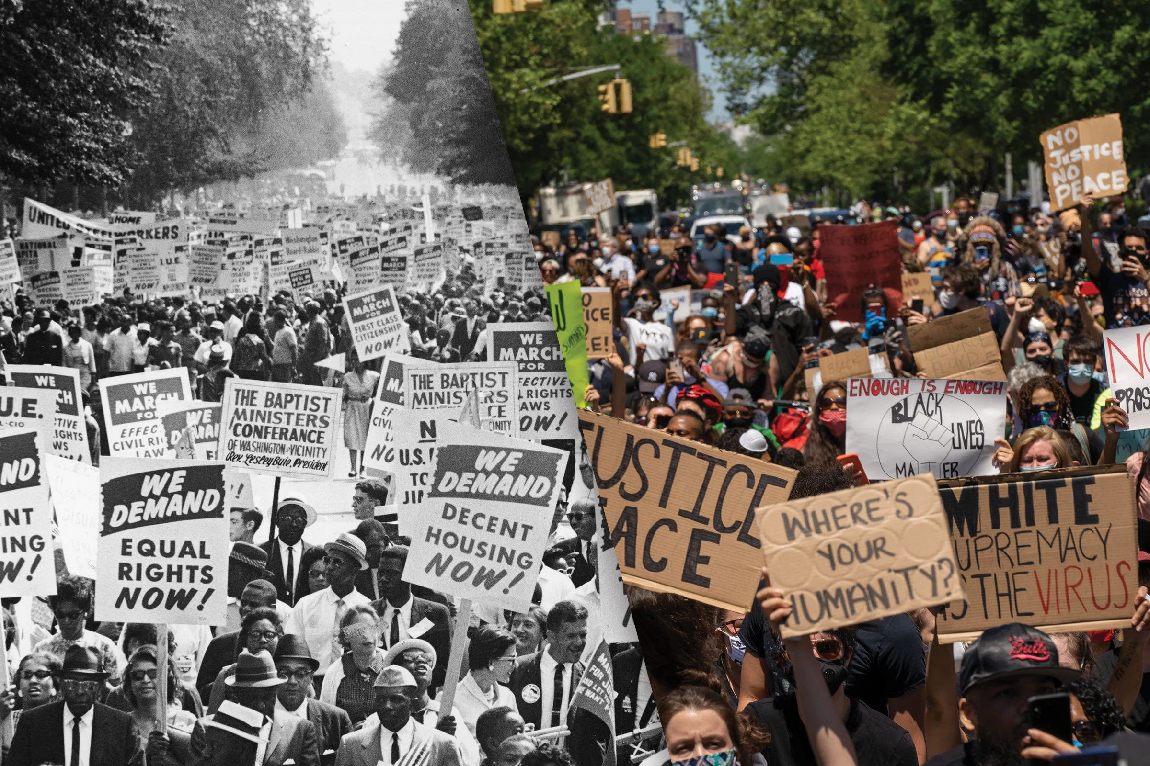
Free At Last? Civil Rights in the
USA, 1918-1968

Slide 19
Free At Last? Civil Rights in the USA, 1918-1968
‘Separate but equal’ to 1939
Civil rights campaigns, 1945-65
Black Panthers and violent protests in the north

Slide 20
Free At Last? Civil Rights in the USA, 1918-1968
3 x Unit Assessment Questions
(2 based on KU, 1 based on skills)
Assessments cannot be taken home

Slide 21
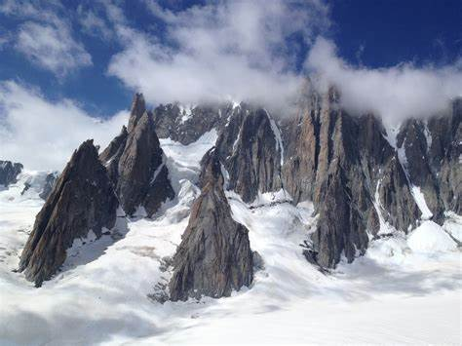
Physical Environments

Slide 22
Physical Environments
‘Landscape Types including; glaciated uplands, limestone, coastlands and rivers
Land use management and sustainability
Weather

Slide 23
Physical Environments
Unit Assessment Questions
(5 based on KU, 2 based on skills)
Assessments cannot be taken home

Slide 24
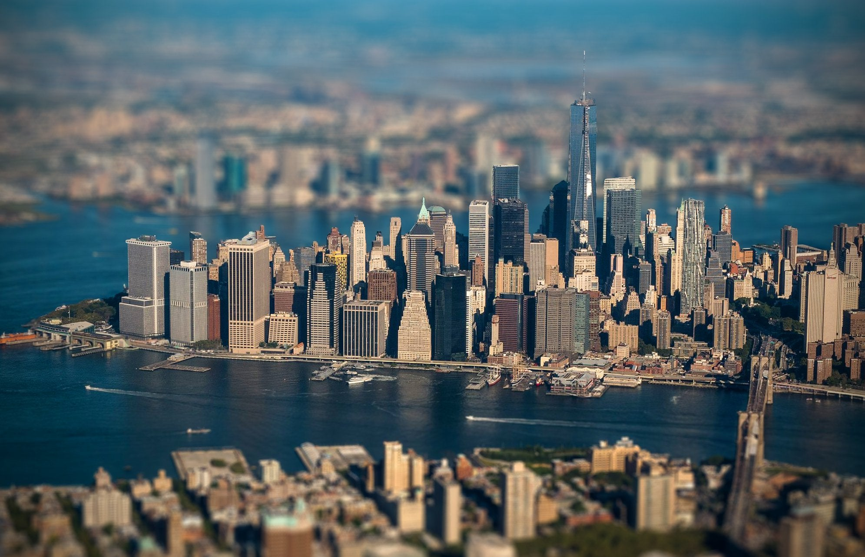
Human Environments

Slide 25
Human Environments
Contrasts in development
World population distribution and change
Issues in changing urban and rural landscapes

Slide 26
Human Environments
Unit Assessment Questions
(5 based on KU, 1 based on skills)
Assessments cannot be taken home

Slide 27
Global Issues

Slide 28
Global Issues
We will study one of the following:
Climate Change
Natural Regions
Environmental Hazards
Tourism
Health

Slide 29
Global Issues
Unit Assessment Questions
(3 based on KU, 2 based on skills)
Assessments cannot be taken home

Slide 30
Added Value Unit Assignments (AVU)
To gain a full N4 qualification in each subject learners must also complete an assignment
For each subject learners will select a relevant topic to research further and produce a project meeting specific criteria
Minimal teacher support
Provides an opportunity to showcase skills developed through unit content

Slide 31
Homework
Homework Assignments are communicated both verbally in class and to students via Teams
Students should be in the habit of checking Teams regularly
If students wish to pursue N5 next year then they need to be in the habit of completing regular homework

Slide 32
Success in Social Subjects
Good attendance
Excellent behaviour in class
Complete homework when set
Awareness of current world issues
Approach assessment booklet questions with 100% effort – no excuse for laziness!
Always try your best!

Slide 33
How can you help?
Encourage good attendance in class to support continuous assessment
Encourage your child to read newspapers and watch the news
Discuss topic related issues with them
Check homework is done on time – Microsoft Teams
Ensure resources are organised at home to support homework completion and encourage a structured approach
Proof-read homework

Slide 34
Summary
3 subjects, 3 units & 1 assignment per subject
Should achieve a N4 award in each subject
2 teachers
No exam, continuous open book assessment
Assessments must be completed in class
Check Teams regularly for homework assignments – develop good habits for potentially moving up to N5

Slide 35
Notes:
Practice Essays

