Slide 1






How To Pass
National 5 Chemistry

Slide 2


Course content
Rates of reactions
Atomic structure
Bonding
Chemical formulae
Acids and bases
Homologous Series
Everyday consumer products
Energy from fuels
Metals
Plastics
Fertilisers
Nuclear Chemistry
Chemical Analysis

Slide 3

Course assessment
3 units
Chemical Changes and Structure
Nature’s Chemistry
Chemistry and Society.

Slide 4

External Assessment
Exam (2½ hours) : 100 marks
Section 1 – multi-choice 25 marks
Section 2 – extended response 75 marks
12th May 2023 – 13.00 to 15.30pm

Slide 5

Our responsibilities
Regular homework with feedback
Opportunities to seek help if required
Progress is tracked and monitored
Pupil support/home contacted when concerns arise
Opportunities for study support provided (lunch and after school)

Slide 6

Pupil responsibility
Ensure homework is submitted on time
Seek help when difficulties arise
Attend study support if required ; especially in run up to assessments/exams
Ensure all relevant material is brought to class
Ensure any work missed is completed in a timely manner.

Slide 7
How you can help
Track homework – Microsoft Teams
Provide a suitable environment for study
Encourage pupil to seek help if required
Assist with revision before assessments (flash cards & revision questions)
Encourage pupil to access revision materials (online & books)

Slide 8

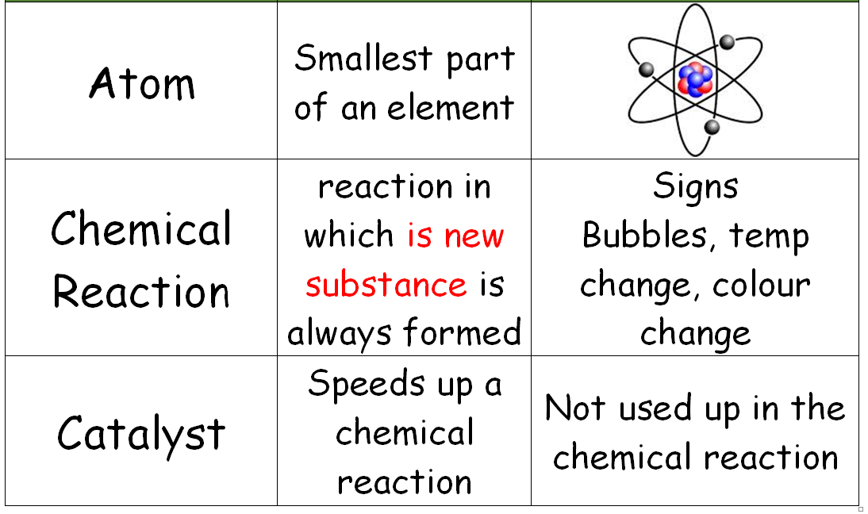
Flash Cards

Slide 9
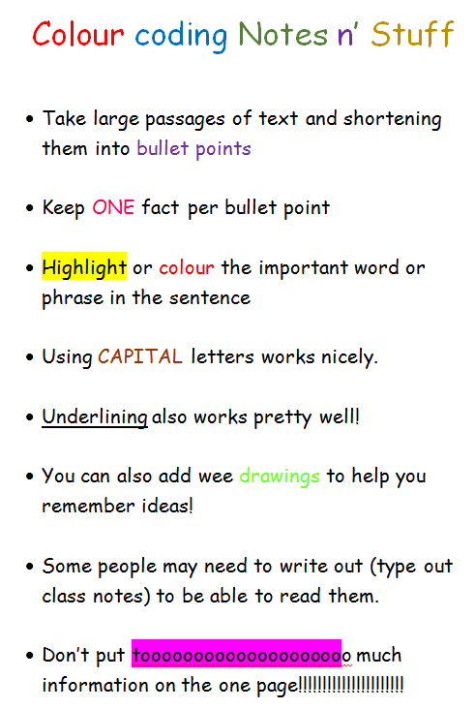
Revision Notes

Slide 10

Mind Maps

Slide 11

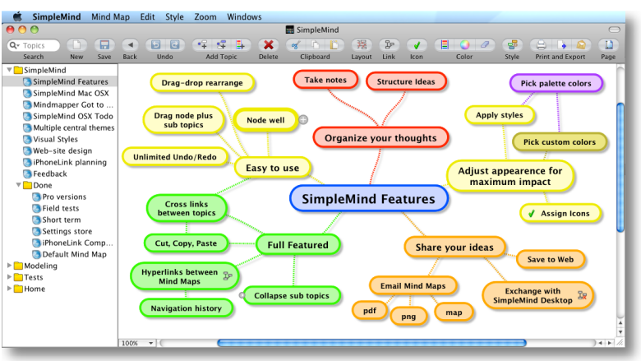
Simple Mind - APP

Slide 12
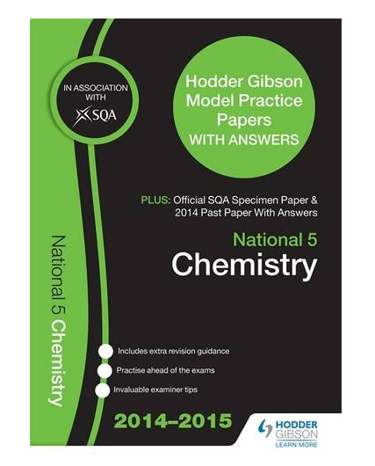
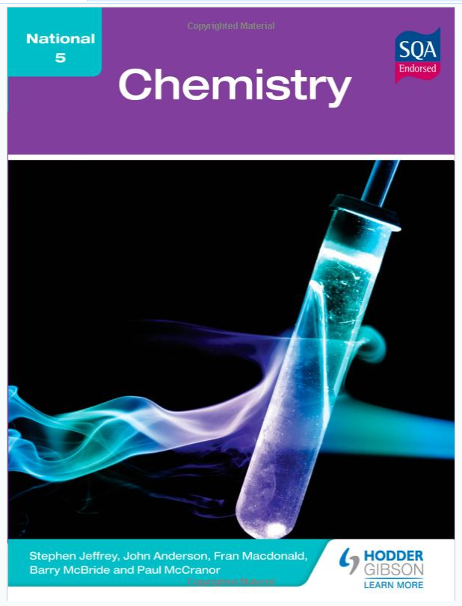
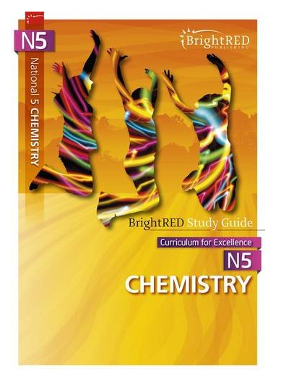
Revision materials
Past Papers
Selected questions only

Slide 13

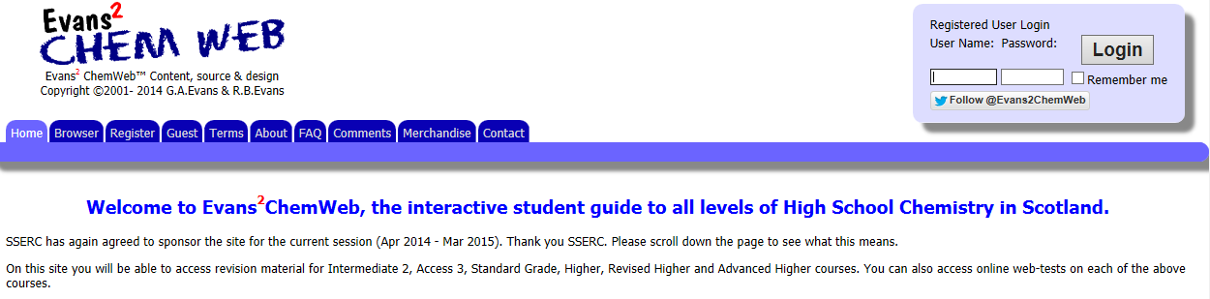
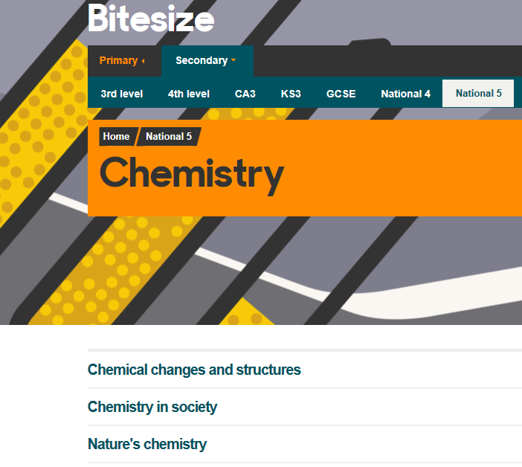
Revision websites
Username: dumfries
Password: chemdhs
Revision Notes
Revision Questions
Short videos

Slide 14
Supported study
3.15pm – 4.30pm
Tuesday with Mrs Earle or Ms Henry
Or drop by at the end of the day.

Slide 15
Check points!
October Assessment
Prelims start in January
Second Prelim just before Easter

Slide 16
End point!
National 5 Chemistry
Exam Tuesday 12th May 2023

