Slide 1
National 4/5 Geography

Slide 2
National 4/5 – The Course Content
Physical Unit
Weather
Coastal Landscapes
Glaciated Landscapes
Human Unit
Population
Urban Landscapes
Rural Landscapes
Global Issues Unit
Health

Slide 3
Assessment
There will be formal assessments at various points through the year to determine whether a pupil is National 4 or National 5.
October Assessment
January Prelim.
We have a 2nd Prelim around March/April once the course is complete.

Slide 4
Exam
The exam is 2 hours 05 minutes and is out of 70 marks.
Some questions ask pupils to describe – where pupils are expected to state factual points. For example, describing trends on a map or graph.
The majority of questions ask pupils to explain – these require pupils to use their subject knowledge to say how or why things happen.

Slide 5
Exam
Homework is a vital part of the course – pupils need to do it and hand it in on time. The majority of homework will be past paper questions to give them exam practice.
It is crucial this is done with full effort at all times to allow teachers and pupils the ability to assess their strengths and weaknesses.
Pupils should also be studying regularly.

Slide 6
Resources
Revision Guide
Practice Papers and Marking Schemes

Slide 7
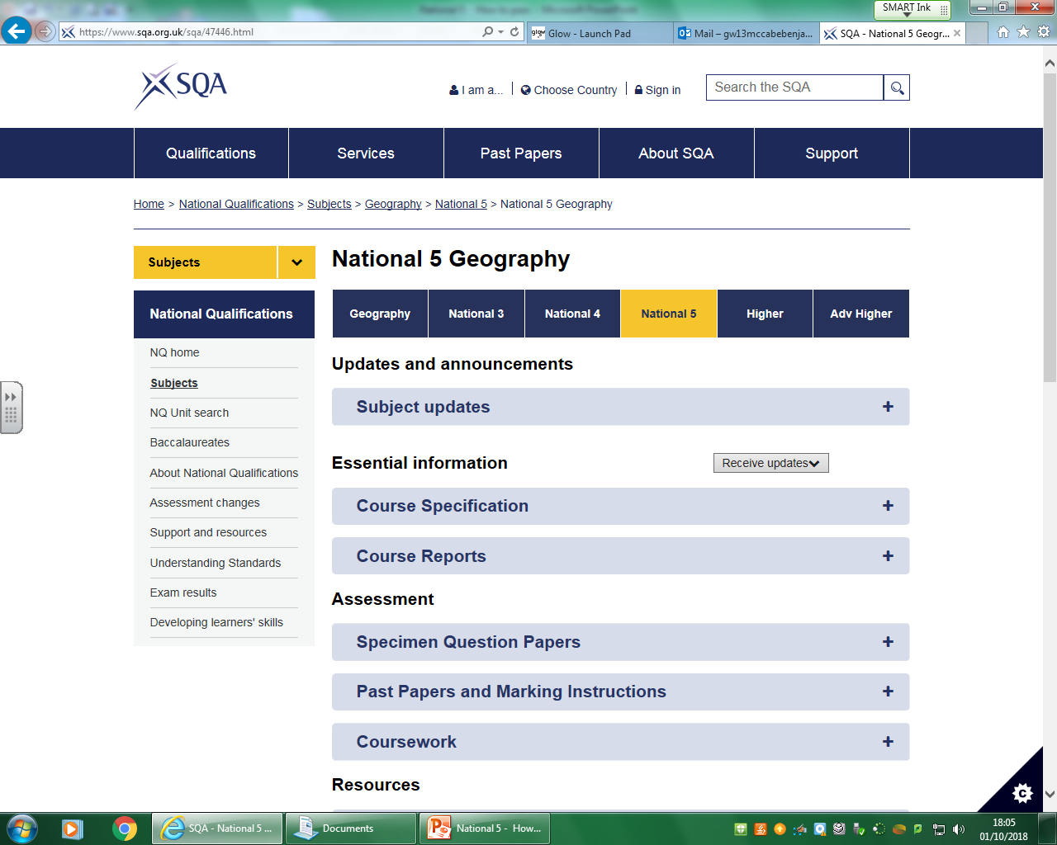
Note: Past papers from 2017 and before were out of 60 marks, not 80. However questions are still suitable.

Slide 8
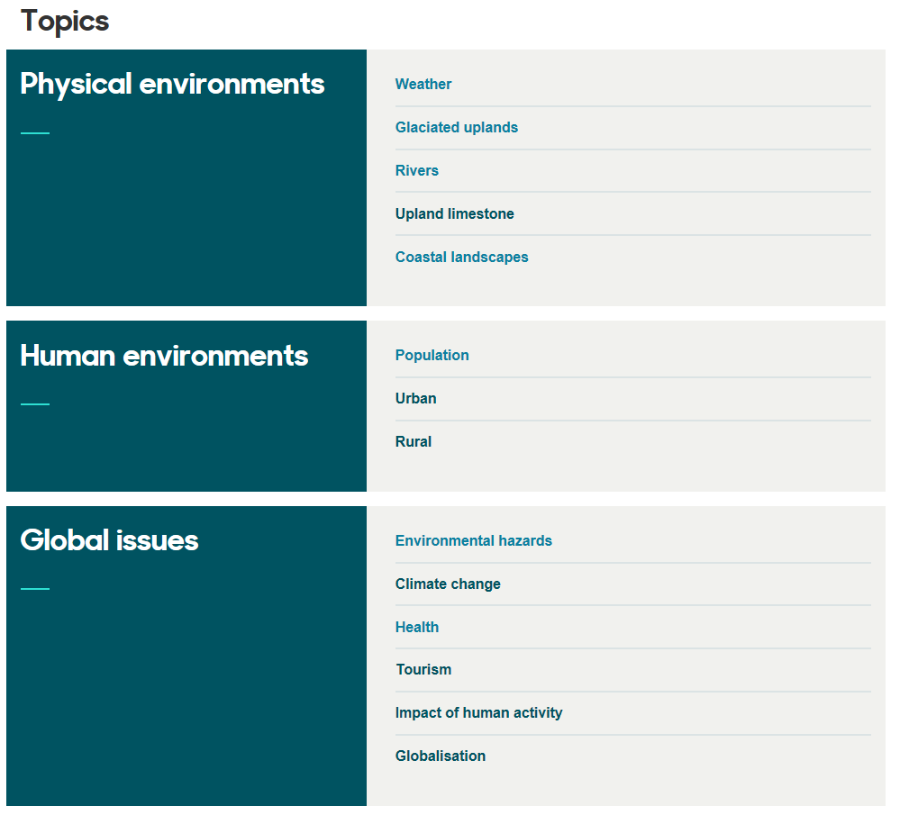
Bitesize

Slide 9
How can you help?
Encourage your son/daughter to study regularly at home (if they have homework or not).
Discuss topic related issues with them.
Read over homework questions and answers.
Ensure resources are organised at home.
Test pupils using core notes and textbooks.

Slide 10
National 4/5 Geography

