Slide 1
How To Pass
National 5 History

Slide 2
Section 1

Slide 3
Era of the Great War
Scots on the Western Front
Domestic Impact of War on Society and Culture
Domestic Impact of War on Industry and Economy
Domestic Impact of War: Politics

Slide 4
Section 2

Slide 5
The Atlantic Slave Trade
The Triangular Trade
Britain and the Caribbean
The Captives Experience and Slave Resistance
The Abolitionist Campaigns

Slide 6
Section 3

Slide 7
Free at Last? Civil Rights in the USA, 1918-1968
The ‘Open Door’ policy and immigration
‘Separate but Equal’, to 1939
Civil Rights Campaigns
The Ghettos and Black American Radicalism

Slide 8
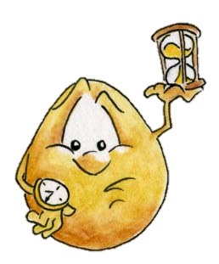
In each section pupils are required to complete four or five questions – approximately 40 minutes per section

Slide 9
In each section pupils are required to complete questions which test their knowledge and understanding
‘Describe…’ questions worth 4 marks
‘Explain the reasons ….’ questions worth 6 marks
‘To what extent…’ questions worth 9 marks

Slide 10
In each section pupils are required to complete questions which test their ability to handle historical sources.
‘Evaluate the Usefulness…’ questions worth 5 marks
‘Compare the views….’ questions worth 4 marks
‘How fully…’ questions worth 6 marks

Slide 11
Pupils will normally get at least one Past Paper Question a week as Homework
Notes:
Practice Essays

Slide 12
http://www.sqa.org.uk/pastpapers
Past Paper Questions from school any time
Notes:
All online, no need to buy. We have bundles in the department too.

Slide 13
The Exam
The Exam is on the 1st May 2019
2 hrs 20 mins

Slide 14
How can you help your child pass?
Check homework is done on time
Encourage a structured approach to revision.
Encourage them to attend after school study support (after Oct) especially before assessments!
Proof read their work

Slide 15
TEAMS
All homework will be set on teams!
Any piece of homework can be submitted on teams.
Lots of revision materials will be posted on teams for pupils use in the ‘Class Materials’ folder

